Slide 1
Collaborating with the National Center for Biomedical Ontology
Mark Musen and the NCBO Team
musen@stanford.edu

Slide 2
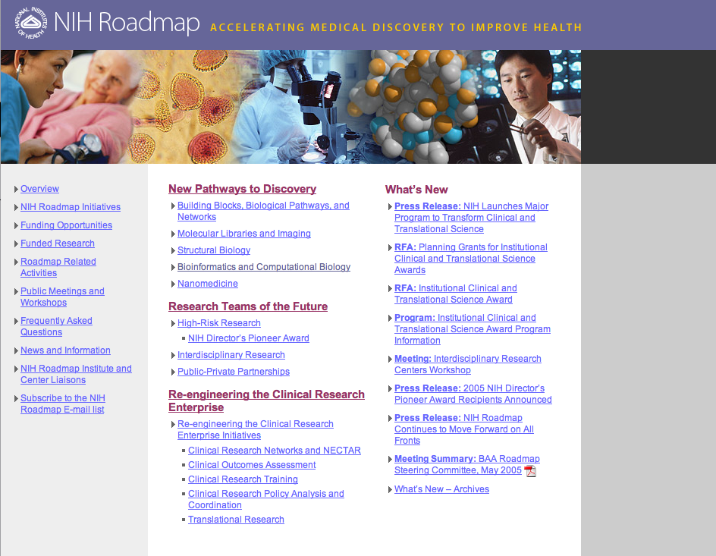

Slide 3
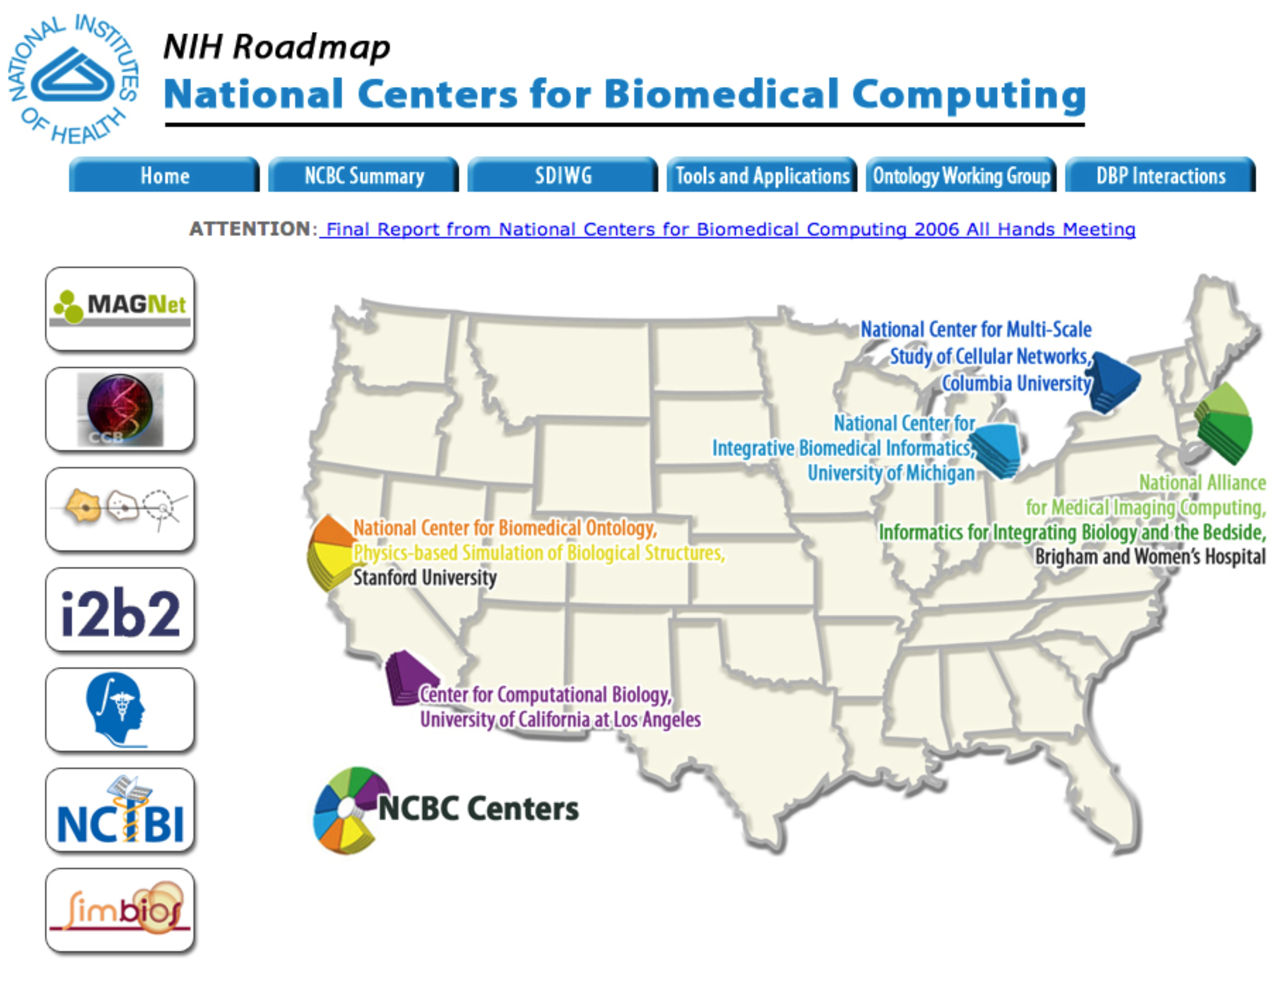
http://www.ncbcs.org

Slide 4

The National Center for Biomedical Ontology
One of three National Centers for Biomedical Computing launched by NIH in 2005
Collaboration of Stanford, Mayo, Buffalo, Washington University, Johns Hopkins, and the Medical College of Wisconsin
Primary goal is to make ontologies accessible and usable
Research will develop technologies for ontology dissemination, use, indexing, alignment, and peer review

Slide 5
NCBO: Key activities
We create and maintain a library of biomedical ontologies.
We build tools and Web services to enable the use of ontologies.
We collaborate with scientific communities that develop and use ontologies.

Slide 6
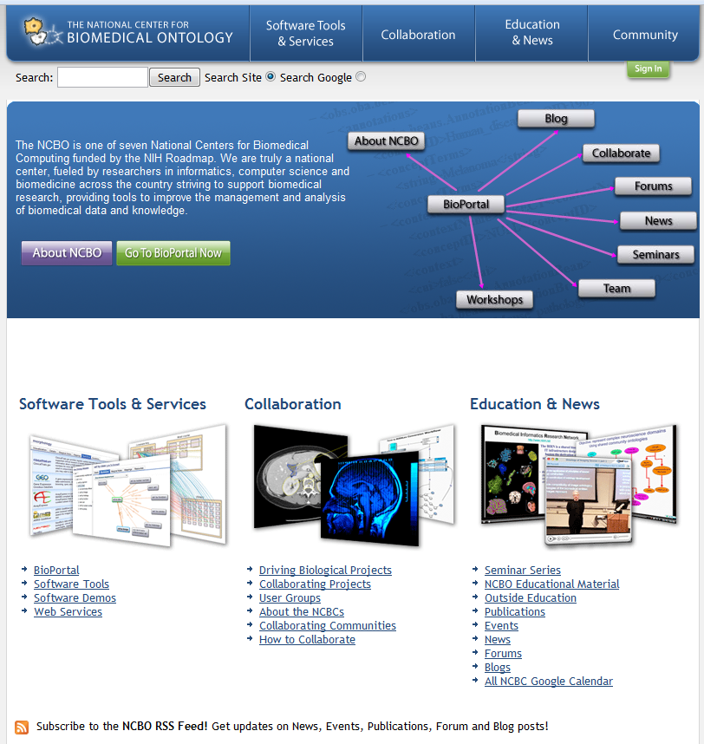
www.bioontology.org

Slide 7
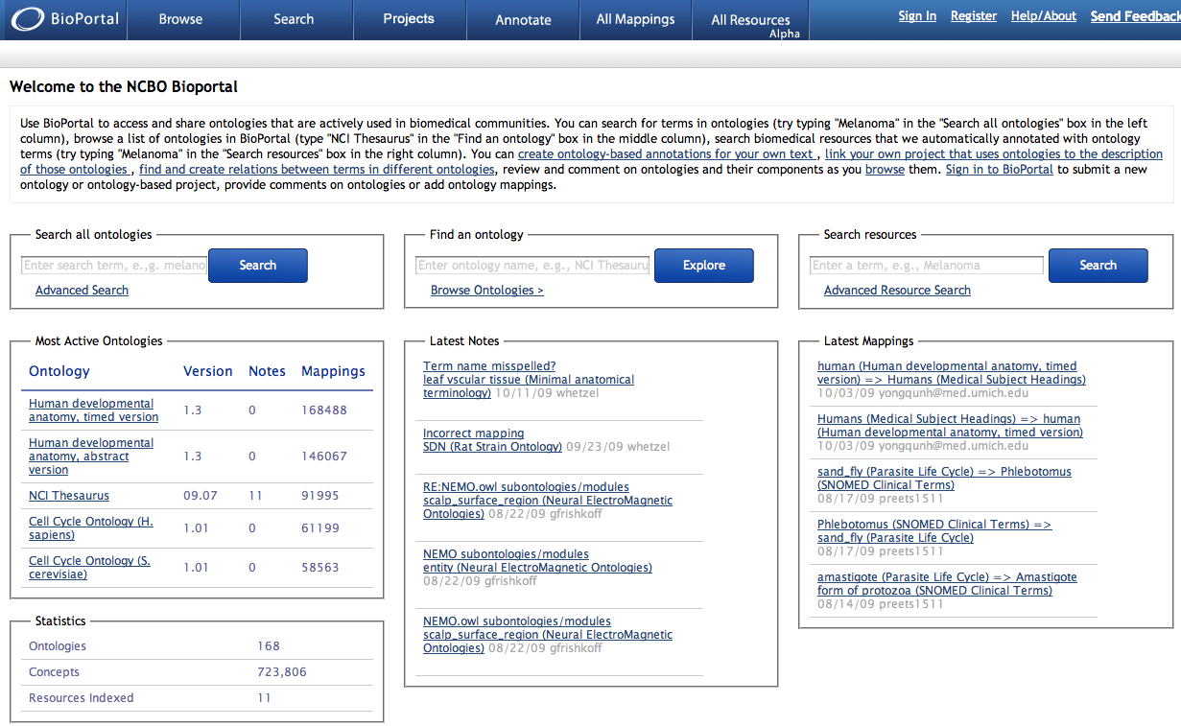
http://bioportal.bioontology.org

Slide 8
BioPortal allows us to experiment with new models for
Dissemination of knowledge on the Web
Integration and alignment of online content
Knowledge visualization and cognitive support
Peer review of online content

Slide 9
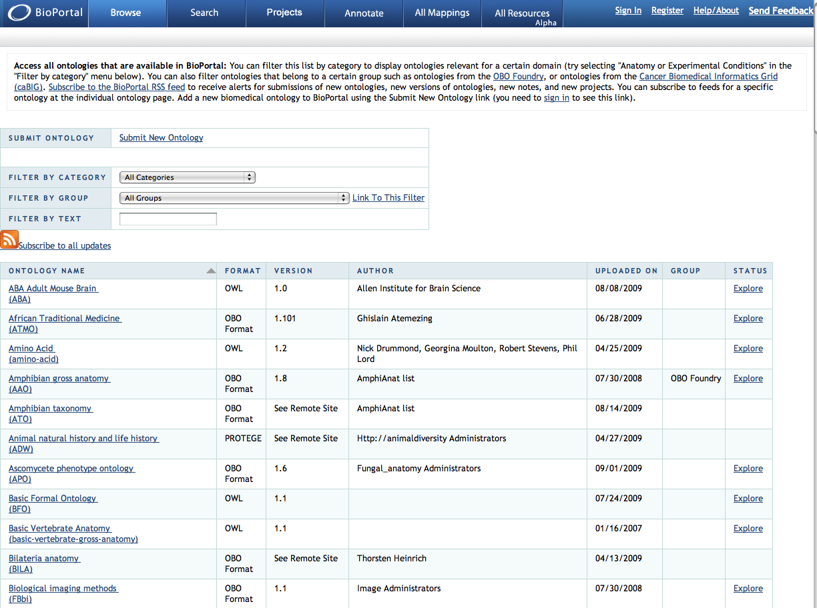

Slide 10
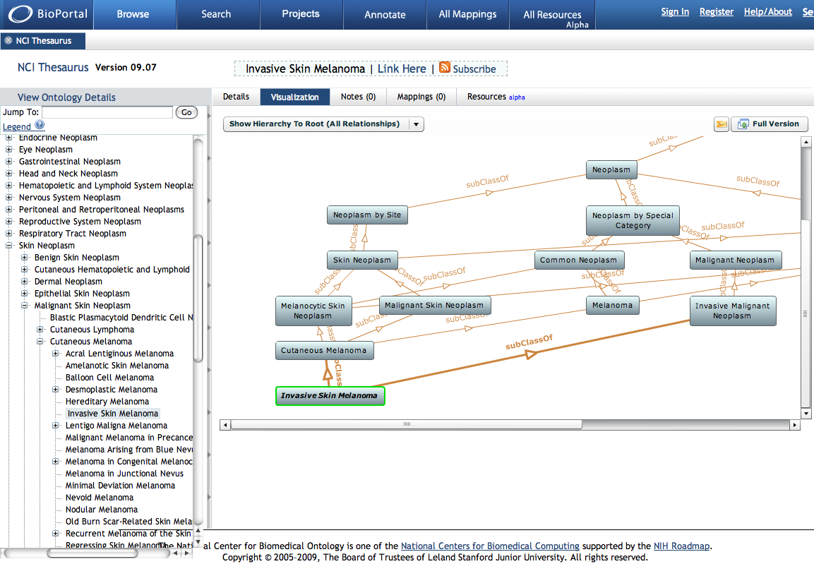

Slide 11
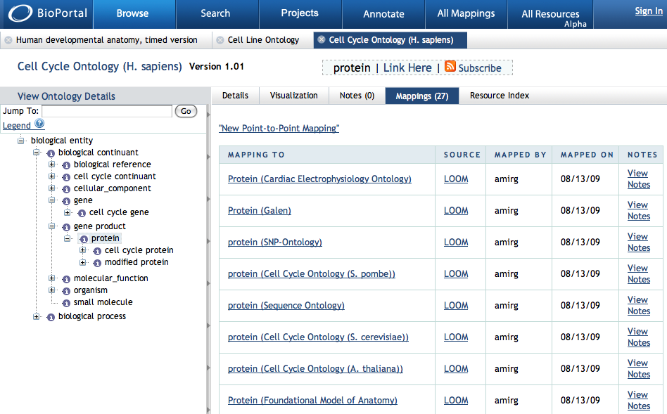
Users can view and create mappings

Slide 12
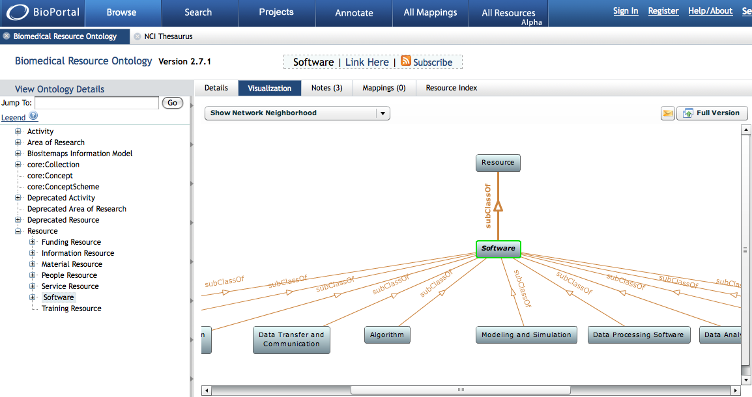
Biomedical Resource Ontology in BioPortal

Slide 13
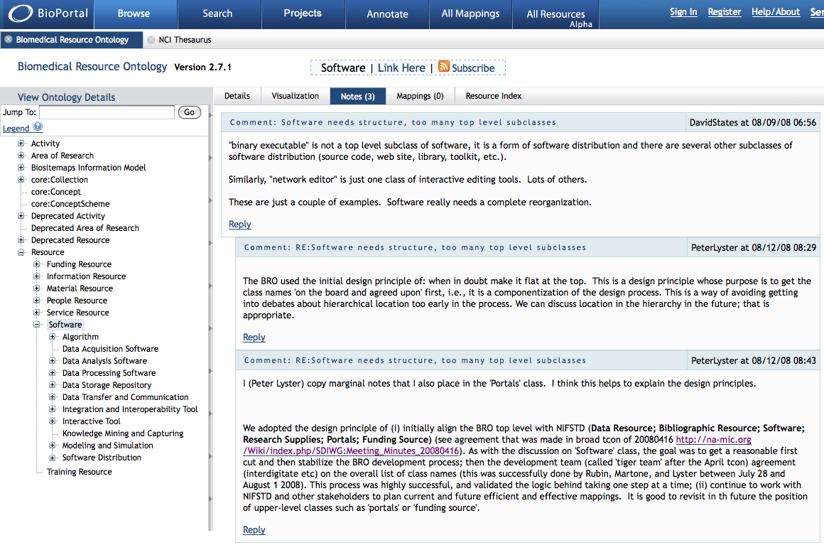
“Notes” in BioPortal

Slide 14
Community-Based Annotation as Peer Review
Makes ontology evaluation a democratic process
Assumes users’ application of ontologies will lead to insights not achievable by inspection alone
Assumes end-users will be motivated to comment on and engage in dialog about ontologies in the repository

Slide 15
BioPortal is building an online community of users who
Develop, upload, and apply ontologies
Map ontologies to one another
Comment on ontologies via “notes” to give feedback
To the ontology developers
To one another
Make proposals for specific changes to ontologies
Stay informed about ontology changes and proposed changes via “push” technology
Incorporate BioPortal services into their own technologies

Slide 16
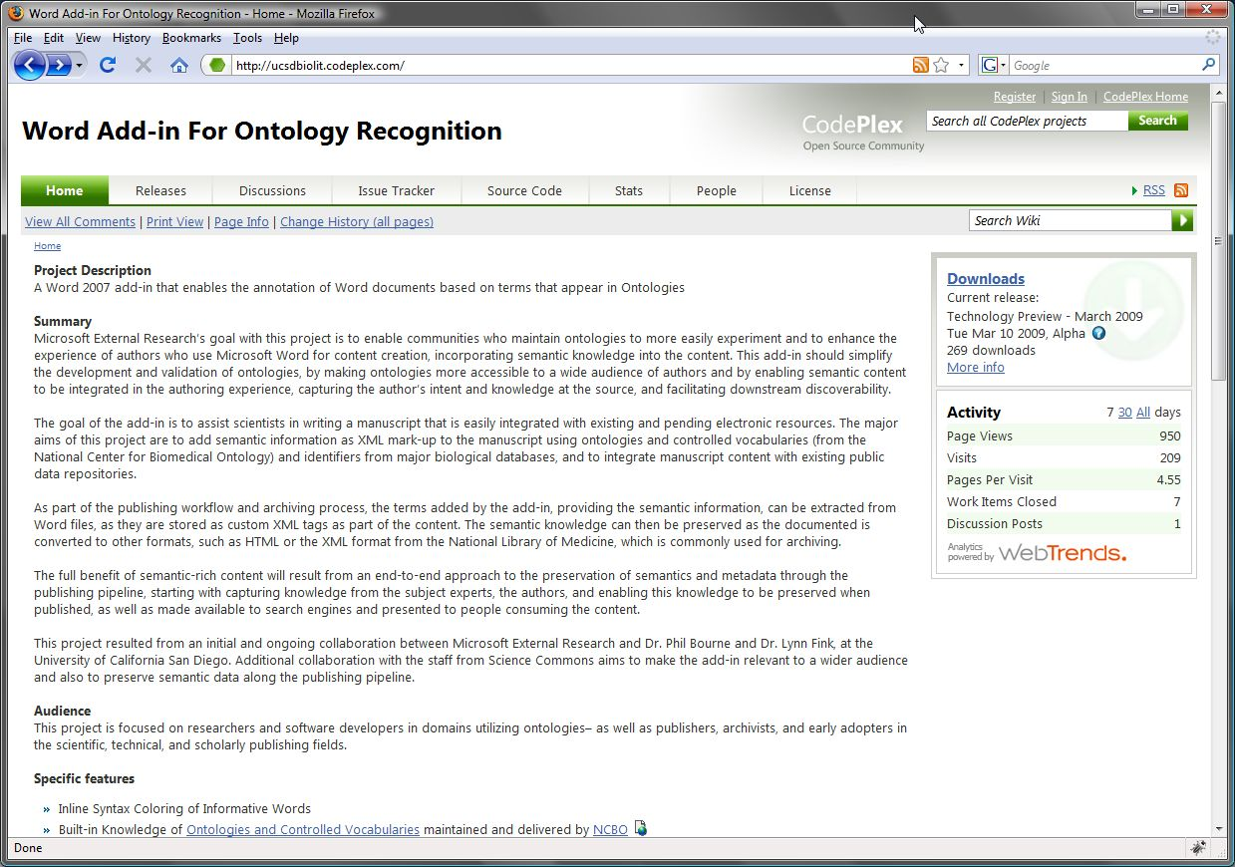
http://ucsdbiolit.codeplex.com

Slide 17
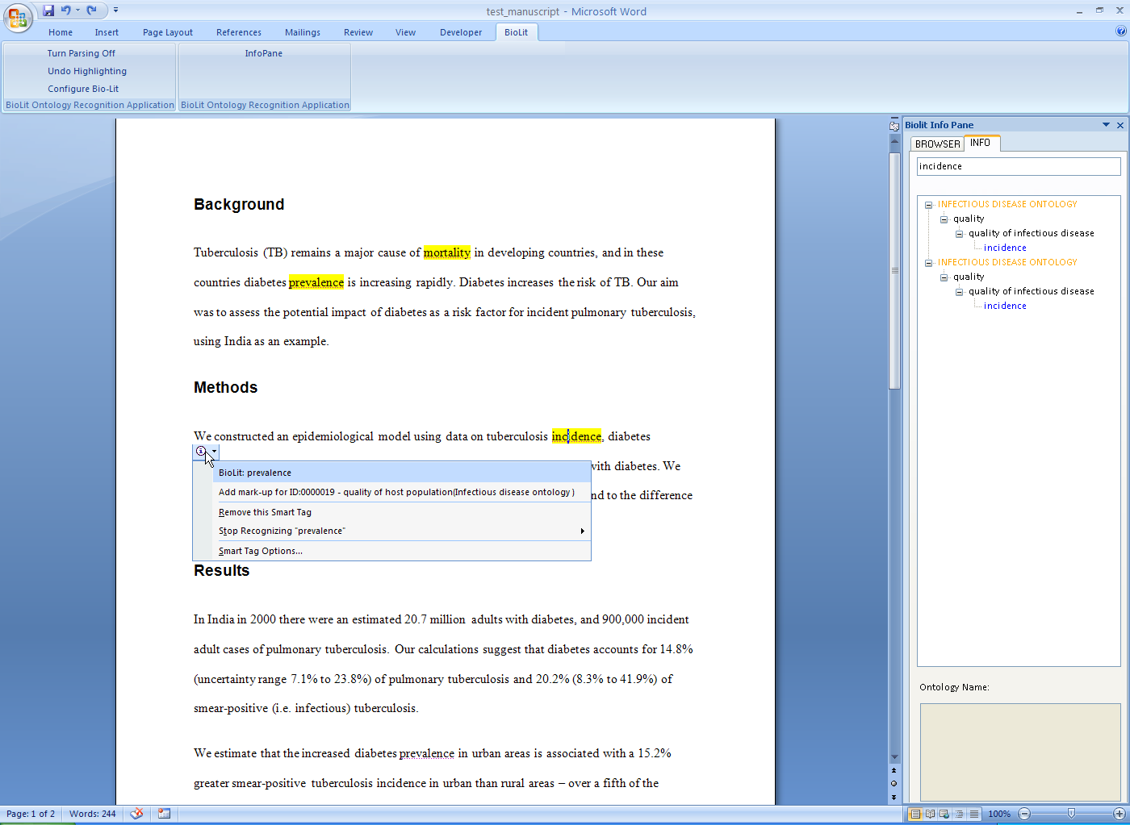
Automated recognition of ontology terms before publication

Slide 18
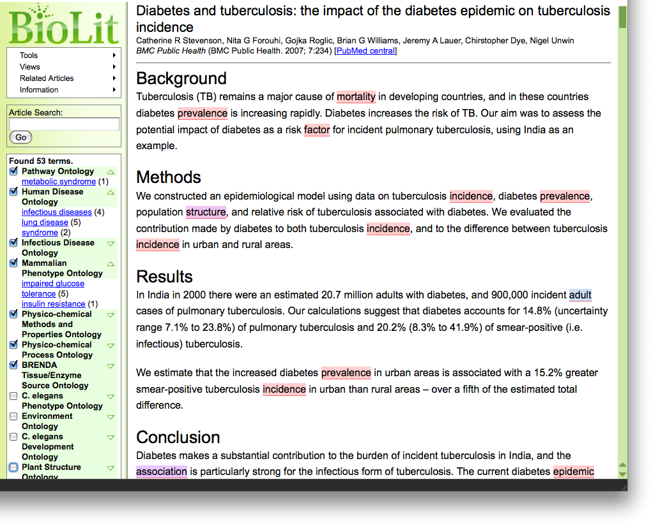
BioLit Web resource: automated recognition of ontology terms and database IDs after publication

Slide 19
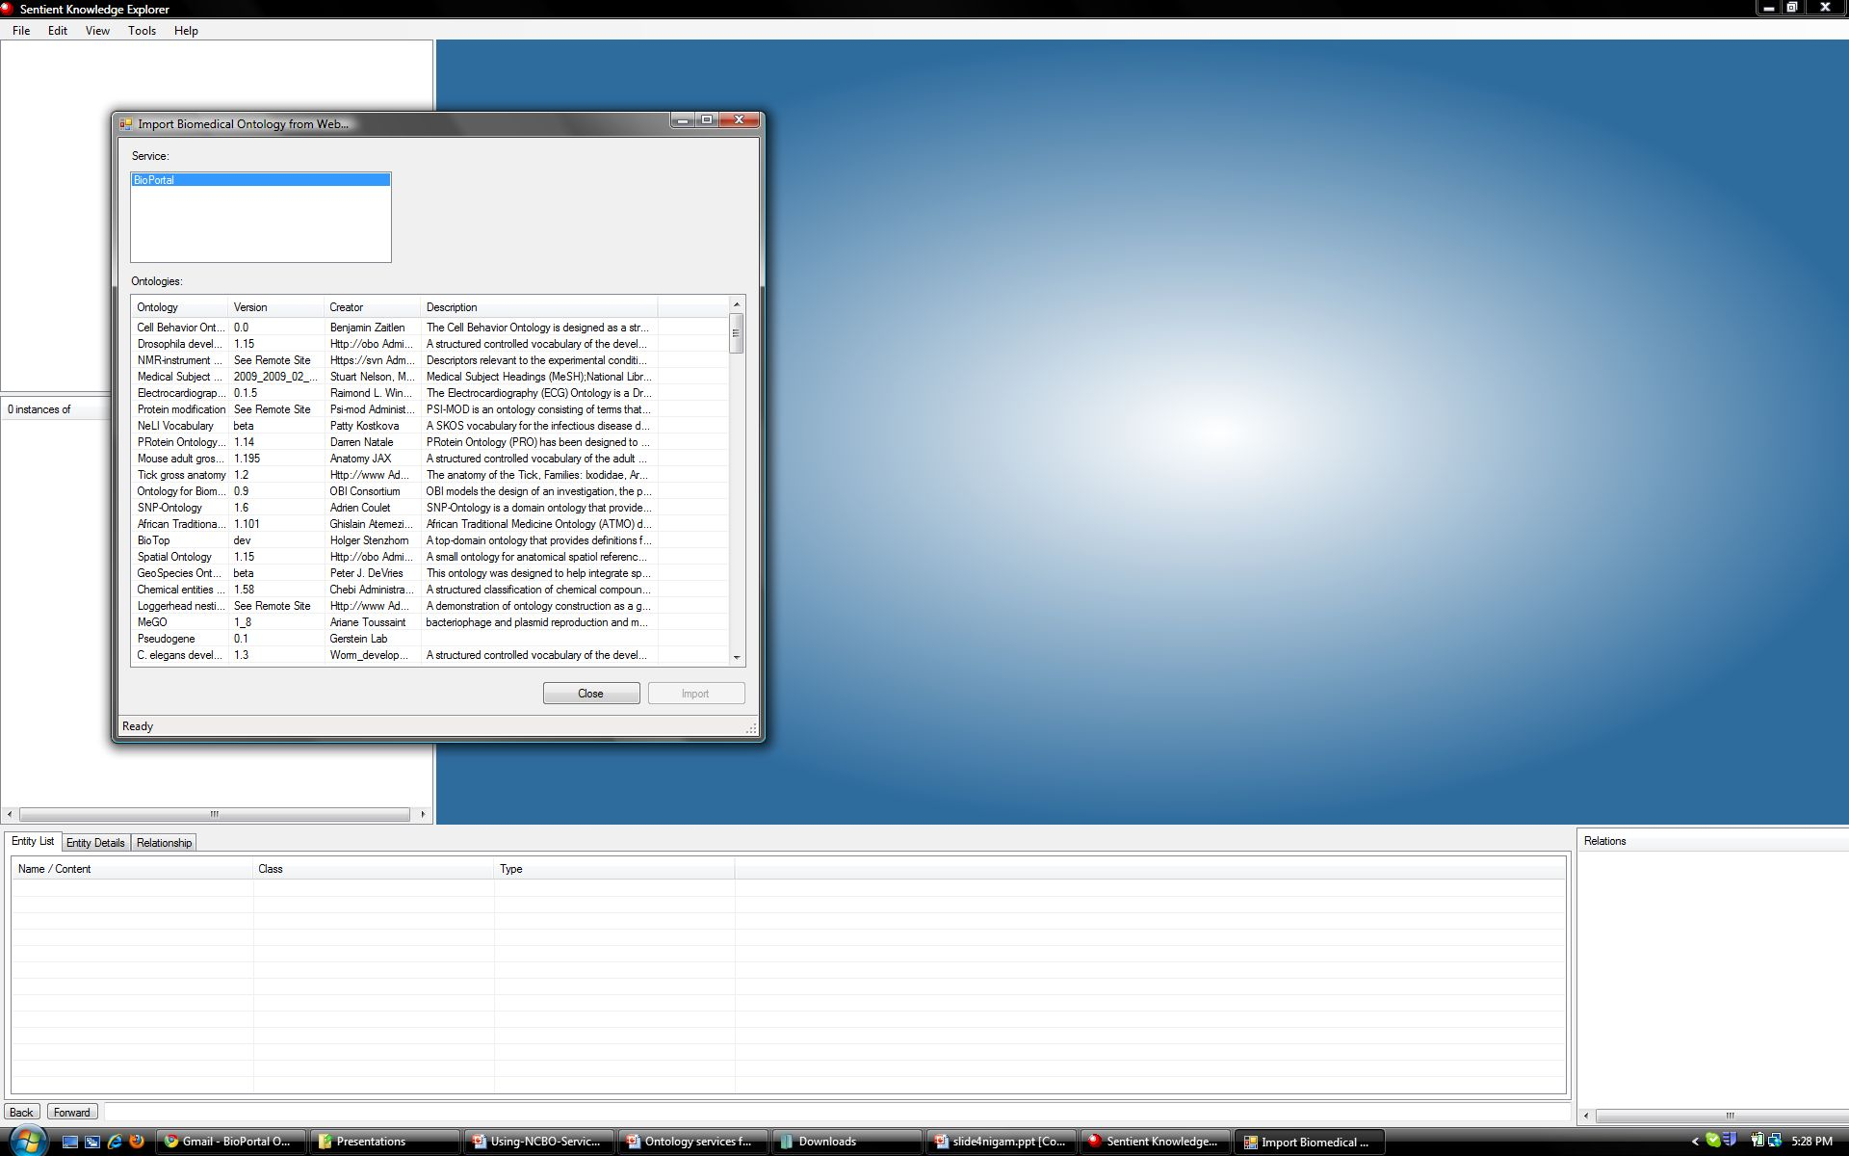
IO informatics uses Ontology Services

Slide 20
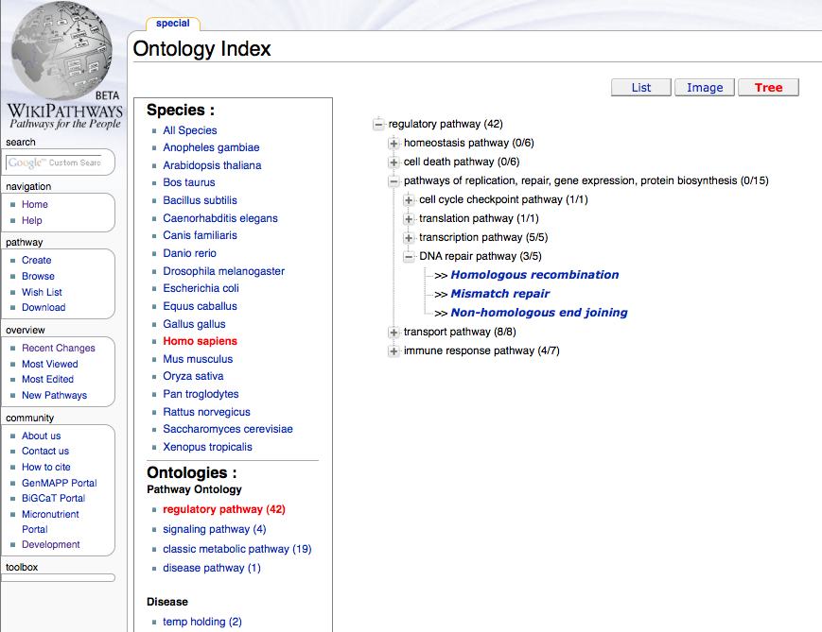
Wikipathways uses Ontology Services

Slide 21
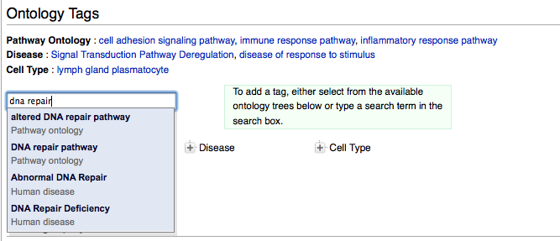
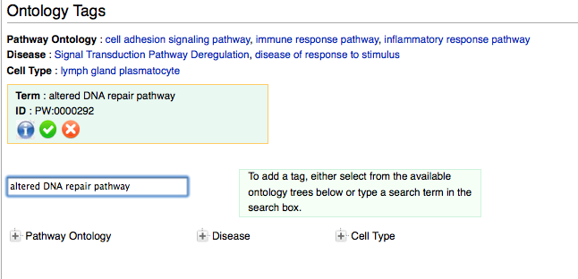

Slide 22
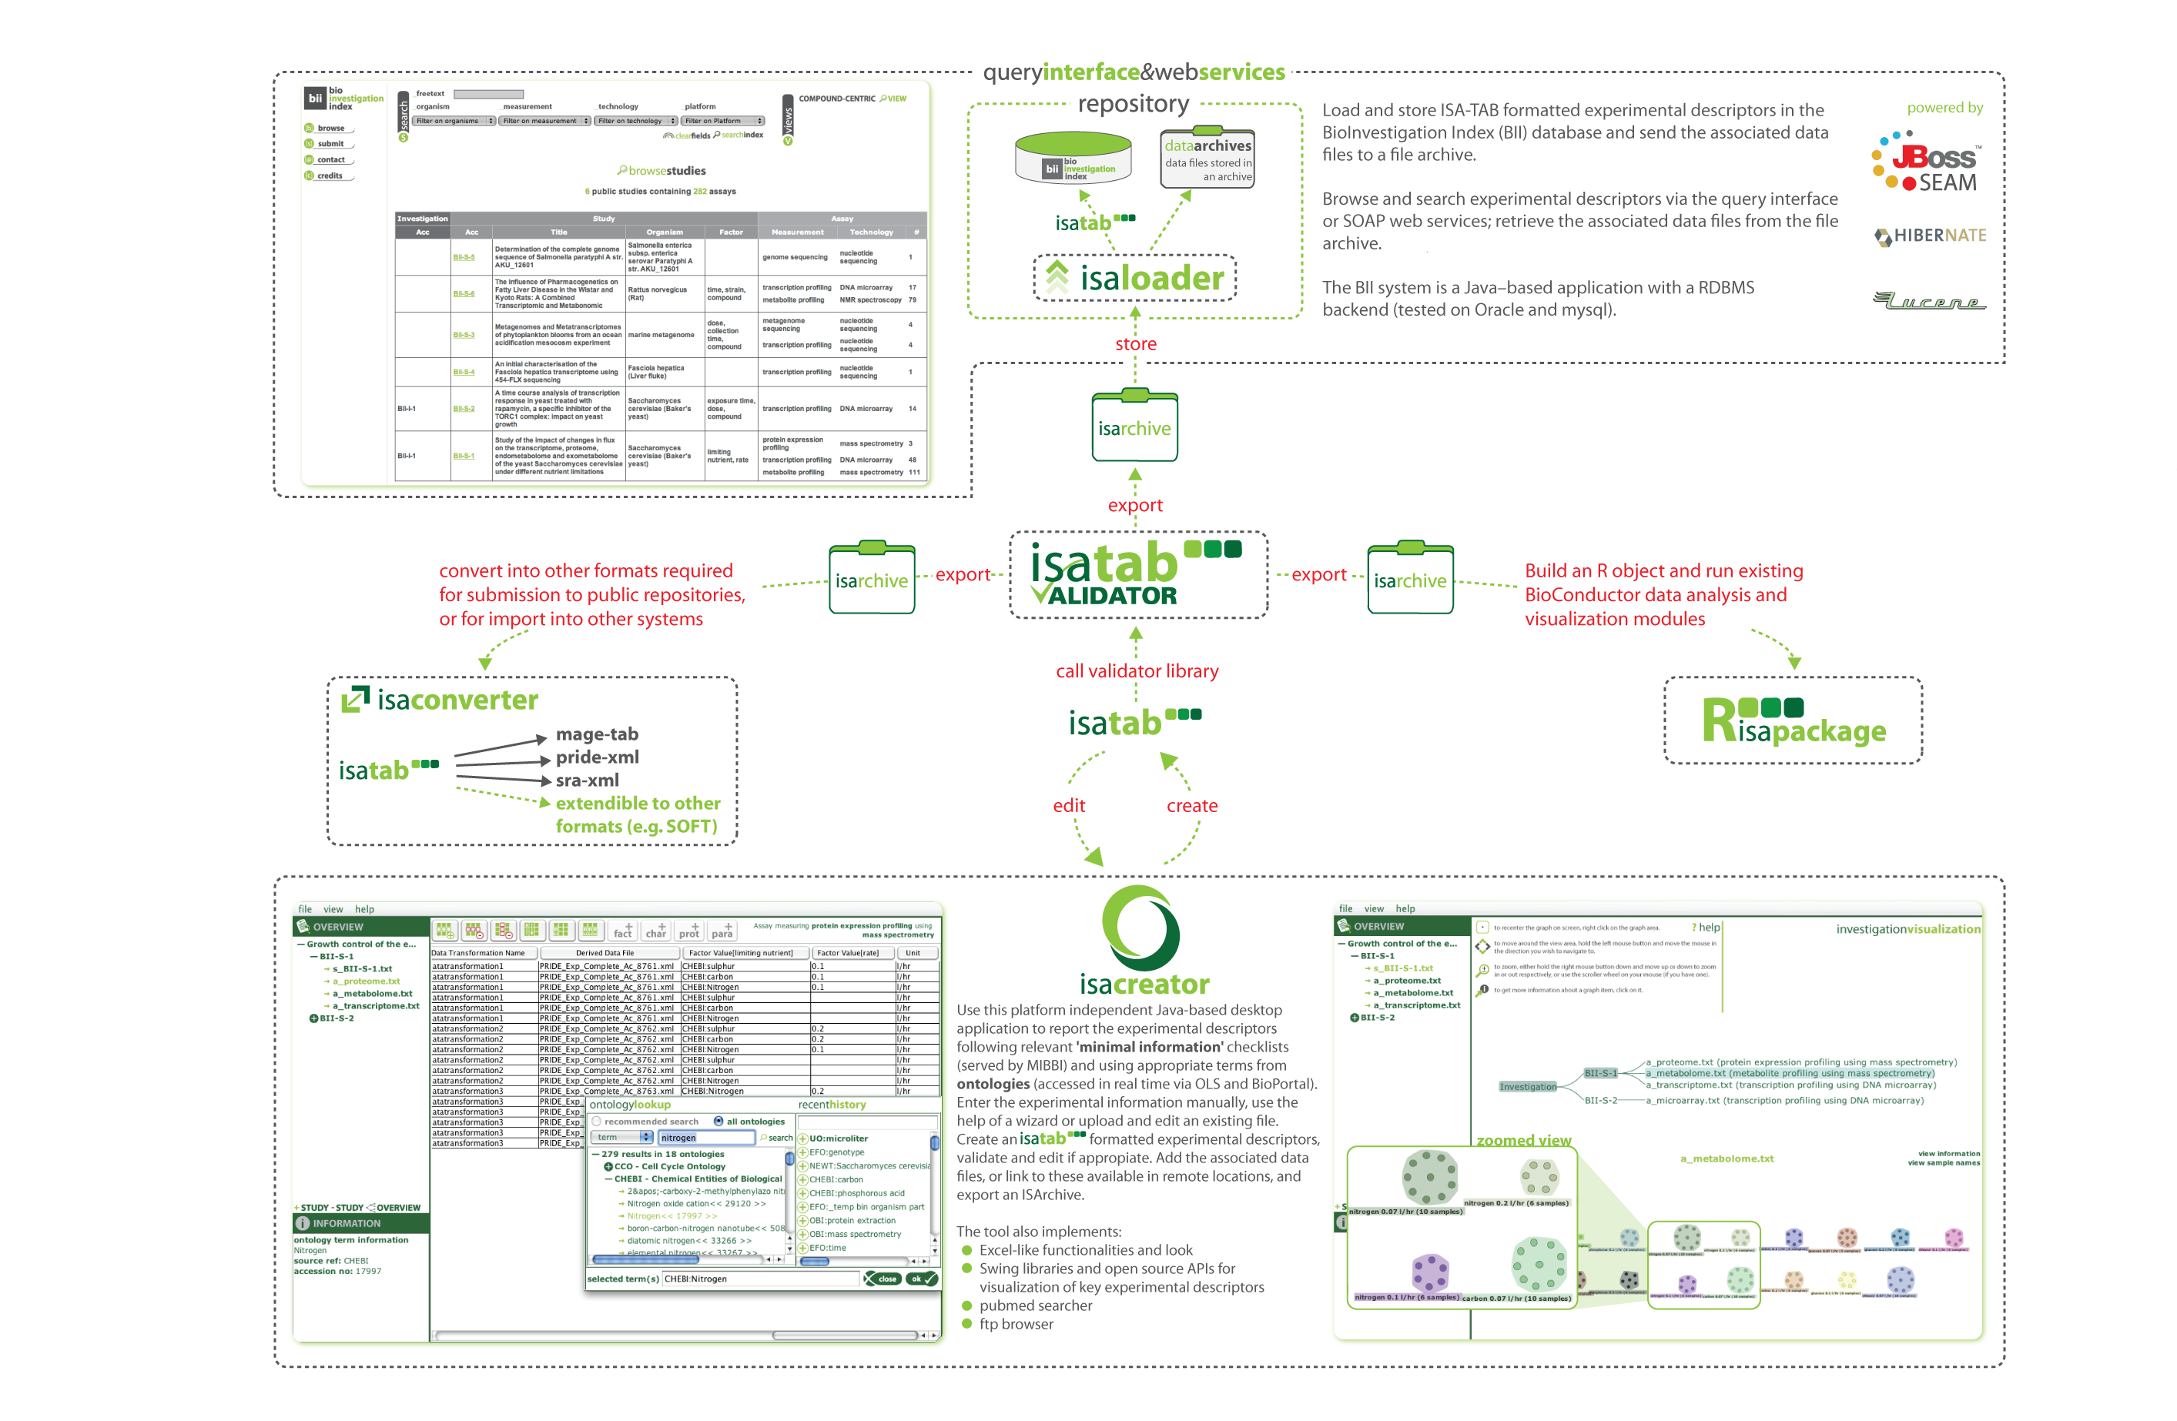
ISAcreator uses Ontology Services
Notes:
A ‘user-friendly’ standalone Java application that assists the experimentalists to annotate the experimental metadata. Depending on the configuration (set via the ISAconfigurator tool), certain fields prompt a pop-up browser to search and select terms from ontologies that are accessed in real time via the Ontology Lookup Service and BioPortal.

Slide 23
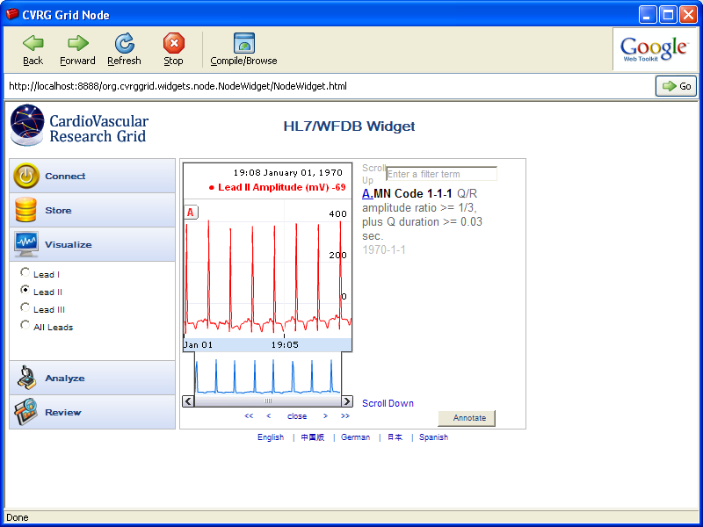
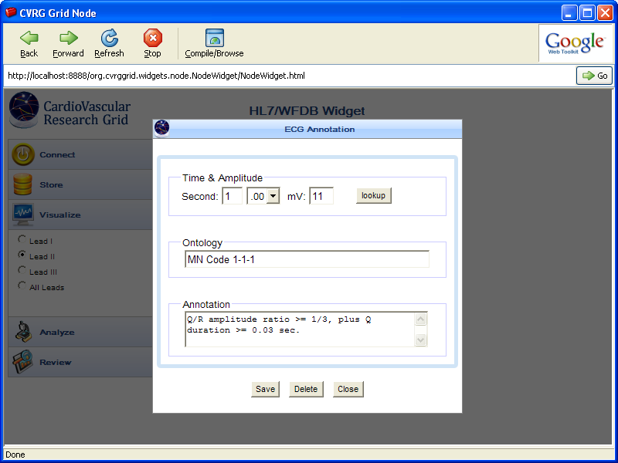
ECG Gadget uses Ontology Services
Notes:
The CVRG ECG Gadget is a Web 2.0 mashup application built using the GoogleWeb Toolkit and Visualization API. †It integrates the CVRG ECG Storage &Analysis Workflows with ECG Visualization/Annotation using REST servicesavailable from the NCBO Bioportal. †The application can be executed using anApache Tomcat server, allowing the application to be run locally and/orremotely. †The application has been tested in Internet Explorer 7 & 8.Questions and feedback on the tool itself are welcome.
23

Slide 24
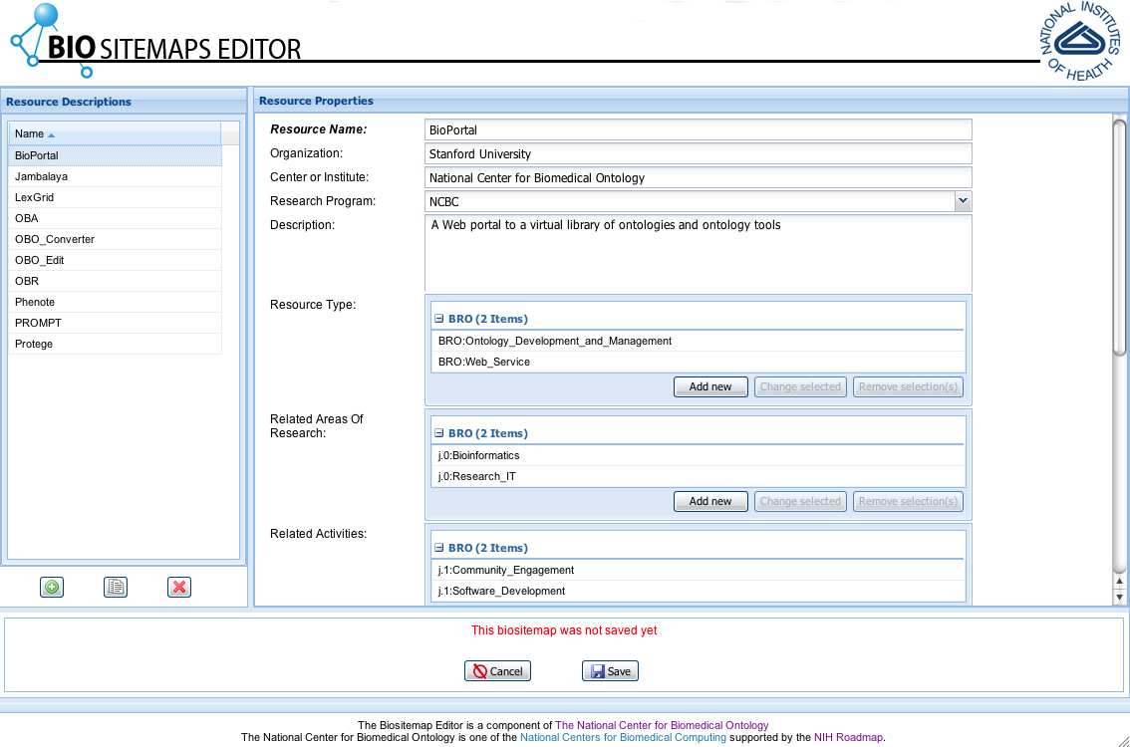
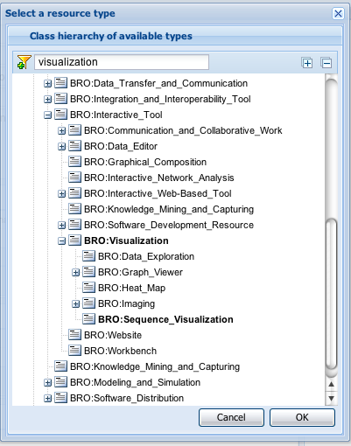
Biositemaps Editor
Notes:
24

Slide 25
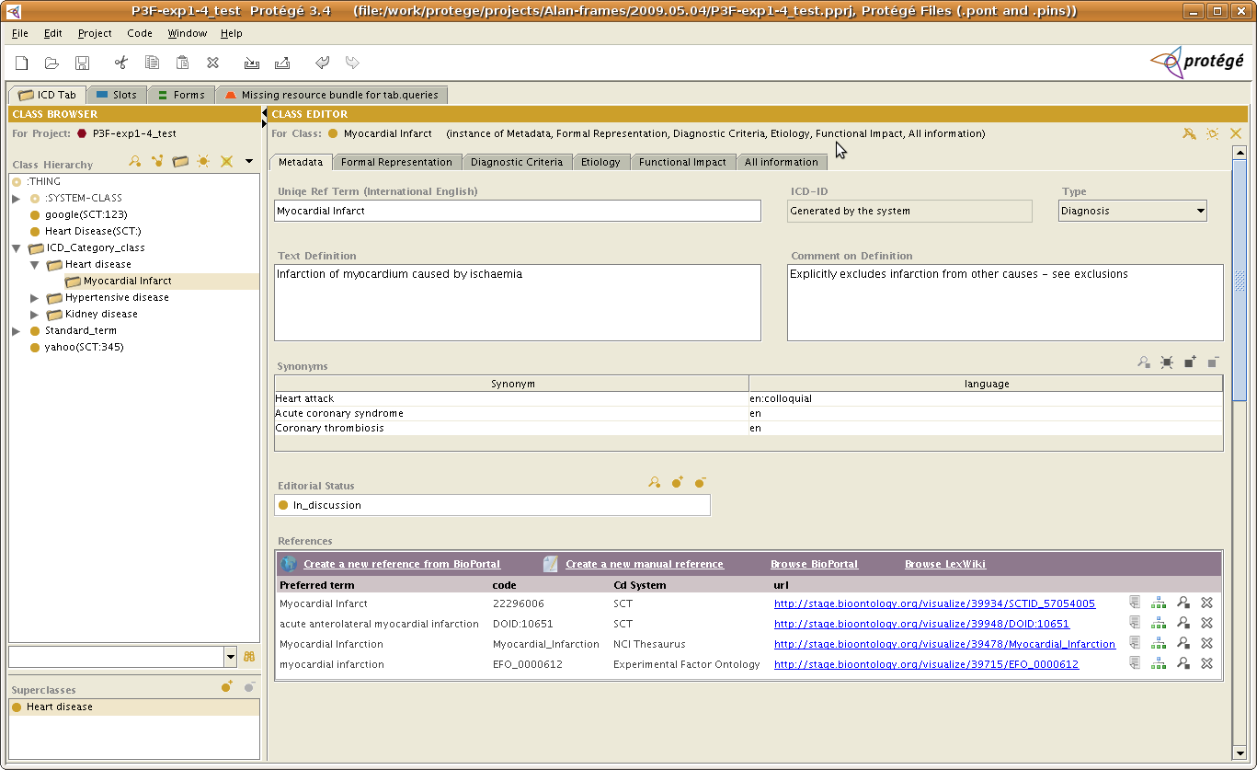
Protégé BioPortal-reference plug-in

Slide 26

Simbios uses NCBO Ontology Web Widgets

Slide 27
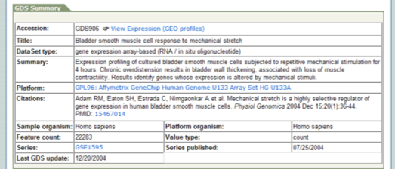
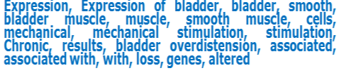
NCBO Annotator: The Basic Idea
Process textual metadata to tag text automatically with as many ontology terms as possible.
Notes:
We want to process the text and assign “tags” to each element in public repositories.

Slide 28
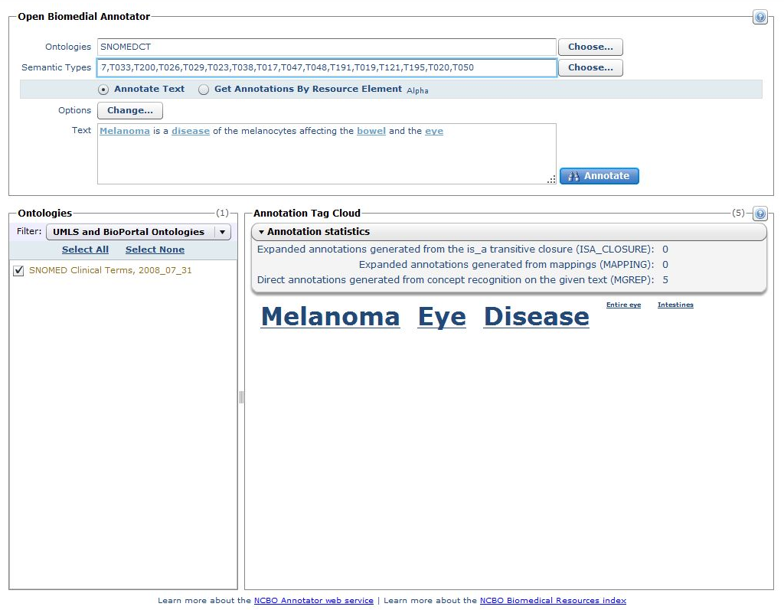
NCBO Annotator http://bioportal.bioontology.org/annotate
Give your text as input
Select your parameters
Get your results … in text or XML

Slide 29
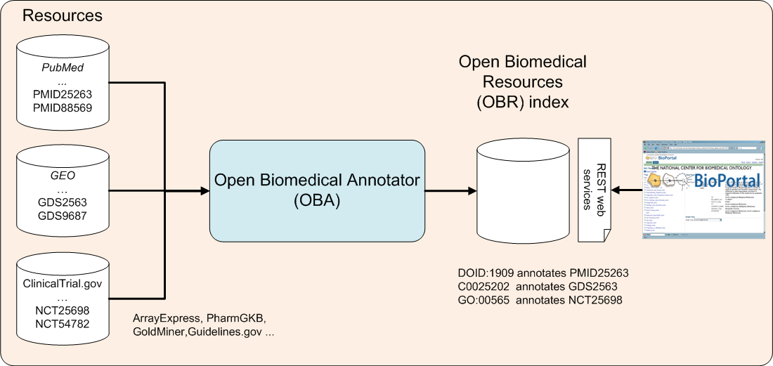
Resources Index: The Basic Idea
NCBO Annotator
The index can be used for:
Search
Data mining
Notes:
Search:
GEO has > 13 datasets on retroperitoneal tumors, none show up without an ontology based search!
- Did you know that GEO contains more public datasets on drug – gene expression information that Connectivity map?
Data mining:
- Extraction of Conditional Probabilities of the Relationships between Drugs, Diseases, and Genes from PubMed guided by relationships in PharmGKB in AMIA spring translational bioinformatics 2009.

Slide 30
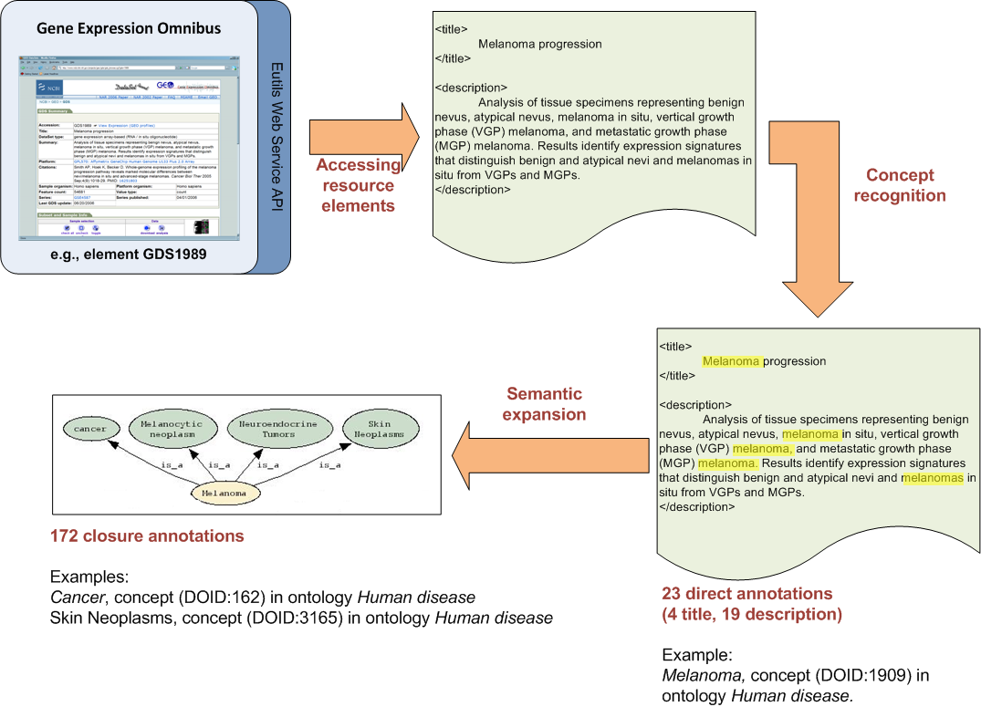

Example: Indexing GEO
Notes:
Indexing an element from GEO. The GEO element GDS1989 is annotated according to its title and its description, as well as by the ontology elements that comprise the transitive closure over the parent–child relationships subsumed by the direct annotations.

Slide 32
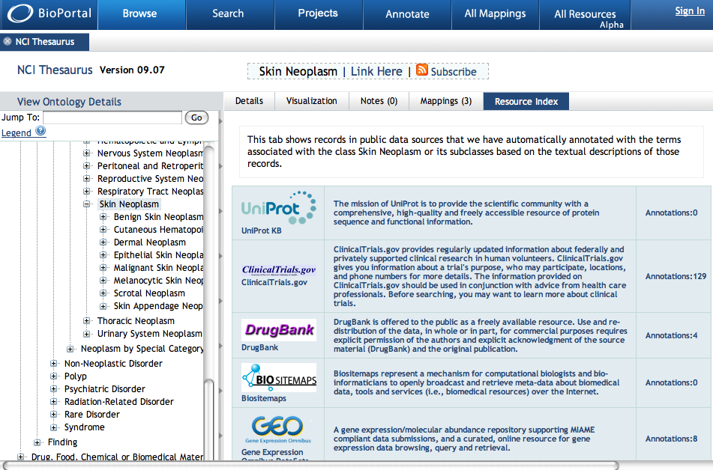
NCBO Indexed Resources

Slide 33
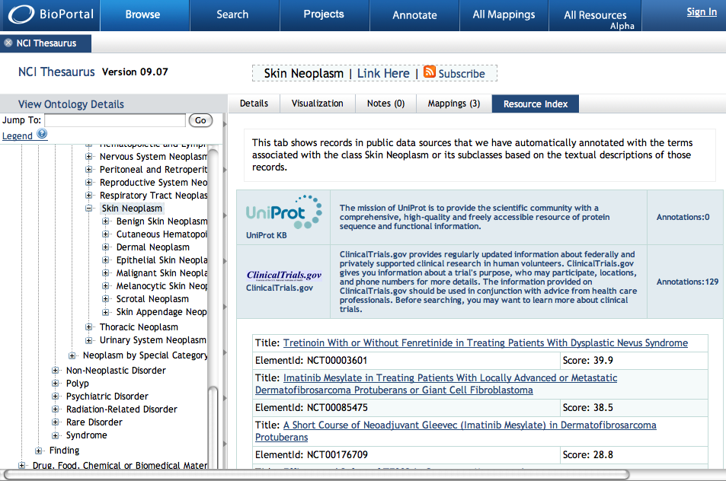
Links to specific resources

Slide 34

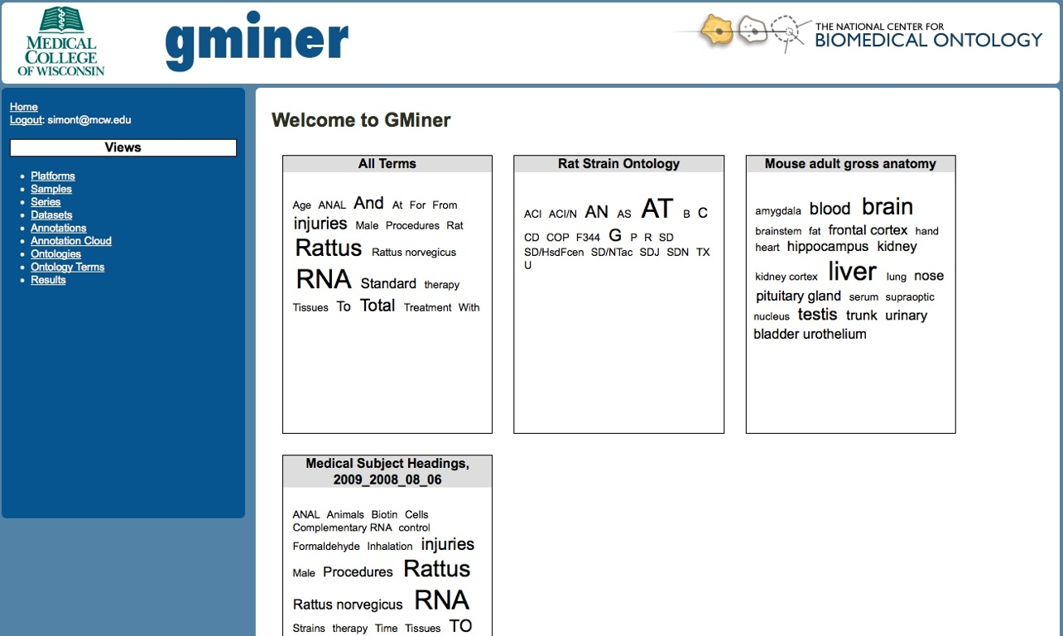
GMiner uses NCBO Annotation Services

Slide 35
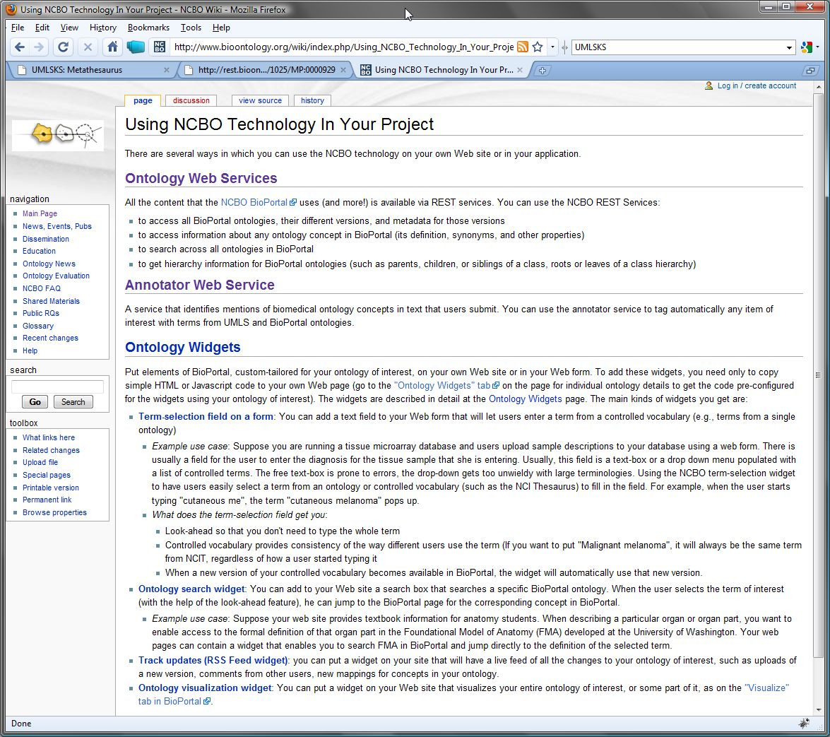
See our wiki to learn more!
www.bioontology.org/wiki/index.php/Using_NCBO_Technology_In_Your_Project

Slide 36
Ways to collaborate with NCBO
Be a user!
Propose a Driving Biological Project (DBP)
Get a collaborating research grant (NIH R01)
Initiate an industrial or academic joint projects

Slide 37



Current Driving Biological Projects
caNanoLab: Workers at Stanford and Wash U developing searchable catalog of therapeutic nanoparticles
Cardiovascular Research Grid: Workers at Hopkins developing ontology of ECGs and electrophysiological studies
Rat Genome Database: Workers at MCW use ontologies to annotate genomic data

Slide 38
Current “Collaborating R01” grants
UW: Creating views of ontologies
UCSD: Using ontologies to annotate neuroimaging data
UC Denver: Ontology enrichment through published literature
Pittsburgh: Ontology enrichment through EMR data
Wright State: Semantic data integration

Slide 39
Some other collaborative activities
CollaboRx, Inc. — Resource annotation
NextBio, Inc. — Ontology-based search
Google, Inc. — Web of Trust
University of Karlsruhe — Use of OMV in BioPortal metadata
World Health Organization — Ontology support for ICD11

Slide 40
Other NCBO components
Education and training
Graduate students
Post docs
Visiting researchers
Outreach and dissemination
Specialized workshops
Support for conferences
ISMB Bio-ontologies SIG
International Conference on Biomedical Ontology

Slide 41
NCBO needs HCLS!
To push on our technology
To drive our requirements
To help disseminate ontology-based methods in biomedicine
To help promote W3C recommendations in biomedicine
To help us in our mission to educate the community and to encourage best practices

Slide 42
http://bioontology.org

