Slide 1
Secure Element API
An introduction

Slide 2
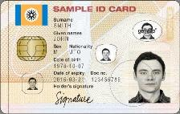
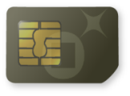
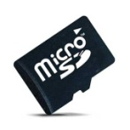
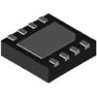
Objectives and use cases
“An API enabling the discovery, introspection, and interaction with hardware tokens (Secure Elements) that offer secure services such as tamper-proof storage, cryptographic operations, etc.”
Secure Elements:
Smart card (contact or contacless)
SIM/ UICC card
Smart/Secure microSD cards
Embedded Secure Elements
Clients
PC
Mobile
Tablet
…

Slide 3
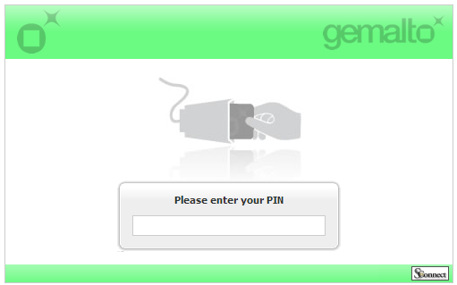
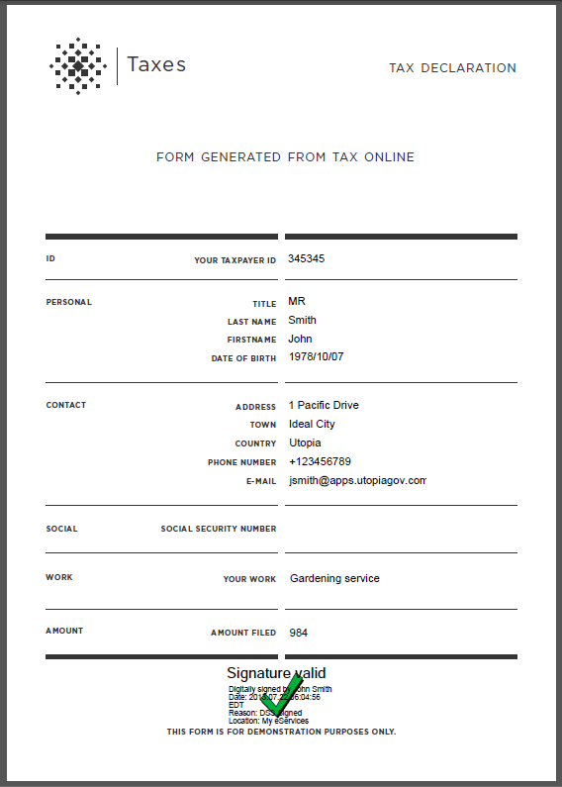
Use Case #1: Web Authentication with SE
PC, with contact or contactless PC/SC reader
Government eID card with contacts
User goes to an eGov web site, and is asked to authenticate
E.g. https://tax.myeservices.net/
User inserts her eID card in PC reader, and types PIN code
User is authenticated
User digital signs a document (eg Tax declaration) using her ID card
Notes:
Conflicts with Web Crypto

Slide 4
Use Case #2: “Card present” mCommerce
Mobile with NFC
UICC or NFC Visa card
User navigates to a merchant web store in mobile browser
User pays with Visa app preloaded on UICC or in contactless Visa banking card
This triggers a system application, which prompts user for confirmation and optionally payment issuer (if multiple available), PIN code, asks SE for “payment credential”, and forward it to payment server
When payment confirmation is received, it is forwarded to originating merchant in the browser, which displays confirmation message

Slide 5
Use Case #3: Reloading transportation card
Mobile with NFC
Public transportation card (e.g. London’s Oyster card)
User open’s mobile browser, and navigates to the card’s emitter web site (e.g. https://oyster.tfl.gov.uk)
User buys a ticket and loads it on her transportation card by tapping it on the mobile
Transportation card now holds the tickets, it can be presented to “touch” readers when travelling

Slide 6
Use Case #4: Mobile ID (OOB auth)
2 devices:
Web application used on PC browser (no SE)
Out-of-band authentication on Mobile with NFC
Company ID card with embedded Auth Certificate
User opens a session on a web application in a PC browser
The server opens a session and waits for credential (a signature) from a pre-registered mobile
User opens a pre-installed authentication application on mobile, and tap her NFC corporate card
Authentication application computes the credential using the embedded card certificate, and sends it to server
Server validates session on PC browser and let user in

Slide 7
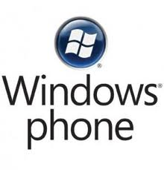
Status
In W3C: SE planned in Phase 2 of SysApp WG
Adoption in Web industry:
Tizen
Open source, standards-based software platform supported by leading mobile operators, device manufacturers, and silicon suppliers for smartphones, tablets, netbooks, in-vehicle infotainment devices, smart TVs, etc.
Webinos
EU funded project delivering a platform for web applications across mobile, PC, home media (TV) and in-car devices
Adoption In Mobile Industry
SIMAlliance’s Open Mobile API
Non-profit trade association working mobile community seeking to create a secure, open and interoperable mobile environment
Deployed devices (NFC):
180+ models by more than 15 manufacturers
Android, BlackBerry (BB OS 10), Windows Phone (7.5)

Slide 8
Commercial devices examples
Acer: Liquid Express C6
Alcatel (TCL): Smart III-4
BlackBerry: Z10
HTC: One X
LG: P940 (Prada)
Nokia: Lumia 610 NFC
Motorola: Droid RAZR (XT926)
Samsung: Galaxy S2, Galaxy S3, Galaxy S4
Sony: Xperia Z
ZTE: P728
….

Slide 9
Roadmap
Editorship offer: 2 co-editors
Gemalto (Olivier Potonniée)
Intel (Tran Dzung D.)
Ready to draft
Start with Use Cases
Contributions welcome
Requirements
How should we manage them?

