Slide 1
Headlight:
Social Networking
Steve Holbrook
IBM, AC rep
14 May 2012

Slide 2
Open the door
to social business
Agenda
Social, Standards & W3C
Social Business Jam
Social CGs
Social Workshop?
Standout organizations are 57% more likely than their peers to allow their people to use social and collaborative tools.
Source: IBM 2010 CHRO Study

Slide 3
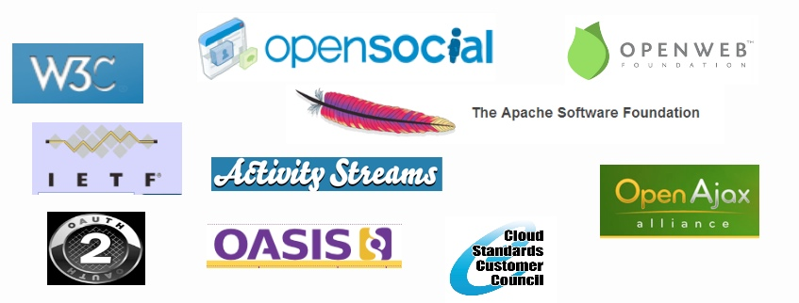
Social Business, Standards & W3C
Customers are seizing the Social Business opportunity!
According to IDC's Social Business Survey conducted in September 2010, 41 percent of respondents indicated that they have already implemented an enterprise social software solution.
Social Business represents an exciting $4.6B* market opportunity by 2013
Many standards organizations target portions of this market
But there is no one place yet that brings together customers with the community in a dialogue that sets the agenda for standards!

Slide 4
Supported by
November 8-10, 2011
Please register to participate:
http://www.w3.org/2011/socialbusiness-jam
W3C, an international community that develops open standards, is hosting the W3C Social Business Jam, a 72-hour online discussion for leaders in business, government and technology to discuss how businesses are using social technologies and the challenges they face integrating the technologies into their existing environments.
Please Join Special Guests Participating in the Jam, Including:
Lee Aase- Director, Mayo Clinic Center For Social Media David Ascher- Social & Communications, Mozilla Yochai Benkler- Professor, Harvard Law School Tim Berners-Lee- Inventor of the Web, W3C Director Angel L. Diaz- Vice President, Software Standards, IBM Software Group Paige Finkelman- General Manager, Enterprise 2.0 Conference Kevin Hauswirth- Social Media Director, Office of the Mayor at City of Chicago Alejandro Jaimes- Manager of Social Media Engagement Group at Yahoo! Research Evan Prodromou- CEO of Status.net Steve Ressler- Founder and President of GovLoop Doc Searls- Well-Known Blogger, Founder of "Vendor Relationship Management" Matt Tucker- Co-founder and Chief Technology Officer, Jive Software
Topics to be discussed by a world-wide audience will range from issues on mobile computing to security to integrating social with existing business processes. Participants will discuss with peers specific ways they can achieve greater business value from social technologies, with a focus on applying open standards.
Please register to participate today! http://www.w3.org/2011/socialbusiness-jam
To learn more, watch this video with Angel Diaz, IBM VP, Software Standards, regarding the W3C Social Business Jam and open standards. http://bit.ly/IBMOpenStandardsW3CJam
Link to Social Business Jam report: http://www.w3.org/2011/socialbusiness-jam/report.html

Slide 5
A Social Business Standards Community Group
Drive Customer requirements into standards development process
Raise awareness of the importance of open standards based Social Business
Deliver customer focused content in the form of best practices, patterns, case studies, use cases, and standards roadmaps.

Slide 6
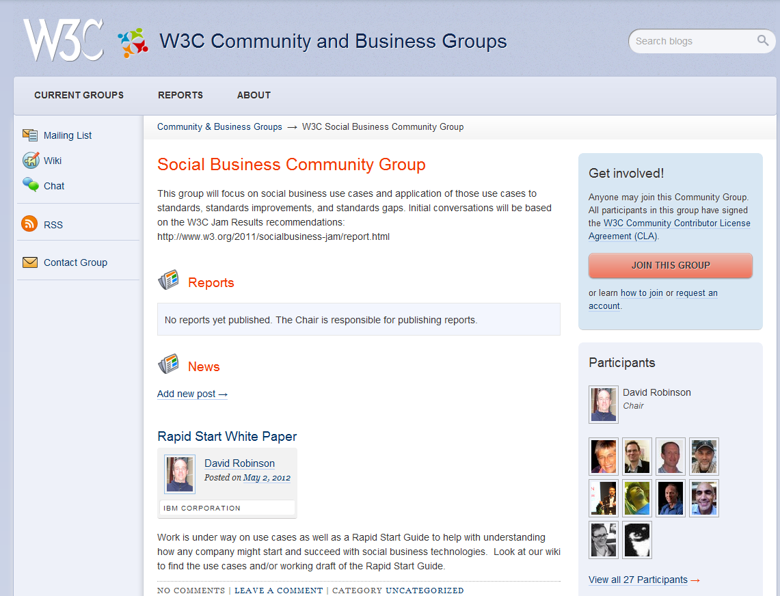
Social Business CG page

Slide 7
Social Networking CGs
Federated Social Web
Social Business
PubSubHubbub
OStatus
Core Mobel Web Platform
ActivityPub
Headlight Projects are a great means of encouraging cross pollination between similarly themed CGs
IBM would like to encourage this practice along with Cross CG task forces.

Slide 8
Headlight: Directions
Social Standards “Boxitecture” (Ann’s presentation)
Co-branded Workshop(s)

Slide 9
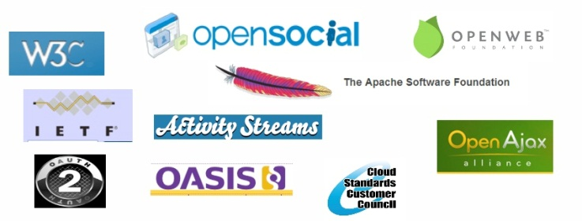
Social Workshop
When: Fall 2012
Where: Bay Area
possibly co-located with Internet Identity Workshop in Oct
What: Bring together key organizations dealing with Social Standards
In early discussions re: co-branding
Use headlights project output as catalyst for Workshop
Use cases & requirements
explore “boxitecture”
Explore standards roadmap
Seeking Workshop Sponsors, interested parties

Slide 10
Discussion
Should W3C pursue further work in Social?
Is a (co-branded) Workshop a good idea?
Q&A…

