Slide 1

W3C eGovernment Interest Group
Launch Workshop
31 October – 1 November 2011

Slide 2
Agenda: Monday 31 October
09:00-09:30 - Introductions by Participants and Observers
09:30-10:00 - Introductions and Goals of the Meeting
10:00-10:30 - View from the Government and Stakeholders, What Is More Important, What Is Missing, What the Future Could Bring to eGov
10:30-10:45 - Break
10:45-12:30 - Reports from Open Government Data Camp
12:30-14:00 - Lunch
14:00-14:30 - Reports from World Bank
14:30-16:30 - Open Government Data Practices and Policies
16:30-16:45 - Break
16:30-17:30 - Social Media
18:30-21:00 - Networking/Dinner

Slide 3
Agenda: Tuesday 1 November
09:00-11:00 – Social Media (John Erickson and Kevin Simkins)
11:00-11:15 - Break
11:15-12:30 - Community Directory and Resources
12:30-13:45 - Lunch
13:45-14:15 – Components of an Open Data Site (Jeanne Holm, Lego)
14:15-15:00 – Data Licensing (Anne Fitzgerald)
15:00-15:45 - Education and Outreach (John Erickson)
15:45-16:00 - Break
15:15-17:30 - Future of eGovernment at W3C: Summary and Actions
18:30-21:00 - Networking/Dinner

Slide 4
Logistics
Face to face
Virtual via teleconference
IRC
  http://www.w3.org/Project/IRC/ OR
  http://irc.w3.org/?channels=egov
  Please volunteer to help scribe
Open discussion around topics

Slide 5
Procedures
Open discussion around topics in order to lead to
  Sharing of best practices and ideas
  Requirements for another W3C standards group
  Recommendations or papers
  Projects
Off-topic discussions welcome via note cards at tables or in IRC with “CARD” preceding comment
  All note cards will be discussed during that day
Have an idea for a project or action use a note card and put it in “space”
  In IRC put “ACTION” preceding the comment
  All actions will be discussed as part of the overall actions and plans
Participate, enjoy, relax, and engage!

Slide 6
Social Media (9:00-10:00)
Social media complements open data in a variety of ways
  Open data formats are used to pull, collect, or aggregate content from a social platform
  Social media is used to communicate about specific open data activities
  Social media is used to create and connect the open data community

Slide 7
Social Media Discussion
What are your favorite social network and social media products and platforms and why?

Slide 8
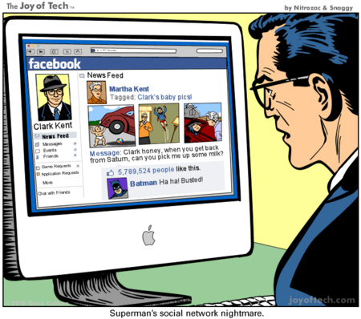
Social Media Discussion
What are your favorite social network and social media products and platforms and why?

Slide 9
Community Directory and Resources (11:00-12:30)
Bernadette Hyland

Slide 10

Brainstorm
What are the components that are necessary for an open government site?
  Discussion
  Think of a way to symbolize the important components
    Create those from Legos
    Bring them to the front to share
    Place them with others that are like them

Slide 11
Open Data Portal Management Questionnaire
Questionnaire is to share facts and figures, insights and lessons learned between open data portal managers
  Results will be shared online via http://www.ePSIplatform.eu, http://www.w3.org and http://okfn.org
  Mailing list which will be used for community communication http://lists.okfn.org/mailman/listinfo/data-catalogs
  Paul Suijkerbuijk (Data.overheid.nl, The Netherlands) Paul.Suijkerbuijk@ictu.nl
  Jeanne Holm (Data.gov, US) Jeanne.M.Holm@jpl.nasa.gov
  Andrew Stott (UK) Andrew.Stott@dirdigeng.com
Questionnairehttps://docs.google.com/spreadsheet/viewform?formkey=dGVwNXM3T3FxRzRrN3cyRTFaaURYblE6MQ
Invitationhttp://epsiplatform.eu/content/invitation-data-portal-managers-join-our-expert-group-do-our-survey

Slide 12
Data Licensing (14:15-15:00)
Anne Fitzgerald

Slide 13
Education and Outreach (15:00-15:45)
John Erickson

Slide 14
Brainstorm: Communications
What are the best no-cost/low-cost ways to:
  Initiate government and public interest in an open data site?
  Generate interest in an existing open data site?
  Engage with developers?
  Communicate to the public about open data?
  Find and identify apps and uses of open data?

Slide 15
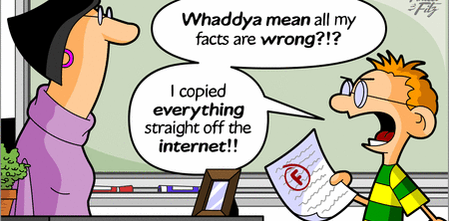
Break (15:45-16:00)
Courtesy http://csmaster.sxu.edu/caviles/images/internet%20comic.gif

Slide 16
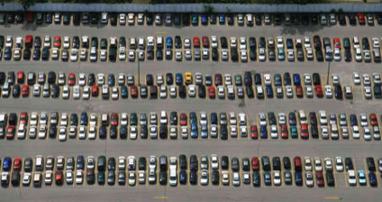
Collect Cards from the Parking Lot
Items to add from today’s discussions?

Slide 17
Future of eGovernment at W3C: Summary and Actions
16.00-17.30 – Jeanne Holm, Phil Archer

Slide 18
From OGD Camp Keynoters
In closing session at Open Government Data Camp, keynoters reflected on what developments they would most like to see in the next year in relation to open government data:
  Open Government Data as a Right
  More Schemas (Knowledge APIs) – keep it focused, let’s not try to boil the ocean
  Open Data as a Platform, Not a Commodity
  Massive Interconnection Between Open Data Sites
  Open Corporate Data (for and by Corporates)
  Standards (e.g. for catalog metadata) for Data Portals and Data Hubs
  Open Data for Growth – making clear the the connection
  Strong international norms for data inventories
  Organizational identifiers–Dunn & Bradstreet should be replaced with open data
  MiData – getting personal data out of corporates and government back into the hands of the people whose data it is

Slide 19
Cards and Actions
Issues
  What happens when the use of open government counters the intent of the government (e.g., revolution)?
  Expression of an eGov policy
  How does eGov fit into the model of digital have-nots
  Provenance: What can be done to associated basic provenance info, even an authority & URL of source, of data in a mashup. John Erickson gave an example that he had to email some developers to find out where they pulled data from; Bernadette gave examples of mashups where data was just incorrect and there was no way to reach back to the developer and cite correct data
  Should we consider helping to inform a standard API(s) that could be included to show how to correct the data?
  Sub force on reputation and trust
  No more papers, only instances of the use of the data.

Slide 20
Cards and Actions: #1 Use Cases
Collect and share best practices and examples of
  eGov policies (stories, benefits, outcomes)
    Inclusive of social media, outreach, education, …
  Should we create examples and a form?
  We should collect and look across for commonalities of elements in published cases and examples

Slide 21
Cards and Actions: Social Media
Social media
  How do we capture the provenance of social media artifacts like policy and technology
  What is the official status of government officials’ tweets?
  Can we use the W3C kit t=to crowdsource on data quality, third parties commenting on ideas
  can we discuss licensing in the social media discussion too? We have groups in UK gov who default to "All rights reserved" (erroneously) when publishing content on social networks.
  Be sure to look broadly at social media in the discussion later today
  Collect the resources of everyone's social media network

Slide 22
Cards and Actions: Apps
Apps
  How can we make open data + apps sustainable?
  How can we provide guidance that is peer-reviewed and properly advertised on the Web, possibly even coming from some standards body or hub site?

Slide 23
Cards and Actions: Coordination
Connect with others
  Coordinate with Crossover project for June 2012 (Barcelona) or final March 2013 (Lisbon)
  DCAT via GLD in W3C
    Clarify the DCAT development/recommendation process within the context of the GLD's work
  Federated Social Web Group in W3C
  Develop the persona of constituents
  What other sub groups are required?

Slide 24
Summary and Actions

Slide 25
Brainstorm: Future States
Where are we headed?
  What outcomes do we want to see in 12 or 24 months?
  How would we measure those outcomes?
  What would be considered a spectacular win for open data?

Slide 26
18.30-21.00 - Networking/Dinner

Slide 27



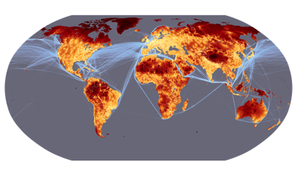

Exercises
IDEO cards
Stair step voting

