Slide 1
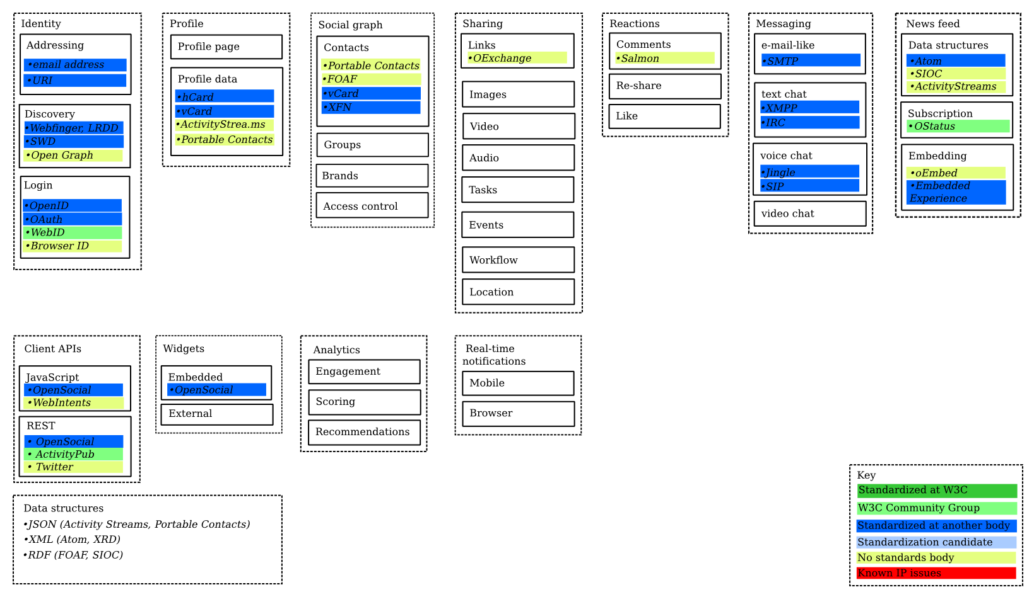
from Harry Halpin, Evan Prodromou, 4/2/2012

Slide 2
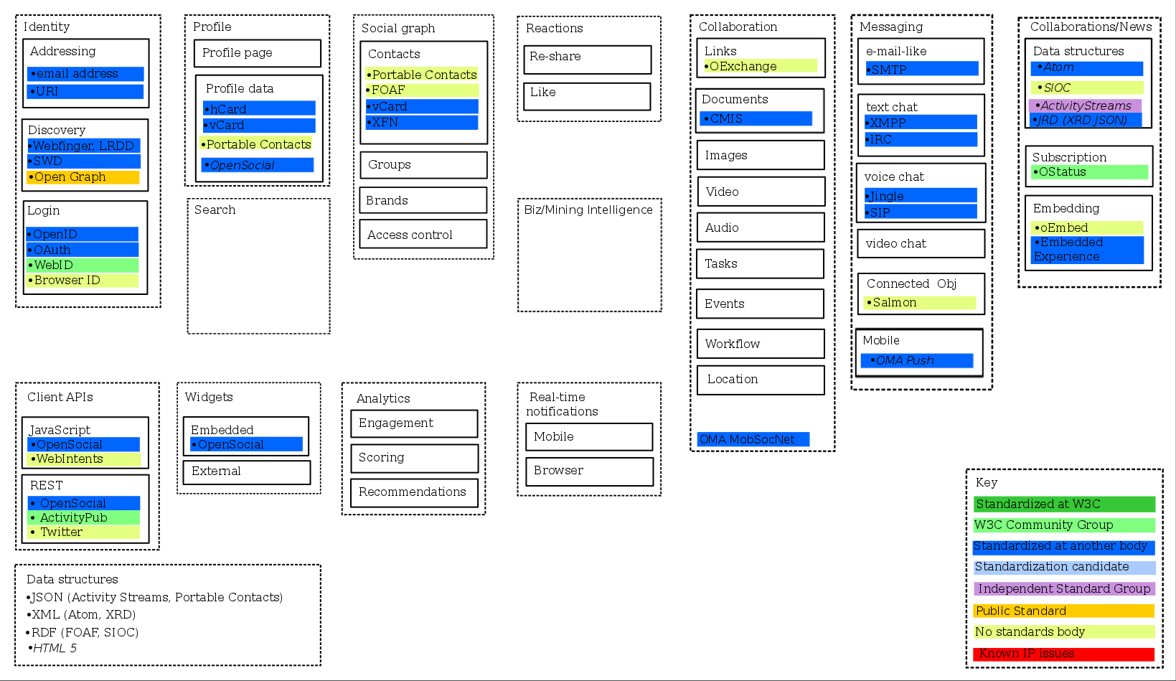
Harry Halpin, Evan Prodromou original, with David Robinson additions highlighted in red by Ann* ... 4/16/2012
was called 'news'
was called 'sharing'
*NOTE: needs to be checked to make sure I found all additions and changes

Slide 3
Human interactions
from Harry Halpin, Evan Prodromou, 4/2/2012; additions from Ann Bassetti, 4/14/2012
Sharing
Messaging
Group Dynamics
(e.g., Community, Team)
Newsfeed
Reactions
Key
Standardized at W3C
W3C Community Group
Standardized at another body
Standardization candidate
No standards body
Known IP issues
Text
E-mail like
SMTP
Data structures
Atom
SIOC
ActivityStreams
Comments
Salmon
Links
OExchange
Create
Text chat (includes 1:1 and 1:multiple; also includes "Live Chat" such as with Helpline person)
XMPP
IRC
Re-share
Images
Join / Un-join
Subscription
OStatus
Video
End / Close
Like / rating
Audio
Membership list(s)
Embedding
oEmbed
Embedded Experience
Recommendations
Tasks
Voice chat
Jingle
STP
Group list(s)
Tags
Events
Distribution list(s)
About the human *
Alerts / Notifications
Workflow
Routing
Signatures
Video chat
Identity
Given/family name
Username(s)
Assigned number(s) (e.g., governmental)
....
Social Graph
Profile
Contacts
Portable Contacts
FOAF
vCard
XFN
Profile page ??
Forward / reply (might be part of others or part of 'Sharing")
Profile data
hCard
vCard
ActivityStrea.ms
Portable Contacts
...
Location
Ubiquitous attributes
Bookmarks
Threaded discussions (e.g., bulletin board; includes "Idea Generation / Jam")
Threading
Sorting (by 'likes', 'most recent',...)
Hyperlinks
Variable device display
Variable security settings
...
Groups
Status
Presence
Microblog
Addressing
snail mail address
email address
URI
Brands
Presence
Access control ??
Location
*Note: inside corporate firewall one has professional
profile, separate from one's personal profile.
Skills
Technical foundations
Client APIs
Widgets
Analytics
Real-time Notifications
Login credentials
OpenID
OAuth
WebID
Browser ID
Data structures
JSON (Activity Streams, Portable Contacts)
XML (Atom, XRD)
RDF (FOAF, SIOC)
JavaScript
OpenSocial
WebIntents
Embedded
OpenSocial
Engagement
Mobile
External
Scoring
Browser
REST
OpenSocial
ActivityPub
Twitter
Recommendations
Discovery
Webfinger, LRDD
SWD
Open Graph
Content 'structures'
Wiki
Blog
HTML+
Microblog
Trends

