Slide 1
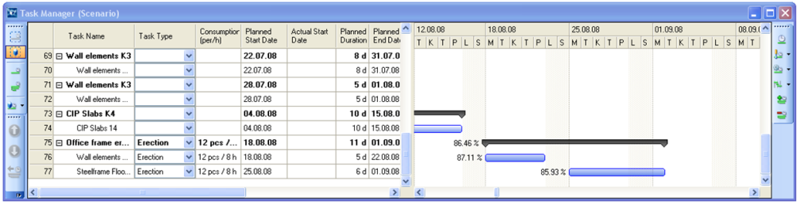
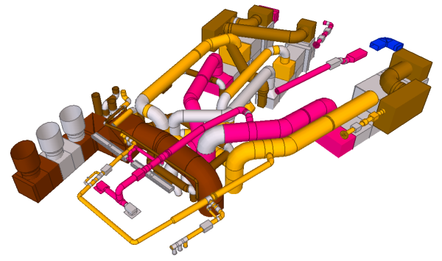
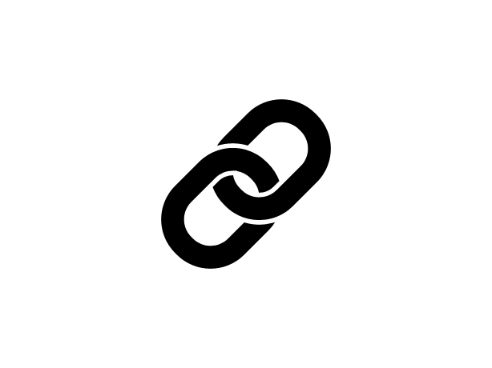
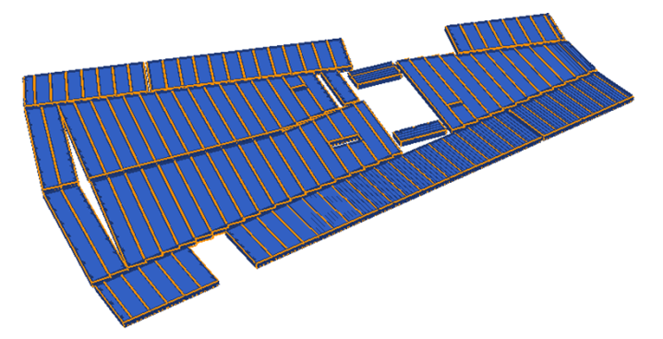
Real-life use cases - Introduction to discussion 24.03.2015 Seppo Törmä Distributed Systems Group Department of Computer Science, Aalto University

Slide 2

Real-life use cases
?
What?
Real need not (completely) met using other technologies
Benefits from truly distributed solution or granular online access to data
Need for loosely coupled integration between heterogeneous datasets
Real data
Existing real-sized datasets (many interrelated IFC models from actual projects)
Existing linksets, linking information, or link generation methods
Real solution approach
How does the use case map to Web of Data technologies?
Why? – To define and evaluate:
Conversions to Web of Data representations
GUIDs to URIs, IFC datatypes to XSD datatypes, IFC data to RDF, IFC schema to OWL
Metadata and linksets
Link representations/ontologies and linkset organization and maintenance
Metadata representations (such as VoID and extensions)
Organization and discovery of models
Performance of importing, querying, and accessing data
Needs for data replication or caching

Slide 3
Seed use cases @ W3C LBD Group
2 General use cases
2.1 Operational Decision Support
2.2 Facility Management
2.3 Energy Efficiency
2.4 Visualization
2.5 Consumption control / optimization
2.6 Planning and design
2.7 Commissioning
2.8 Retrofitting
2.9 Simulation
2.10 SME use of public Linked Building Data
2.11 Building data portal
2.12 Cross-model change management

Slide 4
Building Life Cycle - DRUMBEAT use cases
Cross-model
change
management
Design
coordination
> Reqs –> Design –> Construction –> Oprations –
Issue
management
BAS data
(sensors)
Supply-chain
& production
management
Facility
management
Status
exchange
Product
data

Slide 5
Cross-model change management
Help designers to keep their BIM models in agreement with each other
Utilize the cross-model linking between different BIM models
Automatically detect what has changed
Notify the parties having interlinked models about the focused impact of the change
Objectives
Faster and more focused cycles of cross-model changes in order to keep the models better in agreement with each other
Requirements
The availability of links between models (linking information/link generation methods)
A smooth IFC export functionality in the involved tools
Stable URIs across model versions (“linkable URIs”)
Linked Data benefits
Distributed (clear ownership)
Linking external to models
Native as master (no roundtrip)
Challenges
Fast and accurate diff
Flexible change management protocols
Settings of empirical tests

Slide 6
Cross-model change management
Relations between interrelated BIM models
Design is based on the use of reference models
Architectural model A
(ArchiCAD)
based on
based on
Structural model S
(Tekla Structures)
MEP
model M
(MagiCAD)
share
space

Slide 7
Link generation
Tekla Structures 21 has the object conversion functionality
Converts the entities of an architectural model (imported as a reference model in IFC) into corresponding structural entities
Stores the GUID of an architectural objects as an “initial_GUID” property in the structural entity

Slide 8
The resulting links
Structural
Links available to one party only
Can be used within a same system
A
S
How to make the links accessible to both parties in a distributed setting?
Architectural
Structural
A
S

Slide 9
Use case scenario
Architect
creates the architectural model A with ArchiCAD
publishes the current version (exported as A.IFC and converted to A.RDF) on the Web
Structural engineer
imports A.IFC as a reference model for a new structural model S in Tekla Structures
uses TS to convert objects of A into structural objects of S
The GUID of an architectural object is stored as Initial_GUID into a structural object
publishes the current version (exported as S.IFC and converted to S.RDF) on the Web
extracts the links between architectural and structural models with a SPARQL query
publishes the resulting links as a linkset S-A.RDF
Architect
checks the properties of structural objects in S (e.g., the fabrication status) linked through S-A to the objects of A to determine how easily they can be modified
creates a new version of A
publishes the new version (exported as A.IFC and converted to A.RDF) on the Web
Changed objects are identified through diff computation or object comparison
The structural engineer is notified of the possibly changed linked objects

Slide 10
Details of link generation
Links exported from TS to IFC
#692= IFCPROPERTYSINGLEVALUE('initial_GUID',$,IFCLABEL('3WyVnYyYD449SyF7NsGMcr'),$); #693= IFCPROPERTYSET('0U2hmy4h1CVw8dBM1ZwJyB',#5,'Workflow',$,(#692,#34,#35,#36,#37,#38,#39,#40,#41,#42,#43));
Converted into RDF
model:GUID_Hgq8PBKwTH-iJy1gY-k_Cw a ifc:IfcPropertySet ; ifc:globalId "1e0abc3c-12b0-4c7f-a227-2d6063e93f0b"^^xsd:string ; ifc:hasProperties _:b99 , _:b96 , _:b94 , _:b90 , _:b91 , _:b97 , _:b98 , _:b95 , _:b92 , _:b93 ; ifc:hasProperties [ a ifc:IfcPropertySingleValue ; ifc:name "initial_GUID"^^xsd:string ; ifc:nominalValue [ a ifc:IfcLabel ; rdf:value "3WyVnYyYD449SyF7NsGMcr"^^xsd:string ]] ; ifc:name "Workflow"^^xsd:string ;
SPARQL query
prefix rdfs: http://www.w3.org/2000/01/rdf-schema# prefix model: http://drumbeat.cs.hut.fi/tomcat/marmotta/resource/ prefix owl: http://www.w3.org/2002/07/owl# prefix xsd: http://www.w3.org/2001/XMLSchema# prefix rdf: http://www.w3.org/1999/02/22-rdf-syntax-ns# prefix ifc: http://drumbeat.cs.hut.fi/owl/IFC2X3_Standard# prefix db: http://drumbeat.cs.hut.fi/owl/Drumbeat# CONSTRUCT { ?se model:implements ?ae } FROM http://drumbeat.cs.hut.fi/db/context/structural WHERE { ?se ifc:hasProperties [ ifc:name "initial_GUID"^^xsd:string; ifc:nominalValue [ rdf:value ?a ]] . BIND (URI(CONCAT(http://drumbeat.cs.hut.fi/db/resource/GUID_, encode_for_uri(?a))) AS ?ae)}

Slide 11
Linksets
Linkset contents
@prefix rdfs: <http://www.w3.org/2000/01/rdf-schema#> . @prefix model: <http://drumbeat.cs.hut.fi/tomcat/marmotta/resource/> . @prefix owl: <http://www.w3.org/2002/07/owl#> . @prefix xsd: <http://www.w3.org/2001/XMLSchema#> . @prefix rdf: <http://www.w3.org/1999/02/22-rdf-syntax-ns#> . @prefix ifc: <http://linkedbuildingdata.net/schema/IFC2X3#> . @prefix sesame: <http://www.openrdf.org/schema/sesame#> . @prefix fn: <http://www.w3.org/2005/xpath-functions#> . model:GUID_hvRAUc9QQ0u1c0JYLLdSEQ db:implements model:GUID_1xQ5PL1ez20gb1cc9QX7cq . model:GUID_oylM6yRVQ7izX4g26N-ePw db:implements model:GUID_3SAv2kl21DEhpXVR1lOK6X . model:GUID_Aau5zz-VSz6ofk-LCFUsYQ db:implements model:GUID_24LEAXKHLCtft9x0Ulys5V . model:GUID_57hb9rX4SpeSVZKiF0i3JA db:implements model:GUID_0xLl0o88z2uRr7gFDI65bS . model:GUID_YooPNXxKSLW_SZ9MpYiLYQ db:implements model:GUID_17BZknAj9DdP6TRv99M1p1 . model:GUID_LhIsTtBZSOGnamMwnob0oA db:implements model:GUID_3AS_Ncu5P1tuePRn_H07K8 . model:GUID_yAUgfs6IRqWdxTTAUKfvCQ db:implements model:GUID_3JObB8h7r9mgWi9c81UWP1 . model:GUID_LVtILA13Q9WwT_b5l4SIcQ db:implements model:GUID_2VeYs_lp5CbQ7KEsdNKtXi . model:GUID_chHz68NQRU6scv-LmK7p-Q db:implements model:GUID_3uvWz_I9H8fvsESkRRR1C2 . model:GUID_U5cAQmbjSH-Ne1rXWEi6Og db:implements model:GUID_2898daAKT7aOFEKjFnW1y8 . model:GUID_vAZUOyAxRDCtwsR2zcEJCQ db:implements model:GUID_0on9T20PH43A9SE7rAjBqC …

Slide 12
Utilization of linksets
Cross-model property access
prefix rdfs: http://www.w3.org/2000/01/rdf-schema# prefix model: http://drumbeat.cs.hut.fi/tomcat/marmotta/resource/ prefix owl: http://www.w3.org/2002/07/owl# prefix xsd: http://www.w3.org/2001/XMLSchema# prefix rdf: http://www.w3.org/1999/02/22-rdf-syntax-ns# prefix ifc: http://drumbeat.cs.hut.fi/owl/IFC2X3_Standard# prefix db: http://drumbeat.cs.hut.fi/owl/Drumbeat# SELECT{ ?a ?m} FROM http://drumbeat.cs.hut.fi/db/context/architectural WHERE { ?a a ifc:IfcWall . SERVICE http://drumbeat2.cs.hut.fi/db/sparql { ?s db:implements ?a . ?ma ifc:relatedObjects ?s ;
ifc:relatingMaterial ?m}}
Change management
determine the changed objects in the first model through diff or object comparison
compute the potentially affected objects in another model using the linkset
make a notification about the change

Slide 13

Discussion
Work in progress – data has only recently become available
open questions: performance of diff, protocols for notification, relation to BCF, …
How to have stable URIs for linking?
Metadata of datasets and linksets
Extensions to VoID – model relations, model versions?
Mechanisms for discovery (without a centralized registry)?
Architectural
Structural
Meta-A
Meta-SA
Meta-S
reference model
A
SA
S

Slide 14
Terminology? Linked Building Data or Web of Building Data
Web of Data
Semantic Web
Ontologies
Representations
Reasoning
“complex theory”
Linked Data
Identities
Access
Existing data
“simple practice”
URI
RDF
HTTP

Slide 16
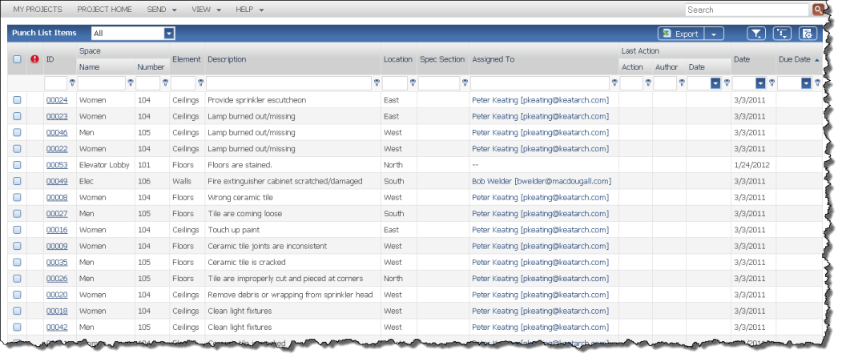
Issue management
Issues
Something that needs to be done
Assigned doer
Status of doing/acceptance
Issue types
Punch lists
RFIs
Safety notices
Required checks
Status
Open
Ready for approval
Closed
How to link to BIM models?
BIM

