Slide 1
Multilingual Terminology Support Linked Open Data for Construction Works Workshop BRE Watford, 24 Mar 2015
LIDER CSA
Budget: 1.482.000€
End date: 1. Nov. 2015
Duration: 2 Years
Dave Lewis
Dave.Lewis@scss.tcd.ie
Director, Knowledge and Data Engineering Group
Trinity College Dublin

Slide 2
BIM Concept/Term/Translation Requirements
An international market based on BIM requires concept/terminology mapping and translation/localisation:
Product data/descriptions used in construction: structural models, materials, HVAC, sensors
BIM-based software: CAD, energy modeling, FM
Services utilising BIM data: architectural, code conformance/certification, FM construction/demolition
Addressed by International Framework for Dictionaries:
http://www.ifd-library.org/images/IFD_Uses_2008-04-25.pdf
bSDD

Slide 3
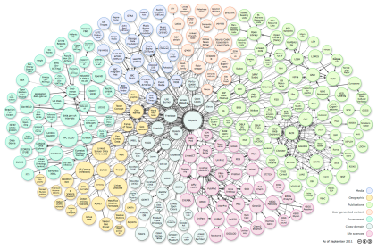
Key Ingredients in Linked Data
Agree on vocabularies for describing metadata and content
Unified and standardized language for describing resources ( RDF(S))
Unified and standardized query language (SPARQL)
Standardized non-proprietary APIs
Links to other resources
Additional Requirements
License (open or closed) information
Provenance of the resource
Use of the resource

Slide 4
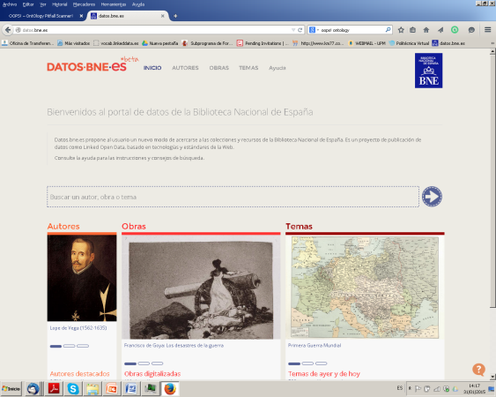
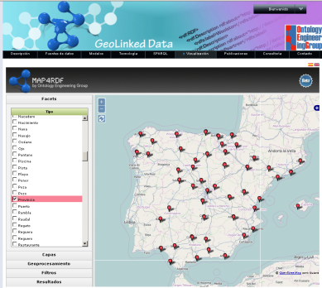
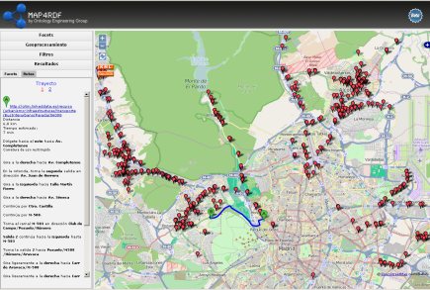
Uses of Linked Data
Programmers built applications using make queries in SPARQL and get RDF
2. Citizens/Users access LD through a user interface (they do not see RDF)
Smart Cities
Culture
(@BNE)
Geograhical
(@IGN)
Metereological
(@AEMET)
3. Machine – Machine data exchange and semantic interoperability in RDF

Slide 5
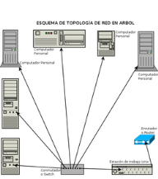
Linked Data for rich extensible dictionaries
femenine
[REDES]
singular
plural
gender
number
Phonetic form
Form
“red”
number
written form
Form
Phonetic form
Red
[RED]
Form
Red
Sense
“red”
Red
Red
written form
equivalent
Sense
Sense
Sense
“malla”
translation
es - en
written form
Red
written form
written form
“red”
“network”
image
https://www.w3.org/community/ontolex/
Grounded in ISO TC37

Slide 6
Relevance for IFC?
What are advantages of reflecting IDF in Linked Data?
Completeness of other IFC-SemWeb mappings
RDF labels with language tabs insufficient
Broader data/dictionary integration with other applications, e.g. GIS, and languages
Cheaper, more accessible web/data infrastructure
Application innovation: e.g. integrated speech interfaces, auto-annotation, image search, machine translation
LIDER CSA & LD4LT W3C Working Group ready to collaborate on developing use cases and mappings -> SWIMing

Slide 7
Lessons learned from other domains
Talk the local data language: round-trip mappings (NOT replacement of) to existing formats – e.g. IFC
IFC/IFD is a well thought out info model for construction domain. Does SemWeb reasoning add much?
Problem is relationship to all the other formats
Using LD for open data management, schema extension/mapping and data/link quality assurance can add value and lower integration costs
URLs are free, charging/controlling identifiers will only constrain uptake – implications for GUIDs

