Slide 1
ifcOWL: community and implementation efforts
Pieter Pauwels
Ghent University, Belgium
Walter Terkaj
CNR-ITIA, Italy

Slide 2
Community efforts

Slide 3
ifcOWL research initiatives 2005-2012
Diverse suggestions in academic research to make IFC available as an OWL ontology to allow the usage of semantic web technologies
Schevers and Drogemuller, 2005
Beetz et al., 2009
General purpose initiative to convert EXPRESS schemas and STEP file to OWL ontology, not focused on IFC
Krima et al., 2009 (OntoSTEP)
Barbau et al., 2012 (OntoSTEP)
From 2012 onwards, increasing uptake in research and developments
=> many different ifcOWL structures floating around
Need for formalisation and standardisation
=> combine efforts and proceed in a more formalised, standard fashion
=> role of standardisation bodies: W3C, BuildingSMART

Slide 4
Event series on Linked Data in Architecture and Construction (LDAC)
2012, Ghent // 2014, Finland // 2015, Eindhoven
Bottom-up research community event about linked data in architecture and construction
- Use case track
- Technical track (ifcOWL formalisation & standardisation)

Slide 5
W3C Linked Building Data Community Group
W3C
The authority of standards for the internet
What are WC3 Community Groups?
Tuned for transition to standards-track: groups complement existing standards track in W3C and policies aim to facilitate transition to the standards track (not a requirement though)
Potential to become a Working Group(e.g. CSS, RDF, XSLT)
Linked Building Data Group
New group, created in June 2014
Goal
Bring together experts in BIM and Web of Data technologies to define existing and future use cases and requirements for linked data based applications across the building life cycle.

Slide 6
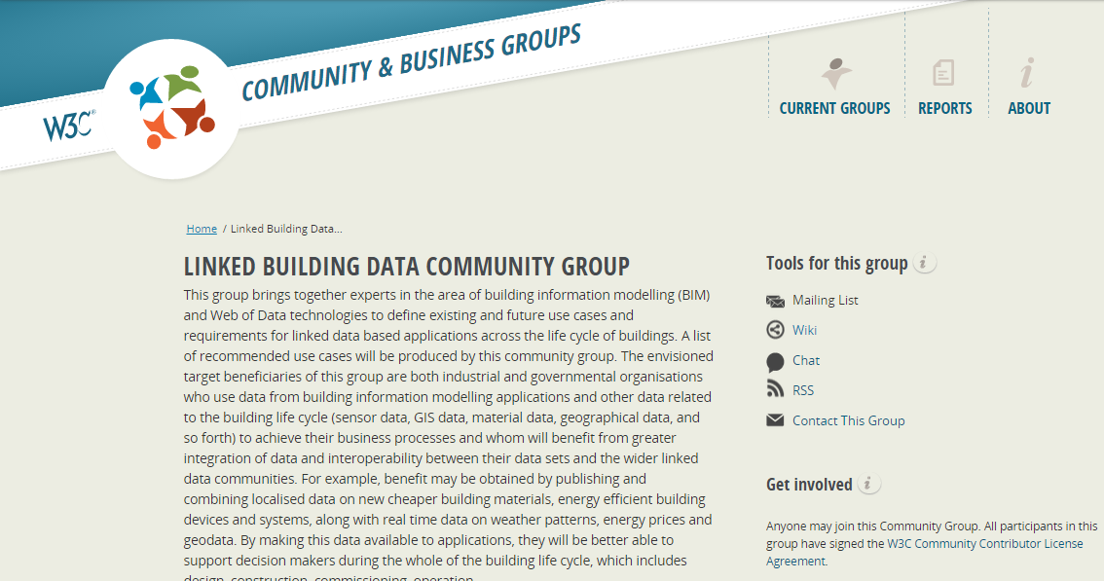
https://www.w3.org/community/lbd/

Slide 7
BuildingSMART initiatives
Set up a working group within buildingSMART that:
maintains and recommends one and only one ifcOWL ontology
documents this as the standard conversion -> a standard ifcOWL, next to the already available EXPRESS- and XSD-schemas
Actions made:
Initial proposal made at buildingSMART Technical Summit in Toronto, 27.Oct 2014
Follow-up session at buildingSMART Technical Summit in Watford, 24 March 2015

Slide 8
ifcOWL: implementation efforts

Slide 9
implementation proposals 2005-2012
Diverse suggestions in academic research to make IFC available as an OWL ontology to allow the usage of semantic web technologies
Schevers and Drogemuller, 2005
Beetz et al., 2009
General purpose initiative to convert EXPRESS schemas and STEP file to OWL ontology, not focused on IFC
Krima et al., 2009(OntoSTEP)
Barbau et al., 2012 (OntoSTEP)
From 2012 onwards, increasing uptake in research and developments
=> many different ifcOWL structures floating around
Need for formalisation and standardisation
=> combine efforts and proceed in a more formalised, standard fashion
=> role of standardisation bodies: W3C, BuildingSMART

Slide 10
Towards a recommendable and usable ifcOWL ontology
When: 2nd half of 2014
Who: Pieter Pauwels (Ugent) and Walter Terkaj (ITIA-CNR)
What: distill ONE recommended conversion procedure for converting an EXPRESS schema into an OWL ontology, based on earlier efforts.
Results:
Conversion procedure documented in article manuscript and separate slideshow
Implemented in JAVA (https://github.com/mmlab/IFC-to-RDF-converter/tree/BS) and C++ converter
Resulting ontologies:
http://linkedbuildingdata.net/resources/IFC4_ADD1.owl
http://linkedbuildingdata.net/resources/IFC2X3_TC1.ttl

Slide 11
converting EXPRESS schema to OWL
IFC
Schema
Simple data type
Defined data type
Aggregation data type
SET data type --------
LIST & ARRAY data type --------
Constructed data type
SELECT data type --------
ENUMERATION data type --------
Entity data type
Attributes --------
Derive attr
WHERE rules
Functions
Rules
ifcOWL
Ontology
owl:class + owl:DatatypeProperty restriction
owl:class
owl:class
-------- owl:ObjectProperty restriction on ifc:hasSet
-------- indirect subclass of ifc:List
owl:class
-------- owl:unionOf ( owl:classes )
-------- one of ( owl:NamedIndividuals )
owl:class
-------- object properties
-
-
-
-
More details in separate presentation

Slide 12
ifcOWL ontologies available
Ifc2x_all_lf.exp
IFC2X2_ADD1.exp
IFC2X2_FINAL.exp
IFC2X2_PLATFORM.exp
IFC2X3_Final.exp
IFC2X3_TC1.exp
IFC4.exp
IFC4_ADD1.exp
not supported
not supported
not supported
not supported
IFC2X3_Final.owl / .ttl
IFC2X3_TC1.owl / .ttl
IFC4.owl / .ttl
IFC4_ADD1.owl / .ttl
http://www.linkedbuildingdata.net/resources/IFC2X3_Final.ttl
http://www.linkedbuildingdata.net/resources/IFC2X3_TC1.ttl
http://www.linkedbuildingdata.net/resources/IFC4.ttl
http://www.linkedbuildingdata.net/resources/IFC4_ADD1.ttl

Slide 13
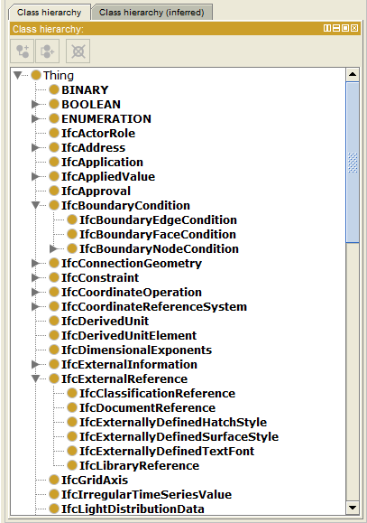
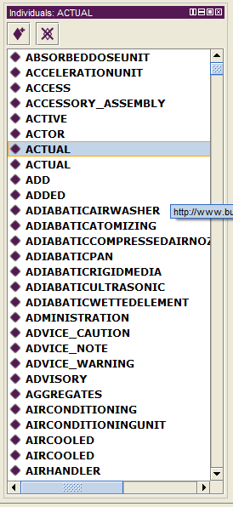
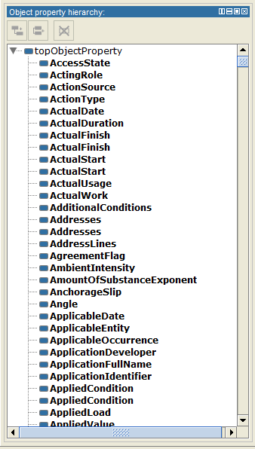
CLASSES
INDIVIDUALS
OJECT PROPERTIES

Slide 14
Decision criteria in devising a recommended EXPRESS-to-OWL conversion procedure
The ifcOWL ontology should remain in the OWL-DL profile in order to enable reasoning.
Enrich the ifcOWL with axioms to match the original EXPRESS schema as closely as possible.
The ifcOWL ontology primarily aims at supporting the conversion of IFC instance files into equivalent RDF files. Thus, herein it is of secondary importance that an instance RDF file can be modelled from scratch using the ifcOWL ontology and an ontology editor.

Slide 15
Key decisions in EXPRESS-to-OWL conversion procedure
Data wrapping -> all EXPRESS data types are converted into owl:class declarations
Including simple data types: ifc:INTEGER / ifc:REAL / etc.
Including defined data types: TYPE IfcAreaDensityMeasure = REAL; END_TYPE;
Including ENUM aggregation data types
Including SELECT aggregation data types
Renaming conventions to guarantee unique names:
properties with identical names but different domains
enumeration individuals with identical names but belonging to a different aggregation
Special construction to represent LIST declarations (allowing to remain in OWL and stay as closely as possible to the original IFC schema), taking as a reference the proposal by Drummond et al., 2006

Slide 16
Future developments to consider in EXPRESS-to-OWL conversion procedure
RULE and FUNCTION declarations are procedural algorithms, which cannot be converted into OWL-DL class expressions. An alternative approach needs to be used for converting these declarations.
WHERE rule declarations are not included in the proposed conversion approach, although they can be converted to some extent by using OWL class expressions or SWRL rules.
Through an ontological analysis of IFC, the ifcOWL ontology might be greatly simplified and it might become easier to use the IFC information.
The EXPRESS to OWL conversion approach was built to be general purpose, even if it was tested mainly for IFC. The approach will still need to be tested on other EXPRESS schemas in order to make it really general purpose.
Exploitation of ontology-related added values: CWA validation, OWA reasoning, extension of IFC data model and integration with other ontologies.

Slide 17
Questions & Remarks & Feedback
Pieter Pauwels
pipauwel.pauwels@ugent.be
Ghent University, Belgium
Walter Terkaj
walter.terkaj@itia.cnr.it
CNR-ITIA, Italy

