Slide 1

World Wide Web Consortium
Legal Entity
Seeking the Internet Society's support to facilitate our relaunch as a stand-alone legal entity
Jeff Jaffe, W3C CEO
Wendy Seltzer, W3C Strategy Lead
July 2019

Slide 2


Outline
Context
About the W3C
Areas of focus
Reasons for fundraising
Call to action

Slide 3
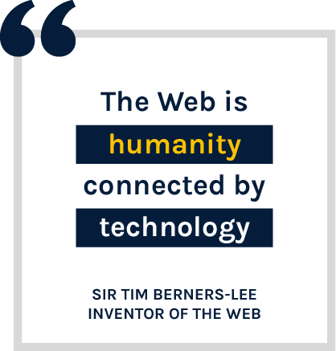
A revolutionary invention
Billions of people use the Web every day.
It is one of the most significant and powerful inventions of our time.

Slide 4

An empowering invention
The Web fosters communication, collaboration, education, innovation, commerce and entertainment on a global scale.

Slide 5
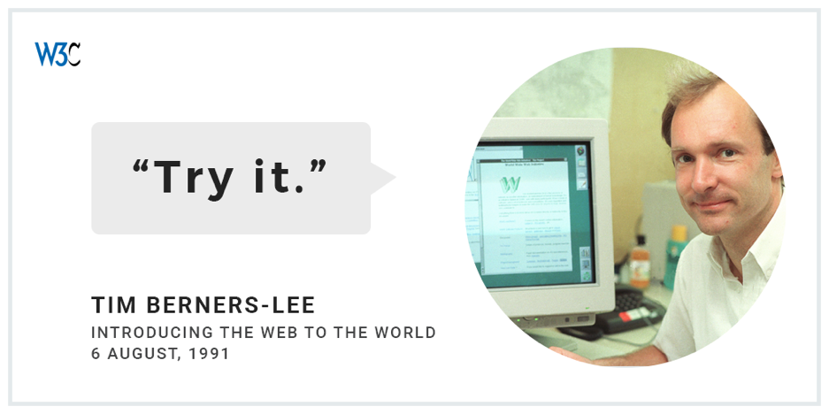
A platform that needs stewards
The Web envisioned by Tim Berners-Lee 30 years ago is now an exciting global commons.
The health of the Web platform relies in large part on leadership by organizations such as the World Wide Web Consortium.

Slide 6
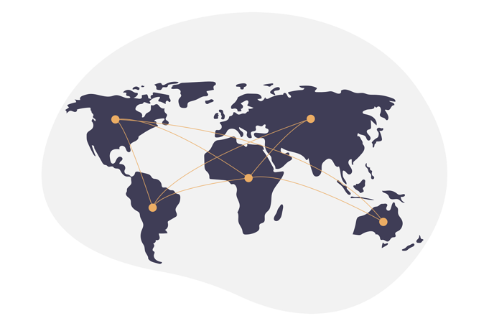
Leading the Web to its full potential
Tim Berners-Lee founded the World Wide Web Consortium in 1994 to ensure the long-term growth of the Web.
We do so primarily by developing freely available and open standards for Web technology.
Web standards are blueprints for the digitally connected world.

Slide 7
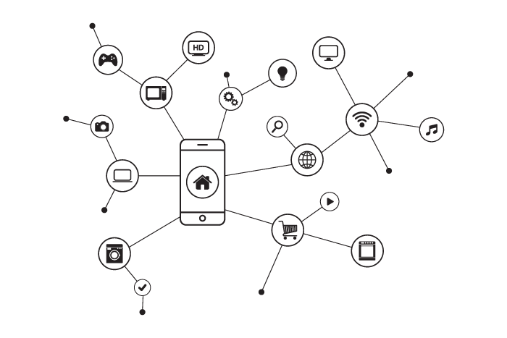
Achievements
Some of the Web Consortium's important contributions:
Hundreds of open technologies powering browsers, smart phones, ebook readers, set top boxes, automobiles, search engines, social media, trillions of dollars of online commerce, and more than a billion Web sites
Enabling people with disabilities to access the Web
Built-in support for many of the world's languages
A royalty-free Patent Policy

Slide 8






Contributions to key industries
Government . . . . . . . . . . . . . . . . .
Telecommunications . . . . . . . . . .
Communications . . . . . . . . . . . . .
Financial Services . . . . . . . . . . . . .
Entertainment and Media . . . . . .
Automotive . . . . . . . . . . . . . . . . . .
Publishing . . . . . . . . . . . . . . . . . . .
Open Data
Mobile Web support
WebRTC (with IETF)
Streamlined payment framework
Streaming video on the web
Vehicle system reporting
EPUB for ebooks

Slide 9

Recognition
The Web Consortium has earned recognition for the impact of its open standards on billions of users:
Ranked by the Boston Globe the most important achievement associated with MIT in its first 150 years
Recipient of two Emmy Awards: for making online videos more accessible with captions and subtitles (2016), for standardization of a Full TV Experience on the Web (2019)
Our impact even extends beyond this planet: NASA has used our technologies in both the Spirit and Opportunity Mars rovers.

Slide 10
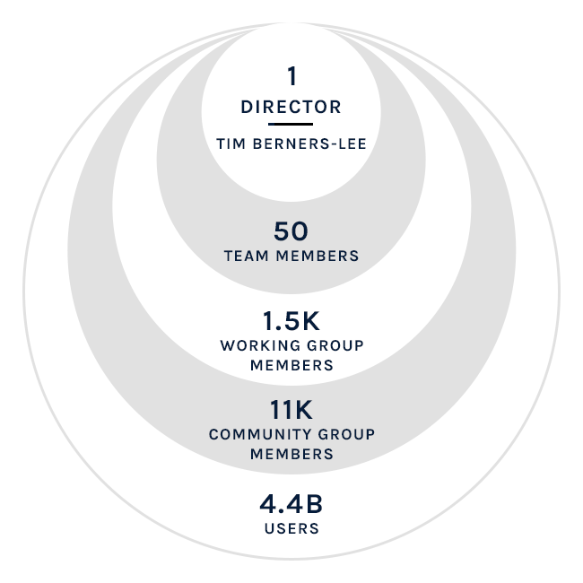
Organization
Standards that meet the varied needs of society are created through the work of the extended Web Consortium community:
Members: > 450 Members around the world lead the development and implementation of standards.
Staff: The not-for-profit organization’s staff of 50, led by Tim Berners-Lee, is supported by Membership dues.
Developers: > 12,000 developers worldwide participate in discussions to incubate new work.

Slide 11




Historical organizational structure
The World Wide Web Consortium is:
Not legally incorporated
A partnership of 4 Hosts
Coordinating across 4 organizations with different budgets, constraints, HR policies
Managed by W3M on behalf of the Director
Guided in its work by the W3C Process Document and advice from the Membership
Assisted by an elected Advisory Board and Technical Architecture Group

Slide 12
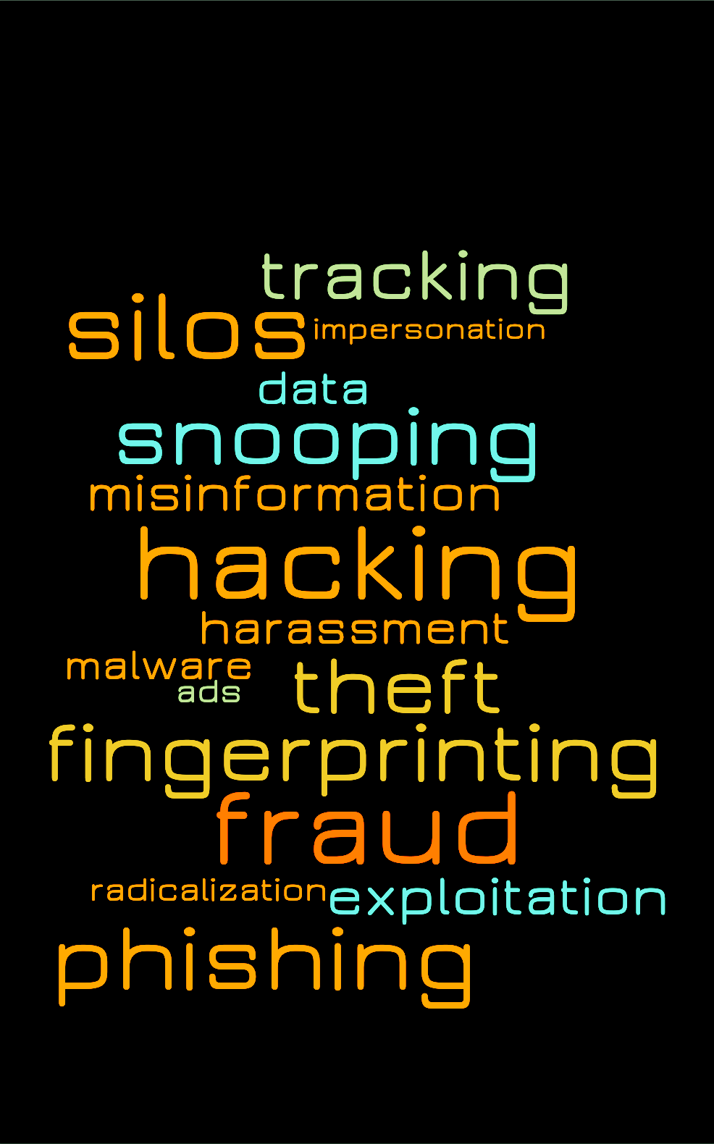
Drivers of organizational transformation (1/2)
Many issues need to be addressed:
Increasingly abundant threats to security
Privacy
Today's Web empowers more creators, more end users, and more high value services
Walled gardens
Misuse of the Web (misleading information, political issues)

Slide 13
Drivers of organizational transformation (2/2)
Today's Web Consortium structure gets in the way:
Management decisions are subject to Host approvals
Need for greater agility to address challenges
Skill acquisition constrained by Hosts’ staffing policies
Member model makes it difficult to reach Global South
Difficult to make new investments that maps to broadening impact of the web
Difficult to engage in public policy
Lack of a strong Board of Directors to guide the future work

Slide 14

Legal Entity plan
Our Steering Committee has approved that we update our organizational structure:
Simplify our legal relations by creating an independent legal entity, seeking U.S. 501(c)(3) non-profit status
Transition our current host contracts into partner relationships with MIT (US), ERCIM (EU), Beihang University (PRC) and Keio University (Japan)
Create an Establishment Fund to provide financial security during this important transition, and enable us to pursue new directions
Begin operation on 1 January 2021
Note: Our global nature will remain the same, as will our open and neutral process.

Slide 15



What a Legal Entity provides
Responsiveness
Increased agility
Acquisition of skills
Ability to make new investments
Expansion of our reach
Financial backing
Effectiveness

Slide 16



Past funding from ISOC
The Web Consortium received from Internet Society $2.5 million in funding that enabled us to re-engineer our organization in 2010-2013:
Strategy for standardization of the Open Web Platform
Launched Community Groups –Today > 11,000 individuals incubate new work in 350 groups
Strengthened our business model, broadened to adjacent industries; hired an experienced global business development lead
Tightened relationships with ISOC and IETF resulting in stronger technical liaisons in Web identity, privacy, Web security; coordinated work to add real-time communications to the Web
Community Groups
WebAuthn

Slide 17

Request to ISOC for new funding
The Internet Society has long promoted the development of the Internet as a global technical infrastructure, a resource to enrich people’s lives, and a force for good in society.
Our request for a $5 million donation from Internet Society will contribute to funding the new legal entity thus positioning the Web Consortium favorably to strengthen the Web –a goal consistent with ISOC's mission.

Slide 18
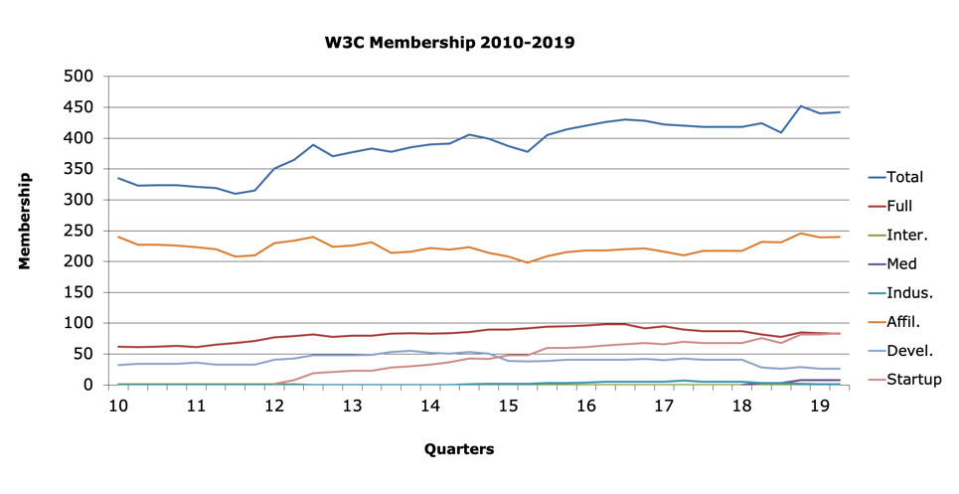
Business context for our request to ISOC
ISOC’s previous grant secured a sustainable business model for the Web Consortium.
The Web Consortium is not looking for operational expenses.
The Establishment Fund will allow for stability and innovation –controlled by the Board of Directors.

Slide 19

ISOC, IETF, and W3C
IETF and Web Consortium have a longstanding partnership.
With IETF being a subsidiary of ISOC, sponsoring the Web Consortium's transition allows ISOC to invest in both internet-level and web-level.
Full support of the development of a global technical infrastructure, a resource to enrich people’s lives, and a force for good in society.
Image credit: Community by Gregor Cresnar from the Noun Project

Slide 20
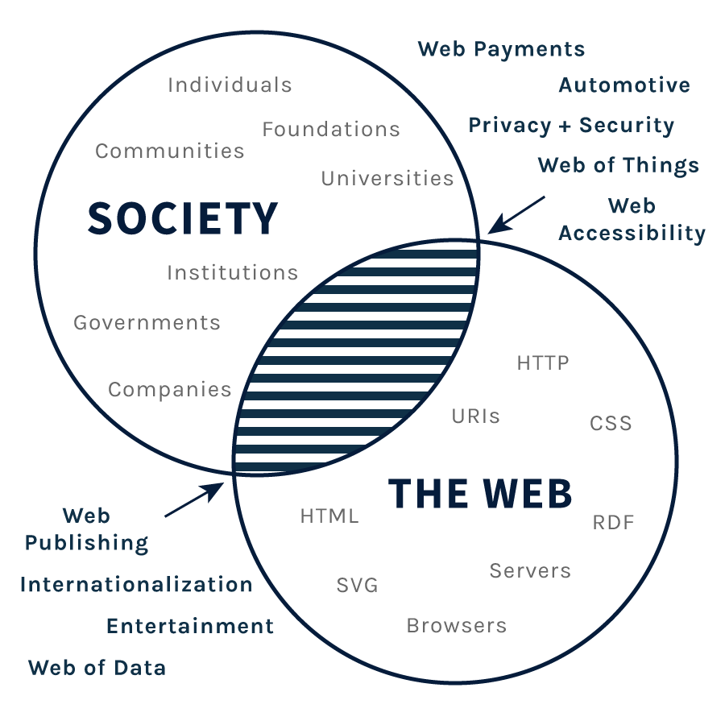
Key focus areas
The Web is expanding; its Industries are changing
Privacy and trust are elusive, but critical.
Problems demanding a neutral multi-stakeholder technical forum grow, while business resources shrink.
Areas of focus include:
accessibility
internationalization
privacy and security
enhancing core technology and industry impact
diversifying involvement and participation

Slide 21
Summary
To evolve our organization to serve the growing needs of the Web,
we are creating a legal entity.
We seek the Internet Society's support so we can strengthen the Web.
Myriad opportunities exist to foster greater digital inclusion, provide a level playing-field to promote innovation, and continue to ensure that Web standards and Web technologies work to the benefit of humanity.
Given ISOC's role in ensuring an open, secure, and trustworthy Internet, and the importance of global technical standards in achieving those goals, we ask ISOC to contribute to our Establishment Fund to facilitate our transition.
A $5 million donation will provide a catalyst for the Web Consortium to spin off from its host institutions and seek independent 501(c)(3) status, and means to fund efforts deemed essential to our mission.

Slide 22

Call to action
To expand and thrive we need Sponsors who share our passion for creating technologies that benefit the world.
Join our core mission-aligned Sponsors
Power Web standardization into the next era.
We would be honored if Internet Society considered contributing $5 million towards our Establishment Fund.

Slide 23




Thank you!
For more information, please contact:
Jeff Jaffe
Wendy Seltzer
W3C CEO
W3C Strategy Lead
jeff@w3.org
wseltzer@w3.org
@w3c

