Slide 1



Part II: Web of Things
ISWC 2016 Tutorial: Semantic Web meets Internet of Things and Web of Things
Soumya Kanti Datta
Research Engineer
Communication Systems Department

Slide 2
Roadmap
Challenges with current IoT ecosystem
Motivation for Web of Things (WoT)
WoT – Concepts and Building Blocks
Use case – WoT for Connected Vehicles
Conclusion

Slide 3
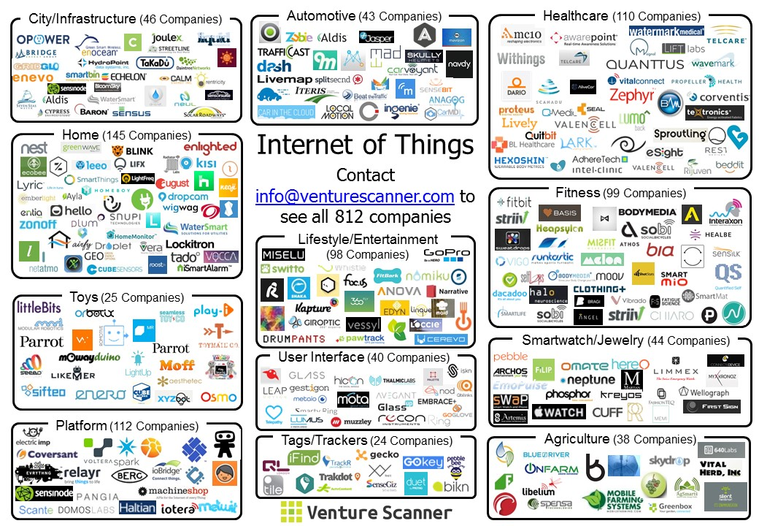
Internet of Things - Landscape

Slide 4
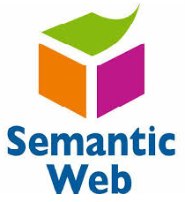
IoT Challenges
Wide range of heterogeneous technologies and devices
Missing data centric and horizontal approach
Processing of sensor data
  No uniform vocabulary for representation and processing of data
  Semantic web technologies can overcome such challenge
Hard task for application developers
  Create cross domain applications
Incompatible IoT platforms leading to data and product silos
No winning standard

Slide 5
Web of Things - Motivation
Today we have devices that can access the web
  Directly
  Via an M2M gateway
Web of Things (WoT) concept is becoming more popular
  Leverage web standards and technologies to interconnect all types of devices.
  Expose functionalities using RESTful APIs making them easier to access and use.
  Provide truly open, flexible, scalable and interoperable services.
Source: http://webofthings.org/

Slide 6

WoT – A Shared Vision
Thing description (TD)
  Description of capabilities and metadata using a machine understandable format
  Technology – RDF (semantic web is used here)
  TD can be hosted on a thing or in a web server (for a legacy thing).
This way, a TD can also be retrofitted on existing device.
It complements existing IoT platforms and standards with rich metadata to enable interoperability across platforms at the thing level.

Slide 7
WoT – A Shared Vision
Flexible protocol bindings
  Enables the mapping of a semantically described Thing interaction to different protocols.
  Useful for domains with different protocol requirements.
Provide a common runtime environment for IoT applications
  Capabilities of powerful things can be improved through software updates.

Slide 8
Note
Rest of the presentation is heavily based on the our work in W3C Web of Things Interest Group
References
  WoT architecture - http://w3c.github.io/wot/architecture/wot-architecture.html
  WoT current practices - http://w3c.github.io/wot/current-practices/wot-practices.html

Slide 9
Concepts and Building Blocks
WoT Servient
Thing Description
Discovery
Scripting API
Security (out of scope for this discussion)

Slide 10
Terminology Used
WoT servient
  An entity consists of Web client, Web server, and device control capabilities.
WoT server
  An entity consists of Web server and device control capabilities.
WoT client
  An entity consists of Web client and/or device control capability that would be realized in Web browser.

Slide 11
WoT Servient
A thing in WoT is represented by servient
  Can be hosted directly on the thing
  The servient can also represent a virtual thing in a smartphone, gateway or cloud
    E.g. a collection of things (all lights in a room)
    E.g. a WoT gateway for legacy devices (a Bluetooth device connected to a smartphone)

Slide 12
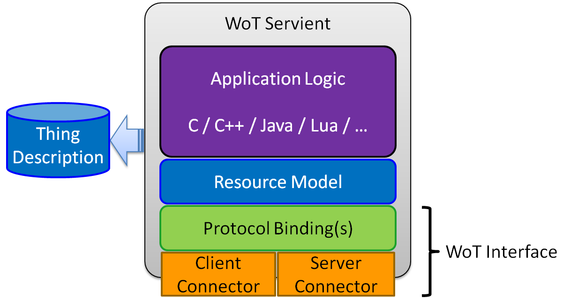
WoT Servient – Internal Architecture

Slide 13
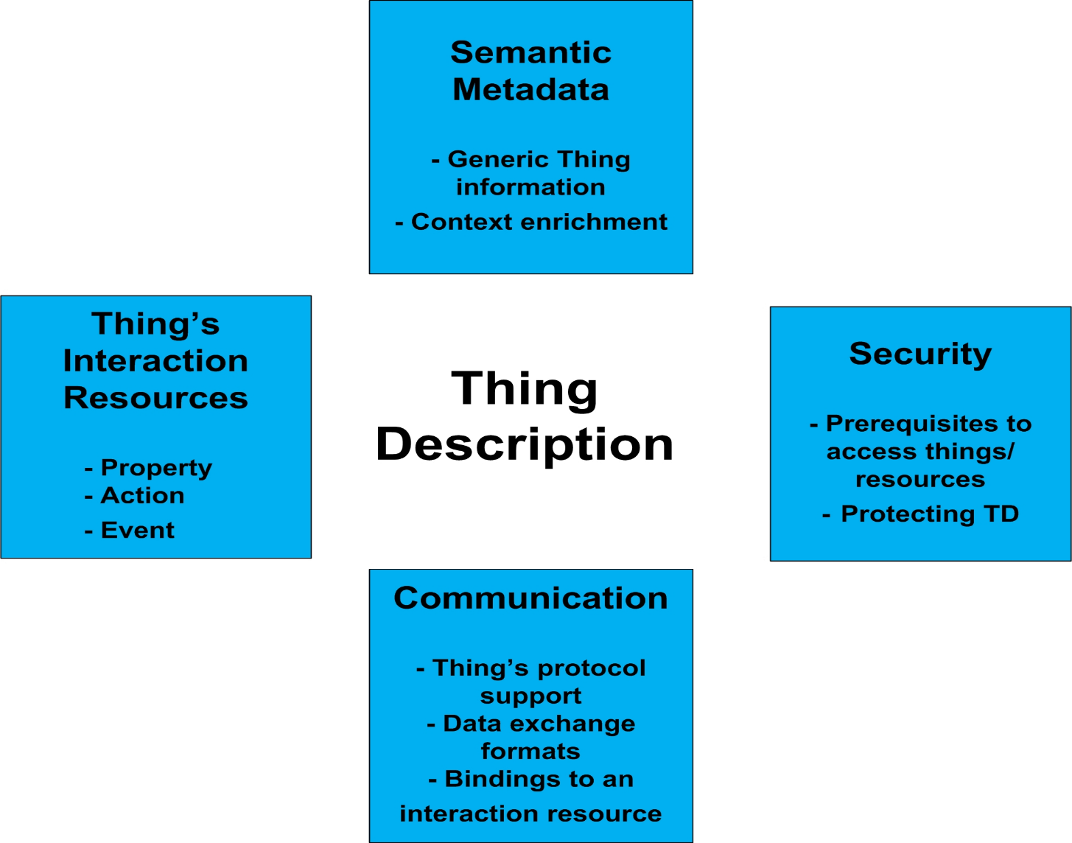
Thing Description

Slide 14
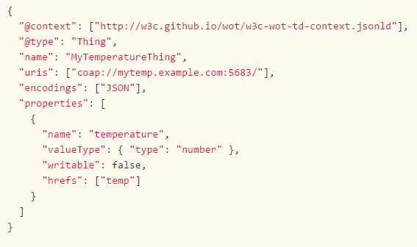
Example TD – Data Only

Slide 15
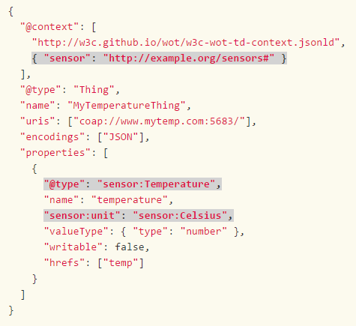
Example TD – With Semantic Annotation
Notes:
Do you use W3C SSN here? Explain better why semantic annotation. Do we have RDF here?

Slide 16
Discovery
In a machine environment, WoT applications and servients need to discover Thing Descriptions.
To ease discovery, TDs can be registered into a well known repository where things of interest can be queried, for instance using SPARQL.
Discovering a thing means acquiring a link to its TD which then contains all the information to interact with it and understand its data.
The URI of the link may point to the Thing (technically the servient) itself, as Things often host their TD directly, or to any other location on the Web.

Slide 17
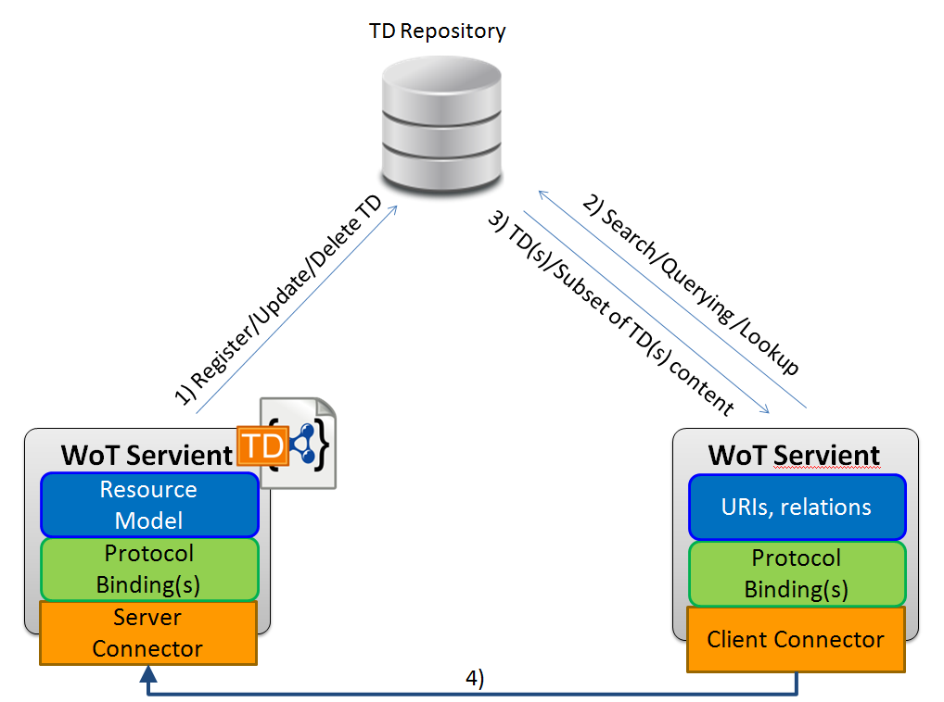
Repository Based Discovery

Slide 18
Discovery Mechanisms
Searching things around me (on a spatial sense)
  BLE beacon based things
Searching things on my network
  mDNS, multicast CoAP
Searching in directories
  CoRE resource directory, XMPP IoT directory, HyperCat
Searching and accessing thing metadata
  CoRE Link Format
Searching based on semantic web
  Offers high richness in search queries
    E.g. “search for all light bulbs in my house”

Slide 19
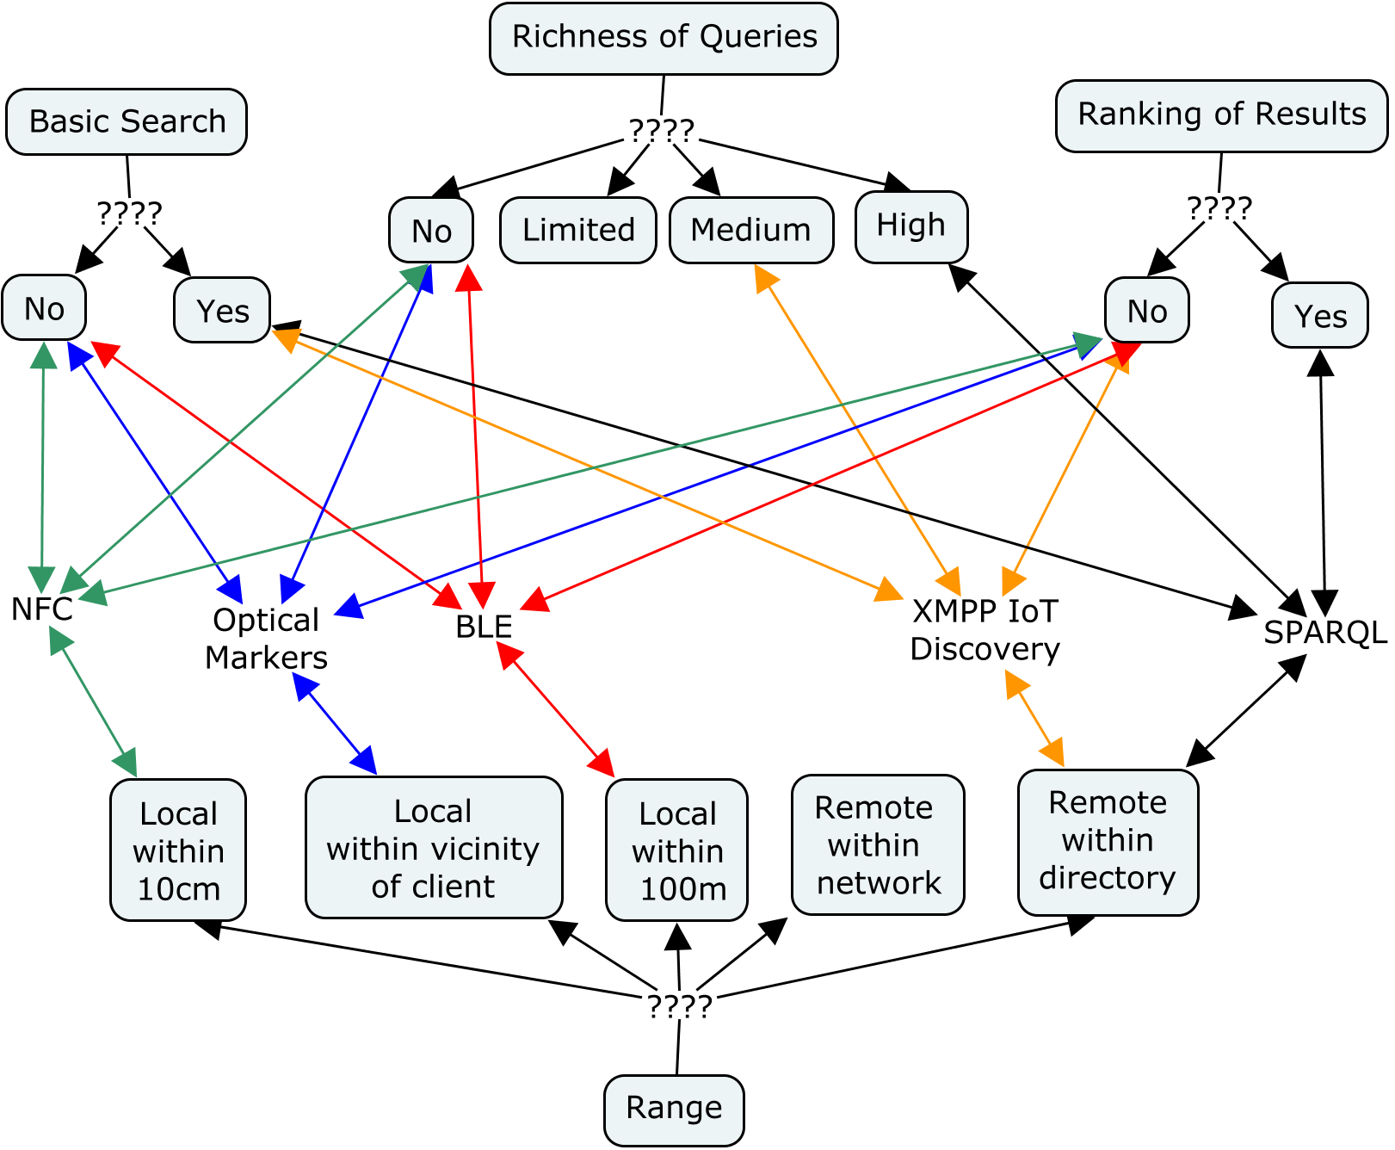
Multi-entry Decision Tree

Slide 20
Scripting API
An API specification to have a uniform way to write scripts and applications for WoT.
Provides mechanism for discovery, provisioning and control of things.
Design principles
  Language-agnostic to enable many runtimes.
  Reactive in nature i.e. developers will using callback functions which get called from the overall WoT framework.
  Provide means to both expose a things and consume a thing (as a client)

Slide 21
WoT in Action

Slide 22
Connected Vehicles
Equipped with Internet access
Has on-board things (sensors and actuators) that can connect to devices, networks and services external to the vehicle
  Other vehicles, infrastructures etc.

Slide 23
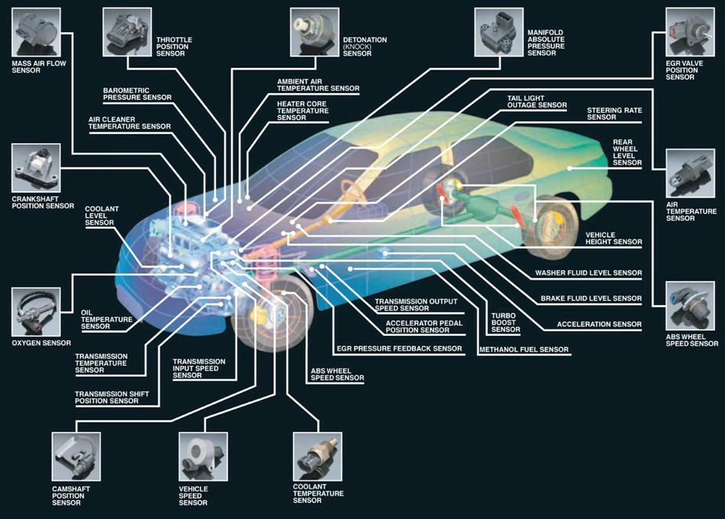
Sensors in Vehicles
Source: sensormag.com

Slide 24






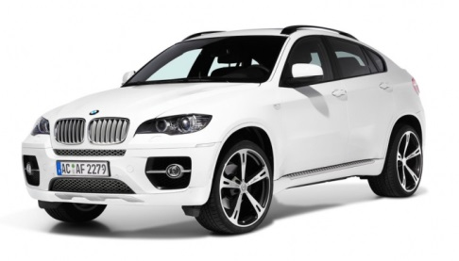
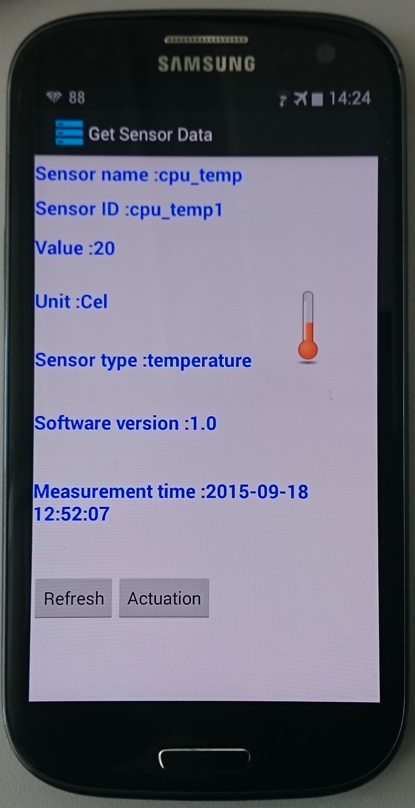
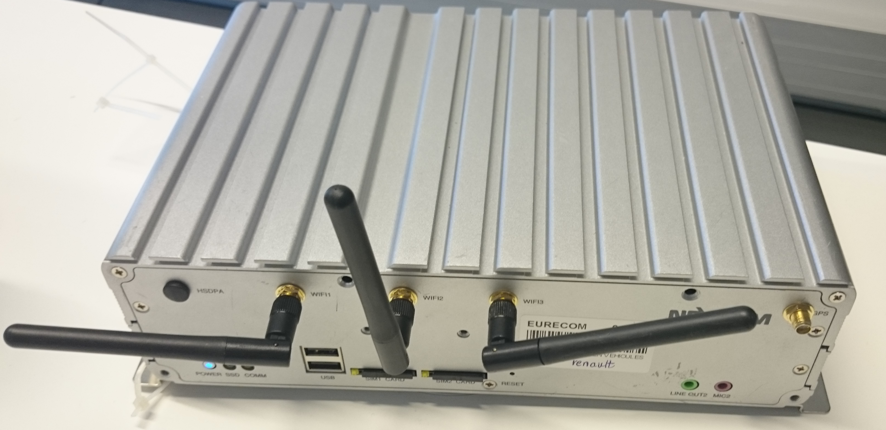
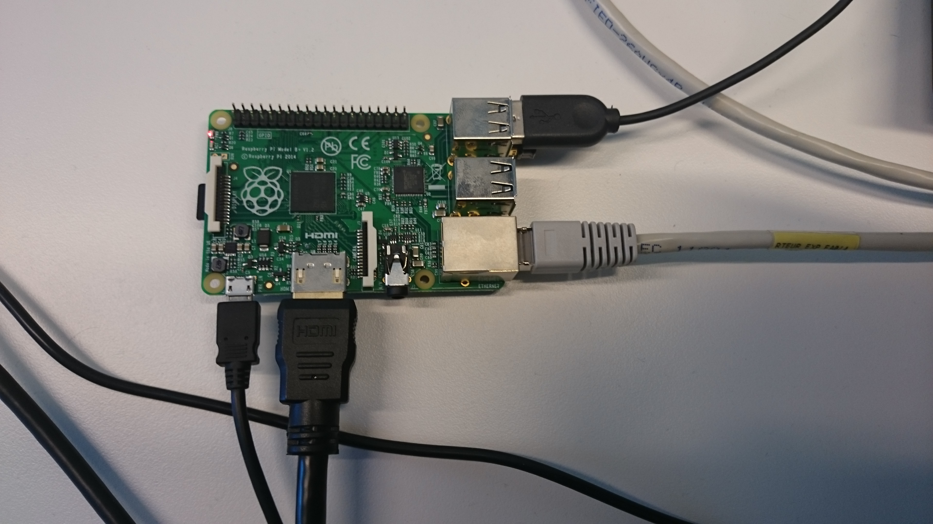
Prototyping Scenario
Discovery
Thing Descriptions
Scripting API
ITS-G5
OBU
RSU
M2M GW
Android App
Data
Generation
Agent
Registration
Collection
Proxy
Lightweight Web of Things Server
Discovery
Consumer Resource Discovery
Discovery
Measurements
Measurements
WoT Servient
WoT Interface
WoT Client

Slide 25
Demonstration Video

Slide 26
Conclusion
WoT germinates from the challenges in IoT ecosystems.
WoT aims to complement the IoT platforms and not create a new standard.
W3C WoT standardization is expected to commence soon.
We need semantic web technologies for:
  Interoperability of data, uniform vocabulary and platforms.
  Creating horizontal applications combining sensor data and knowledge of multiple domains.

Slide 27


Slide 28


Connect with Me …
Email: dattas@eurecom.fr
Twitter: @skdatta2010

Slide 29
Backup Slides

Slide 30
WoT Architecture – Data Driven
Data collection service
Data dissemination service
Data consumption service
Configuration management service

Slide 31
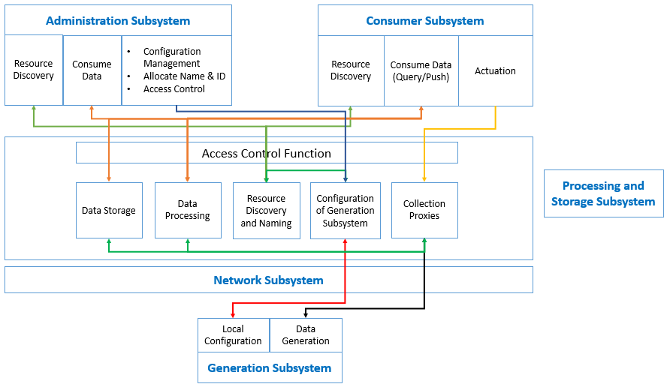
Subsystems and Elements

