Slide 1
WOT F2F meeting @Pune Siemens
Unrestricted

Slide 2
Pune Airport / Hotels

Slide 3
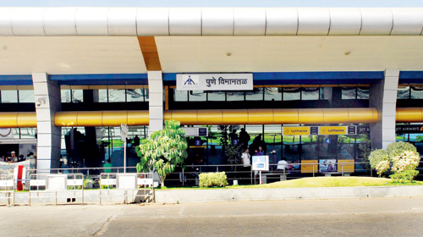
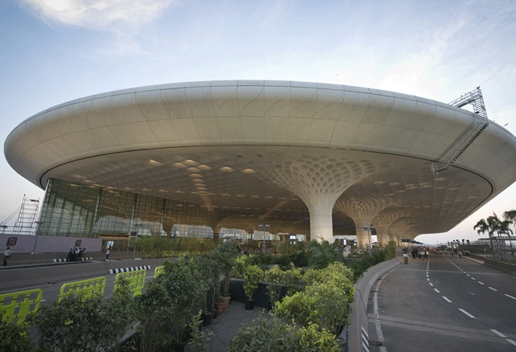
Nearby Airports
Pune airport
There are two airports:
One being Mumbai airport where a travel from Mumbai airport to Pune would be required (its on an average 3 hours journey from Mumbai airport to Pune Hotel)
Pune airport is rather smaller with less frequency of flights but the travel time to Pune Hotel would be around 30-40 minutes.
Mumbai airport

Slide 4
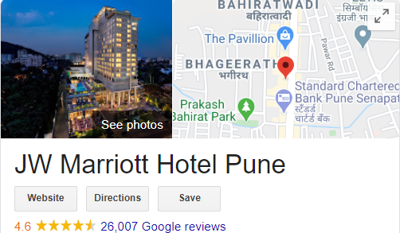
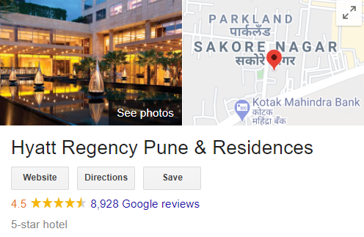
Hotels
There are multiple 5-star hotels in Pune, Two of the preferred ones are given below.
https://www.marriott.com/hotels/hotel-photos/pnqmc-jw-marriott-hotel-pune/
https://www.hyatt.com/en-US/hotel/india/hyatt-regency-pune/punhr/photos-reviews

Slide 5
Conference Rooms

Slide 6
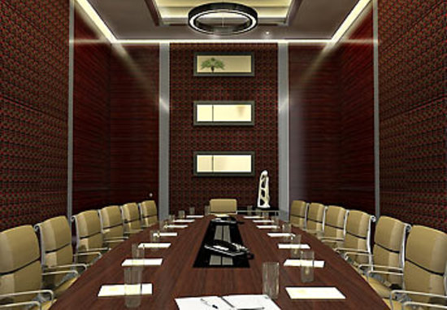
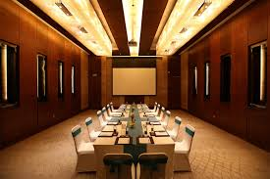
Conference, Plug-Fest and an Open Day with External Companies participation
We have two Siemens offices in Pune.
We can have the conference in any of the office premises.
Or Siemens can also sponsor to have it in external locations- which can be a facility provided by the hotels: Few pictures of Conference rooms shown here.
Plug Fest and an Open Day can be organized outside office in bigger location with all the infrastructure required.

Slide 7
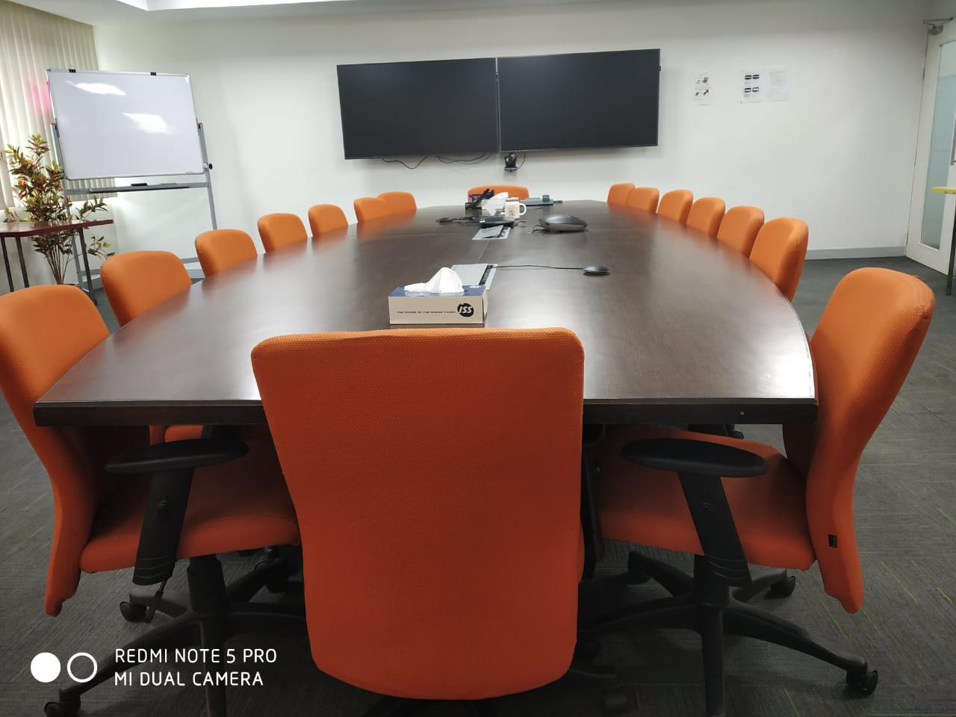
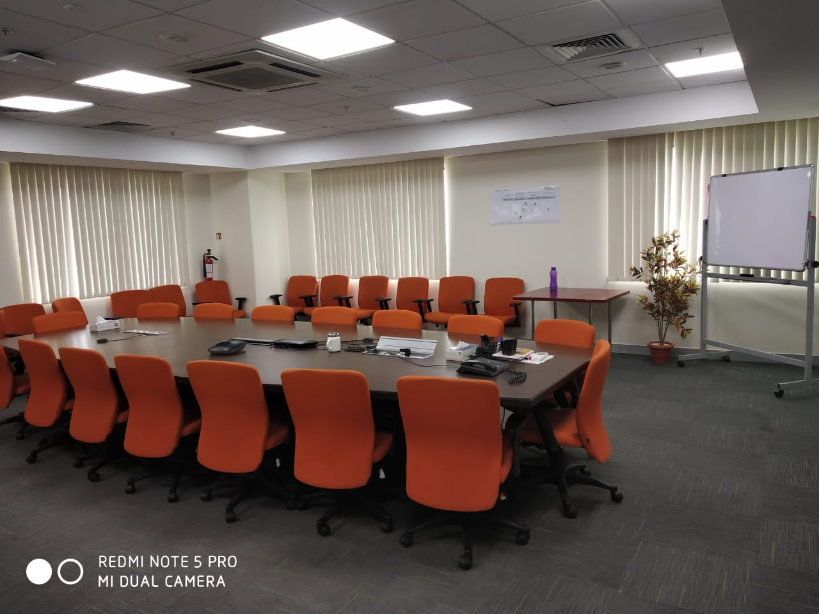
Conference Room in Office with Video Conferencing facility

Slide 8
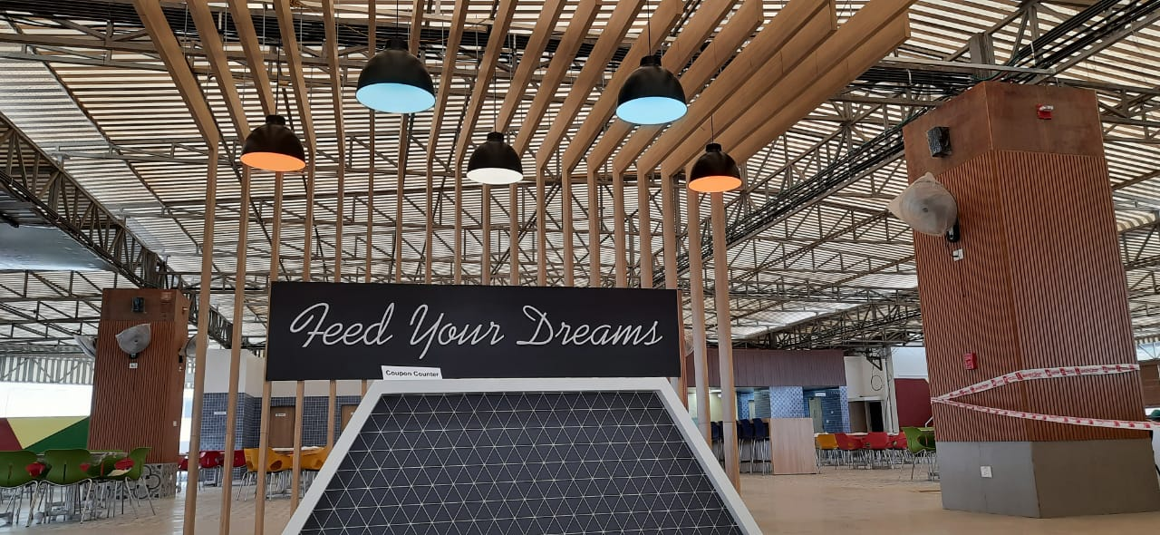
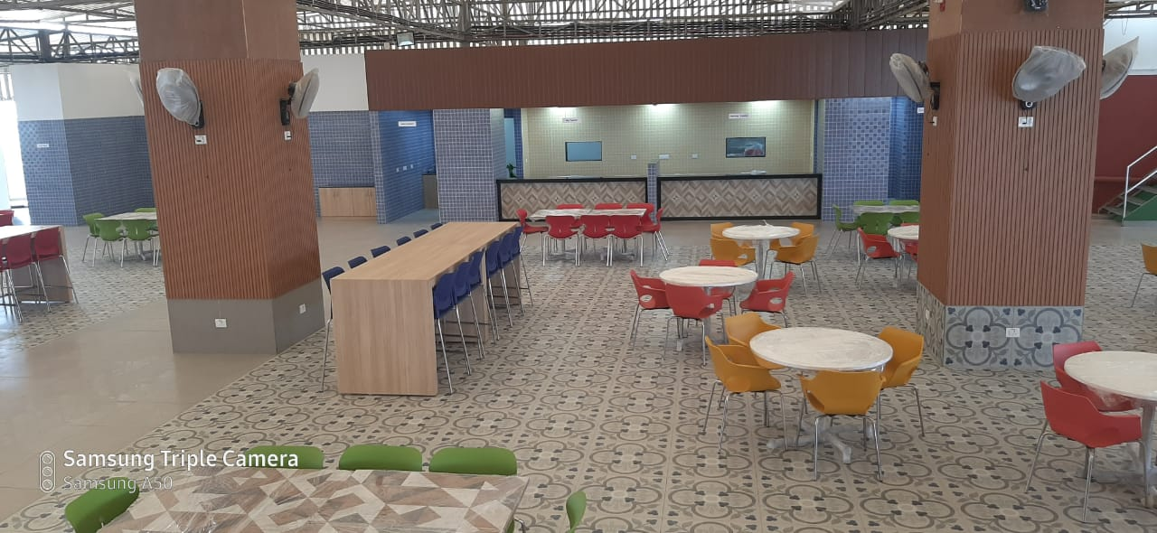
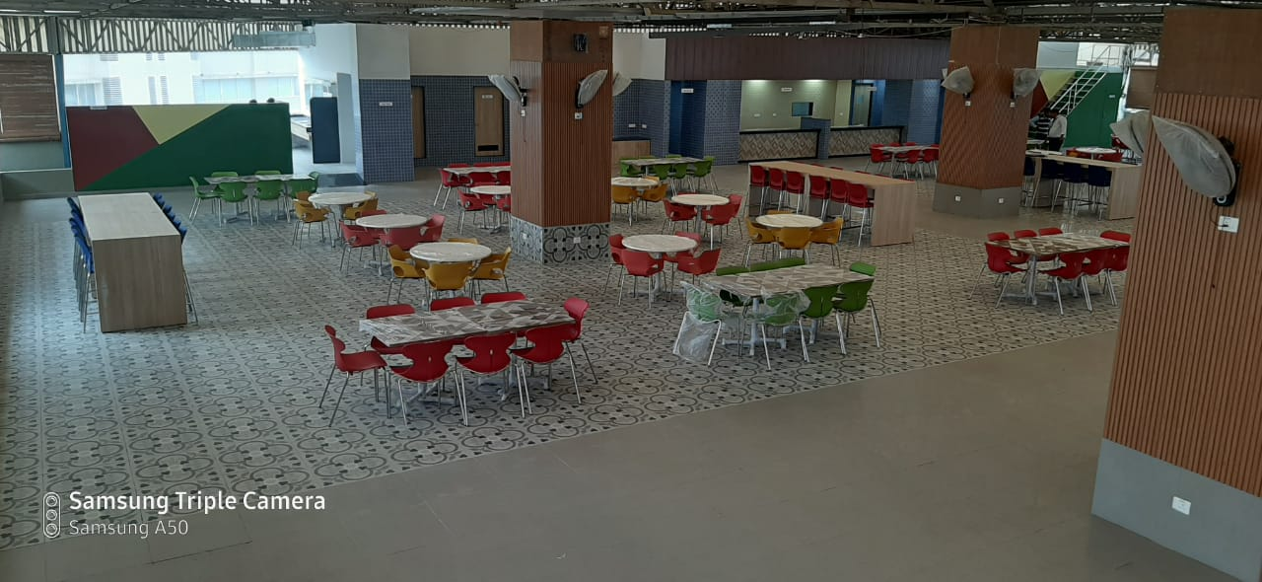
Cafeteria

Slide 9
Around Pune

Slide 10
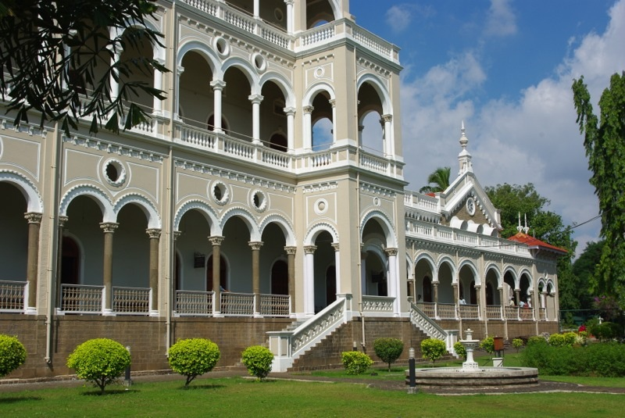
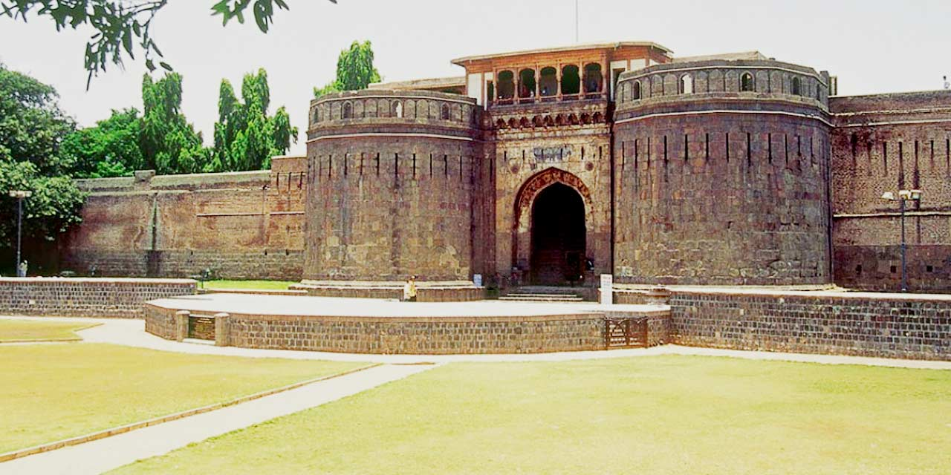
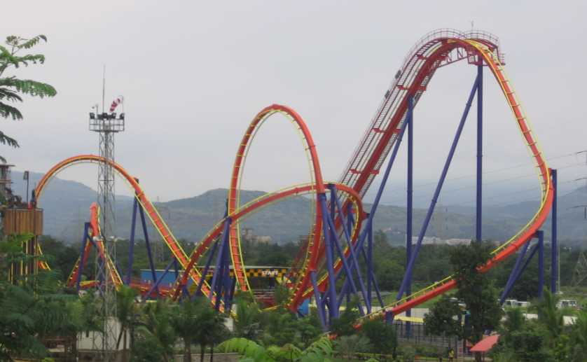
Places to Visit Nearby Pune
Aga Khan Palace, Pune
Imagica Amusement Park
Shaniwar Wada, Pune

Slide 11
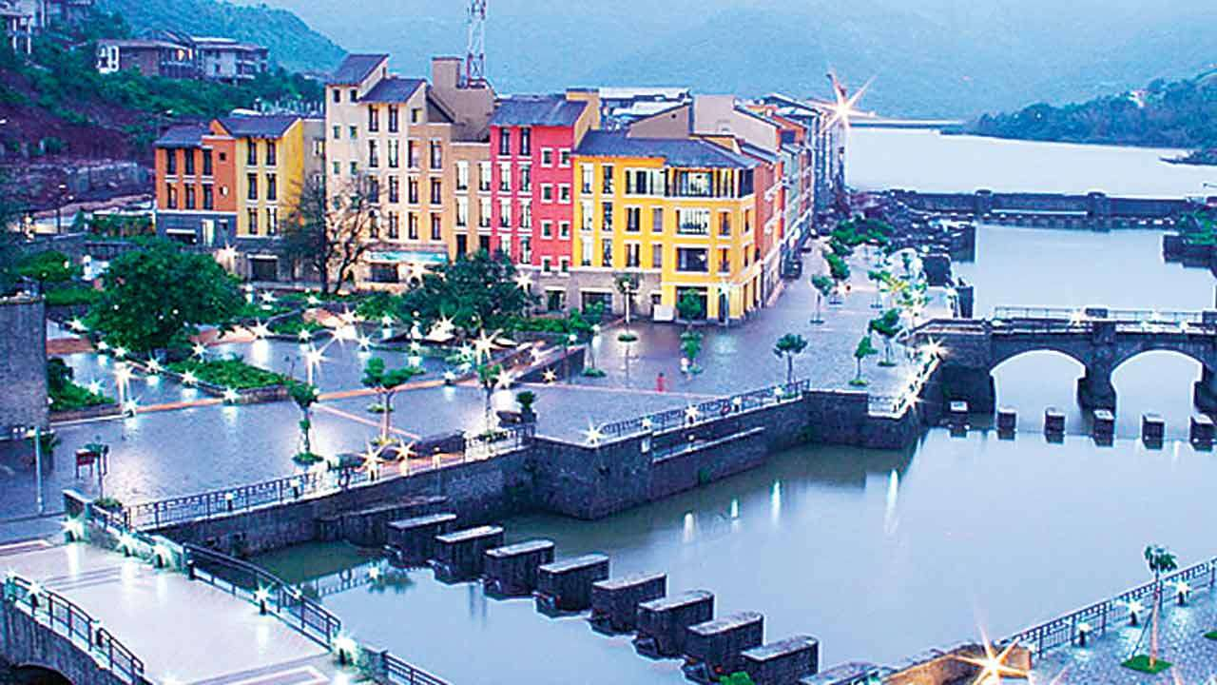
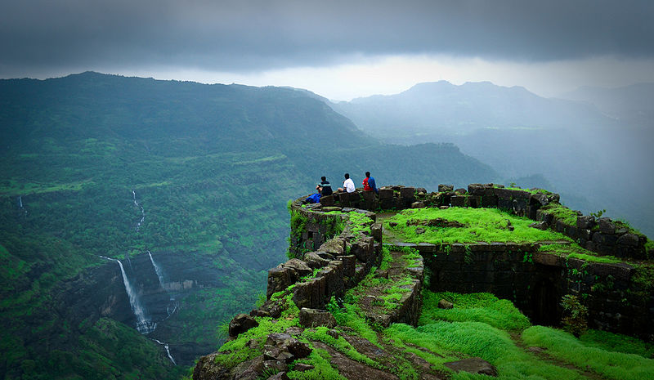
Places to Visit near Pune
Forts around Pune
Forts around Pune
Lavasa City

Slide 12
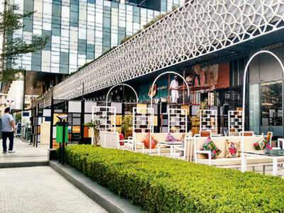
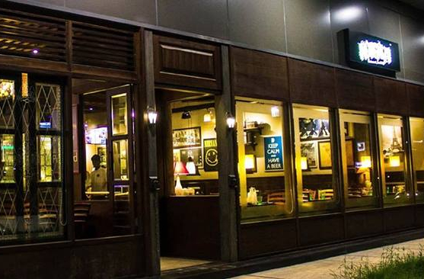
Evenings and Dining

