Slide 1
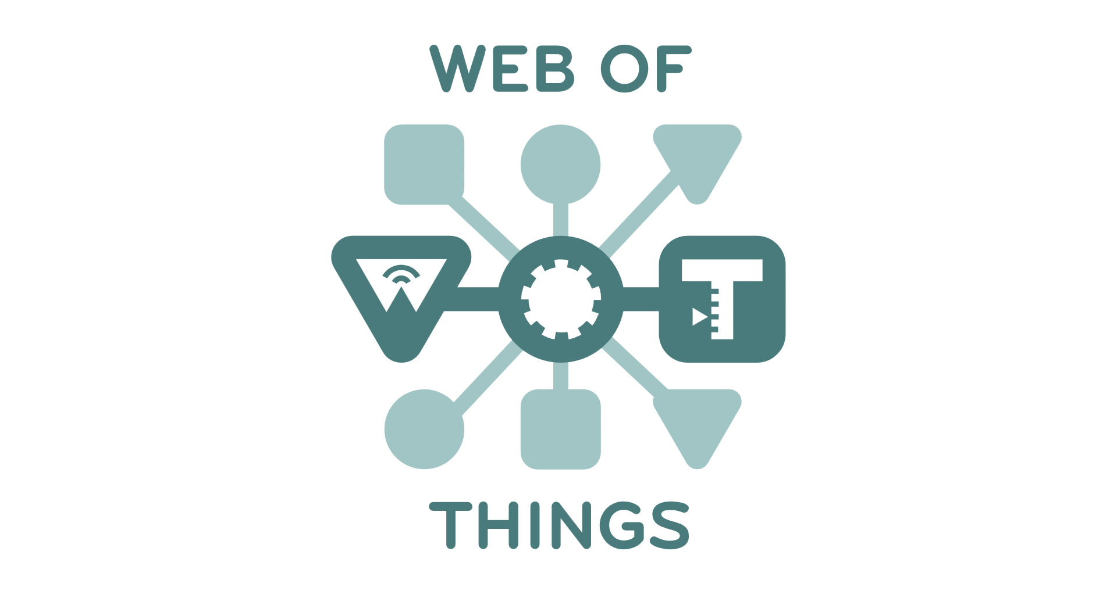
Protocol Bindings
Joint oneM2M Call, 31 Aug 2016

Slide 2
WoT Interface
Interface of Things exposed to the network
“Thing”
“Thing”
WoT Interface
WoT Interface
Protocol

Slide 3
Protocol Bindings
Various protocols can implement the interface
“Thing”
“Thing”
Protocol
Bindings
Protocol
Bindings
WoT Interface
HTTP
WoT Interface
HTTP
HTTP

Slide 4
Protocol Bindings
Various protocols can implement the interface
“Thing”
“Thing”
Protocol
Bindings
Protocol
Bindings
WoT Interface
CoAP
WoT Interface
CoAP
CoAP

Slide 5
Protocol Bindings
Multiple bindings per Thing possible
“Thing”
“Thing”
Protocol
Bindings
Protocol
Bindings
WoT Interface
MQTT
WS
WoT Interface
WS
WebSocket

Slide 6
Resource Model
Interaction points are Web resources
Interactions
Properties
  Retrieve
  Update
Actions
  Invoke
    Retrieve
    Update
    Cancel
Events
  Subscribe
    Update
    Cancel
“Thing”
“Thing”
Resource
Model
Resource
Model
Protocol
Bindings
Protocol
Bindings
WoT Interface
∙··
WoT Interface
∙··

Slide 7
Interaction Role
Consuming Things are in client role
Exposing Things are in server role
“Consuming Thing”
“Exposing Thing”
Web Links
Interaction
Resources
http://wot.example.com/res
Protocol
Bindings
Protocol
Bindings
Client Role
∙··
Server Role
∙··

Slide 8
Interaction Role
Usually both roles at the same time → Servient
WoT Servient
WoT Servient
WoT Servient
Web Links
Interaction
Resources
Web
Links
Interaction
Resources
Web
Links
Protocol
Bindings
Protocol
Bindings
Protocol
Bindings
Client Role
∙··
Both Roles
∙··
Both Roles
∙··

Slide 9
Explicit Bindings
Map Interaction methods to protocol
  Retrieve (e.g., HTTP GET)
  Update (e.g., HTTP PUT)
  Invoke (e.g., HTTP POST)
  Subscribe (e.g., CoAP Observe)
  Cancel (e.g., CoAP DELETE)
Proposal
  Instead of implicit mappings, document protocol operation in Thing Description, e.g., “writeable”: “PATCH”
  Evaluate HYDRA

