Slide 1
SSN/SOSA Alignment
WoT IG TF-LD, 18th August 2017

Slide 2
TD & SSN/SOSA
td:InteractionPattern
td:Thing
td:inputData
td:providesInteractionPattern
td:outputData
(from Maxime Lefrançois' e-mail)

Slide 3
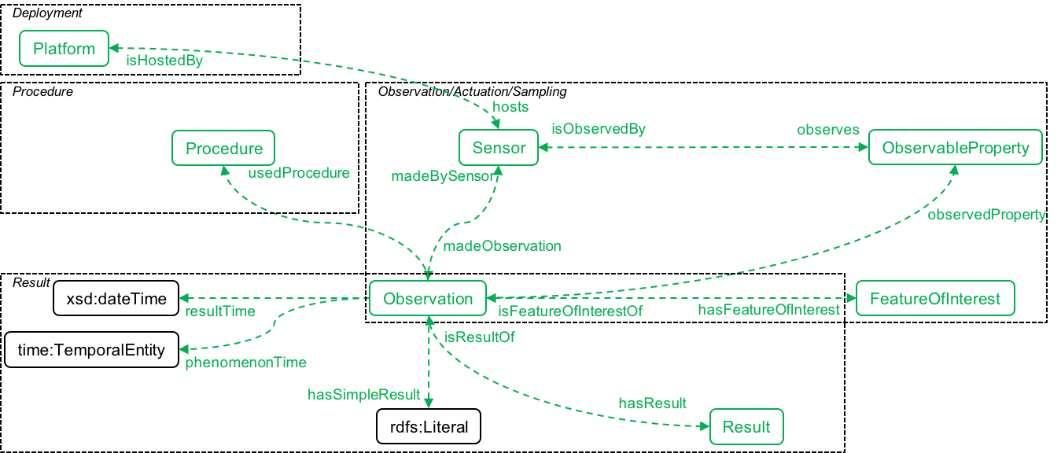
TD & SSN/SOSA
td:Property
?
td:Event
td:Thing
(see F2F@Düsseldorf)

Slide 4
TD & SSN/SOSA
SSN/SOSA
Property vs. Observation
Event
How to sort them chronologically?

