Slide 1

Support Tools
WAI-Tools Final Open Meeting
Online, 26 January 2021
Horizon 2020 Project
Grant Agreement 780057

Slide 2
WCAG-EM Report Tool
Horizon 2020 Project
Grant Agreement 780057

Slide 3
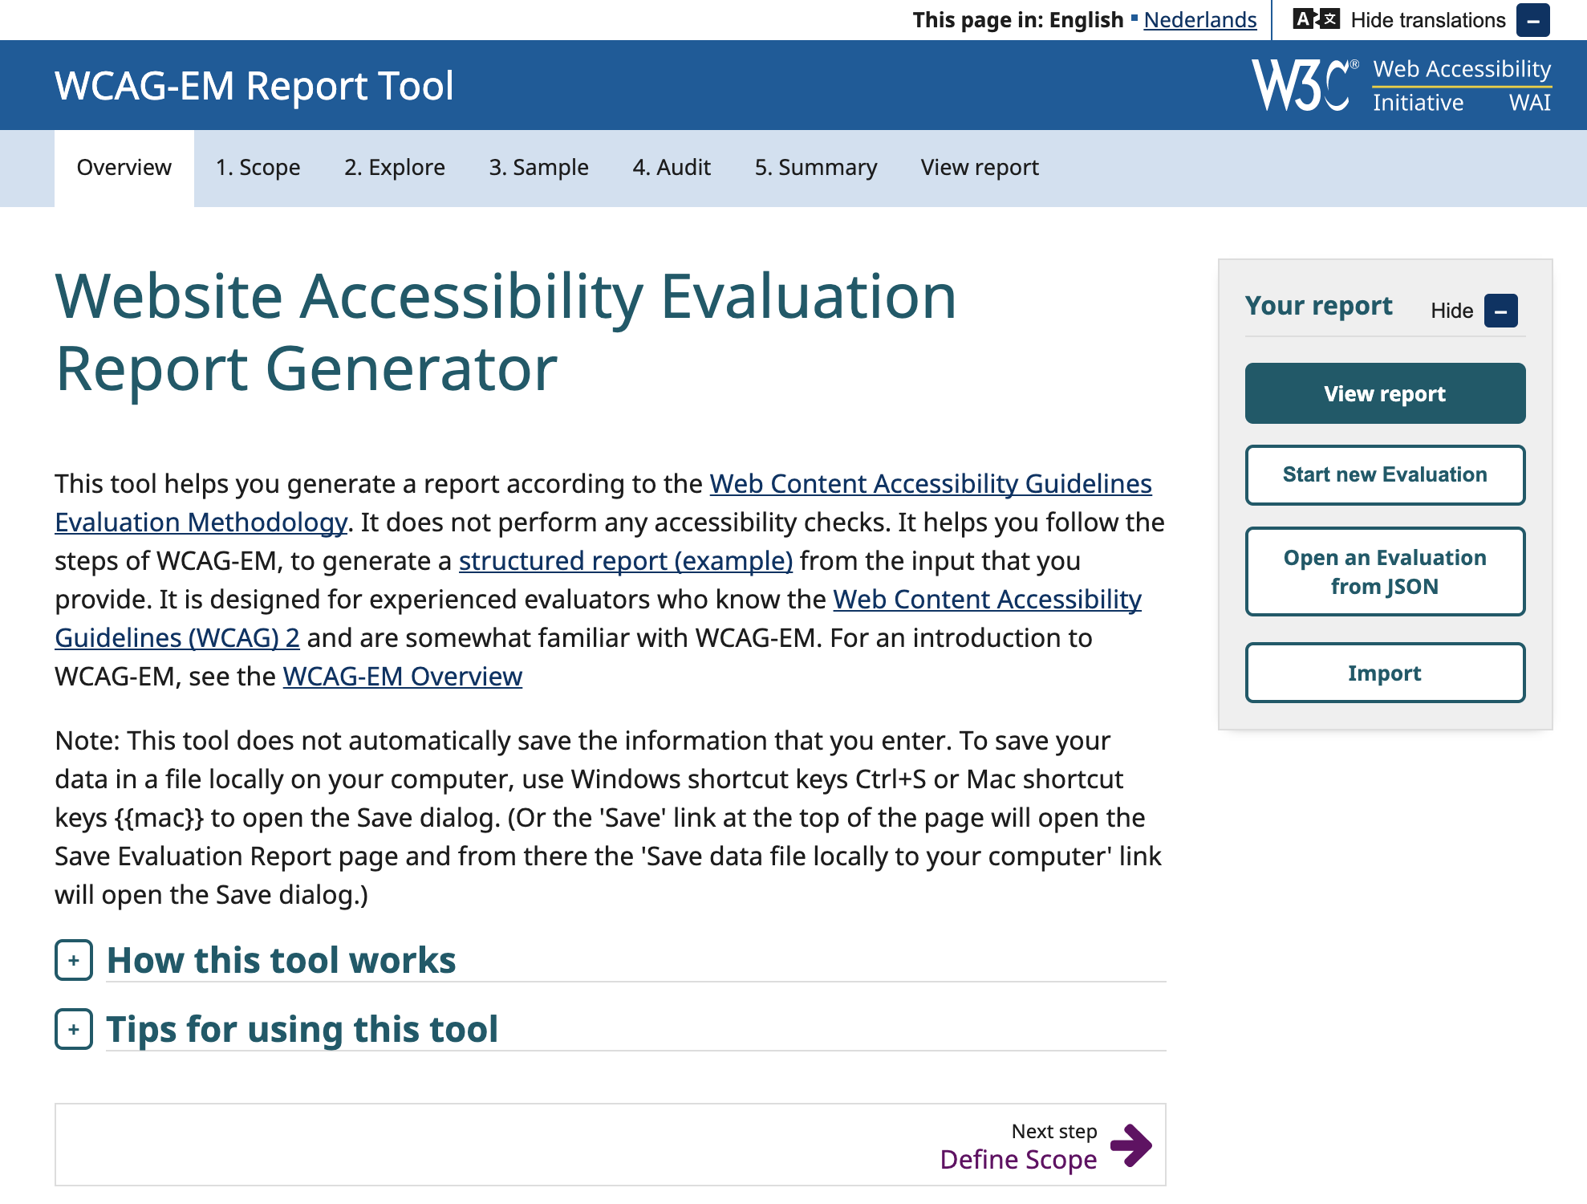
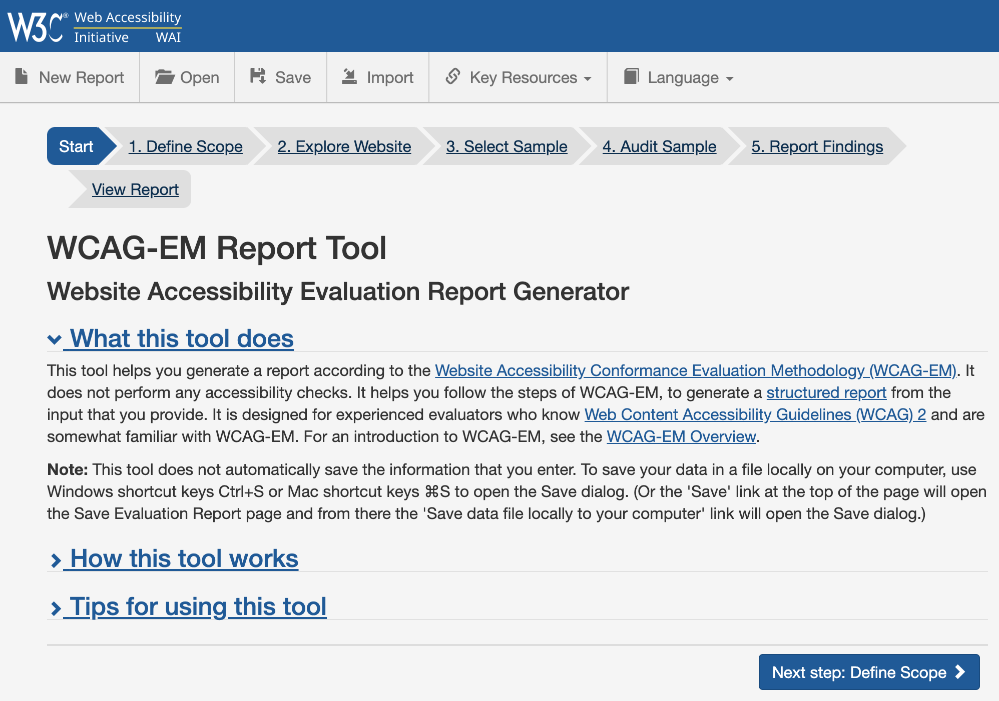
Web Accessibility Reporting Tool (1)
Update of the tool
with your input

Slide 4
Web Accessibility Reporting Tool (2)
w3.org/WAI/eval/report-tool/ (updated design following soon)
WCAG-EM Report Tool (Website Accessibility Evaluation Report Generator Tool) – follows procedure to evaluate websites.
Helps you generate a report according to WCAG-EM
Support and links to relevant information and tools
Aligned with “WCAG Conformance Claims”
Supports WCAG 2.0 and WCAG 2.1 (can show differences)

Slide 5
Web Accessibility Reporting Tool (3)
Manual tool (does not do any automated checks by itself)
Possibility to open and save input (so you can exchange results)
Supports and links to relevant information and tools
Easy translation file to change it into your language (EN and NL)
Changed to new WAI-Design and framework
Import of data from tools (using EARL-format, currently supported by SiteImprove, Deque, and others outside the project)

Slide 6
Web Accessibility Reporting Tool (4)
Live demo

Slide 7
Accessibility Statements
Horizon 2020 Project
Grant Agreement 780057

Slide 8
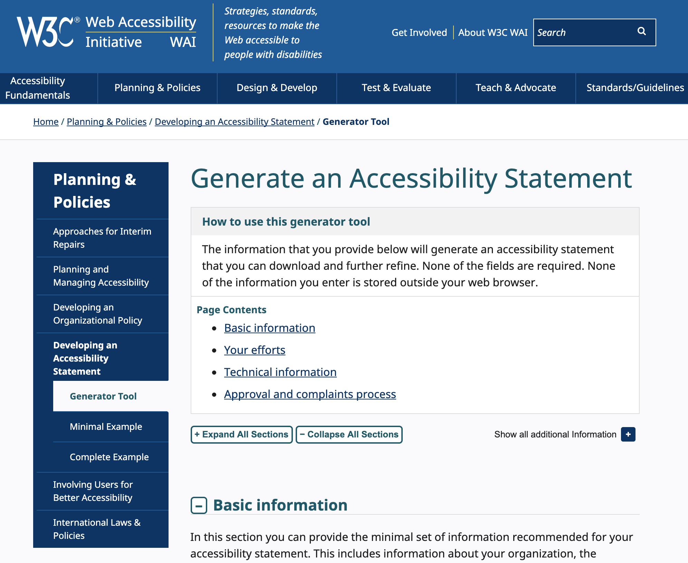

Accessibility Statements Generator (1)
w3.org/WAI/planning/statements/

Slide 9
Accessibility Statements Generator (2)
Guidance on providing accessibility statements
Aligned with EU Web Accessibility Directive (WAD) and
with WCAG 2 Conformance Claims
Manual generator (does not do any automatic checks)
Output available in both human- and machine-readable formats
Tool includes: (1) examples of statements, (2) guidance to make accessibility statements (3) statements generator tool
Including input from community and experts
Almost ready for translation to your language!

Slide 10
Accessibility Statements Generator (3)
Why provide an accessibility statement?
  Show users that you care; Provide them with valuable help; CSR; Requirement in Directive 2016/2102 for PSB, etc.
What does the tool do?
  It asks questions: basic information, your efforts, technical information and regarding the approval and complaints process
  Helps create accessibility statement that can be further customized, branded etc.
  Helps make accessibility statement conformant with EU Directive 2016/2102.
Who is the output for?
  Not for lawyers but for users of your content! Make sure they understand so they know what to do.
Future work: translations (working on it now), add your own questions

Slide 11
Accessibility Statements Generator (4)
Live demo

Slide 12
Thank You
w3.org/WAI/
Horizon 2020 Project
Grant Agreement 780057

