Slide 1

ACT Rules Development WAI-Tools Final Open Meeting Online, 26 January 2021
Horizon 2020 Project
Grant Agreement 780057

Slide 2
Goals of ACT
Improve consistency in tests of:
Accessibility test tools
Test methodologies*
(* Any document that describes how to test WCAG)

Slide 3
Benefits of ACT
Benefits for many different audiences:
Far more consistent test results
Formally published rule by W3C
Resolves questions around WCAG
Builds trust in accessibility testing

Slide 4
Features of ACT
ACT Rules provide consistency and transparency:
Unambiguous language
Document assistive technology issues
Documented assumptions
Tool & methodology agnostic

Slide 5
ACT Rules Developed By The Project
Overview on ACT Rules developed by the project:
Initial target was total of 70 rules, of which 30 automatable rules, 25 semi-automated rules, and 15 manual rules
At project begin tried to cover as much ground as possible: eg. text content, graphics, audio/visual media, and more
Later on rules became more specialized and focused on increasingly narrow aspects of web content
Several rules for requirements outside WCAG were also developed, covering things like WAI-ARIA and its Authoring Practices

Slide 6
How ACT Rules Were Developed
Rules development was carried out with community involvement:
Various selection criteria were used to ensure that rules chosen for development provided as much value as possible
Promising rules were incubated in the ACT Rules Community Group with input from both project partners and from the wider community
Once developed, the rules were implemented by the project partners and validated against a fixed set of real web pages
Mature rules were sent to the ACT Task Force of the W3C Accessibility Guidelines (AG) Working Group for publication as WAI resources

Slide 7
Adoption and Impact of ACT Rules
ACT Rules are being increasingly adopted in the community:
Rules developed by the project represent consensus among project partners and other members of the Community Group about the interpretation of specific aspects of WCAG
Some rules have been adopted by tool vendors and are now part of their products, while others have been adopted by manual testers in their methodologies
Through either of these paths they have reached monitoring bodies
11 ACT Rules have been formally published by W3C; more coming

Slide 8
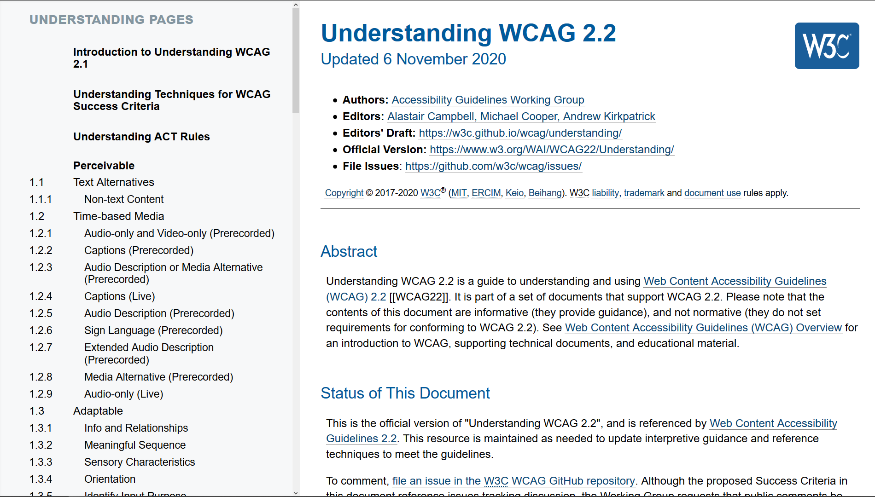

Slide 9
Getting Involved in Further Work
The project started the work, and now it’s up to you!
Read the rules, check the test cases, compare your outcomes and interpretation, and comment
Implement ACT Rules in your tools and methodologies and let the community know about your implementations
Get actively involved the Community Group (anyone can get involved, with or without W3C membership): review, propose, or write rules
Get actively involved in W3C to support adoption of more rules in WCAG 2.2 and potentially also WCAG 3.0

Slide 10
Thank you
act-rules.github.io/
Horizon 2020 Project
Grant Agreement 780057

