Slide 1
WCAG-EM Report Tool
Horizon 2020 Project
Grant Agreement 780057

Slide 2
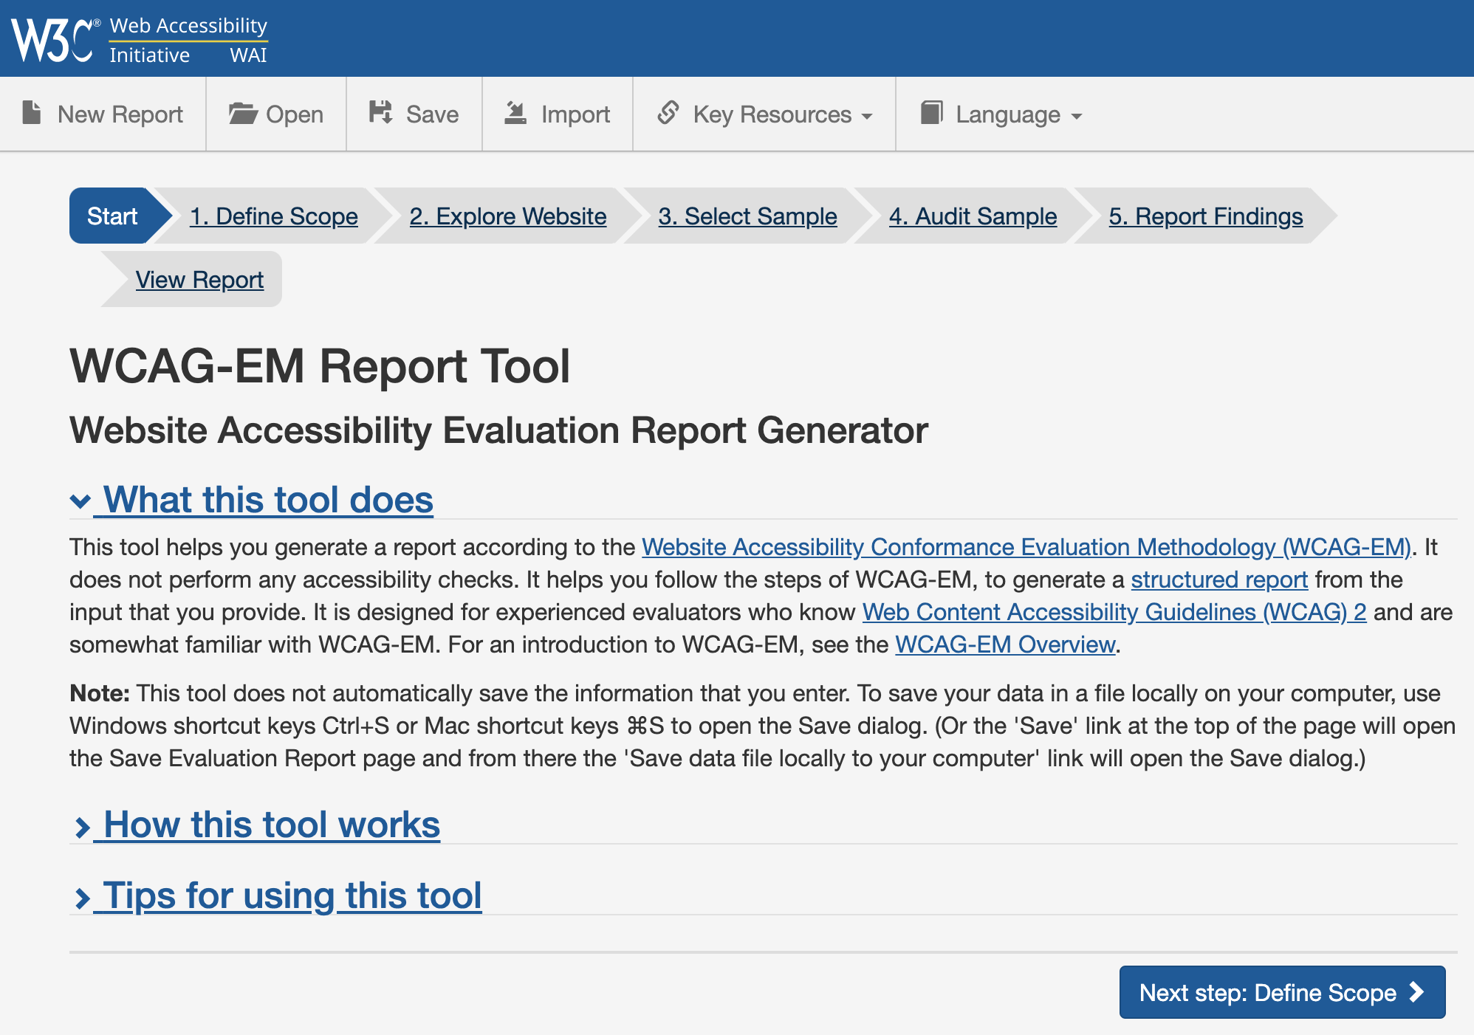
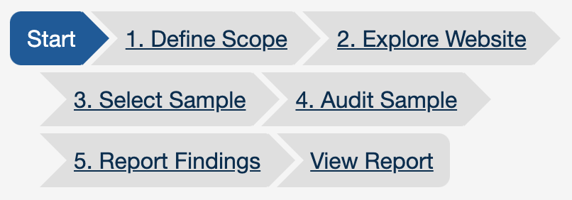
Web Accessibility Reporting Tool (1)

Slide 3
Web Accessibility Reporting Tool (2)
https://www.w3.org/WAI/eval/report-tool/
WCAG-EM Report Tool (website accessibility evaluation report generator tool) – procedure to evaluate websites.
Helps you generate a report according to WCAG-EM
Aligned with “WCAG Conformance Claims”
Manual tool (does not do any automated checks by itself)
Possibility to open and save input
Support and links to relevant information and tools

Slide 4
Web Accessibility Reporting Tool (3)
Live demo

Slide 5
Web Accessibility Reporting Tool (4)
Issues we are working on:
Done: Updated to WCAG2.1
Support importing automated results (busy)
Change to new WAI design (busy)
Facilitate easy translations (busy)
Other issues (see Github and add your own wishes):
Repair bugs (Github issues overview)
Editable template
Sample selection wizard

Slide 6
Accessibility Statements
Horizon 2020 Project
Grant Agreement 780057

Slide 7
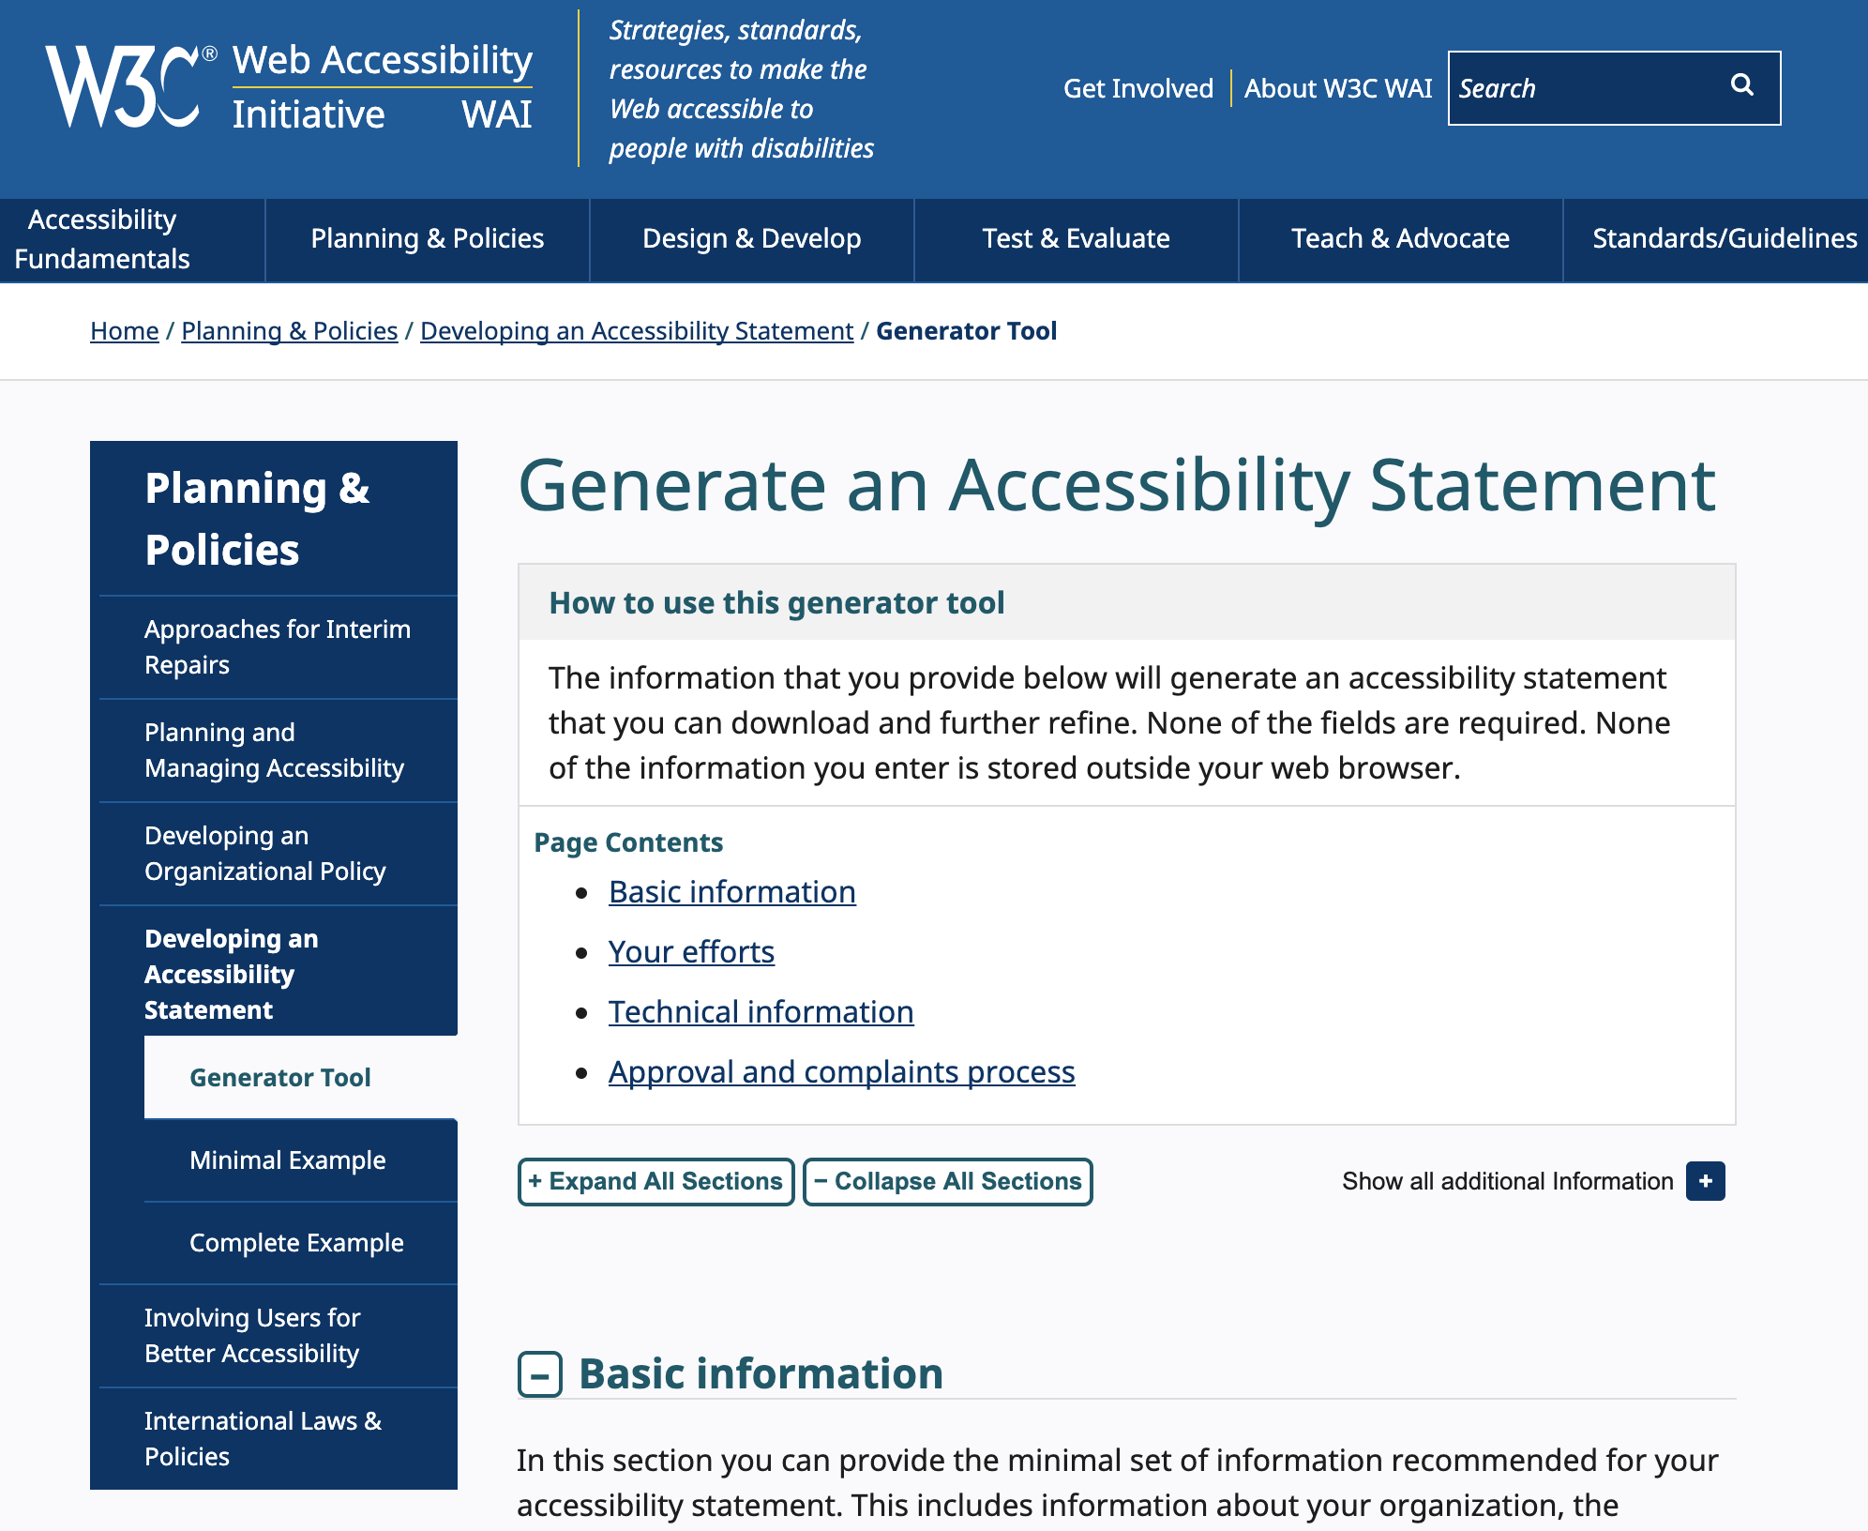
Accessibility Statements Generator (1)
https://www.w3.org/WAI/planning/statements/

Slide 8
Accessibility Statements Generator (2)
Guidance on providing accessibility statements
Aligned with Web Accessibility Directive and WCAG Conformance Claims
Manual generator
Output available in both human- and machine-readable formats
Tool includes: (1) examples of statements, (2) guidance to make accessibility statements,(3) using the tool
Including input from community and experts

Slide 9
Accessibility Statements Generator (3)
Why provide an accessibility statement?
Show users that you care; Provide them with valuable help; CSR; Requirement in Directive 2016/2102 for PSB, etc.
What does the tool do?
It asks questions: basic information, your efforts, technical information and regarding the approval and complaints process
Helps create accessibility statement that can be further customized, branded etc.
Helps make accessibility statement conformant with EU Directive 2016/2102.
Who is the output for?
Not for lawyers but for users of your content! Make sure they understand so they know what to do.
Future work: translations (working on it now), add your own questions

Slide 10
Accessibility Statements Generator (4)
Live demo

