Slide 1

WAI-Tools Project Overview on the Portuguese National Observatory 22 September 2020 Lisbon, Portugal
Horizon 2020 Project
Grant Agreement 780057

Slide 2
An Observatory to raise awareness and improve learning [is not a shame campaign]
We believe that…
“(...) the monitoring should (...) raise awareness and encourage learning in Member States. For that reason, and in order to enhance transparency, the overall results of the monitoring activities should be made publicly available in an accessible format.” (recital 2 of the Implementing Decision (EU) 2018/1524)

Slide 3
The Directive and the PT Transposition
Evaluation Methods to be done by each Entity (decentralized) (ref. from the PT legislation - The DL n.º 83/2018 of 19 October)
Simplified: based on Automatic/Semi-automatic Tools
In-Depth “light”: manual evaluation based on a checklist “10 critical aspects of functional accessibility” (such a kind of W3C’s Easy Check)
Usability tests w/ People w/ Disabilities (minimum: 1 task; 1 users’ typology from the EN 301 549)

Slide 4
Simplified Method based in Evaluation tools
From the PT Legislation:
Simplified LIGHT Method (decentralised):
Page sample: homepage + all pages linked from the home (from the historical studies in Public Sector Body in PT this means an average of 60 pages)
Evaluation: Auto Tools to WCAG 2.1 ‘AA’
The PSB can use any tool, but the AMA’s team will load the sample in the Portuguese Observatory of Web Accessibility
From the Directive:
Simplified Method (centralised):
Page sample: “For the simplified monitoring method, a number of pages appropriate to the estimated size and the complexity of the website shall be monitored in addition to the home page” (see 3.4 of Annex I of Implementing Decision (EU) 2018/1524).

Slide 5
PorTuguese Evaluation Tools
Different tools, the same evaluation engine - QualWeb
(...)
(...)
(...)
AccessMonitor
MyMonitor
An accessibility report of:
One page
A tool of:
Monitoring
Detailed indicators
Correct practices
(...)
Observatory
A tool of:
Awareness
Teach/Learning
Global statistics
(...)
Helping to create a
Network of People

Slide 6

impact of the ACT-Rules in the tests of tools
HTML
(...)
An a11y report
per page
12 ACT-Rules changed 20 Tests of the PT Observatory (work in progress).
At the end we estimated 75% of the 99 tests will be different
(...)
QualWeb
Engine
(...)
ACT-Rules
Export datasets
Observatory
EARL
Rebuild tests (a more comprehensive analysis)
Browser Post-processing (a better vision)
All the code are opensource (https://amagovpt.github.io/eed)
I18n ready. (ready to translate)
CSV

Slide 7
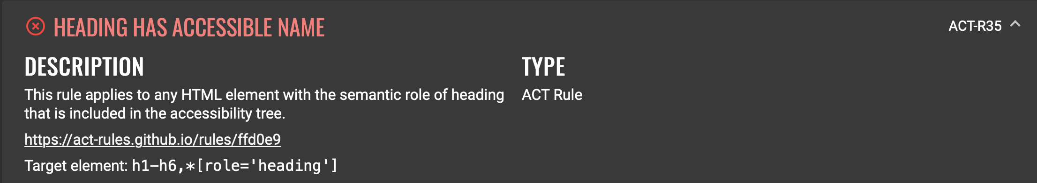
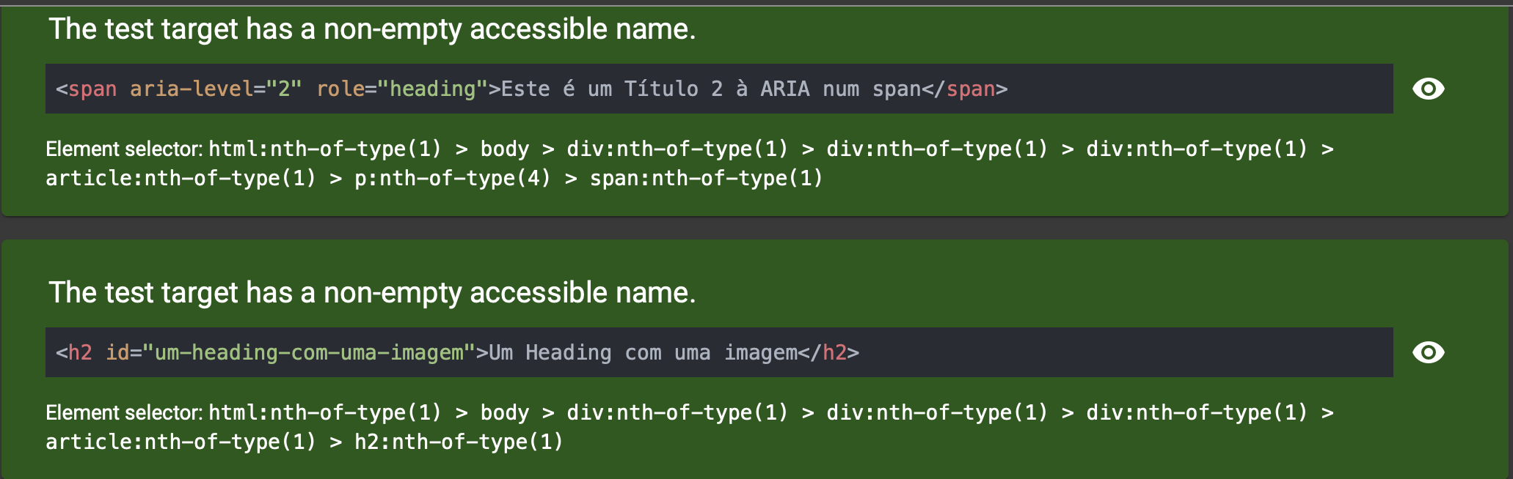
impact of the ACT-Rules in the tests of tools
Past: analysis of elements H1, …, H6
Now: an H1, … H6 but also role=“heading” + aria-level=“1” (…) “6”
2 Examples:
Headings
Images

Slide 8
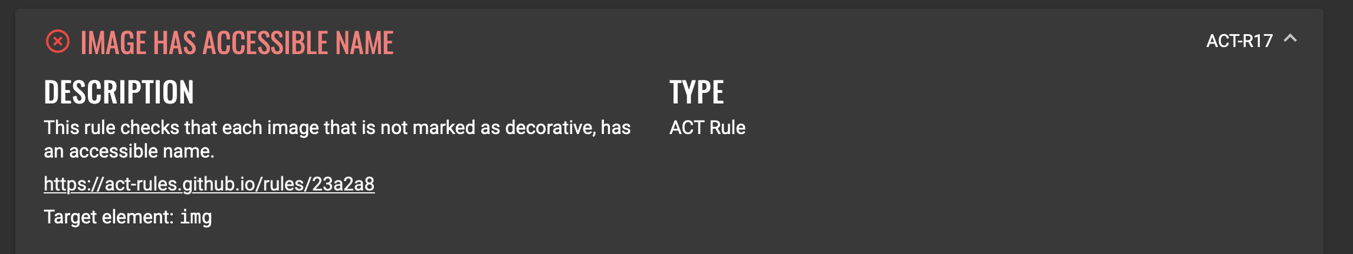
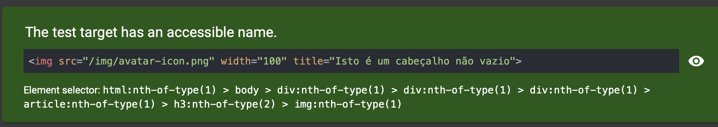
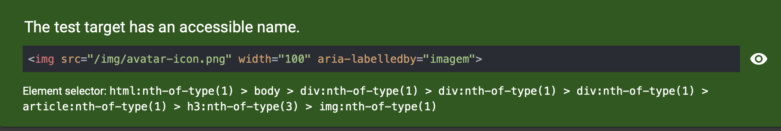
impact of the ACT-Rules in the tests of tools
Past: analysis of <img> element: only alt atribute
Now: alt, title, aria-label, aria-labelledby
2 Examples:
Headings
Images

Slide 9
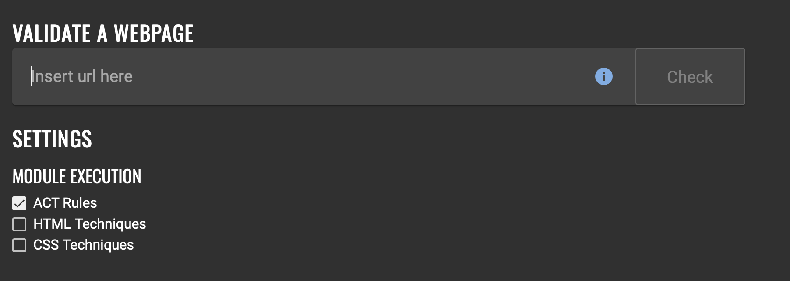
QualWeb engine
If you want to try all the ACT Rules that we have at the moment:
http://qualweb.di.fc.ul.pt
A PT implementation of all the ACT-Rules (Work in Progress)

Slide 10
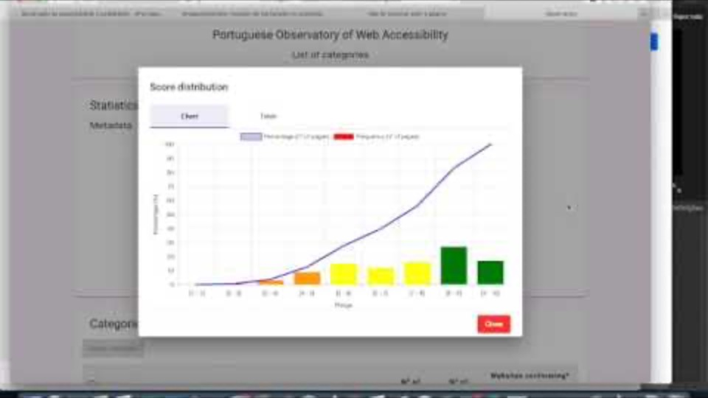
Demo of the Observatory
The Observatory TRIO of Tools:
- AccessMonitor
- Observatory
- MyMonitor
Helping to create a
Network of People

Slide 11
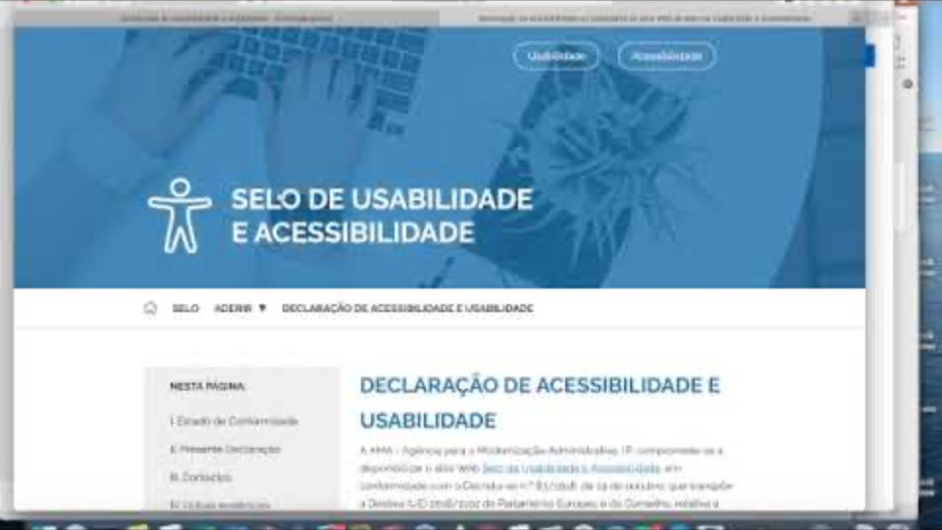
The Accessibility Statement
The PT Generator is based on WAI-Tools’ Generator
PT Generator of Accessibility Statement (based on WAI-Tools AS’ Generator): https://www.acessibilidade.gov.pt/gerador
Source code: https://github.com/amagovpt/gerador

Slide 12
Thank you
PT Observatory Ecosystem
https://accessmonitor.acessibilidade.gov.pt
Horizon 2020 Project
Grant Agreement 780057

