Slide 1

Semantic Web Activities @ W3C
Ivan Herman
2012-05-30
(Changing slide set, re-used and a copy frozen for a specific presentation)

Slide 2
Before going into details…

Slide 3
What does the term “Semantic Web” mean to people?

Slide 4
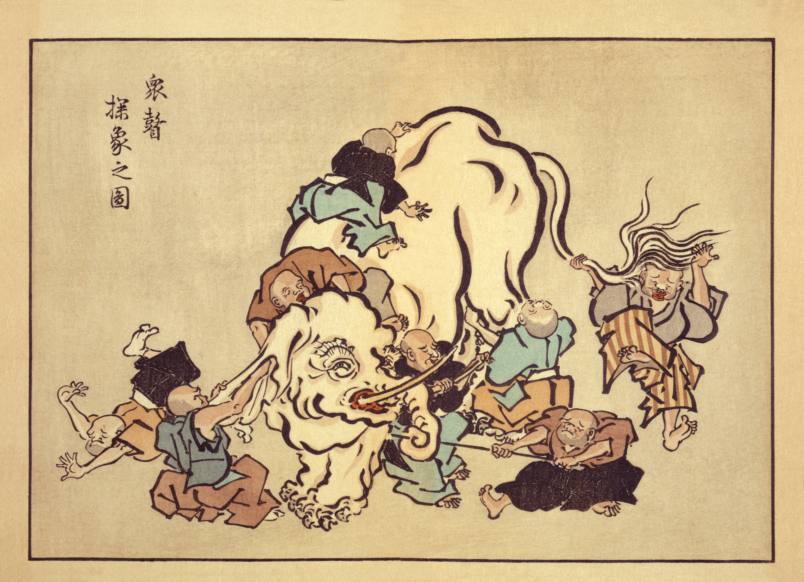

Slide 5
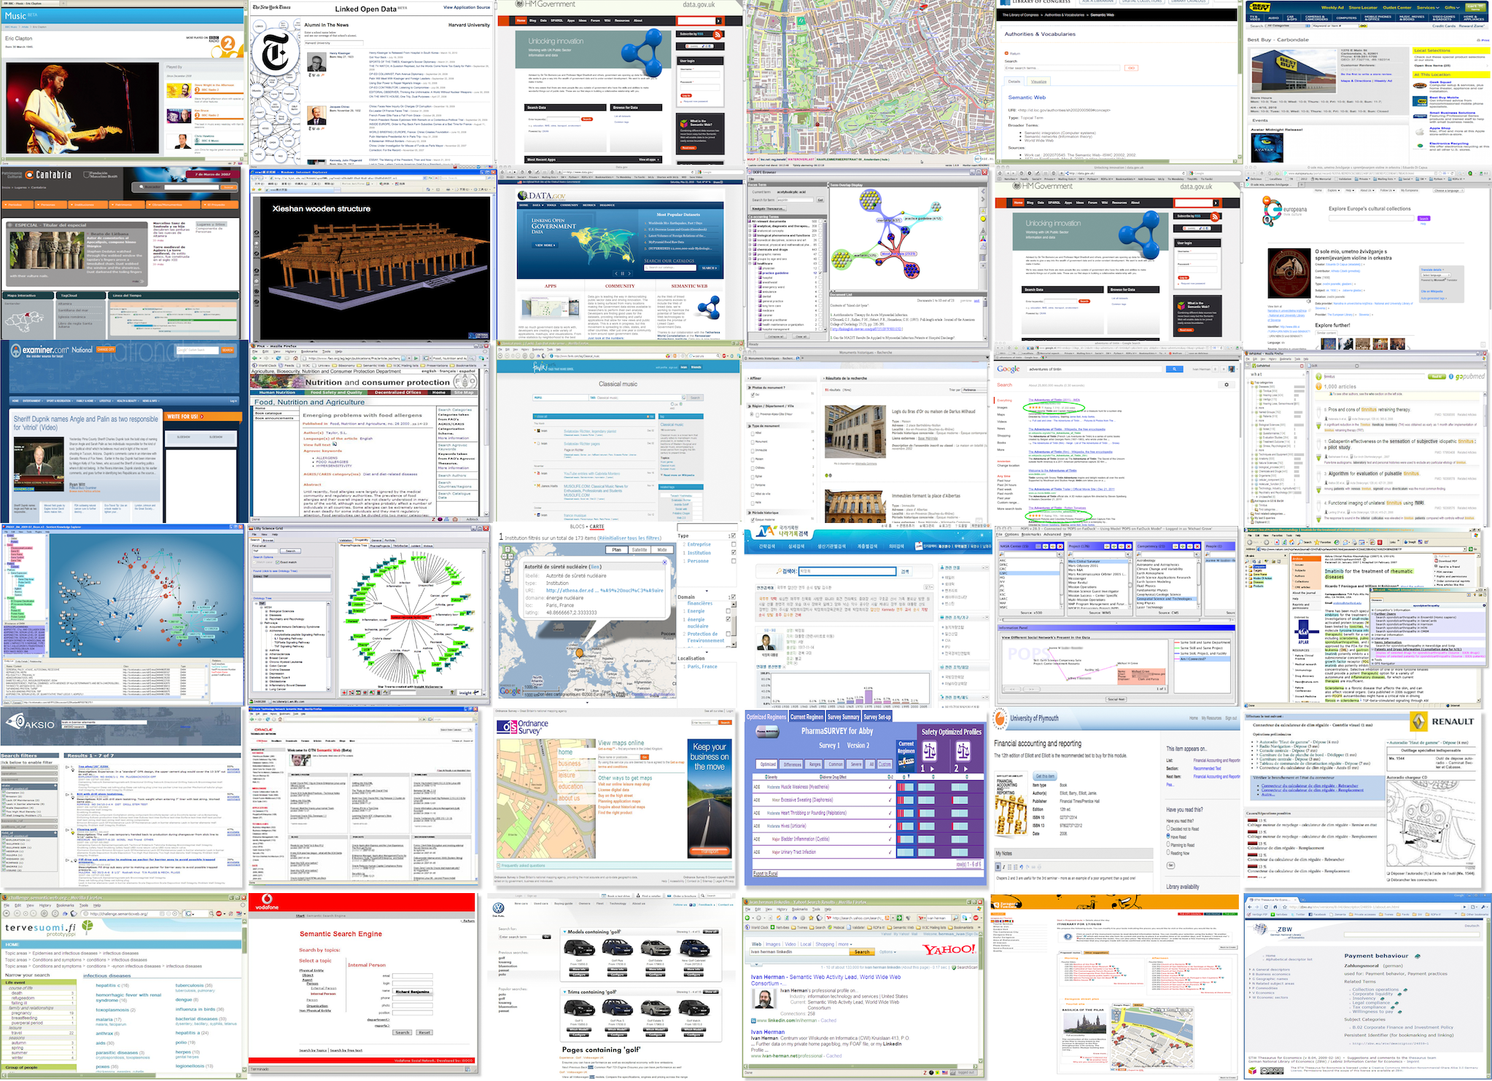

Slide 6
For some people, Semantic (Web) is…
A system manipulating and analyzing knowledge bases
e.g., via big ontologies, vocabularies
Google’s Knowledge Graph?
Improve search by adding structure to embedded data
A means to integrate many different pieces of data
Integrate data-oriented applications
And a mixture of all these…
Notes:
For the second bullet: in some cases graph based databases simply work better

Slide 7
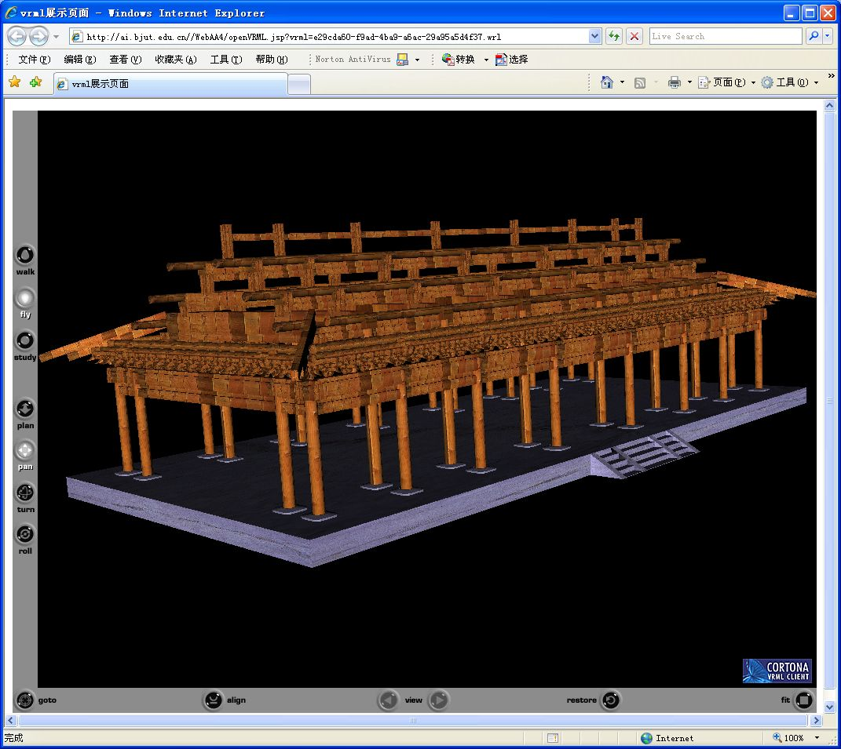
Xieshan wooden structure
Courtesy of Songmao Zhang, Academy of Mathematics and System Sciences, China
Notes:
All the knowledge about the wooden structures is encoded in OWL plus also SWRL rules, which then drives an external program to generate animation

Slide 8
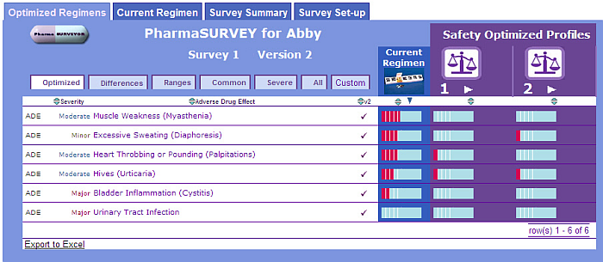
Courtesy of Erick Von Schweber, PharmaSURVEYOR Inc., (SWEO Use Case)
Notes:
Tool to find the best drug usage adapted to an individual patient. The navigator tool combines various databases, ontologies to provide a better tool.
The flexibility of the interface is important: the structure of the underlying data (e.g., databases, regulation) change often, but by localizing the change on the database-to-RDF mapping, the rest of the system is protected against change; one of the main reasons why this approach was chosen

Slide 9
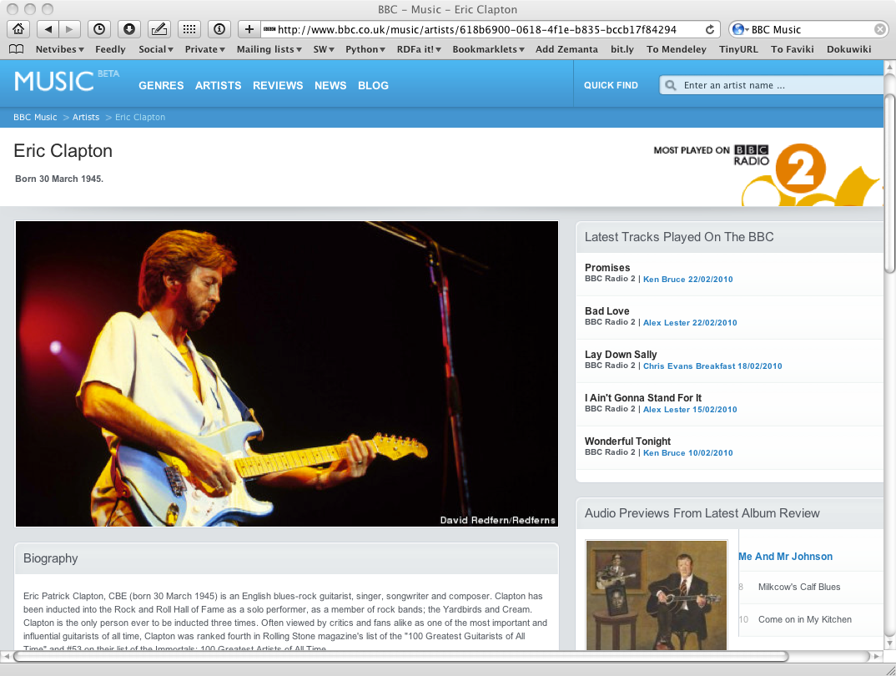

Slide 10
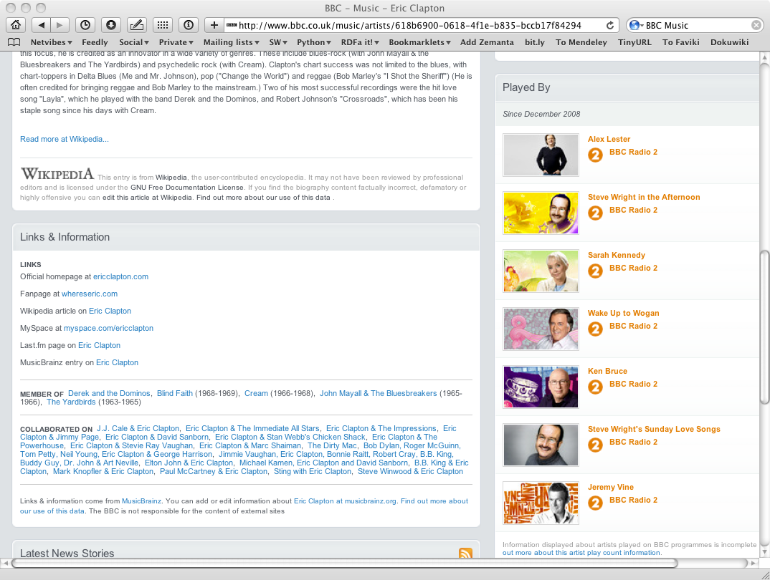

Slide 11
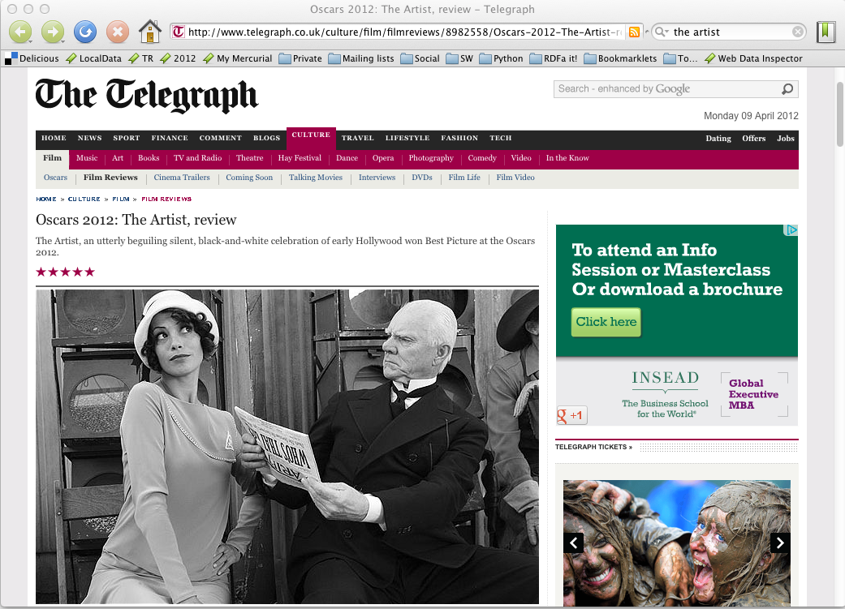

Slide 12
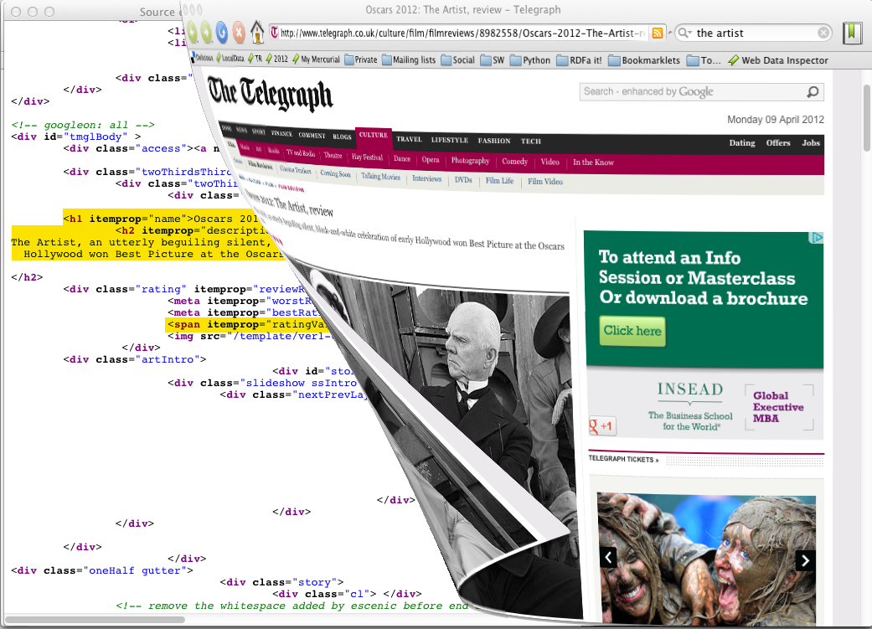

Slide 13
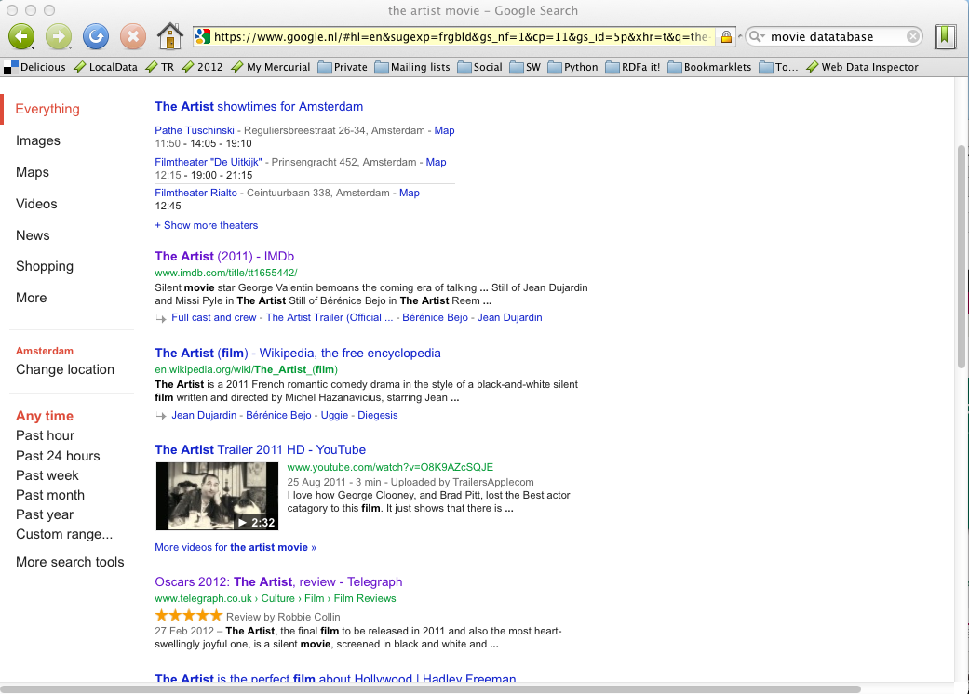

Slide 14
And that is all right!

Slide 15
And that is all right!

Slide 16
We have to acknowledge that the field has grown and has become multi-faceted
All different “views” have their success stories
There are also no clear and water-proof boundaries between the different views
The question is: where is the emphasis?

Slide 17
An obvious trend: Data on the Web
There are more and more data on the Web
government data, health related data, general knowledge, company information, flight information, restaurants,…
More and more applications rely on the availability of that data

Slide 18
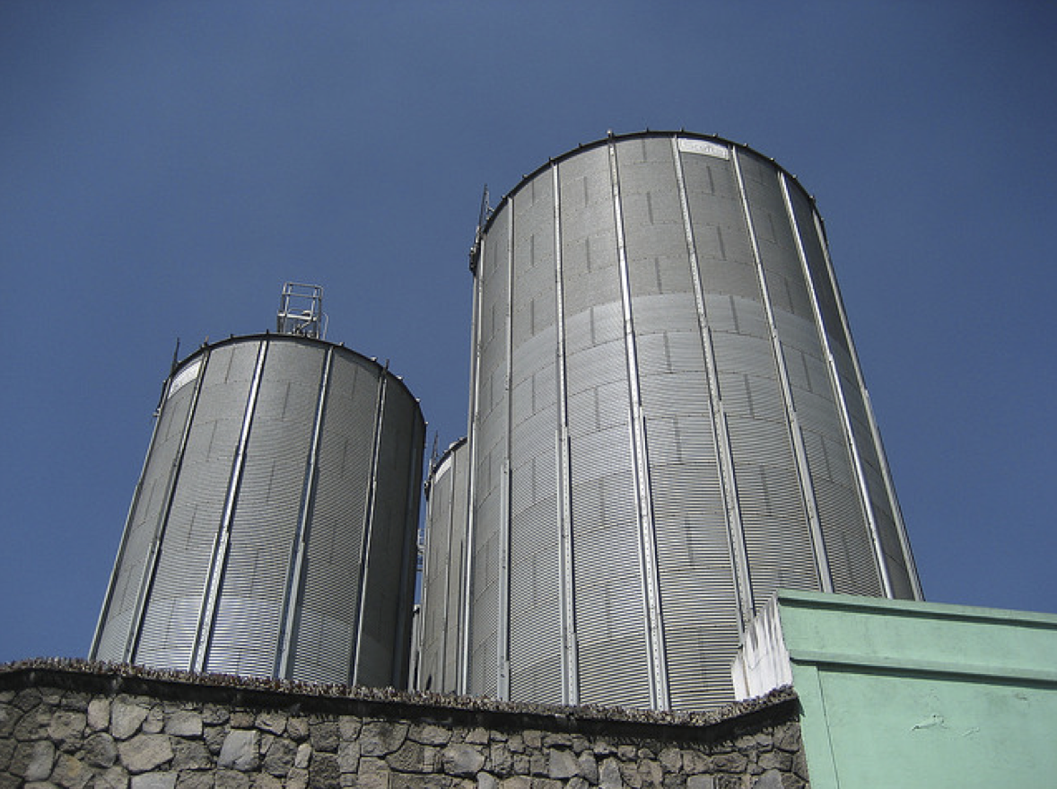
But: we do not want that!
Photo credit “nepatterson”, Flickr

Slide 19
Imagine…
A “Web” where
documents are available for download on the Internet
but there would be no hyperlinks among them

Slide 20
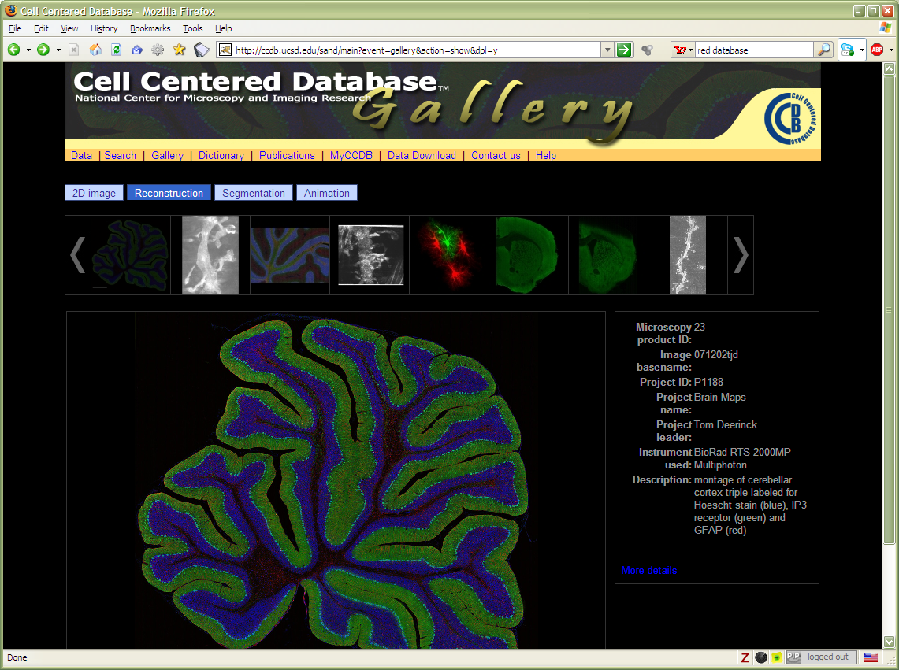
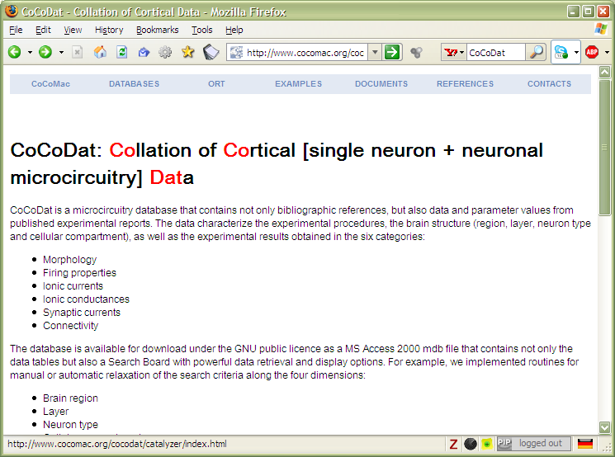
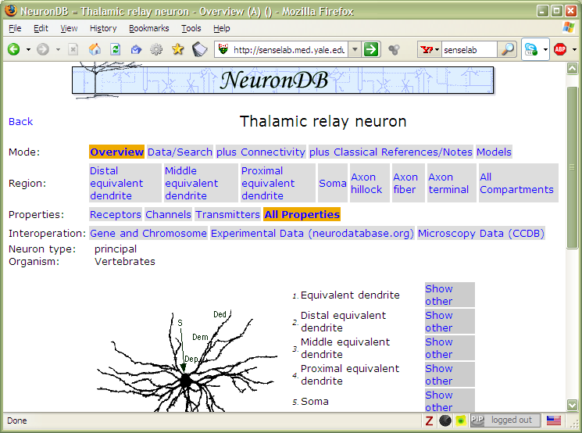

Slide 21
Data on the Web is not enough…
We need a proper infrastructure for a real Web of Data
data is available on the Web
accessible via standard Web technologies
data are interlinked over the Web
the terms used for linkage are well defined
I.e.: data can be integrated over the Web

Slide 22
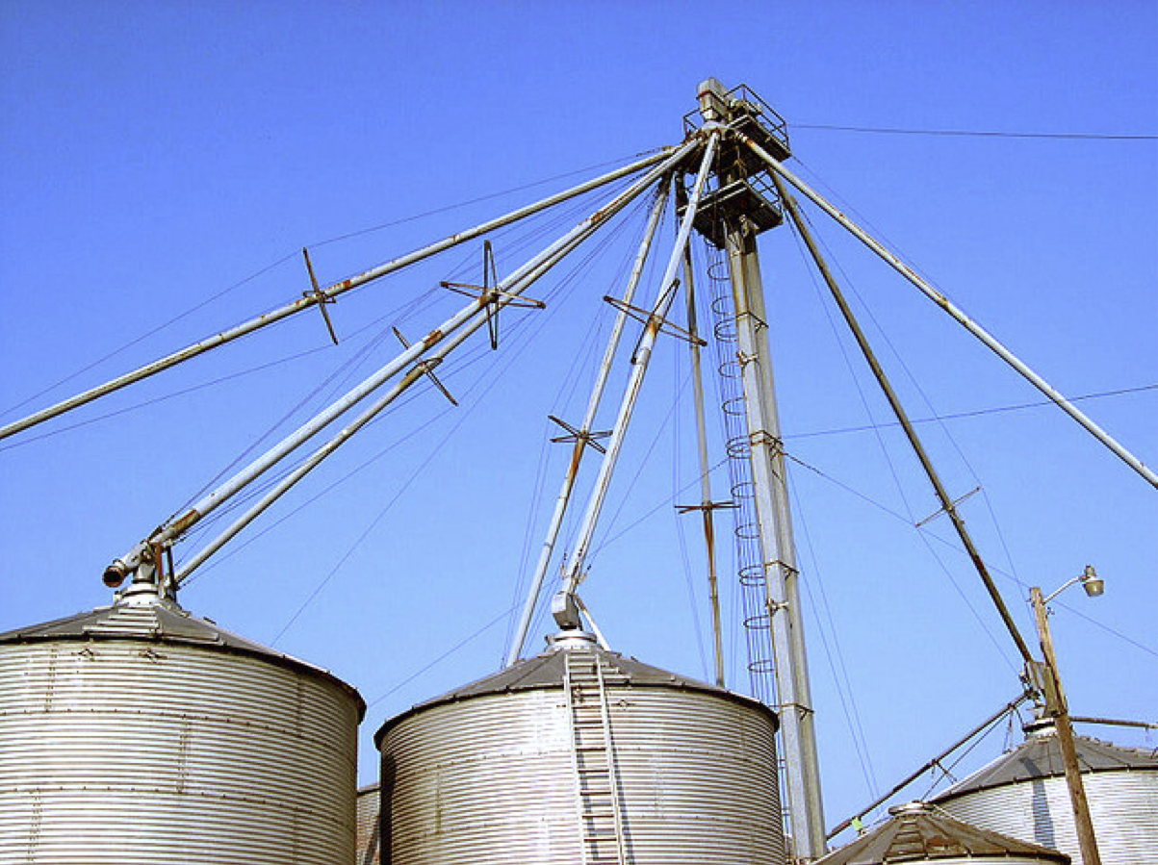
This is what we want!
Photo credit “kxlly”, Flickr

Slide 23
Semantic Web technologies should be at the service of such a Web of Data

Slide 24
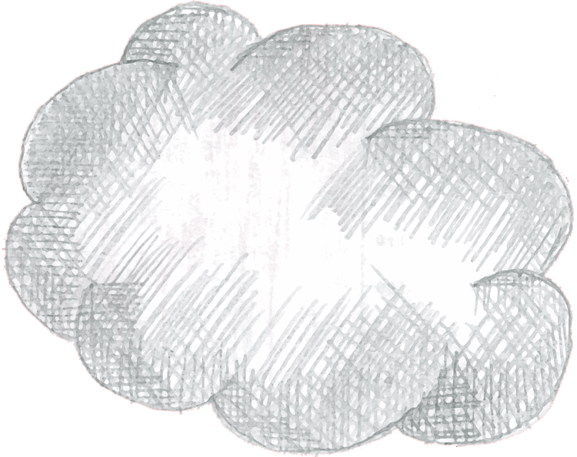
Web of Data Applications
Stand Alone Applications
Browser Applications
Query
Common Format &
Common Vocabularies
Inferencing
“Bridges”
Data on the Web

Slide 25
On a longer term…
Data should be easily manipulated from an application
i.e., read and write
But this is still further down the road…

Slide 26
Web of Data Applications
Stand Alone Applications
Browser Applications
Query and Update
Common Format &
Common Vocabularies
Inferencing
“Bridges”
Data on the Web

Slide 27
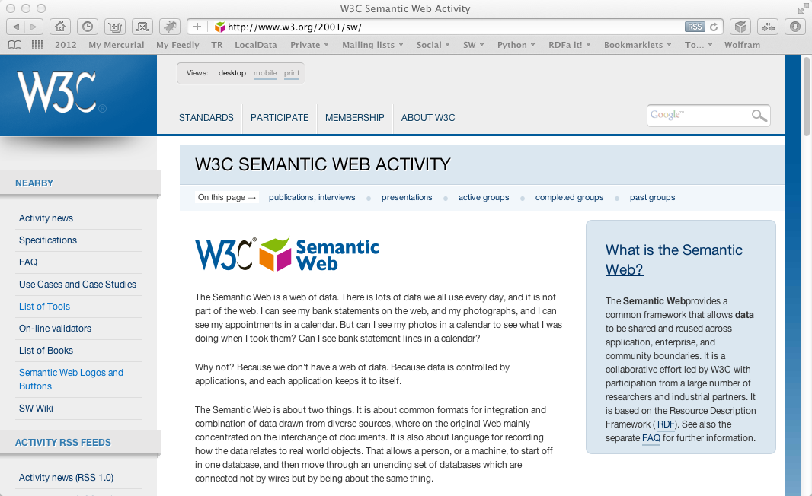
So… what is happening at W3C?

Slide 28
The (almost) past
Some technologies are, essentially, done:
Ontology for Media Resources
Media Fragments URI
SPARQL 1.1 (SPARQL Protocol and RDF Query Language)
RDB2RDF (Relational Databases to RDF)
RDFa 1.1 (RDF in attributes)

Slide 29
The present
Some areas are subject of intensive work
RDF update
Provenance
Linked Data Platform

Slide 30
The future
Just starting
Linked Data Platform
We are discussing new works, new areas, e.g.,
Access Control issues
Constraint checking on Semantic Web data
…

Slide 31
Link to specialized communities
Various communities have different emphasis on which part of the Semantic Web they want to use
W3C has contacts with some of those
health care and life sciences (a separate IG is up and running)
libraries, publishing
financials
the oil, gas, and chemicals community
governments
… but there are many more!

Slide 32
These links are not a one-way street!
The communities often contribute technologies that can be used in general
For example:
New vocabularies may come to the fore: SKOS or FRBR (from libraries), annotations (originally form the HCLS work), Person vocabularies (from the eGov work)
Health Care had a major influence on the Provenance work
etc.

Slide 33
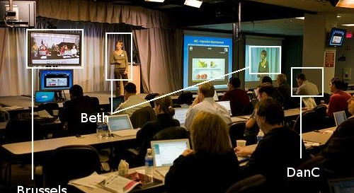
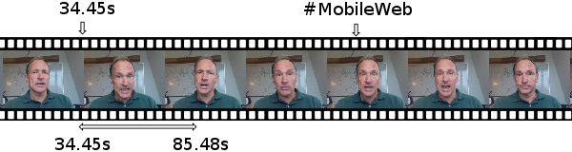
Audio, Video, and Semantics
Photo credit Robert Freund

Slide 34
Audio and Video are now first class entities on the Web

Slide 35
But… video and audio on the Web is not only what you see and hear
— it is also what you can search, discover, distribute, and manage!

Slide 36
Ontologies for Media Resources
The “usual” Semantic Web problem: what vocabularies to use?
The problem is not that there aren’t any… but that there are too many!
EXIF, MPEG7, XMP, MRSS, …
none of these cover all aspects
The Ontology for Media Resources document
defines a core vocabulary
defines a set of mappings to other formats

Slide 37
Some Media Ontology terms
Classes for Tracks (audio track, video track)
Specific properties for media (average bit rate, frame height and width, locator)
Some general “metadata” properties (copyright, creation date, creator, title)
Most of these have a formal mapping
In some cases the mapping is “exact” (e.g. title vs. Dublin Core’s title)
In some cases it is more or less general (e.g., creator vs. XMP’s creator)

Slide 38
Media Fragment URIs
Questions:
what is the standard URI for, say, a temporal fragment of a video?
what should be the behavior of the user agents for these URIs?
These are covered by the Media Fragments URI document, e.g.
http://www.example.com/video.ogv#t=10,20
http://www.example.com/video.ogv#track=audio
http://www.example.com/video.ogv#xywh=160,120,320,240

Slide 39
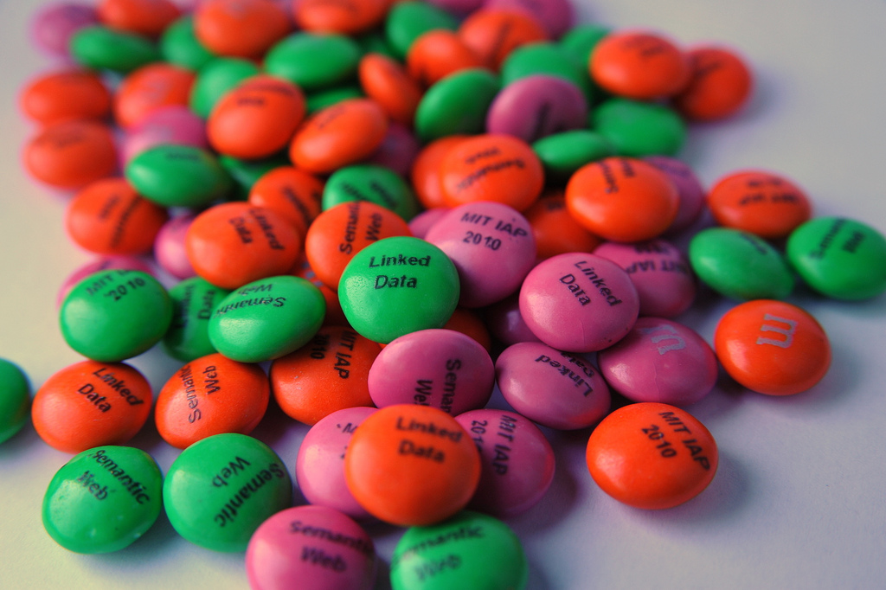
Query RDF: SPARQL 1.1
Photo credit “reedster”, Flickr

Slide 40
Reminder…
SPARQL is a query language on RDF data
SPARQL is defined in terms of a protocol, to send query and results over the Web
Is based on the idea of “graph pattern matching”:
a graph pattern is described in the query, with real and unknown nodes (“variables”)
if the pattern can match a portion of the graph, the unknown nodes are replaced by the “real” ones
resulting information is returned
First version of SPARQL was published in 2008

Slide 41
SPARQL 1.1: adding missing features to SPARQL
Nested queries (i.e., SELECT within a WHERE clause)
Negation (MINUS, and a NOT EXIST filter)
Aggregate function on search results (SUM, MIN,…)
Property path expression (?x foaf:knows+ ?y)
SPARQL UPDATE facilities (INSERT, DELETE, CREATE)
Combination with entailment regimes

Slide 42
SPARQL 1.1 and RDFS/OWL/RIF
SPARQL Engine with entailment
RDF Data
RDFS/OWL/RIF data
entailment
SPARQL Pattern
RDF Data with extra triples
SPARQL Pattern
Query result
pattern matching

Slide 43
SPARQL as a unifying point
Application
SPARQL Endpoint
SPARQL Endpoint
SPARQL Construct
SPARQL Construct
Triple store
SPARQL Processor
Database
RDFa, Microdata
NLP Techniques
GRDDL, RDFa
SQL⬄RDF
RDF Graph
Relational
Database
HTML
Unstructured Text
XML/XHTML

Slide 44
SPARQL 1.1 as a unifying point
Application
SPARQL Endpoint
SPARQL Endpoint
SPARQL Construct
SPARQL Construct
Triple store
SPARQL Update
SPARQL Processor
SPARQL Update
Database
Inferencing
RDFa, Microdata
NLP Techniques
GRDDL, RDFa
SQL⬄RDF
RDF Graph
Relational
Database
Inferencing
HTML
Unstructured Text
XML/XHTML

Slide 45
SPARQL 1.1 Status
Technology has been finalized
Goes to “Proposed Recommendation” soon
Should be finished this fall

Slide 46
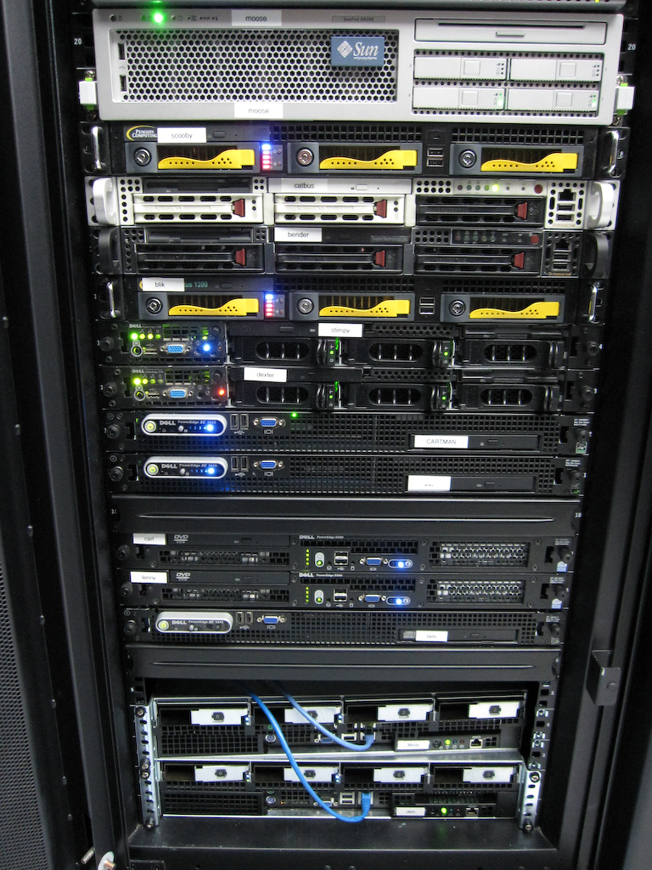
Access to Relational Databases
Photo credit “mayhem”, Flickr

Slide 47
Relational Databases and RDF
Most of the data on the Web is, in fact, in RDB-s
Proven technology, huge systems, many vendors…
Data integration on the Web must provide access to RDB-s
RDB2RDF provides means to “see” relational data as RDF

Slide 48
Many RDB systems can handle RDF
Relational database vendors realize the importance of the Semantic Web market
Many systems have a “hybrid” view:
traditional, relational storage, usually coupled with SQL
RDF storage, usually coupled with SPARQL
examples: Oracle 3g, IBM’s DB2, OpenLink Virtuoso,…

Slide 49
RDF provides a common “view”
Common “view”
in
RDF
export
export
query
query
query
export

Slide 50
What is “export”?
“Export” does not necessarily mean physical conversion
for very large databases a “duplication” would not be an option
systems may provide SPARQL⇔SQL “bridges” to make queries on the fly
Result of export is a “logical” view of the RDB content

Slide 51
Simple export: Direct Mapping
A canonical RDF “view” of RDB tables
Only needs the information in the RDB Schema

Slide 52
Fundamental approach
Each column name provides a predicate
ISBN | Author | Title | Publisher | Year
0006511409X | id_xyz | The Glass Palace | id_qpr | 2000
0007179871 | id_xyz | The Hungry Tide | id_qpr | 2004
Each row is a subject
Table references are URI objects
Cells are Literal objects
ID | Name | Homepage
id_xyz | Ghosh, Amitav | http://www.amitavghosh.com

Slide 53
Fundamental approach
ISBN | Author | Title | Publisher | Year
0006511409X | id_xyz | The Glass Palace | id_qpr | 2000
0007179871 | id_xyz | The Hungry Tide | id_qpr | 2004
0006511409X
<Book#ISBN>
<Book#Author>
id_xyz
The Glass Palace
<Book#Title>
<Book/ISBN-0006511409>
2000
<Book#Year>
<Book#ref-Author>
id_xyz
ID | Name | Homepage
id_xyz | Ghosh, Amitav | http://www.amitavghosh.com
<Person/ID-id_xyz>
<Person#ID>
<Person#Name>
<Person#Homepage>
Ghosh, Amitav
http://www.amitavghosh.com

Slide 54


Tables
RDB Schema
Direct Mapping
“Direct Graph”

Slide 55
Pros and cons of Direct Mapping
Pros:
Direct Mapping is simple, does not require any other concepts
know the Schema ⇒ know the RDF graph structure
know the RDF graph structure ⇒ good idea of the Schema(!)
Cons:
the resulting graph is not what the application really wants

Slide 56
Tables
RDB Schema
Direct Mapping
“Direct Graph”
Graph Processing
(Rules, SPARQL, …)
Final, Application Graph

Slide 57
Beyond Direct Mapping: R2RML
Separate vocabulary to control the details of the mapping, e.g.:
finer control over the choice of the subject
creation of URI references from cells
predicates may be chosen from a vocabulary
datatypes may be assigned
etc.
Gets to the final RDF graph with one processing step

Slide 58
R2RML Instance
Tables
RDB Schema
R2RML
Mapping
Final, Application Graph

Slide 59
Relationships to the Direct Mapping
Fundamentals are similar:
each row is turned into a series of triples with a common subject
Direct mapping is a “default” R2RML mapping

Slide 60
R2RML and Direct Mapping Status
Technology has been finalized
Implementations revealed some minor issues to fold into the specification
Should be finished this summer

Slide 61
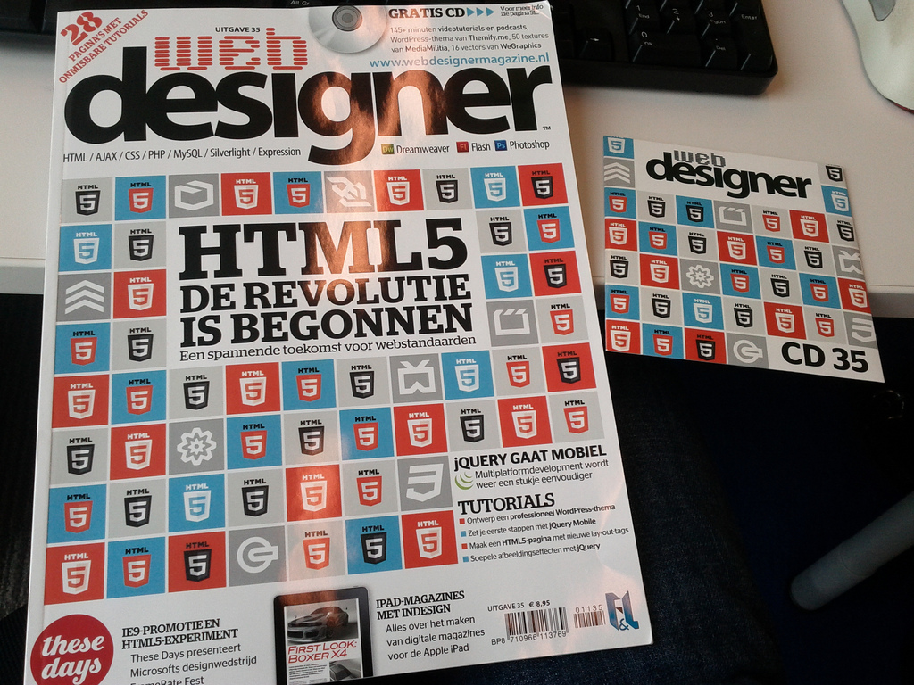
Structured data in HTML:
RDFa & microdata
Photo credit “shetladd”, Flickr

Slide 62
HTML pages are a huge source of structured data
Not necessarily large amount of data per page, but lots of them…
Have become very valuable to search engines
Google, Bing, Yahoo!, or Yandex (i.e., schema.org) all committed to use such data
Two syntaxes have emerged at W3C:
microdata with HTML5
RDFa with HTML5, XHTML, and with XML languages in general

Slide 63
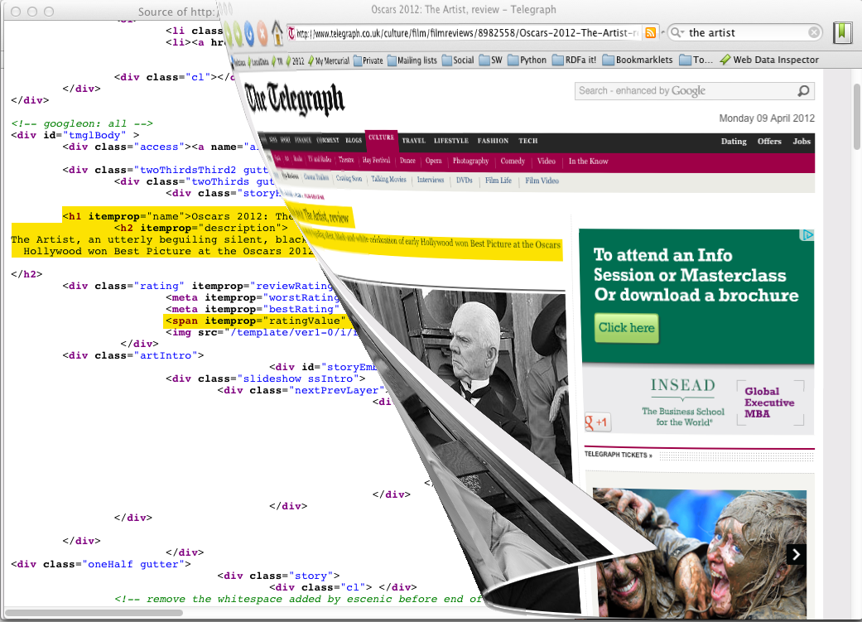

Slide 64
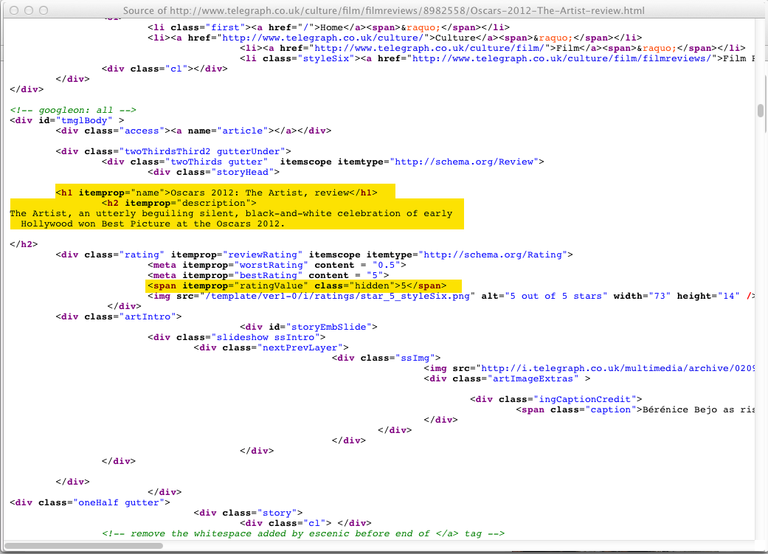

Slide 65
In RDF…
[ rdf:type schema:Review ;
schema:name "Oscars 2012: The Artist, review" ;
schema:description "The Artist, an utterly beguiling…" ;
schema:ratingValue "5" ;
…
]

Slide 66
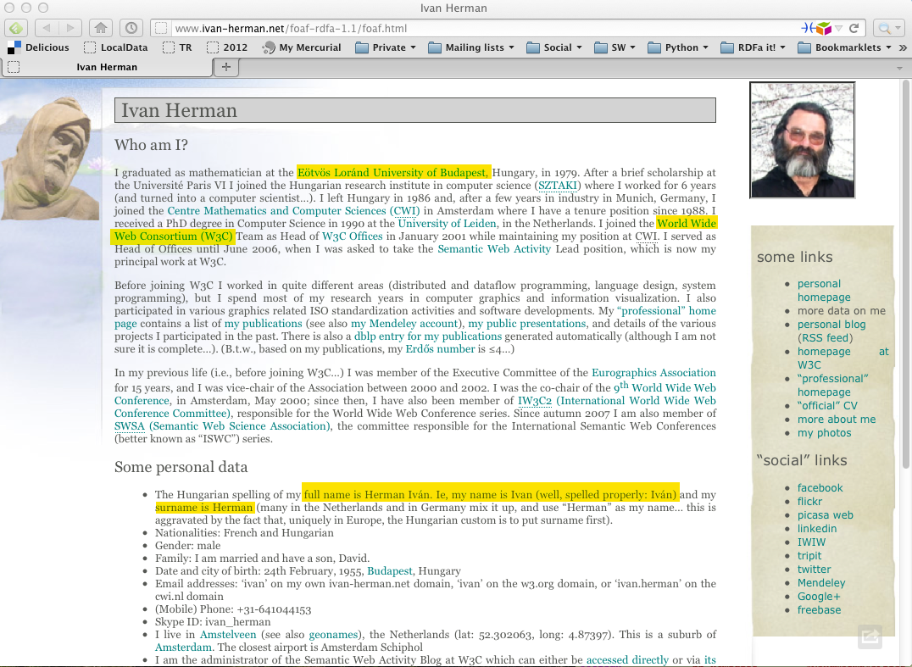

Slide 67
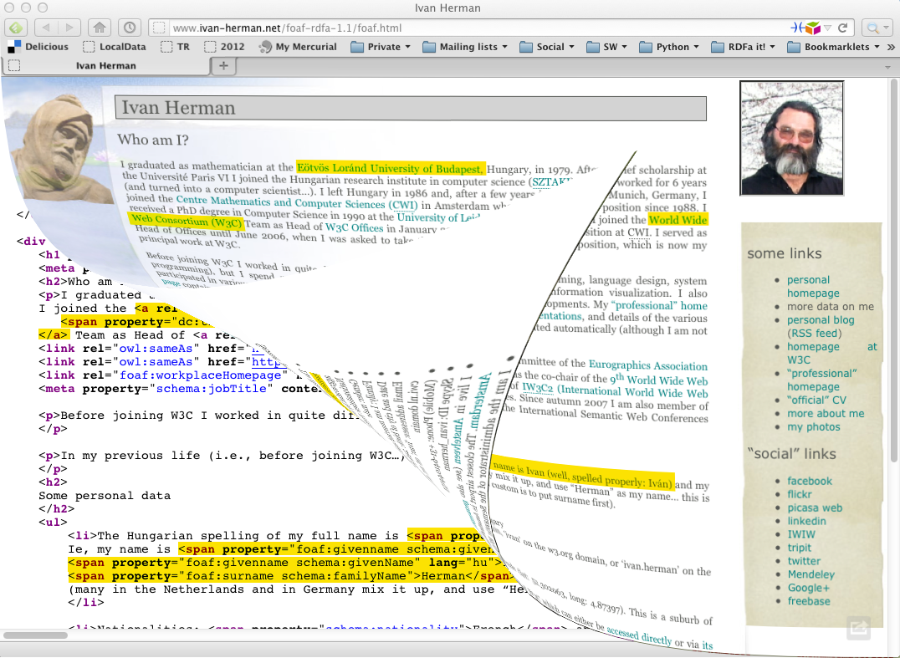

Slide 68
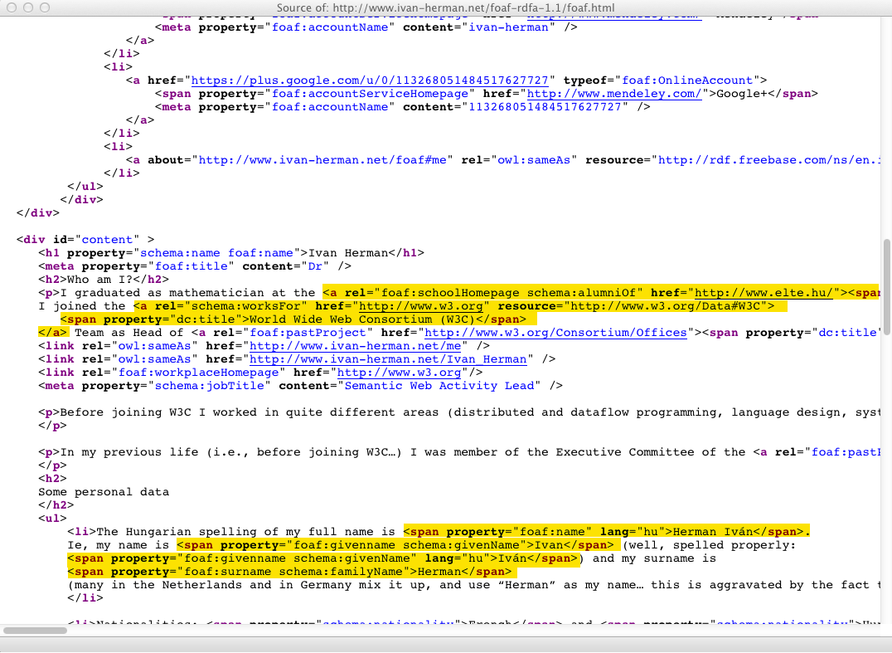

Slide 69
Yielding…
<http://www.ivan-herman.net/foaf#me>
schema:alumniOf <http://www.elte.hu> ;
foaf:schoolHomePage <http://www.elte.hu> ;
schema:worksFor <http://www.w3.org/W3C#data> ;
…
<http://www.elte.hu>
dc:title "Eötvös Loránd University of Budapest" .
…
<http://www.w3.org/W3C#data>
dc:title "World Wide Web Consortium (W3C)”
…

Slide 70
RDFa and microdata: similarities
Both have similar philosophies:
the structured data is expressed via attributes only (no specialized elements)
both define some special attributes
e.g., itemscope for microdata, resource for RDFa
both reuse some HTML core attributes (e.g., href)
both reuse the textual content of the HTML source, if needed
RDF data can be extracted from both

Slide 71
RDFa and microdata: differences
Microdata has been optimized for simpler use cases:
one vocabulary at a time
tree shaped data
no datatypes
RDFa provides a full serialization of RDF in XML or HTML
the price is an extra complexity compared to microdata
RDFa 1.1 Lite is a simplified authoring profile of RDFa, very similar to microdata

Slide 72
A relevant W3C note
HTML Data Guide
published by a separate W3C Task Force
help publishers to choose what to use
how to combine microdata and RDFa in one document

Slide 73
Structured data in HTML is mainstream!
… we see a five-fold increase in RDFa usage […] over 7% of web pages containing microdata.
Mail from Peter Mika, Yahoo!
Based on a crawl evaluation by P. Mika and T. Potter
LDOW2012 Workshop, April 2012, Lyon, France
… web pages that contain structured data has increased from 6% in 2010 to 12% in 2012.
Hannes Mühleisen and Christian Bizer
Web Data Commons—Extracting Structured Data from Two Large Web Corpora,
LDOW2012 Workshop, April 2012, Lyon, France

Slide 74
RDFa 1.1 and microdata status
For RDFa 1.1
Technology has been finalized
Is in “Candidate Recommendation”
Should be finished this summer
For microdata
Technology has been finalized
The microdata→RDF mapping is defined in a separate Note
Is part of HTML5, hence its formal advancement depends on other technologies

Slide 75
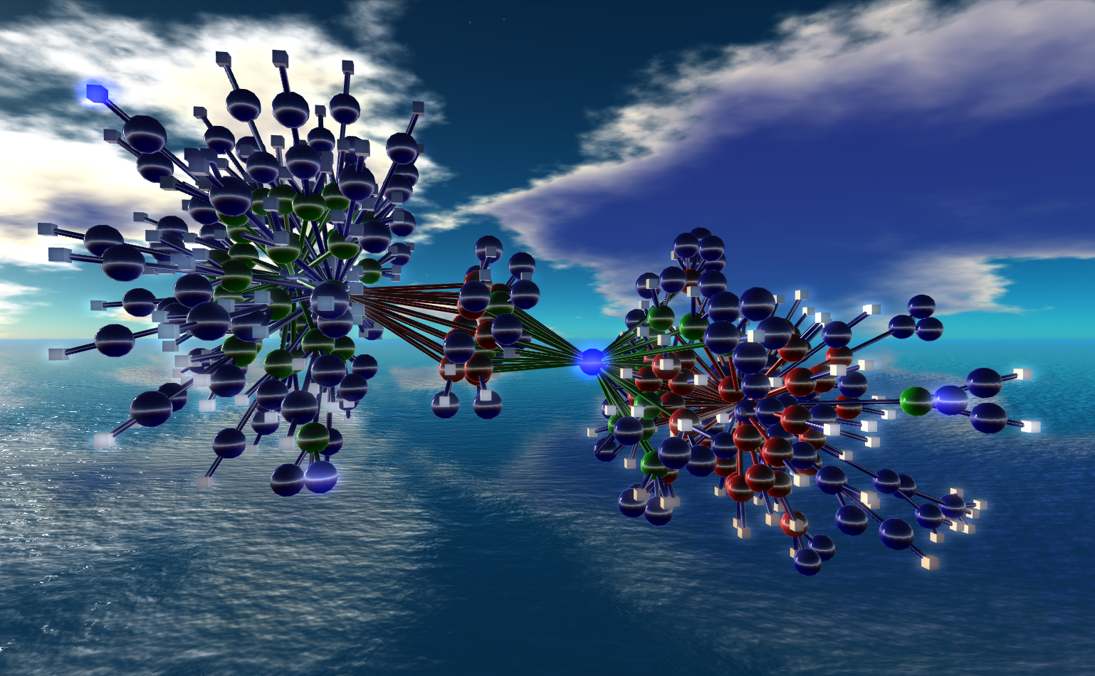
Cleaning up RDF
Nexus Simulation Credit Erich Bremmer

Slide 76
Reminder…
Resource Description Framework: a graph-based model for (Web) data and its relationships
has a simple (subject,predicate,object) model
makes use of URI-s for the naming of terms
objects can also be Literals
informally: defines named relationships (named links) among entities on the Web
has different serialization formats
Latest version was published in 2004

Slide 77
RDF cleanup (a.k.a. RDF1.1)
Many issues have come up since 2004:
deployment issues
new functionalities are needed
underlying technology may have moved on (e.g., datatypes)
The goal of the RDF Working Group is to refresh RDF
NOT a complete reshaping of the standard!

Slide 78
Some new features/plans
Standardize Turtle as a serialization format
Clean up some aspects of datatyping, e.g.:
plain vs. typed literals
introduction of an rdf:HTML datatype
details and role of rdf:XMLLiteral
Proper definition for “named graphs”
including concepts, semantics, syntax, …
obviously important for linked data access
but generates quite some discussions on the details
JSON format for Linked Data (JSON-LD)

Slide 79
Editorial improvements
Cleanup the documents, make them more readable
possibly rewrite all documents
maybe a completely new primer
new structure for the Semantics document

Slide 80
Status
Turtle is almost finalized
JSON-LD is in a very good shape
Agreement on most of the literal cleanup
Lots of discussion currently on named graphs…

Slide 81
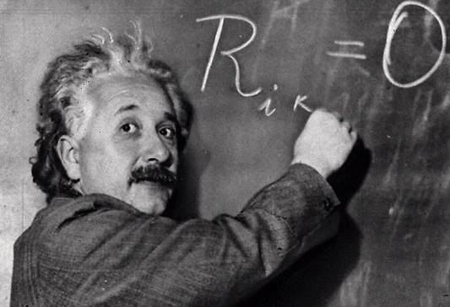
Provenance

Slide 82
The goal is simple…
We should be able to express all sorts of “meta” information on the data
who played what role in creating the data (author, reviewer, etc.)
view of the full revision chain of the data
in case of data integration: which part comes from which original data and under what process
what vocabularies/ontologies/rules were used to generate some portions of the data
etc.

Slide 83
…the solution is more complicated
Requires a complete model describing the various constituents (actors, revisions, etc.)
The model should be usable with RDF
Has to find a balance between
simple provenance: easily usable and editable
complex provenance: allows for a detailed reporting of origins, versions, etc.
That is the role of the Provenance Working Group (started in 2011)

Slide 84
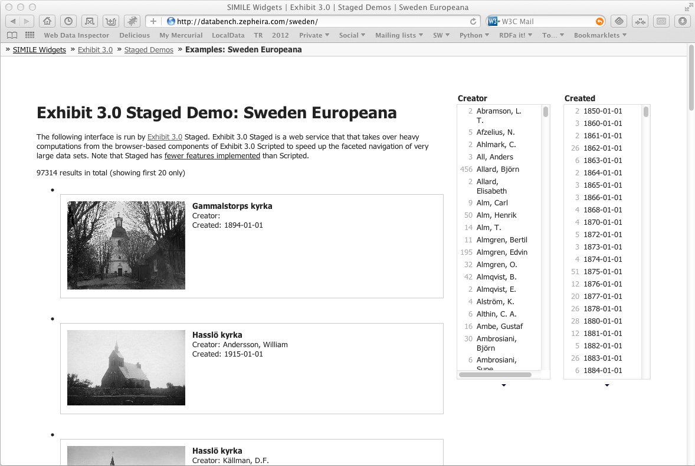
ex:photosDB
ex:facetedView
ex:integratedData
used
ex:metadata
wasGeneratedBy
used
wasGeneratedBy
used
sim:exhibit
ex:integrate
wasAttributedTo
wasAssociatedWith
wasAssociatedWith
foaf:name
foaf:mbox
foaf:mbox
foaf:name
Derek
mailto:derek@ex.com
mailto:betty@ex.com
Betty
Screendump from Zepheira

Slide 85
Status
Drafts have been published
abstract data model, OWL version
protocol (where to find provenance data)
primer
Goal is to finalize the technical design in fall

Slide 86
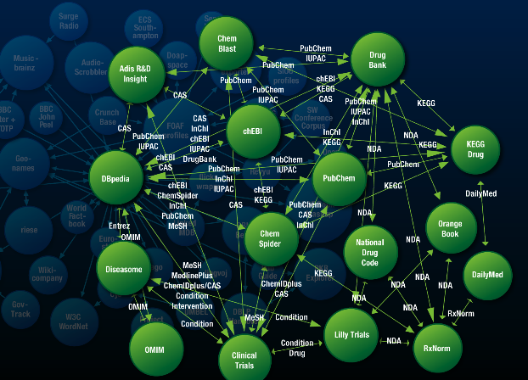
Linked Data Platforms

Slide 87
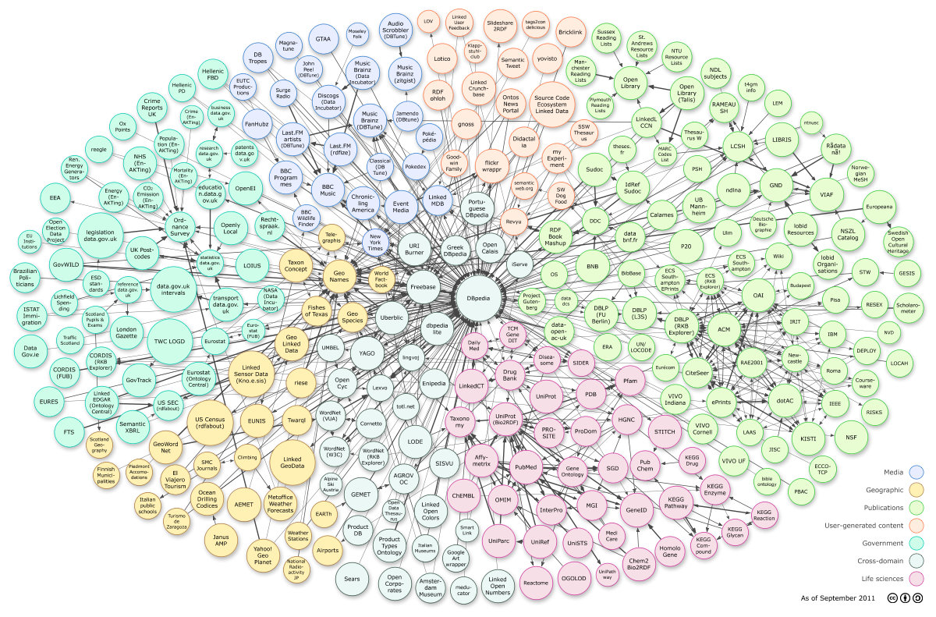
Courtesy of Richard Cyganiak and Anja Jentzsch
Notes:
295 datasets, cca. 31.6B triples

Slide 88
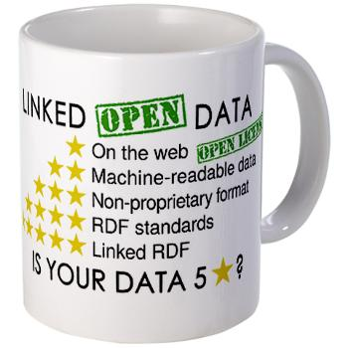
Reminder
“Linked Data” is also a set of principles:
put things on the Web through URI-s
use HTTP URI-s so that things could be dereferenced
provide useful information (using standards) when a URI is dereferenced
include links to other URI-s
RDF is an ideal vehicle to realize these principles

Slide 89
Some characteristics of Linked Data and its Applications
The datasets are essentially read-only
they are curated “out of band”: regularly extracted from other databases, changed manually by data owners, etc
The dominating paradigm is to extract data via SPARQL queries
Applications use (very) large datasets via (RDF based) integration

Slide 90
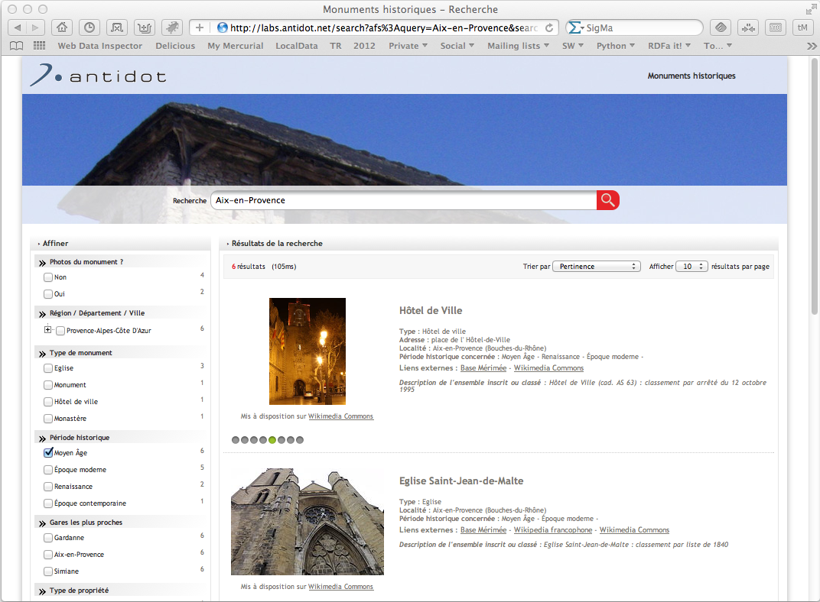
Notes:
Integrated datasets: dbpedia, open street maps, INSEE geographical information, official french list of historical monuments; not all made available in RDF, but integrated in RDF with the available conversion tools; results are merged in an RDF database (over 4.5 million triples) and a company tools is created for the user interface. Done in a few days using available tools

Slide 91
However… Linked Data Has Potentials for “Simpler” Applications

Slide 92
Example: Data-intensive application integration
Application Lifecycle Management
integration of development teams around the globe
management of bug report, user requirements
versioning
Distributed access to, and management of Library Catalogue data
Integrated view of corporate and private address book data

Slide 93
There has been approaches in the past
Point-to-point via API
Centralized repository
Central Hub/Bus
Inspired by Arnaud Le Hors, IBM, LDOW2012 Presentation

Slide 94
None of these are really satisfactory ☹
They force to re-invent the wheel on many fronts
distribution of data around the Internet
access control issues
definition and implementation of new API-s, Protocols, data formats
etc.

Slide 95
Why not make use of an architecture that is…
Distributed at its core
Scalable in terms of users, of data, of hardware and software architecture
Open to anyone
Has a wide variety of available tools
Widely known
Sounds Familiar? ☺

Slide 96
Linked Data Provides a Better Paradigm: Use the Existing Web Architecture!
Application #1
Application #2
HTTP GET, HEAD
URI+HTTP
HTTP PUT, DELETE
Linked Data
on Server #1
Linked Data
on Server #2

Slide 97
Example: Simple Application Integration via Linked Data
Public Library
Bookshop
HTTP GET, HEAD
HTTP PUT, DELETE
Catalogue
in Library of Congress
Catalogue
in the Centre Pompidou

Slide 98
Example: Simple Application Integration via Linked Data
Private Email Client
Corporate Email Client
HTTP GET, HEAD
HTTP PUT, DELETE
Private Address Data
Corporate Contact Data

Slide 99
Linked Data Platform WG
Provide a simple, HTTP based infrastructure to publish, read, write, or modify linked data
The infrastructure should be easy to implement and install
more complex applications may require more sophisticated tools like SPARQL, Provenance, OWL,…
provides an “entry point” for Linked Data applications!

Slide 100
Linked Data Platform WG
Main Work items:
define a RESTful way to access/update RDF data via HTTP
what does HTTP GET/PUT/DELETE/POST/… mean for Linked Data?
define a “profile” of minimal requirements for applications:
what RDF datatypes are used
what serialization syntax(es) must be supported
how to access reasonable chunks of information (paging)
how to manage collections of RDF data
what vocabulary items to use for metadata
etc.

Slide 101
Status
Just starting, almost as we speak!

Slide 102

What else may be on the horizon?

Slide 103
Further challenges raised by Linked Data
Knowledge vs. data ratio is different: very shallow, simple vocabularies for huge sets of data
the role of reasoning is different (vocabularies, OWL DL, etc., may not be feasible)
Not enough links among datasets
lots of work on “creating” further links

Slide 104
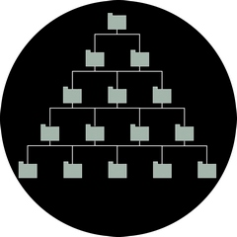
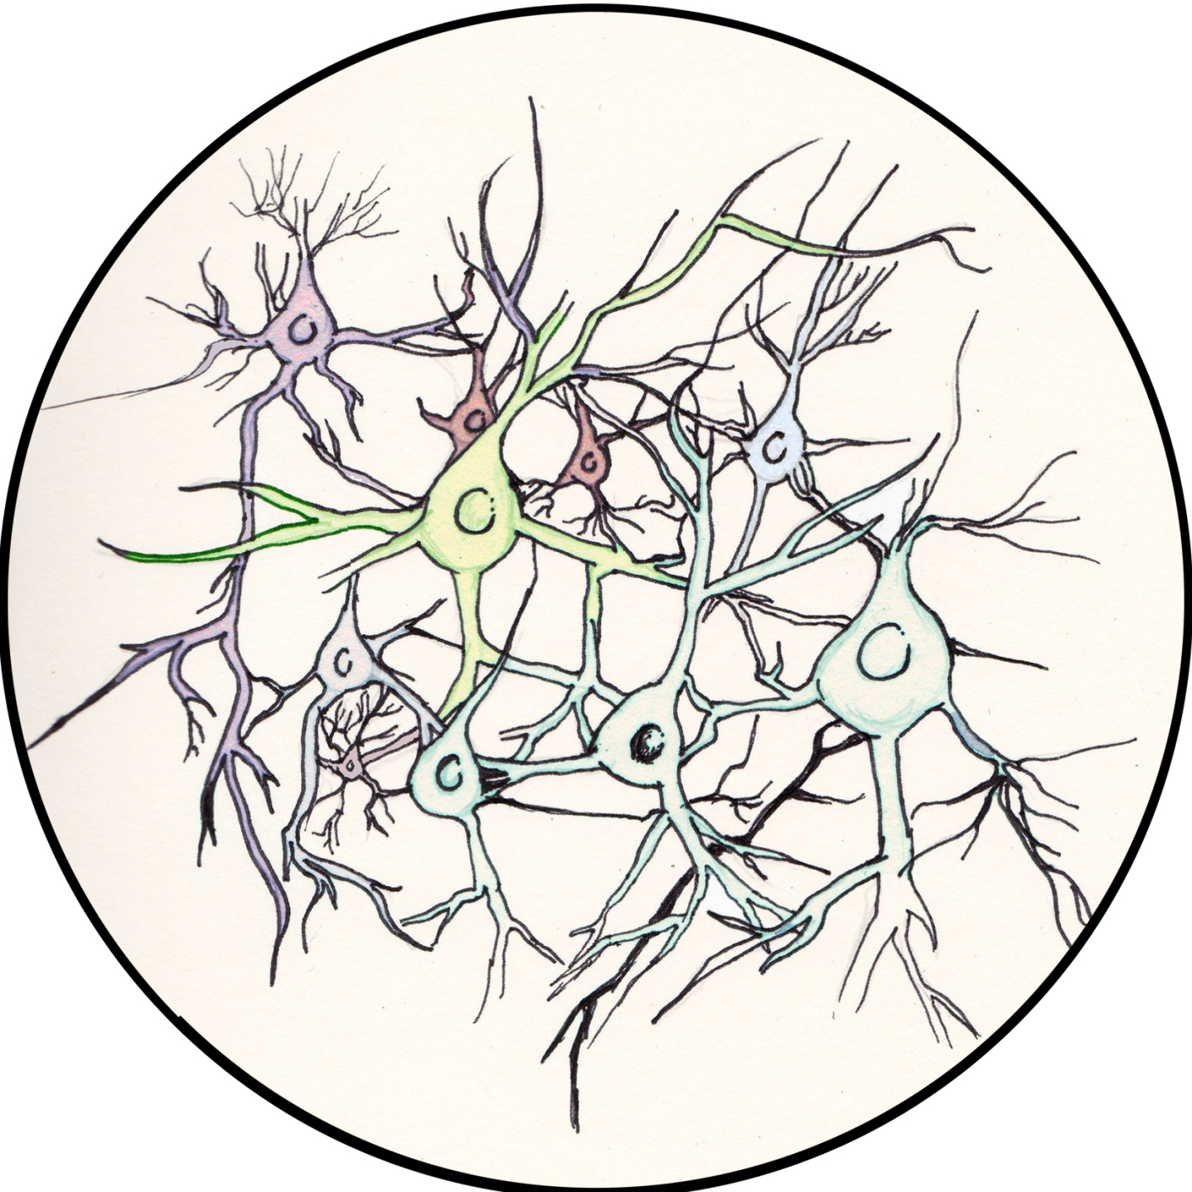
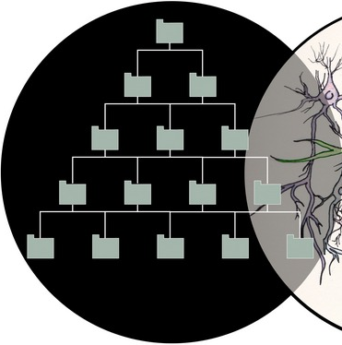
For example: data vs. vocabularies
Courtesy of Frank van Harmelen, ISWC2011 keynote address
Notes:
as an aside: the graph is now big enough to do statistics on it.

Slide 105
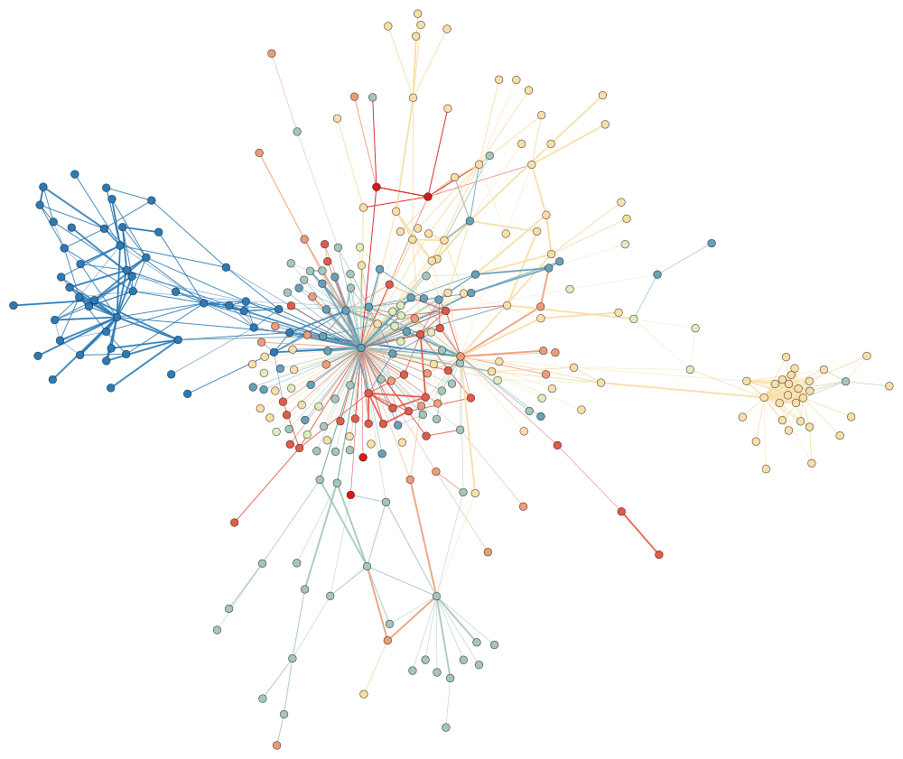
Missing links
Courtesy of Frank van Harmelen, ISWC2011 keynote address

Slide 106
Other, possible future works in the activity
Profiles for the publication of Linked Data, e.g.,
further profiles of OWL (beyond what is already in OWL 2)
URI patterns
datatypes to be used (or not)
usage of Blank Nodes
etc.
Standardized approaches for Access Control to data
Reconsider rule languages for (e.g., for Linked Data applications)
Relationship to JSON

Slide 107
Other, possible future works in the activity
Constraint checking of Data
API-s for client-side Web Application Developers
Issues around internationalization of Semantic Web technologies
Relationship between Semantic Web technologies and Big Data, Cloud Storage and Computing,…
Specific standard vocabularies (e.g., data annotation, governmental vocabularies)
some of these may be defined at W3C, some elsewhere

Slide 108

To summarize…

Slide 109
To remember…
Data on the Web is a major challenge
technologies are needed to use them, to interact with them, to integrate them
Semantic Web technologies, Linked Data principles and practices, etc., should play a major role in publishing and using Data on the Web

Slide 110
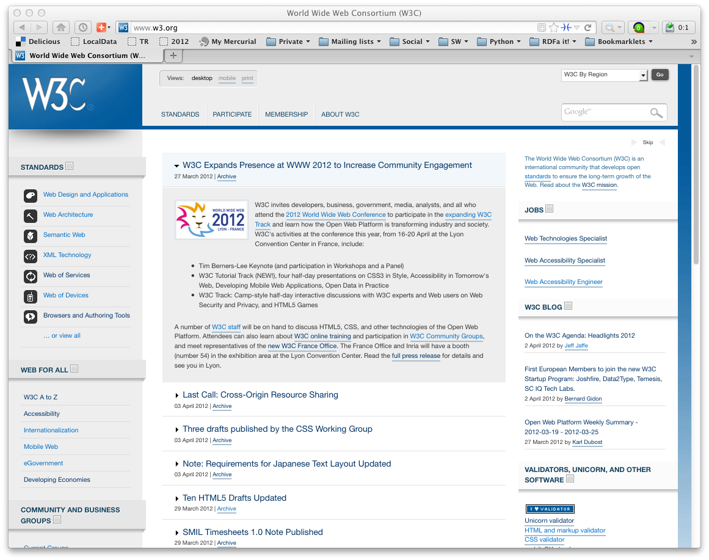
Lot remain to be done…
Lots of issues to be solved
But… W3C needs experts!
consider joining W3C, as well as the work done there!

Slide 111

Thank you for your attention
These slides are also available on the Web:
http://www.w3.org/2012/Talks/@@@-IH/

