Slide 1
RDFa

Slide 2
WARNING TO THE READER!
This is an evolving slide set. This means:
it changes frequently
there may be bugs, inconsistencies
it may try to reflect the latest view of technology evolution but that is often a moving target
“Frozen” versions are instantiated for a specific presentation, and those become stable

Slide 3
What is RDFa?
For RDF people, it sounds very simple:
RDFa is a serialization of RDF embedded in XHTML, HTML, or XML in general

Slide 4
So why bother? Why should we care? Why is that of any importance?

Slide 5
RDFa may become the single biggest source of RDF triples on the Web after direct database access! (well, this is a bit cheating, because the RDFa data may come from a database, too…)

Slide 6
Data for a Web of Data
Apart from relational databases, most of the data on the Web are in… (X)HTML content
New content is generated every day
How would one get structured data from that information?

Slide 7
Authors of the “traditional Web”…
Do not generate RDF/XML files separately
RDF/XML is complex
it requires a separate storage, generation, etc mechanism
that is also valid for, e.g., Turtle
even when authoring with, say, Emacs, creating an extra file is a load

Slide 8
Solution
Add extra structured content to the (X)HTML pages
Let processors extract those and turn into RDF

Slide 9
Existing approaches
Microformats
reuses HTML attributes like @class, @title
separate vocabularies (address, CV, …)
difficult to mix microformats (no concept of namespaces)
possible to transform via, e.g., XSLT + GRDDL, but all transformations are vocabulary dependent

Slide 10
Existing approaches
Microdata
adds new attributes to HTML5 to express metadata
can use URI-s, it also fixes some vocabulary mappings (e.g., to Dublin Core elements)
works for simpler usages, not well suited for complex vocabularies
has no notion of datatypes, namespaces
but generic processing becomes possible to generate RDF

Slide 11
Existing approaches
RDFa
adds new (X)HTML/XML attributes
has namespaces and URIs at its core; i.e., mixing vocabulary is just as easy as in RDF
complete flexibility for using Literals or URI Resources
is a complete serialization of RDF
generic processing becomes possible to generate RDF

Slide 12
RDFa is a complete bridge between the Web of Documents and the Web of Data

Slide 13
Therefore…
It is very important for RDF experts to
know RDFa
parse it alongside Turtle, RDF/XML or other
when appropriate, generate RDFa pages

Slide 14
What does RDFa look like ?

Slide 15
Main principles of RDFa
RDFa means “RDF in attributes”. I.e.:
all RDF contents are defined through XML attributes (no elements)
the XML/HTML tree structure is used
many of the attributes are defined by RDFa
some attributes (@href, @rel) are also reused
if possible, the text content is also reused (for literals) as well as @href values

Slide 16
What does this mean in practice?
The same (X)HTML file:
is used, unchanged, by browsers
they ignore attributes they do not know
can be used by specialized processors (or APIs) to extract RDF triples

Slide 17
Before getting into details…
The current Recommendation is RDFa 1.0
There is an RDFa1.1 in the making, almost ready
I will talk about RDFa1.1 and warn when the feature is not available in RDFa1.0

Slide 18
XML or (X)HTML?
XHTML+RDFa
HTML5+RDFa
SVG
1.2
ODF
…
RDFa Core 1.1
(valid for any XML)
Formally:
RDFa WG defines Core and XHTML
HTML WG defines HTML5
this tutorial uses XHTML examples

Slide 19
How does it work?

Slide 21
The source and generated RDF…
<p about="http://www.w3.org/ns/entailment/RDFS"
property="http://purl.org/dc/terms/description">
Unique identifier for <em>RDFS Entailment</em>.</p>

Slide 22
The source and generated RDF…
<p about="http://www.w3.org/ns/entailment/RDFS"
property="http://purl.org/dc/terms/description">
Unique identifier for <em>RDFS Entailment</em>.</p>
<http://www.w3.org/ns/entailment/RDFS>
… .

Slide 23
The source and generated RDF…
<p about="http://www.w3.org/ns/entailment/RDFS"
property="http://purl.org/dc/terms/description">
Unique identifier for <em>RDFS Entailment</em>.</p>
<http://www.w3.org/ns/entailment/RDFS>
<http://purl.org/dc/terms/description>
… .

Slide 24
The source and generated RDF…
<p about="http://www.w3.org/ns/entailment/RDFS"
property="http://purl.org/dc/terms/description">
Unique identifier for <em>RDFS Entailment</em>.</p>
<http://www.w3.org/ns/entailment/RDFS>
<http://purl.org/dc/terms/description>
"Unique identifier for RDFS Entailment." .

Slide 26
The source and generated RDF…
<a about="http://www.w3.org/ns/entailment/RDFS"
rel="http://www.w3.org/2000/01/rdf-schema#seeAlso"
href="http://www.w3.org/TR/2004/REC-rdf-mt-20040210/">
RDF Semantics.
</a>

Slide 27
The source and generated RDF…
<a about="http://www.w3.org/ns/entailment/RDFS"
rel="http://www.w3.org/2000/01/rdf-schema#seeAlso"
href="http://www.w3.org/TR/2004/REC-rdf-mt-20040210/">
RDF Semantics.
</a>
<http://www.w3.org/ns/entailment/RDFS>
….

Slide 28
The source and generated RDF…
<a about="http://www.w3.org/ns/entailment/RDFS"
rel="http://www.w3.org/2000/01/rdf-schema#seeAlso"
href="http://www.w3.org/TR/2004/REC-rdf-mt-20040210/">
RDF Semantics.
</a>
<http://www.w3.org/ns/entailment/RDFS>
<http://www.w3.org/2000/01/rdf-schema#seeAlso>
… .

Slide 29
The source and generated RDF…
<a about="http://www.w3.org/ns/entailment/RDFS"
rel="http://www.w3.org/2000/01/rdf-schema#seeAlso"
href="http://www.w3.org/TR/2004/REC-rdf-mt-20040210/">
RDF Semantics.
</a>
<http://www.w3.org/ns/entailment/RDFS>
<http://www.w3.org/2000/01/rdf-schema#seeAlso>
<http://www.w3.org/TR/2004/REC-rdf-mt-20040210/> .

Slide 30
Is that it?

Slide 31
What we have is… Ntriples in HTML
The combination of @about with @rel/@property and possibly @href covers most of we need…
But this is too complex for authors

Slide 32
Just compare
<http://www.w3.org/ns/entailment/RDFS>
<http://purl.org/dc/terms/description>
"Unique identifier for RDFS Entailment." .
<http://www.w3.org/ns/entailment/RDFS>
<http://www.w3.org/2000/01/rdf-schema#seeAlso>
<http://www.w3.org/TR/2004/REC-rdf-mt-20040210/> .
with
@prefix rdfs: <http://www.w3.org/2000/01/rdf-schema#> .
@prefix dc: <http://purl.org/dc/terms/> .
<http://www.w3.org/ns/entailment/RDFS>
rdfs:seeAlso <http://www.w3.org/TR/2004/REC-rdf-mt-20040210/> ;
dc:description "Unique identifier for RDFS Entailment." .

Slide 33
The “Turtle” aspects of RDFa
Use compact URI-s when possible
Make use of XML structure for
shared subjects
shared predicates
create blank nodes
…

Slide 34
Compact URIs (“CURIE”s)
Just like in Turtle:
define a prefix via @prefix
use prefix:reference to abbreviate a URI

Slide 35
CURIE definition and usage
<html>
…
<p about="http://www.w3.org/ns/entailment/RDFS"
property="http://purl.org/dc/terms/description">
Unique identifier for <em>RDFS Entailment</em>.</p>
…
</html>
can be replaced by:
<html prefix="dc: http://purl.org/dc/terms/">
…
<p about="http://www.w3.org/ns/entailment/RDFS"
property="dc:description">
Unique identifier for <em>RDFS Entailment</em>.</p>
…
</html>

Slide 36
Some details on @prefix
Can be anywhere in the XML tree and is valid for the whole sub-tree
i.e., the html element is not the only place to have it
The same @prefix attribute can hold several definitions:
prefix="dc: http://purl.org… rdfs: http://…"

Slide 37
Some details on @prefix
An alternative (deprecated) syntax is
xmlns:dc="http://purl.org/dc/terms/"
CURIEs and “real” URIs can be mixed
if an attribute value can be interpreted as a CURIE, fine
alternatively, it is considered as a URI
CURIEs cannot be used on @href

Slide 38
RDFa 1.0 Warnings on CURIEs
In RDFa 1.0
only the xmlns:XXX syntax is usable
CURIEs on @about can only be used with the syntax: about="[pref:ref]"
Only CURIEs can be used on, e.g., @property or @rel (no fallback on URIs)

Slide 39
Sharing subjects
The basic principle: @about is inherited by children nodes
i.e., no reason to repeat it

Slide 40
Shared subject example
<html prefix="dc: http://purl.org/dc/terms/
rdfs: http://www.w3.org/2000/01/rdf-schema#">
…
<body about="http://www.w3.org/ns/entailment/RDFS">
…
<p property="dc:description">
Unique identifier for <em>RDFS Entailment</em>.</p>
<p>…<a rel="rdfs:seeAlso"
href="http://www.w3.org/TR/2004/REC-rdf-mt-20040210">
RDFS Semantics</a>…</p>

Slide 41
… yielding
@prefix rdfs: <http://www.w3.org/2000/01/rdf-schema#> .
@prefix dc: <http://purl.org/dc/terms/> .
<http://www.w3.org/ns/entailment/RDFS>
rdfs:seeAlso
<http://www.w3.org/TR/2004/REC-rdf-mt-20040210/> ;
dc:description "Unique identifier for RDFS Entailment." .

Slide 42
Intricacies of literals

Slide 43
Date examples
<body about=".." prefix="dc: http://…"
<address>
<p property="dc:date">2010-07-05</p>
</address>
</body>
This leads to:
@prefix dc: <http://…>
<..> dc:date "2010-07-05" .

Slide 44
Datatypes
<body about=".." prefix="dc: http://… xsd: http://…"
<address>
<p property="dc:date" datatype="xsd:date">2010-07-05</p>
</address>
</body>
This leads to:
@prefix dc: <http://…>
@prefix xsd: <http://…>
<..> dc:date "2010-07-05"^^xsd:date .

Slide 45
Controlling the literal
The basic rule says: the (RDF) Literal is the enclosed text from the HTML content
This is fine in 80% of the cases, but…
It may not be natural in all cases! E.g.,
2010-07-05 is the “official” ISO format (for xsd:date)
but “July 5, 2010” looks much more natural for a human…

Slide 46
Usage of @content
<body about=".." prefix="dc: http://… xsd: http://…"
<address>
<p property="dc:date" datatype="xsd:date"
content="2010-07-05">July 5, 2010</p>
</address>
</body>
Also leads to:
@prefix dc: <http://…>
@prefix xsd: <http://…>
<..> dc:date "2010-07-05"^^xsd:date .

Slide 47
Subjects, and objects, and subjects again…

Slide 48
The rules until now
What we said is:
@about sets the subject
@href sets the object
But that is not always good enough
we do not always want active links (i.e., the "a" element)
what about other links in HTML?

Slide 49
@src also sets the object
<body about="…">
…<img rel="foaf:depiction"
src="http://www.ex.org/img.png"/>…
</body>
yields:
<…> foaf:depiction <http://www.ex.org/img.png> .

Slide 50
We may not always want links…
The RDFa @resource attribute is equivalent to @href
it sets the object, just like @href
but it is ignored by a browser, i.e., not a link!
e.g.,:
<span about="http://www.ivan-herman.net/foaf#me">
<span rel="rdfs:seeAlso"
resource="http://www.ivan-herman.net/foaf">
Activity Lead</span>
</span>

Slide 51
“Chaining”
Here is what we would like to have in RDFa
<http://www.w3.org/ns/entailment/RDFS>
dc:creator <http://www.ivan-herman.net/foaf#me> .
<http://www.ivan-herman.net/foaf#me>
foaf:mailbox <mailto:ivan@w3.org> ;
foaf:workplaceHomepage <http://www.w3.org> .

Slide 52
“Chaining”
A straightforward way:
<body about="http://www.w3.org/ns/entailment/RDFS">
…
<address>
<span rel="dc:creator"
resource="http://www.ivan-herman.net/foaf#me"/>
<span about="http://www.ivan-herman.net/foaf#me">
<a rel="foaf:mailbox"
href="mailto:ivan@w3.org">ivan@w3.org</a>,
<a rel="foaf:workplaceHomepage"
href="http://www.w3.org">W3C</a>
</span>
</address>

Slide 53
“Chaining”
A straightforward way:
<body about="http://www.w3.org/ns/entailment/RDFS">
…
<address>
<span rel="dc:creator"
resource="http://www.ivan-herman.net/foaf#me"/>
<span about="http://www.ivan-herman.net/foaf#me">
<a rel="foaf:mailbox"
href="mailto:ivan@w3.org">ivan@w3.org</a>,
<a rel="foaf:workplaceHomepage"
href="http://www.w3.org">W3C</a>
</span>
</address>

Slide 54
“Chaining”: when objects become subjects…
An alternative:
<body about="http://www.w3.org/ns/entailment/RDFS">
…
<address>
<span rel="dc:creator"
resource="http://www.ivan-herman.net/foaf#me">
<a rel="foaf:mailbox"
href="mailto:ivan@w3.org">ivan@w3.org</a>,
<a rel="foaf:workplaceHomepage"
href="http://www.w3.org">W3C</a>
</span>
</address>

Slide 55
Chaining means
@resource (or @href) becomes a subject for the sub-tree
This feature is a bit like in RDF/XML

Slide 56
Some extra features

Slide 57
Some extra features
Blank nodes can be created using “_:XX”
Shorthand for RDF types
An API has been defined for Web Applications

Slide 58
Typing
Typing can of course be done using @rel="rdf:type"
But that is a widely used combination, so there is a separate @typeof attribute for that

Slide 59
Typing example
<span about="http://www.ivan-herman.net/foaf#me"
typeof="foaf:Person">
<span property="foaf:name">Ivan Herman</span>
</span>,
yields
<http://www.ivan-herman.net/foaf#me> a foaf:Person ;
foaf:name "Ivan Herman" .

Slide 60
Profile files
Prefix declarations can be collected in a separate file and referred to via a @profile attribute
the “profile file”
RDFa1.0 warning: this is an RDFa1.1 feature!

Slide 61
“Term” declarations
A profile file can also define a term:
assign a URI to a simple string
The term can be used directly by authors, without prefixes

Slide 62
Term Example
Say, file “http://ex.org/prof” defines a mapping:
"desc" → "http://purl.org/dc/terms/description"

Slide 63
Term Example
<html prefix="dc: http://purl.org/dc/terms/
rdfs: http://www.w3.org/2000/01/rdf-schema#">
…
<body profile="http://ex.org/prof.html" about="…">
…
<p property="desc">
Unique identifier for <em>RDFS Entailment</em>.</p>
yields
@prefix dc: <http://purl.org/dc/terms/> .
<…> <http://purl.org/dc/terms/description>
"Unique identifier for RDFS Entailment."

Slide 64
Terms are important…
Usage of CURIEs and URIs is intuitive for RDF people…
It is not for average HTML authors!
Profile files can be published by major publishers:
Dublin Core, FOAF, …
FaceBook, Google, …
… and users can simply refer to the profiles

Slide 65
Publishing RDFa

Slide 66
A typical deployment pattern
A browser usually asks for an HTML content:

Slide 67
A typical deployment pattern
Via content negotiations this goes to:

Slide 68
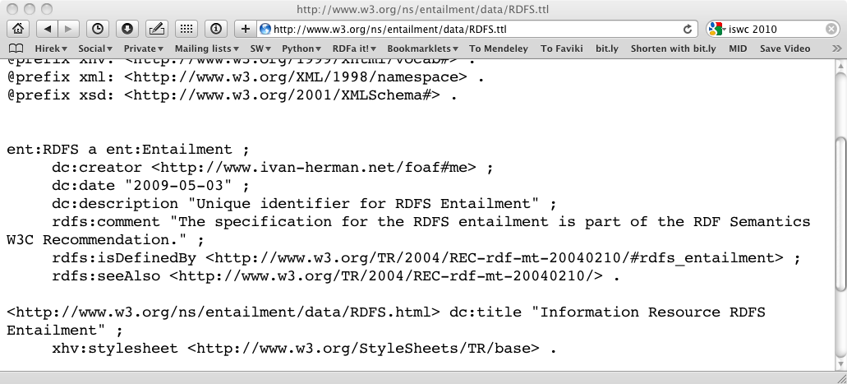
A typical deployment pattern
But a client could ask for, say, Turtle:

Slide 69
…corresponding to:

Slide 70
Where does the Turtle content come from?
The triples are embedded in the HTML file
a client may know how to extract RDF triples directly from that file; or
an online “distiller” service is used; or
the server is set up to generate the Turtle file automatically and let content negotiation work (previous examples)

Slide 71
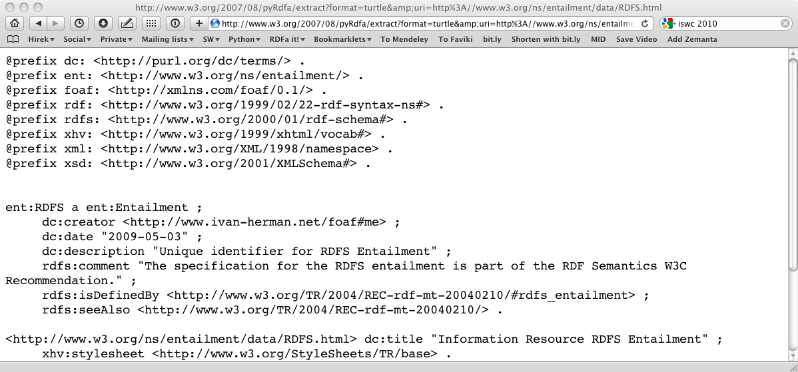
For example, use an online service…

Slide 72
… or set up the server…
RewriteEngine On
RewriteBase /ns/entailment/data/
RewriteRule RDFS.ttl
/2007/08/pyRdfa/extract?format=turtle&amp;
uri=http://www.w3.org/ns/entailment/data/RDFS.html [L]

Slide 73
Publishing RDFa
RDFa gives an easy way of publishing RDF data on the Web
Often, the same RDF data is available in different formats, including RDFa
it is up to the client to choose which one to use
Web Applications would rely on RDFa
non-RDFa aware clients would rely on RDF/XML
etc.

Slide 74
Publishing via CMS systems
Drupal 7 has RDFa at its core, i.e.,
Drupal 7 clients and users get RDFa whether they care or not!

Slide 75
Some deployment examples

Slide 76
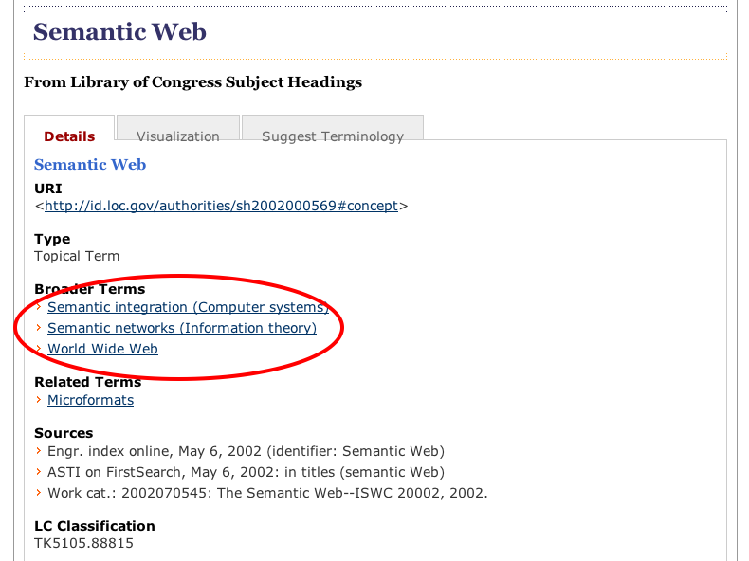
LOC example

Slide 77
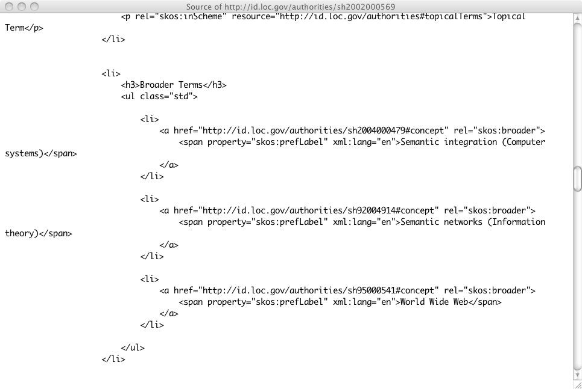
LOC example

Slide 78
Consuming RDFa
Various search engines begin to consume RDFa
Google, Yahoo, …
they may specify which vocabularies they “understand”
this is still an evolving area
Facebook’s “social graph” is based on RDFa

Slide 79
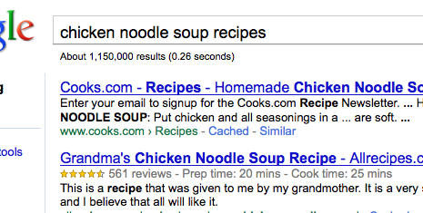
Google’s rich sniplet
Embedded metadata (microformat or RDFa) is used to improve search result page
at the moment only a few vocabularies are recognized, but that will evolve over the years

Slide 80
Effects of, e.g., Google
A number of popular sites publish RDFa as part of their normal pages:
Tesco, BestBuy, Slideshare, The London Gazette, Newsweek, MSNBC, O’Reilly Catalog, the White House…
Creative Commons snippets are in RDFa

Slide 81
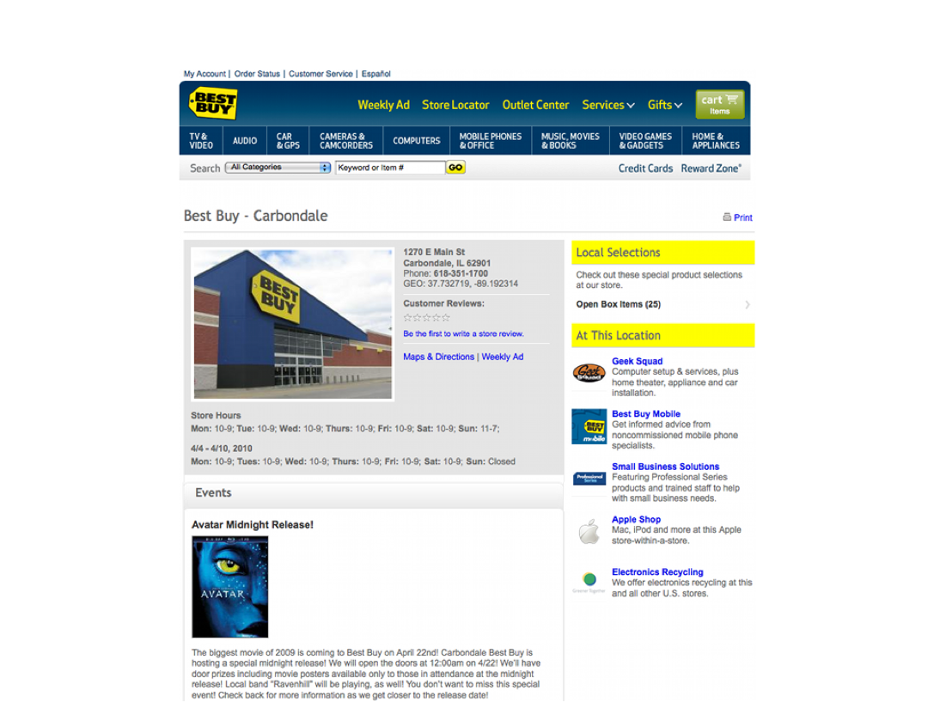
BestBuy Example for RDFa Usage
Courtesy of Jay Myers, BestBuy, SemTech2010 Presentation

Slide 82
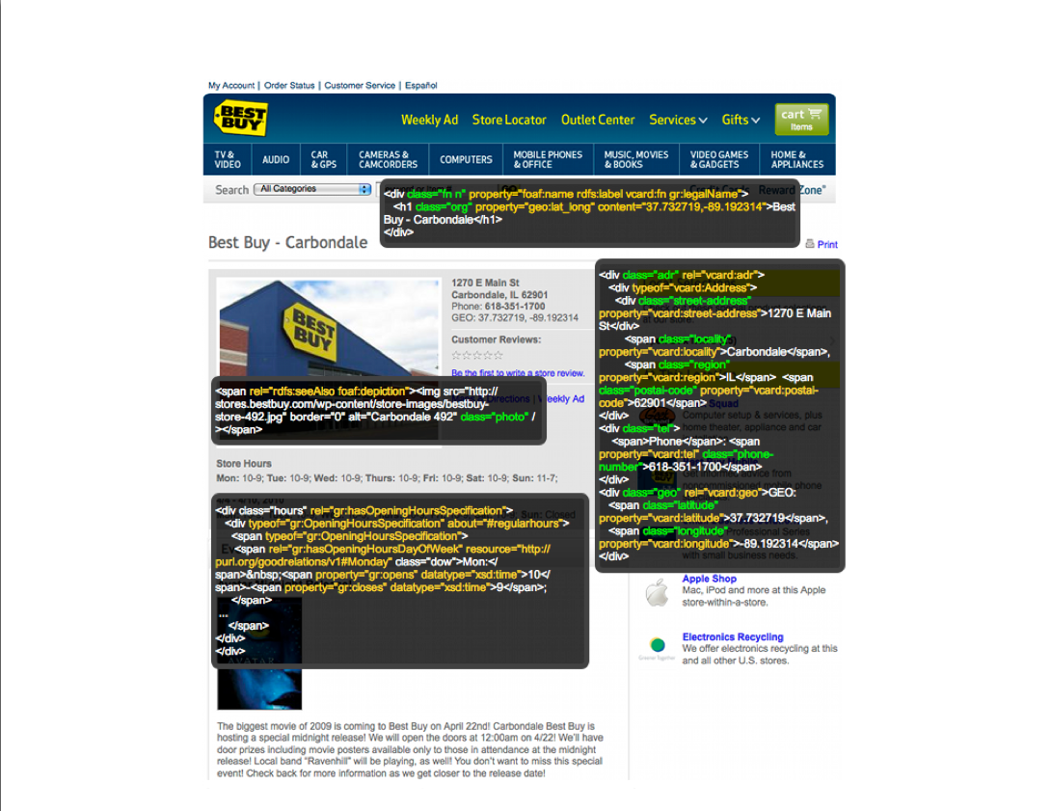
BestBuy Example for RDFa Usage
Courtesy of Jay Myers, BestBuy, SemTech2010 Presentation

Slide 83
Effects on BestBuy
Reported in a BestBuy blog:
GoodRelations+RDFa improved Google rank tremendously
30% increase in traffic on BestBuy store pages
Yahoo observers a 15% increase in click-through rate
Not bad…

Slide 84
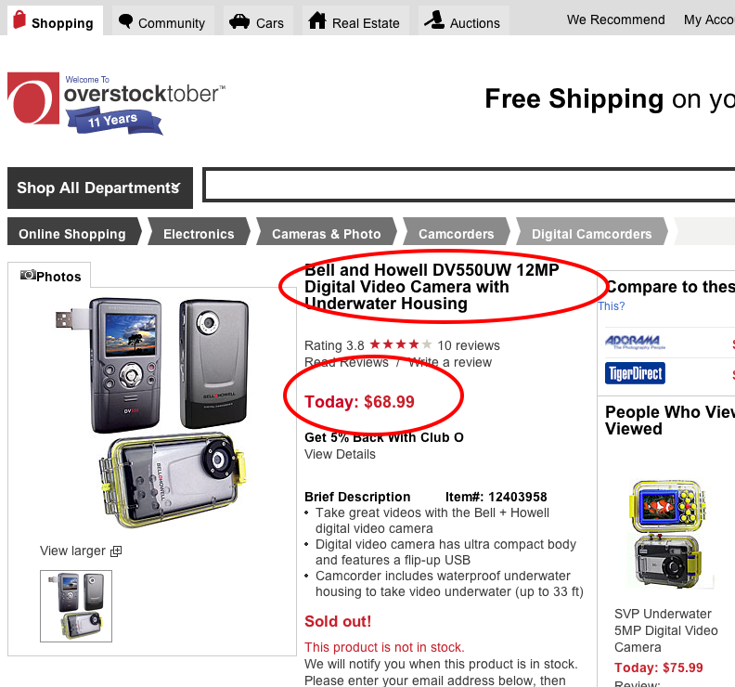
Overstock.com example

Slide 85
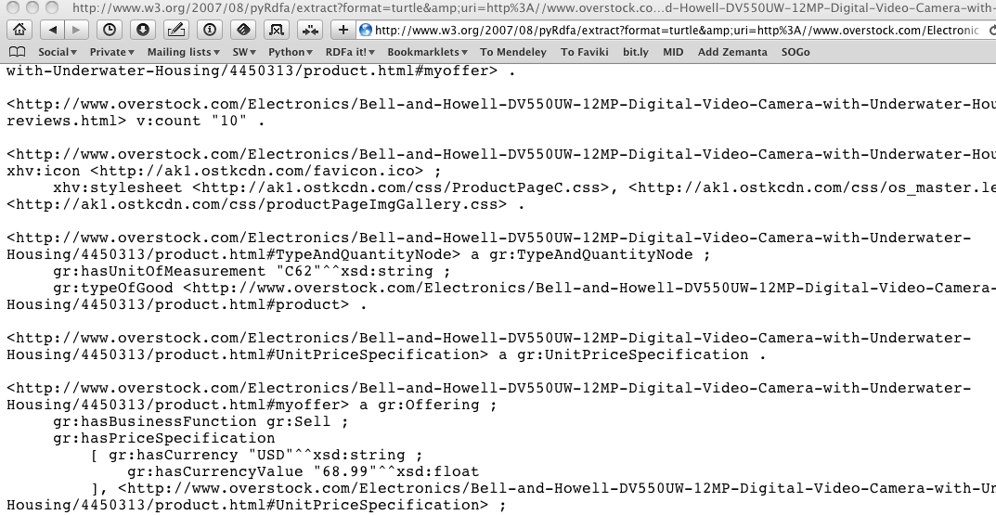
Overstock.com example

