Slide 1
Disambiguation and TA Annotation Implementation using Enrycher
Tadej Štajner
Jožef Stefan Institute
25.9.2012, Prague

Slide 2
Enrycher: Disambiguation, TA Annotation
Disambiguate fragments in the HTML input, marking them up with ITS2.0 disambiguation tags
Mark the document that a certain text analysis annotation tool was used on the content
Preserve HTML tree
Could be used by CMS or MT preprocessing
Disambiguation
Text analysis annotation
The ITS markup provides the key information about what entities are mentioned
Provides means for specific translation scenarios
Provides means for for text-data integration scenarios

Slide 3
Enrycher: Disambiguation, TA Annotation
Disambiguation – Marking up fragment of text that mention named entities with their identity references or class references
Text analysis annotation – Mark up the fragment with the fact that it was processed by a particular tool

Slide 4
Process steps
Input: HTML parser
Extract plain text from HTML
  remembering where individual nodes came from
  build model of existing ITS2.0 annotations
Produce named entity extraction & disambiguation
Consolidate new ITS attributes with existing ones
Re-map disambiguation annotation spans to HTML nodes (or create new ones)
Output: Serialize into HTML/ITS2.0

Slide 5
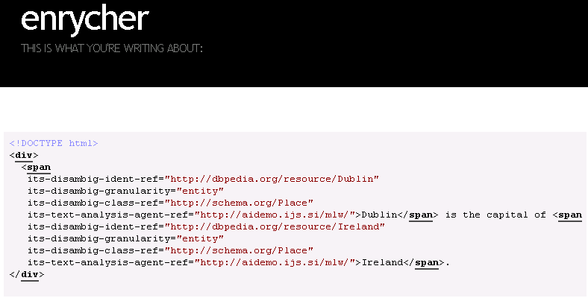
Output example

Slide 6
Todo
Domain (via <meta>, using DC.subject)
Lexical disambiguation
Text analysis annotation -> „tool info“

