Slide 1
Presenting the current status of ILO
2012-06-18, GotoMeeting
Notes:
Ändern des Bildes: Rechtsklick/Bild ändern; Wählen des Bildausschnitts: Bild anklicken, Reiter „Bildtools“/Zuschneiden/Füllbereich – Bildgröße durch Ziehen variieren, Ausschnitt festlegen, Esc drücken. Der Untertitel kann auch zweizeilig werden.

Slide 2
INIT in a minute
Notes:
Zwischentitel ohne Bild mit der Möglichkeit Text in der orangefarbenen Fläche unterzubringen.

Slide 3
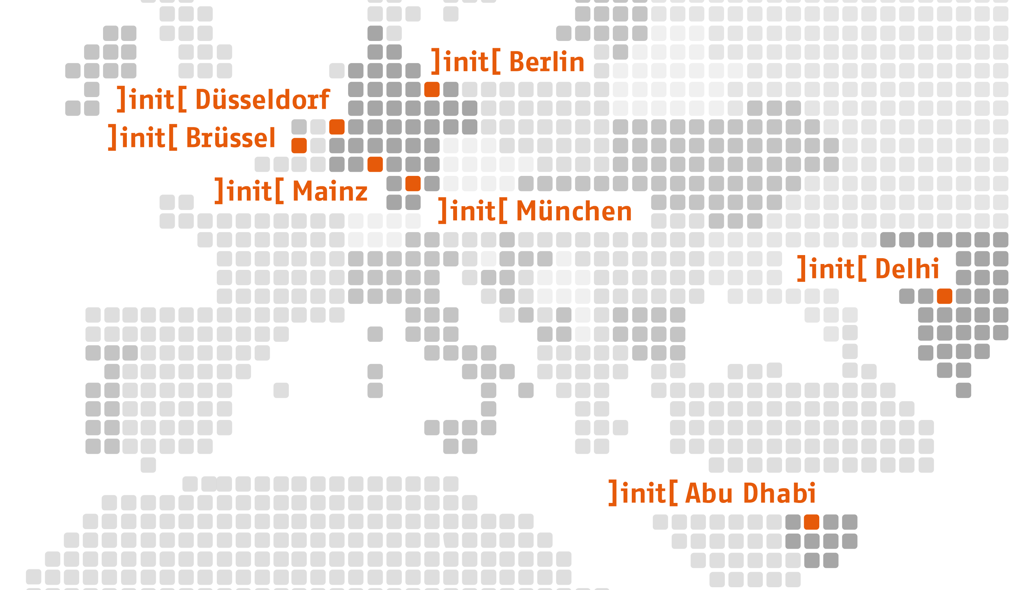
Unsere Standorte

Slide 4
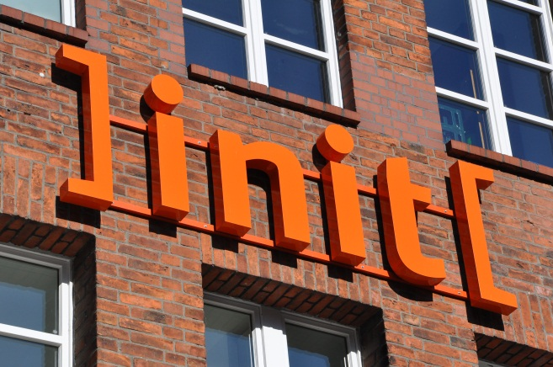
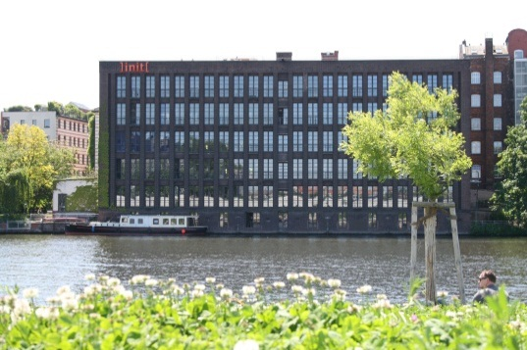
]init[ in a Minute
Specialized in IT Solutions for governments, administrations, NGOs, financial institutions and businesses since its founding (1995)
Privately held & technology independent
Over 270 employees in five departments:
Applications & Platforms
Consulting
Content & Media Services
Creative & Portals
Operations
Business volume 2011: 22 million Euro (thereof over 80% in the public sector)
Certified Quality Management (ISO 9001:2000) and certified IT Security Operations Management (ISO 27001)

Slide 5
Clients | International
<
<<<<
0

Slide 6
Business need
Public agency customers like working offline
We create documents, studies, guidelines for our customers using word processing software
The Production of text mainly in German, sometimes delivery in up to 23 EU languages needed)
Those files are sent to translation agencies …
… and retrieved back as translated deliverables

Slide 7
Business need
Now discovering that there is ITS:
We would like to use mark-up the document with tags like:
Do not translate
Local filter and
This term is a candidate for a glossary
Localization notes
in a word processing environement (Libre Office)

Slide 8
ILO Data formats, flows and roundtrip - short
Original ODT
Bookmark-ODT
XLIFF
Localisation Service Provider
XLIFF
ITS-ODT
Bookmark ODT
ITS-ODT

Slide 10
ITS Libre Office Implementation (ILO) showing pre-final Demo
Notes:
Zwischentitel ohne Bild mit der Möglichkeit Text in der orangefarbenen Fläche unterzubringen.

Slide 11
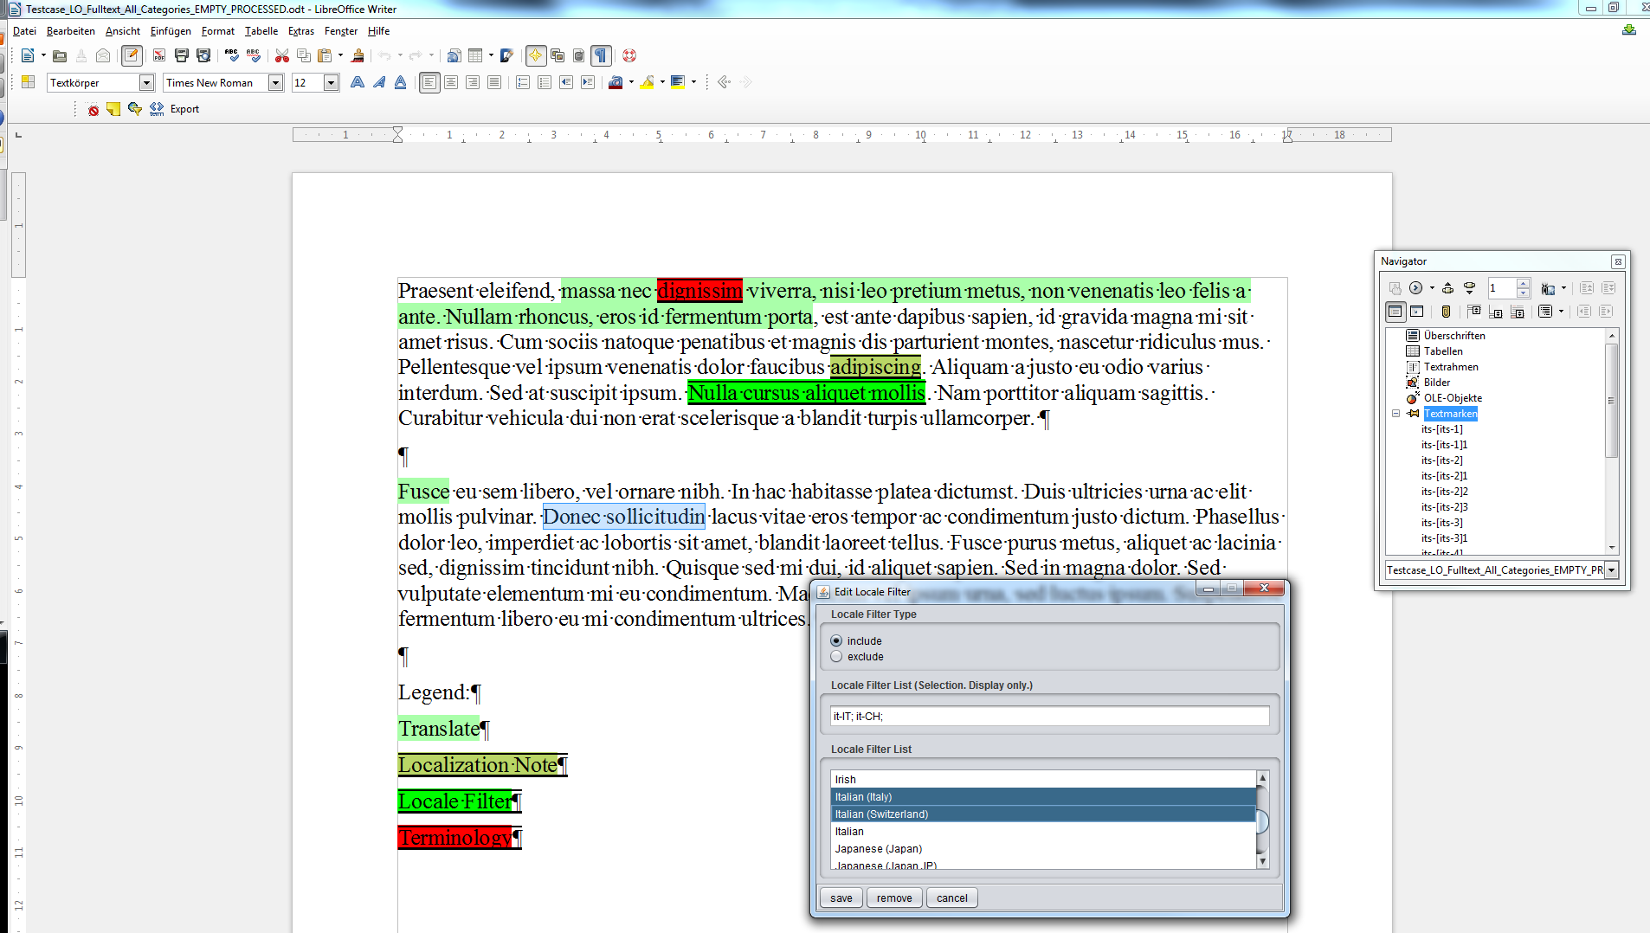
Screenshot from Pre-Demo

Slide 12
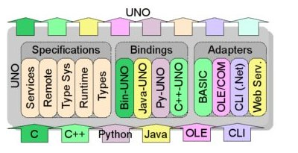
Implementation challenges
Libre Office cascade: Core->UNO->Extension
Not everything that is available in LO CORE can be used in extensions
→ We were looking a long time for a way to use LO inbuilt mechanisms:
1. LO Annotations / Comments: Unfortunately cannot be nested
2. Hidden fields: Unfortunately can be destroyed by user input
3. Finally we use bookmarks (but not values can be stored inside)
b) UNO API turned out to be an extremely challenging
We asked for UNO API experts with no sucessful results and now switch to bypass UNO
using Java Swing Dialogs in LO and
do the processing in external conversion scripts outside LO.

Slide 13
Implementation challenges
2. Libre Office MS Windows file locking behavior
a) a file opened by LO cannot be replaced and not even be read (operating system lock)
Solved by forcing users to quit LO for further script processing :-/
3. Libre Office XML does not use the full power of nestling in XML
→ Solved by doing a conversion from a name-attribute encoded flat XML structures to a real nested XML tree
“LO XML” | Normal XML
<start-span name=“text1”/> <end-span name=“text1”/> | <span name=“text1”> </span>

Slide 14
Next steps
Consider your input and thoughts
Debug GUI issues
Present / let present the extension in Dublin
Finalise XLIFF Import and Export
Finalise and publish in July

Slide 15
Thank you for your attention to our implementation
Sebastian Sklarß
Consultant
Sebastian.Sklarss@init.eu
http://www.init.de/en/libreofficeWriter
Soon on:
http://extensions.libreoffice.org/extension-center
Notes:
Kontaktfolie.
Unteres Feld:
Telefon +49 (30) 97006 - XY
E-Mail Vorname. Nachname@init.de
Internet www.init.de

