Slide 1

MultilingualWeb –
Language Technology
A New W3C Working Group
Felix Sasaki, David Filip, David Lewis

Slide 2
MultilingualWeb-LT
New W3C Working Group under I18n Activity
  http://www.w3.org/International/multilingualweb/lt/
Aims: define meta-data for web content that facilitates its interaction with language technologies and localization processes.
Already have 28 participants from 20 organisations
  Chairs: Felix Sasaki, David Filip, Dave Lewis
Timeline:
  Feature Freeze Nov 2012
  Recommendation complete Dec 2013

Slide 3
Approach
Standardise Data Categories
  ITS (1.0) has: Translate, Loc note, Terminology, Directionality, Ruby, Language Info, Element Within Text
  MLW-LT could add: MT-specific instructions, quality-related provenance, legal?
Map to formats
  ITS focussed on XML
    useful for XHTML, DITA, DocBook
  MLW-LT also targets HTML5 and CMS-based ‘deep web’
  Use of microdata and RDFa

Slide 4
Candidate Stakeholders
Content Author
CMS-based
  Localisation Management
  Translator/Posteditor/ Reviewer
LSP-based (CAT/TMS users)
  Translator/Posteditor/ Reviewer
  Translation/Review Process Manager
MT Service Provider
Text Analytics Service Provider
CMS Developer
Localisation Tool developer
Systems Integrator
Search engine crawler
Content Consumer

Slide 5
Scope of Use Cases
Language Technology
Create Content
Language Resources
Translate Content
Consume Content

Slide 6
Source Content Processing
Language Technology
Create
Language Resources
<..>
Author
Named entity recognition
Glossary
<..>
Identify no -translate
Identify terms
Term-base
<..>
<..>
<..>
Localisation Preparation
Translate
<..> = Possible MLW-LT Metadata

Slide 7
Localisation Quality Assurance
Language Technology
Create
Language Resources
Localisation Preparation
Term-base
<..>
Translate
<..>
Machine Translation
Postediting
Translation Memory
<..>
<..>
Translation Review
<..>
Translation Memory+
<..>
<..>
XLIFF
Publish to CMS
Consume Content
<..> = MLW-LT Metadata

Slide 8
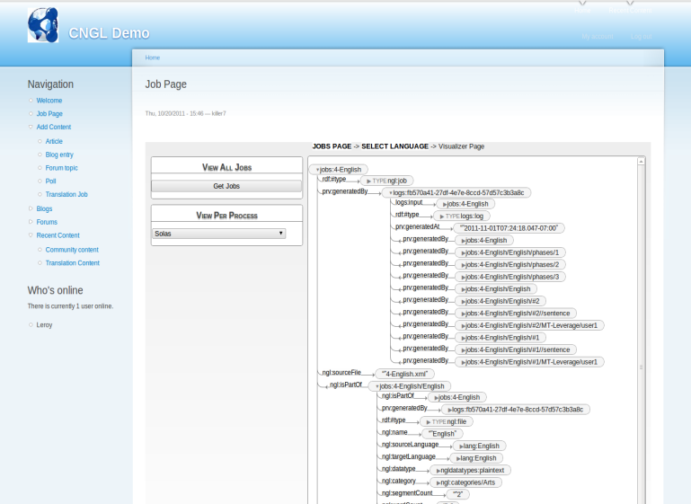
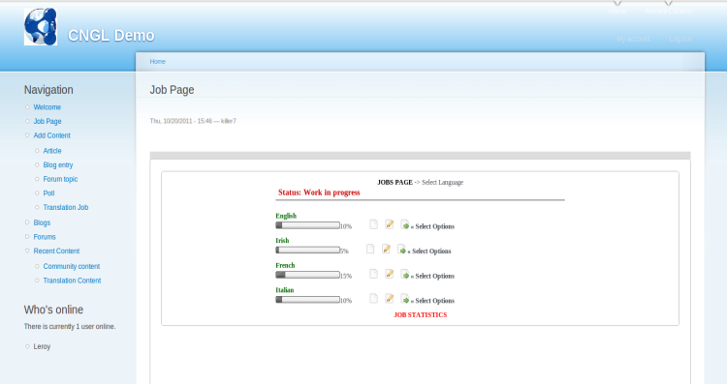
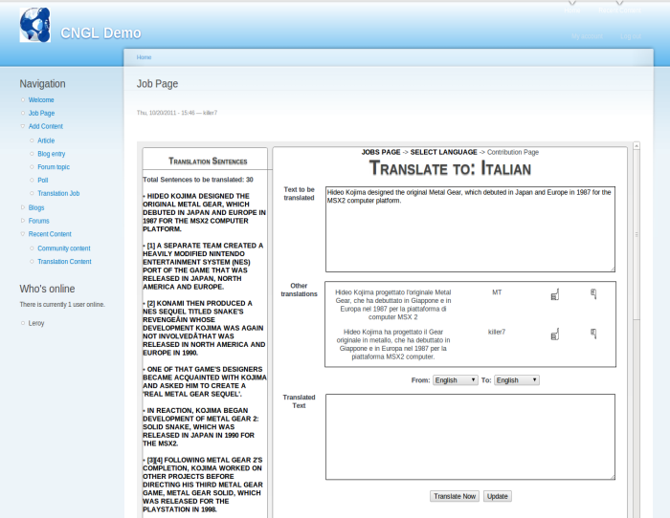

CMS-L10N integration via RDF & XLIFF
Drupal Web CMS
Apache Web Server:
Servlet container
RDF Provenance TripleStore
RDF Provenance Visualiser
Sesame Server
Sesame Workbench
RDFLogger
Translation tools
XLIFF
XLIFF
Translation Tool
MT Service
User Data

Slide 9
Leverage Target Quality Meta-data
Translate
Language Resources
Publish to CMS
Language Technology
Consume Content
<..>
<..>
Reading/
Reusing
<..>
Search Indexing
Machine Translation
Term-base
MT Training
<..>
<..>
<..>
Translation Memory+
<..> = MLW-LT Metadata

Slide 10
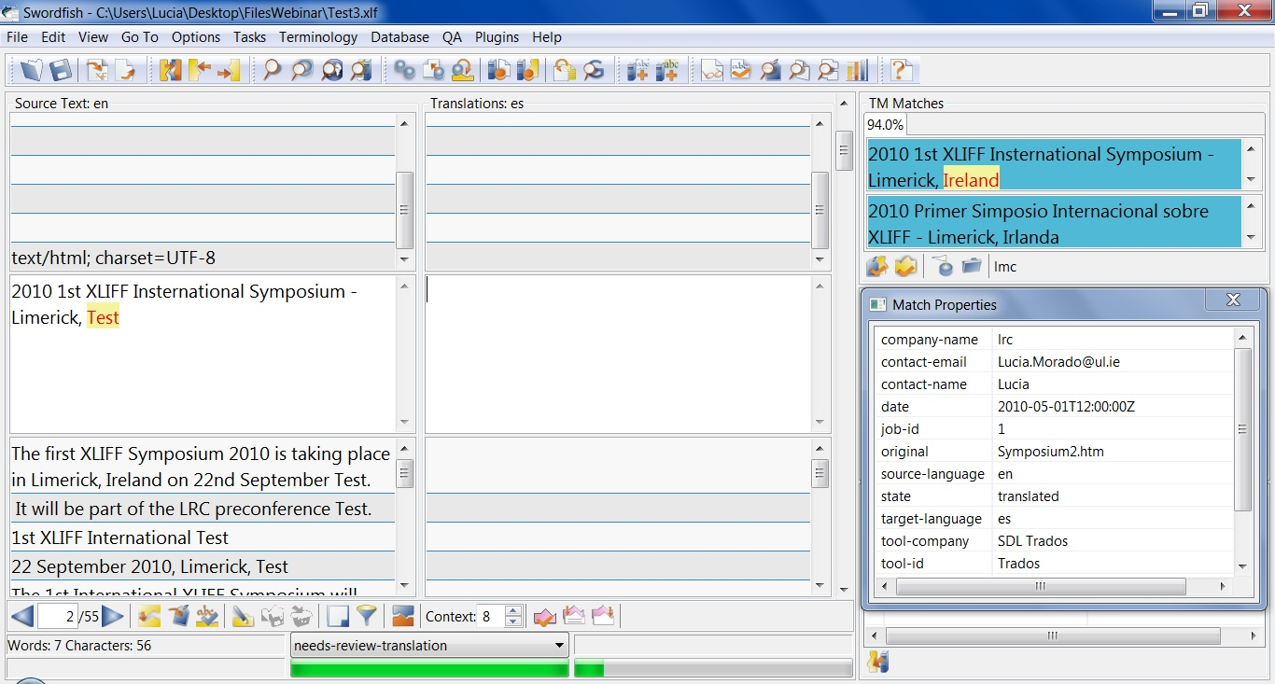
Rich Meta-data for TM Leverage

Slide 11
Next Steps
Contribute to MLW-LT requirements gathering
  Breakout session Friday
  Feedback on Requirements
    New ones? Priorities?
    http://www.w3.org/International/multilingualweb/lt/wiki/Requirements
Get involved in WG
  Participate as W3C members
  Feedback via public list and WG site
  Requirements Workshop in Dublin in 11-12 June
  Implementations
Where next ?– mapping the future of the MLW
  MLW-MultiModal Interaction ....
  MLW-Audio-Visual Content ....
  MLW-JavaScript ....

