Slide 1
NIF 2.0 and ITS 2.0 in 10 minutes
Felix Sasaki
DFKI / W3C Fellow
ITS 2.0 Showcase Dublin 18 June 2013
With material from Sebastian Hellmann (Univ. Leipzig, main developer of NIF) and Dom Jones (TCD)

Slide 2
NLP Interchange Format
RDF/OWL-based format that aims to achieve interoperability between Natural Language Processing (NLP) tools, language resources and annotations
Adressing primary data - character offsets:
http://www.w3.org/DesignIssues/LinkedData.html#char=717,729
Mapping tag sets
  Tibeto-Burman languages
  Russian TreeTagger
  German STTS
  English Penn
  → all have items that map to
  http://purl.org/olia/olia.owl#NonFiniteVerb

Slide 3
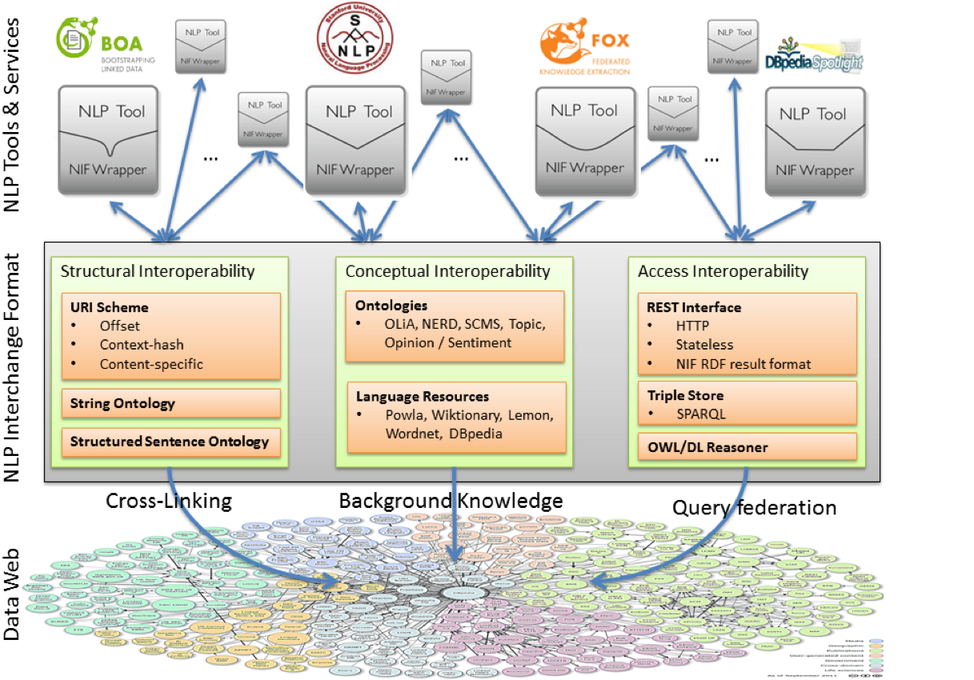

Slide 4
NIF as a Web service
Try it yourself
http://nlp2rdf.lod2.eu/demo/NIFStanfordCore?input=Welcome+to+Dublin+in+Ireland&input-type=text

Slide 5


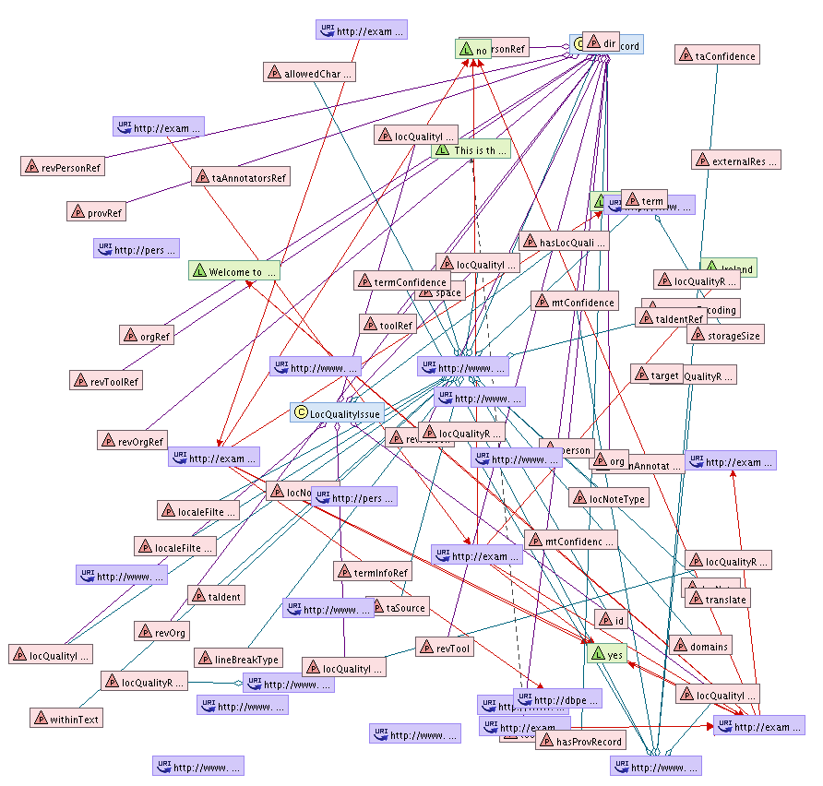
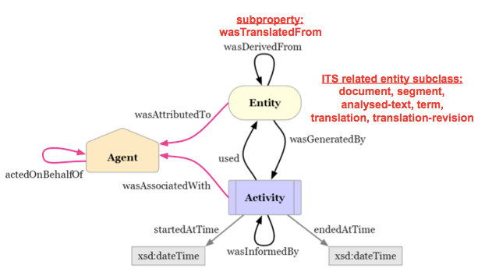
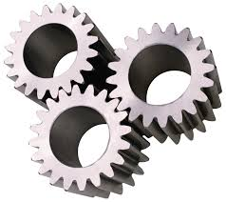


ITS XML / HTML to NIF & RDF:
ITS/RDF Ontology
OR
XML
The PROV Ontology
ITS 2.0
NIF-RDF
http://www.w3.org/TR/its20/#conversion-to-nif

Slide 6
NIF and ITS 2.0
Converting ITS 2.0 to NIF – potential input
<html><body><h2 translate="yes">Welcome to <span
its-ta-ident-ref="http://dbpedia.org/resource/Dublin" its-within-text="yes" translate="no">Dublin</span> in <b translate="no" its-within-text="yes">Ireland</b>!</h2></body></html>
Part of potential output
<http://example.com/exampledoc.html#char=11,17>
rdf:type nif:RFC5147String ;
nif:beginIndex "11" ;
nif:endIndex "17" ;
itsrdf:translate "no";
itsrdf:taIdentRef <http://dbpedia.org/resource/Dublin> ;
nif:referenceContext
<http://example.com/exampledoc.html#char=0,29> .

Slide 7
NIF and ITS 2.0
Converting NIF to ITS 2.0 – potential input
<http://example.com/exampledoc.html#char=21,28>
itsrdf:taIdentRef
<http://dbpedia.org/resource/Ireland> .
Part of potential output
<b its-ta-ident-ref="http://dbpedia.org/resource/Dublin">
Ireland</b>

Slide 8
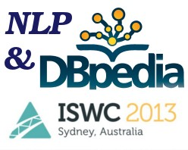
Upcoming:
NLP & DBpedia workshop
http://nlp-dbpedia2013.blogs.aksw.org/
Part of ISWC 2013, October 2013
Knowledge extraction from text and HTML documents
Representation of NLP tool output and NLP resources as RDF/OWL
Novel applications using the extracted knowledge

