Slide 1

Best Practices for Multilingual Linked Open Data
Jose Emilio Labra Gayo
University of Oviedo, Spain
http://www.di.uniovi.es/~labra

Slide 2
About me
WESO Research Group (Web Semantics Oviedo, since 2004)
Several projects involving Multilingual LOD
Example: EU Public procurement notices (MOLDEAS)
Catalog of product schema clasifications (1842053 triples)
http://thedatahub.org/dataset/pscs-catalogue
Common Procurement vocabulary (803311 triples)
http://thedatahub.org/dataset/cpv-2008
23 EU languages

Slide 3






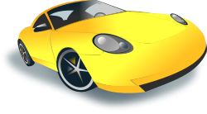

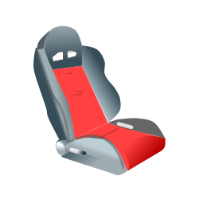
Towards the web of data
Web of documents
Web of Data
Unit of information: Web page (HTML)
Human readable
Challenge: Multilingual pages
Unit of information: data (RDF)
Machine readable
Intrinsically Multilingual

Slide 4
Example
English
<html lang="en">
<body>
<h1>Juan's Home page</h1>
<p>Juan is a Professor at the University of Oviedo, Spain</p>
<p>Phone: +34-1234567</p>
</body>
</html>
<html lang="es">
<body>
<h1>Página personal de Juan</h1>
<p>Juan es Catedrático en la
Universidad de Oviedo, España</p>
<p>Tlfno: +34-1234567</p>
</body>
</html>
Espanish
http://uniovi.es/people#juan
Intrinsically multilingual
foaf:phone
tel:+34-1234567

Slide 5
Multilingual data
Data that appears in a multilingual context
It contains labels/comments
Human-readable information
Using different languages/conventions

Slide 6
Example of Multilingual Data
English
<html lang="en">
<body>
<h1>Juan's Home page</h1>
<p>Juan is a Professor at the University of Oviedo, Spain</p>
<p>Phone: +34-1234567</p>
</body>
</html>
<html lang="es">
<body>
<h1>Página personal de Juan</h1>
<p>Juan es Catedrático en la
Universidad de Oviedo, España</p>
<p>Tlfno: +34-1234567</p>
</body>
</html>
Espanish
http://uniovi.es/people#juan
Web of Data
ex:position
ex:position
Unit of information: data (RDF)
Human + Machine readable
New Challenge: Multilingual
"Professor"@en
"Catedrático"@es

Slide 7
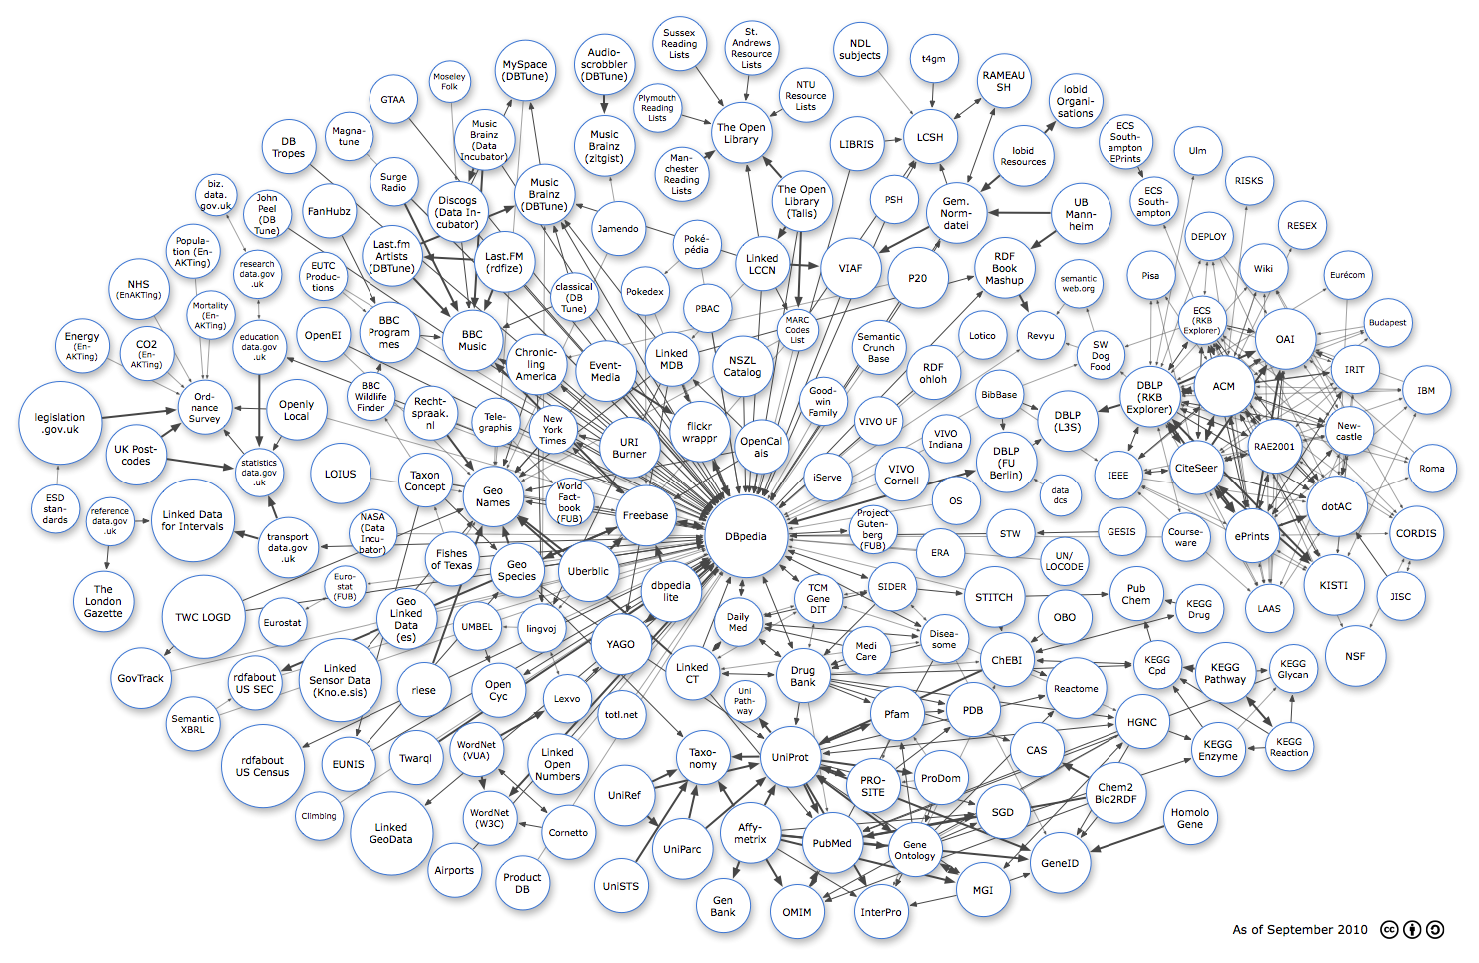
Linked Open Data
Principles on how to publish data
Increasing adoption

Slide 8
Best practices for LOD
Several proposals:
Linked data book [Heath, Bizer, 2011]
Linked data patterns [Dodds, Davis, 2012]
Best Practices for Publishing Linked Data [Hyland et al]
SemWeb Rules of thumb [R. Cyganiak]
etc. . .
In this talk
Best practices affected by multilinguality

Slide 9
Multilingual LOD practices
Design a good URI scheme
Model resources, not labels
Use human-readable info
Labels for all
Use Multilingual literals
Content negotiation
Literals without language
Multilingual vocabularies

Slide 10
1. Design a good URI scheme
Cool URIs
Don't change
Identify things
If possible, use human-readable URIs
http://dbpedia.org/resource/Spain

Slide 11

1. Design a good URI scheme
Use IRIs?
Most datasets use only URIs
IRIs may be difficult to maintain
Domain names, phising, …
IRI support in current libraries
Human-readability?
http://dbpedia.org/resource/Armenia
http://dbpedia.org/resource/Հայաստան
հտտպ://դբպեդիա.օրգ/րեսօուրսե/Հայաստան

Slide 12
2. Model resources, not labels
Define URIs only for resources
Resources do not depend on a given language
Assign labels to those resources
Do not mint separate URIs for labels

Slide 13
2. Model resources, not labels
e:workPlace
http://example.org/UniversityOfOviedo
http://uniovi.es/people#juan
e:workPlace
http://example.org/UniversidadDeOviedo
http://uniovi.es/people#juan
e:workPlace
http://example.org/Uniovi
rdfs:label
rdfs:label
“University of Oviedo”@en
“Universidad de Oviedo”@es

Slide 14
2. Model resources, not labels
Some domains may require to model labels
Thesaurus
Assertions and relations between labels
Example: SKOS-XL labels
Resources of type sxosxl:Label
Labels are URI-identifiable

Slide 15
2. Model resources, not labels
Mint different URIs for each language?
Localized URIs
Language dependant URIs
http://dbpedia.org/resource/Armenia
http://dbpedia.org/resource/Հայաստան
http://dbpedia.org/resource/Armenia/en
http://dbpedia.org/resource/Armenia/hy

Slide 16
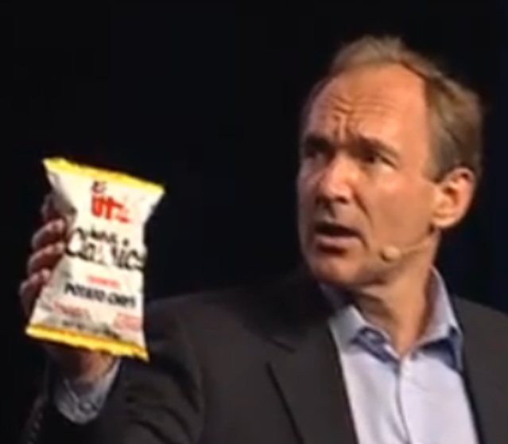
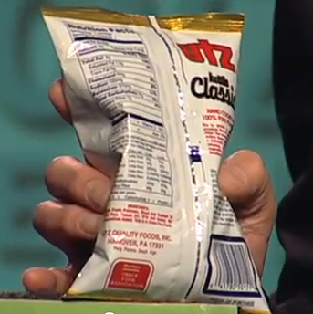
3. Use human-readable info
Not only machine-readable information
Combine machine & human-readable info
Human-readable info must be multilingual

Slide 17
3. Use human-readable info
Facilitates search over the web of data
Linked data browsing
Applications can display labels instead of URIs
Some common properties:
rdfs:label
skos:prefLabel
dcterms:title
dcterms:description
rdfs:comment
etc.

Slide 18
3. Use Human-readable info
What is the right level of textual information?
Balance between HTML/RDF world

Slide 19
4. Labels for all
Provide labels for all URIs
Individuals / Concepts / Properties
Not just the main entities
Displaying labels becomes easier and faster
Reduce number of requests

Slide 20
4. Labels for all
It may be difficult to select the right label
Don't provide more than one preferred label
Not feasible for some datasets
Only 38% non-information resources have labels
[B. Ell et al, 2011]
Avoid camel case or similar notations
http://www.example.org#uniovi
rdfs:label
"UniversityOfOviedo"

Slide 21
5. Use Multilingual literals
Use language tags
Select the right IETF language tag (RFC 5646)
Example:
"University of Oviedo"@en
"Universidad de Oviedo"@es
"Universidá d'Uvieu"@ast
"Օվիեդոյի համալսարանում"@hy

Slide 22
5. Use Multilingual literals
Multilingual literals & SPARQL
http://uniovi.es/people#juan
ex:position
ex:position
"Professor"@en
"Catedrático"@es
SELECT * WHERE {
?x ex:position "Professor" .
}
Returns Nothing
SELECT * WHERE {
?x ex:position "Professor"@en .
}
Returns <...#juan>

Slide 23
5. Use Multilingual literals
Underused feature
4.78% non info-resources have one language tag
Only 0.7% datasets contain several language tags
Most commonly language used:
44.72% (en), 5.22% (de), 5.11% (fr), 3.96% (it),...
[B.Ell et al, 2011]

Slide 24
5. Use Multilingual literals
What about longer descriptions:
dcterms:description, rdfs:comment…
CDATA like or XML literals ?
Reuse existing practices in XML I18n
Problems:
Gap between descriptions and RDF model
SPARQL maybe a challenge

Slide 25
6. Content negotiation
Use HTTP Accept-Language
Return different sets of labels
Reduce load in client applications

Slide 26
6. Content negotiation
No Accept-Language declaration (all)
http://uniovi.es/people#juan
ex:position
ex:country
ex:position
ex:country
"Professor"@en
"Catedrático"@es
"Spain"@en
"España"@es

Slide 27
6. Content negotiation
Accept-language: es
http://uniovi.es/people#juan
ex:country
ex:position
"Catedrático"@es
"España"@es

Slide 28
6. Content negotiation
Accept-language: en
http://uniovi.es/people#juan
ex:position
ex:country
"Professor"@en
"Spain"@en

Slide 29
6. Content negotiation
Implementation issues
Return equivalent representations for each language
Content represented by spanish labels
Content represented by english labels
equivalent to

Slide 30
7. Literals without language tag
Include literals without language-tag
SPARQL queries are easier
Example:
http://uniovi.es/people#juan
ex:position
ex:position
ex:position
"Professor"
"Professor"@en
"Catedrático"@es
SELECT * WHERE {
?x ex:position "Professor" .
}
Returns <...#juan>

Slide 31
7. Literals without language tag
Selecting a default language maybe controversial
How to declare the primary language of a dataset?

Slide 32
8. Multilingual vocabularies
Link to existing vocabularies
Quality selection criteria for vocabularies
Vocabularies should contain descriptions in more than one language
[Hyland et al, 2012]

Slide 33
8. Multilingual vocabularies
What to do if they are not localized?
Enrich vocabularies with translated extensions?
Example:
dc:contributor rdfs:label "Colaborador"@es .

Slide 34
8. Multilingual vocabularies
Beware of cross-lingual mappings
Example:
Concept of professor in english culture
Concept of professor in spanish culture
≠
"Professor"@en
"Profesor"@es
Possible solutions:
Ontology-lexicon, Lemon Model
[Gracia et al, 2011, Buitelaar et al, 2011, McCrae et al 2011]

Slide 35
Other issues not covered
Unicode support in N-Triples
Language declarations in Microdata
Internationalization topics:
Text direction
Ruby annotations
Notes for localizers
Translation rules

Slide 36
Conclusions
LOD adoption offers new challenges
Web of data is not just for machines
At the end, human users will employ LOD applications.
Human users speak different languages
Challenge:
Best? practices for multilingual LOD

Slide 37
Acknowledgements
Aidan Hogan
Richard Cyganiak
Basil Ell
Jose María Álvarez Rodríguez
Elena Montiel
Jeni Tennison

Slide 38
References
[Buitelaar et al, 2011] Ontology Lexicalisation: The lemon Perspective, 9th International Conference on Terminology and Artificial Intelligence, 2011
[Cyganiak] SemWeb Rules of thumb
http://www.w3.org/wiki/User:Rcygania2/RulesOfThumb
[Dodds, Davis, 2012] Linked data patterns
http://patterns.dataincubator.org/book/
[Ell et al, 2011] Labels in the Web of Data, ISWC 2011
[Gracia et al, 2011] Challenges for the Multilingual Web of Data, International Jounal on Semantic Web and Information Systems, 2011
[Hogan et al, 2012] An empirical study of Linked Data Conformance, Journal of Web Semantics, to appear.
[Heath, Bizer, 2011] Linked data: Evolving the Web into a Global Data Space
http://linkeddatabook.com/editions/1.0/
[Hyland et al] Best Practices for Publishing Linked Data
https://dvcs.w3.org/hg/gld/raw-file/default/bp/index.html#internationalized-resource-identifiers
[Hyland et al] Linked data cookbook. Open Government Linked Data
http://www.w3.org/2011/gld/wiki/Linked_Data_Cookbook
[McCrae et al, 2011] Linking Lexical Resources and Ontologies on the
Semantic Web with lemon, ESWC, 2011

Slide 39

End of presentation
http://purl.org/weso

