Slide 1
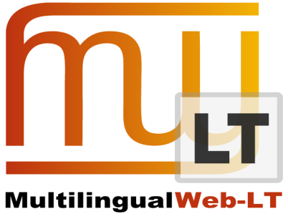
Interoperability and Quality Check
FEISGILTT – June 2013 – London
Yves Savourel – ENLASO Corporation

Slide 2
Need for Improvement
Quality Check/Assurance is often done
using in-house or third party tools that are not always integrated with the translation tools.
The Internationalization Tag Set (ITS) 2.0 offers two data categories that can be used for enhancing interoperability:
  Localization Quality Issue
  Localization Quality Rating

Slide 3
Localization Quality Issue /1
One of the new 2.0 data categories
Provides information about quality problem on a section of the content. Fields available:
  Type of issue (pre-defined list)
  Comment (human readable text)
  Severity (a number between 0.0 to 100.0)
  Profile reference (a URI to some resource)
  Enabled/disabled flag (allows to “check off” the issue)

Slide 4
Localization Quality Issue /2
Pre-defined list of issue types:
http://www.w3.org/TR/its20/#lqissue-typevalues
Tools can provide their mapping:
http://www.w3.org/International/its/wiki/Tool_specific_mappings

Slide 5
Localization Quality Issue /3
Special standoff notation allows a single
node to have several occurrences of the same data category.
<span its:locQualityIssuesRef="#lqi1">bad text</span>
...
<its:locQualityIssues xml:id="lqi1">
<its:locQualityIssue type="mistranslation"/>
<its:locQualityIssue comment="Need capitalization"/>
</its:locQualityIssues>
Another example…

Slide 6
Localization Quality Rating
One of the new 2.0 data categories
Provides a way to grade the quality of a translation
Can be expressed:
  as a score (a number between 0.0 to 100.0)
  or as a vote (a signed value)
A threshold can be also defined to indicate when the quality rating is deemed too low
Example…

Slide 7
ITS Usages
Can be marked up in XML documents
Can be marked up in HTML5 documents
Can also be used with any data model because the data categories are defined at an abstract level. The ITS XML or HTML5 representations are just two of the possible ones.

Slide 8
Demonstration
Several documents in different formats
Extraction and translation automated
QA process applied by different tools
Results seen through one UI

Slide 9
Questions?
LanguageTool:
http://www.languagetool.org/
Okapi Framework:
http://okapi.opentag.com/
ITS 2.0:
http://www.w3.org/TR/its20/

