Slide 1


The Multilingual Web http://www.multilingualweb.eu/
David Filip, David Lewis, Felix Sasaki
dave.lewis@cs.tcd.ie

Slide 2
Why Multilingual Web?
Commercial translation market $21-26bn annually
Enables order of magnitude more in cross border trade
51% European retailers sell via Web, but only 21% cross border
30% Europeans buy online, only 7% cross border
Only a third of Web users now claim English as first language
Biggest growth in Chinese, Russian and Arabic
Interoperability problems estimated to impose 20% overhead on language services industry

Slide 3
Multilingual Web Initiative
W3C is active in ensuring the multilingual viability of the World Wide Web
  Unicode, IRI, language tags
Internationalisation Activity
  Best Practice, Internationalisation checker
  Internationalisation Tag Set (ITS)
Multilingual Web Initiative
  EC-funding for W3C workshop series
  Assemble Stakeholders who create, localise, publish and use multilingual web content, applications and technologies

Slide 4
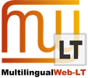
Multilingual Web – LT (Language Technology)
Web Content Management
Create & Publish
CCMS - OASIS DITA
L10N
LSP Roundtrip
OASIS XLIFF
Language Technologies
Machine translation
Text analytics
CMS-based

Slide 5
MultilingualWeb-LT Approach
Standardise Data Categories
  Document header rules, element attributes, precedence rules
  ITS (1.0) has: Translate, Loc note, Terminology, Directionality, Ruby, Language Info, Element Within Text
  MLW-LT could add: MT-specific instructions, localisation workflow, quality-related provenance, legal
Map to formats
  ITS focussed on XML
    Useful for XHTML, DITA, DocBook
  MLW-LT also targets HTML5 and CMS-based ‘deep web’
  Use of microdata and RDFa

Slide 6
Scope of Use Cases
Language Technology
Create Content
Language Resources
Translate Content
Consume Content

Slide 7
Source Content Processing
Language Technology
Create
Language Resources
<..>
Author
Named entity recognition
Glossary
<..>
Identify no -translate
Identify terms
Term-base
<..>
<..>
<..>
Localisation Preparation
Translate
<..> = Possible MLW-LT Metadata

Slide 8
Localisation Quality Assurance
Language Technology
Create
Language Resources
Localisation Preparation
Term-base
<..>
Translate
<..>
Machine Translation
Postediting
Translation Memory
<..>
<..>
Translation Review
<..>
Translation Memory+
<..>
<..>
XLIFF
Publish to CMS
Consume Content
<..> = MLW-LT Metadata

Slide 9
Leverage Target Quality Meta-data
Translate
Language Resources
Publish to CMS
Language Technology
Consume Content
<..>
<..>
Reading/
Reusing
<..>
Search Indexing
Machine Translation
Term-base
MT Training
<..>
<..>
<..>
Translation Memory+
<..> = MLW-LT Metadata

Slide 10
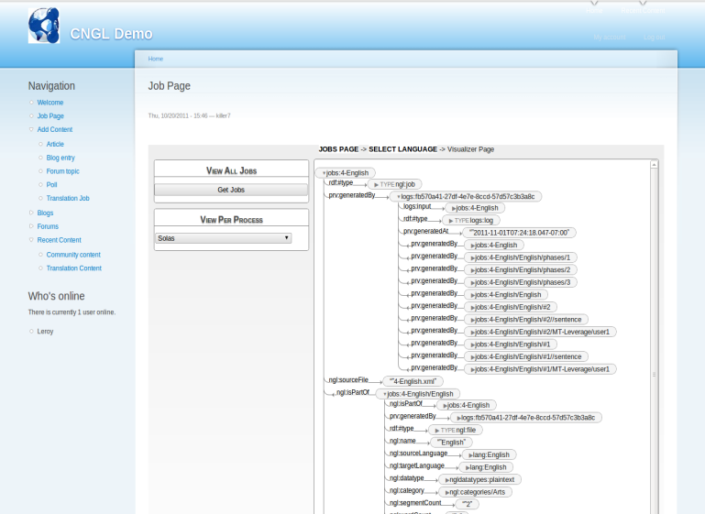
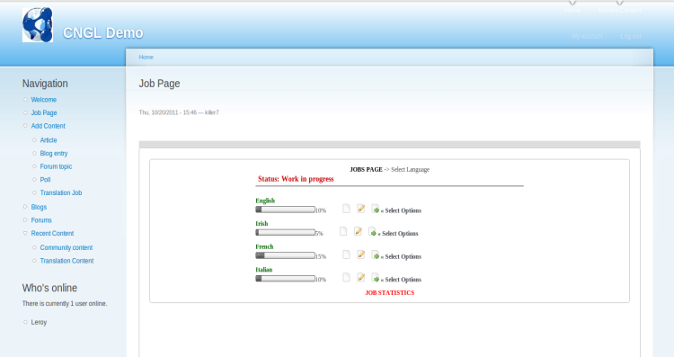
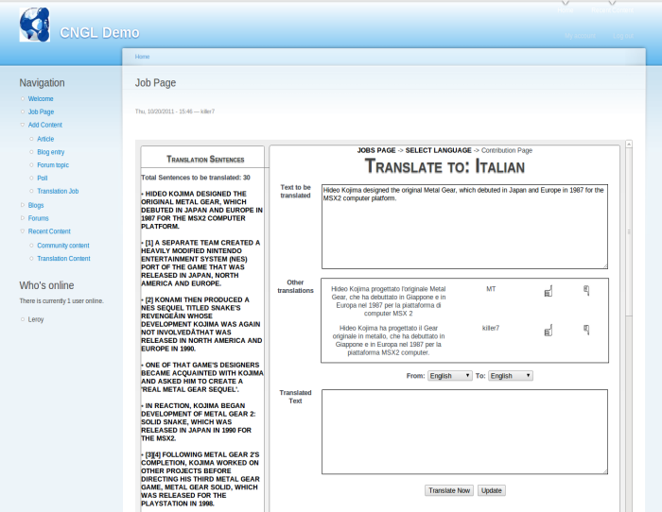

CMS-L10N integration via RDF & XLIFF
Drupal Web CMS
Apache Web Server:
Servlet container
RDF Provenance TripleStore
RDF Provenance Visualiser
Sesame Server
Sesame Workbench
RDFLogger
Translation tools
XLIFF
XLIFF
Translation Tool
MT Service
User Data

Slide 11
Its Your Multilingual Web
Get involved in MultilingualWeb-LT WG
  Participate as W3C members
  Follow via public list and WG site
    http://www.w3.org/International/multilingualweb/lt/
  Requirements Workshop in Dublin in 12-13 June
  Implementations
Where next ?– mapping the future of the MLW
  MLW-Linked Open Data ..... Dublin 11 June
  MLW-MultiModal Interaction ....
  MLW-Audio-Visual Content ....
  MLW-JavaScript ....
http://www.multilingualweb.eu/

