Slide 1
LIDER: : Linked Data as an enabler of cross-media and multilingual content analytics for enterprises across Europe
Asunción Gómez-Pérez (UPM)
asun@fi.upm.es
(Project coordinator)
CSA
Budget: 1.482.000€
Starting date: 1. Nov. 2013
Duration: 2 Years

Slide 2
Table of content
Partners
Vision and Goals
Collection of business use cases
Guidelines and best practices for industry
Reference architecture and roadmap
Community building and dissemination

Slide 3
The LIDER consortium
Universidad Politécnica de Madrid
(UPM, Spain) [COORDINATOR]
Trinity College Dublin (Ireland)
DFKI (Germany)
National University of Ireland, Galway (Ireland)
Institut für Angewandte Informatik EV (INFAI, Germany)
University of Bielefeld (Germany)
Universita degli Studi di Roma La Sapienza (Italy)
GEIE ERCIM (France)

Slide 4
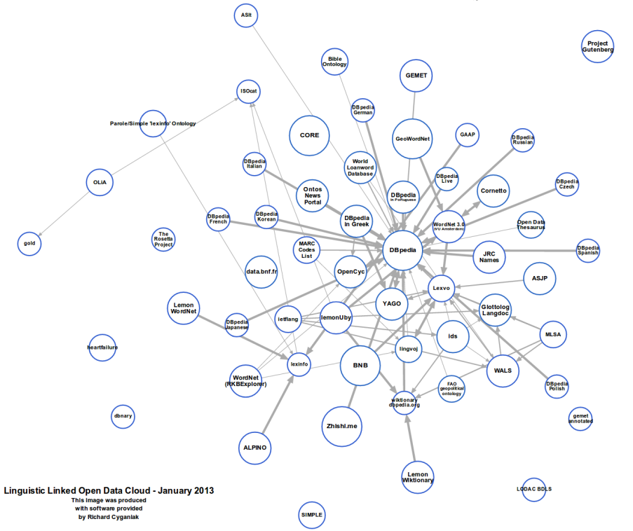
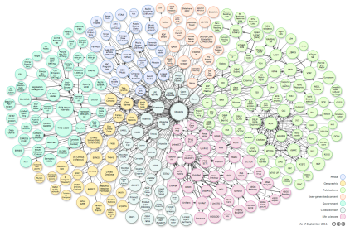
Linked Open Data and Language
LOD is increasingly multilingual
LOD interconnects resources in many languages
3. Linguistic LOD
Not every resource in this
Figure is a “pure” linguistic resource

Slide 5
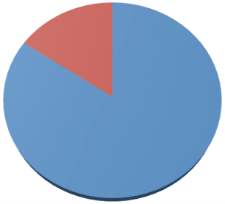
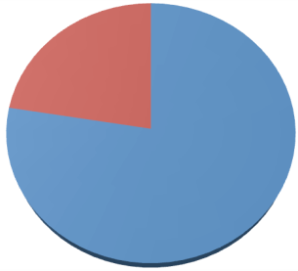
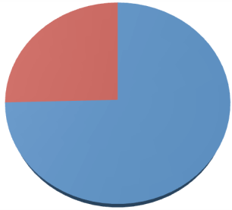
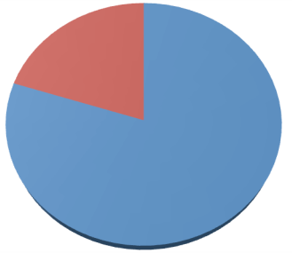
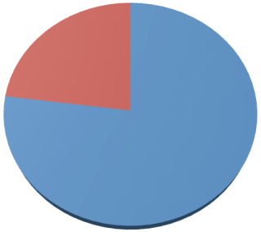
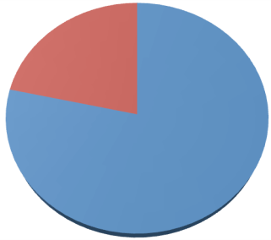
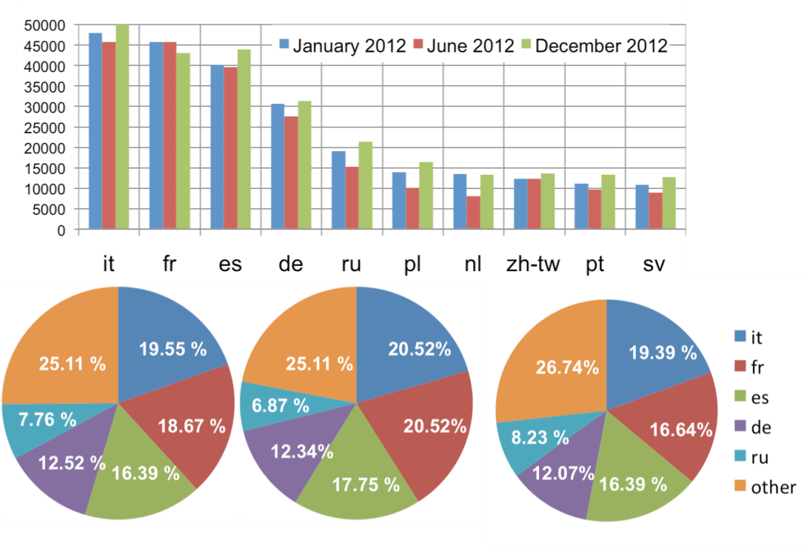
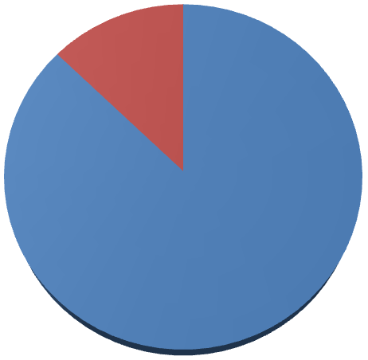
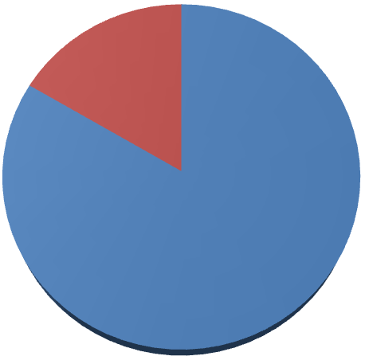
LOD is dominated by the English language
Monolingual
datasets
Multilingual
datasets
RDF literals without
language tag
RDF literals with
language tag
349
635
676
2,567,324
3,154,779
3,365,930
1,906
2,201
1,984
10,250,936
10,594,338
12,272,806
January 2012
June 2012
December 2012
January 2012
June 2012
December 2012
1. Number of Monolingual and multilingual datasets
2. Current usage of language tagging capabilities in RDF
RDF literals with
English tag
RDF literals with
other language tag
431,660
403,714
557,785
2,135,664
2,751,065
2,808,145
January 2012
June 2012
December 2012
3. English tags versus other languages' tags
4. Evolution of top-10 languages (non Eglish)

Slide 6
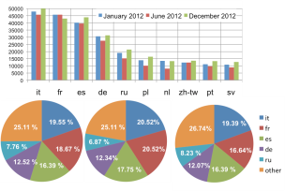
Motivation: Overcome language barriers for content analytics
Content
Analytics
Producers
Consumers
Multimedia and
Multilingual Content
LOD-aware NLP services
Metadata Generation
Multilingual content medatada
LLOD (language resources as LD)
LOD generation
...
Language Resources (Lexicon, corpora, ...) some of them are FOI other are private

Slide 7
Evidence of industrial demand
Multilingual multimedia content annotation.
Increase demand for NLP services that combine text processing with Multimedia meta-data and media processing components.
LOD generation from linguistic resources
data is already being published by companies, but not linguistic resources as LLOD
LOD-based NLP services for Content Analytics
CA related companies that actively use Dbpedia: OpenCalais, Zemanta, Ontos, Yahoo!, Nerd, etc.
multilingual LLOD would be vital for reaching EU-wide and global markets

Slide 8
Challenge: The use of LOD for NLP in Content Analytics
Which extensions to the LOD are needed to support a new generation of large-scale content analytics applications that will overcome language barriers.
Linguistic Linked Licensed Data (3LD)
Linguistic LOD is a subset
identification of key NLP tasks that require background knowledge
Specification of NLP services that are LOD-aware and can exploit LOD

Slide 9
Community building networking
Industry use cases
WP4
WP1
Roadmap, guidelines, target architecture
WP2, 3

Slide 10
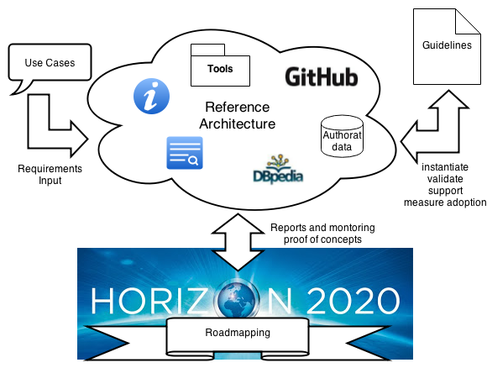
WP2
WP1
WP3
WP3

Slide 11
Goals of Industry Community Engagement
To enumerate baseline awareness of the potential of:
Linked data in general
Linked data in applications of NLP
NLP for content analytics
To elicit use cases or pain points that could be addressed by the use of linked data in application of NLP for content analytics
To elicit requirements and constraints that may impact applications of linked data in NLP applications for content analytics
Implicit goals:
Improve awareness of potential of linked data for NLP applications and the expertise in Europe
Identify potential partners for H2020

Slide 12
Method
Identify industry grouping
Seed use cases
Deploy questionnaire/
survey
Analyse Results
Revise use cases
Regroup+ interviews+ petition use cases

Slide 13
Draft Classification of 3LD Use Cases
Use of NLP
Uses 3LD to tune/train NLP
Use NLP to curate and/or leverage multilingual & multimedia content annotated with 3LD
Sell NLP services
Access to more/better/cheaper data for client services
Leverage content + meta-data
Convert to 3LD for publishing/sale
Link to other resources for added value/attribution
Enrich 3LD with NLP
Make it easier for clients to train their NLP

Slide 14
Industry Sectors
Multilingual Language Services
Language Services Clients
Language Services Providers
ML Language Resource Curators
Language Technology Vendors
Crow
Multimedia and Multilingual Content analysis
Market Intelligence - Sentiment analysis
Event detection
Trend Mining
Enterprise Search
Translation
Content Management
Content Management tool vendors
Service/product vendors (customer support)
Libraries, Museums, Digital Humanities
Public Sector publishers
Peer production communities
Media, News and journalism
eHealth, eEnergy, eTransport,
Finance

Slide 15
WP2
WP1
WP3
WP3

Slide 16
Guidelines and best practices
Vocabularies and best practises for generating metadata and linking it to (multilingual and multimedia) content
for multilingual resources (NIF, lemon, etc.) and multimedia resources (Media Ontology, W3C Media Fragments, etc.)
Guidelines supporting the lifecycle of Linguistic Linked Data
Guidelines for NLP services exploiting Linguistic Linked Data, enabling conversion, integration and use of data
Best practices and vocabularies
Guidelines and models for 3LD
Guidelines for 3LD-aware NLP services
Use Cases
Reference Architecture
Vocabs
Tools
Data
Sources
Services
Guidelines and best practices

Slide 17
WP2
WP1
WP3
WP3

Slide 18
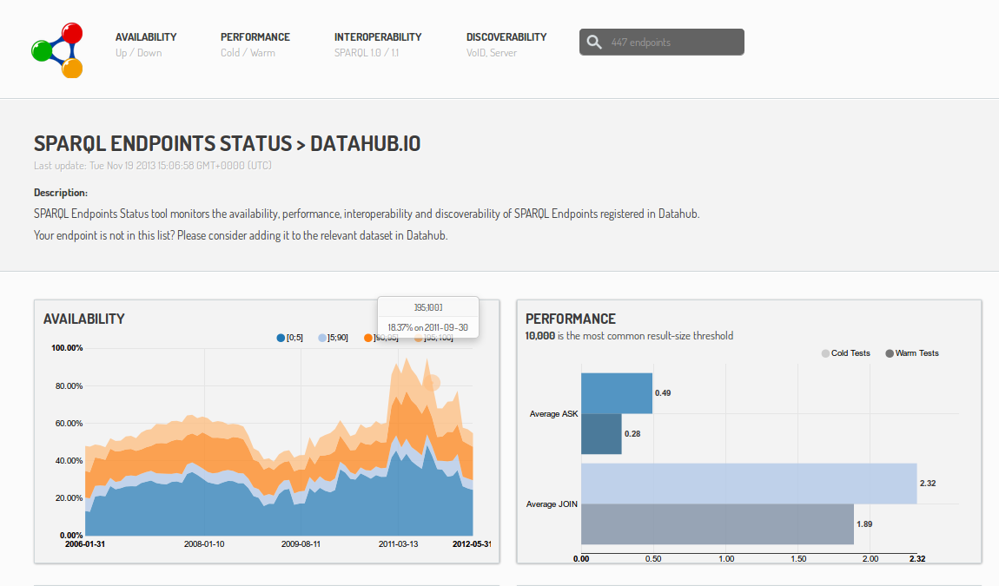
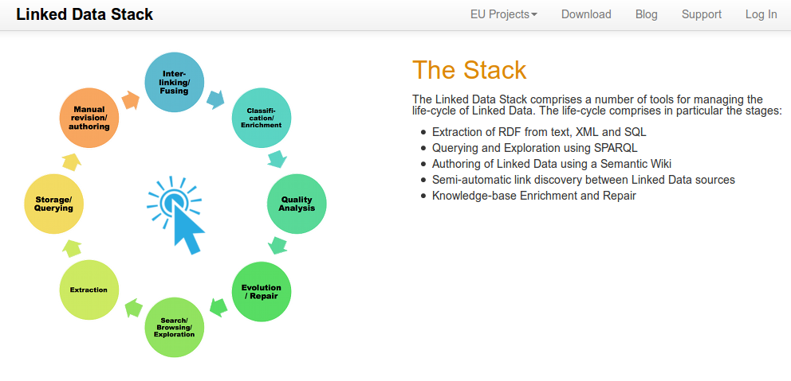
Reference Architecture
Consolidate
Evaluate, select and (if necessary) adapt existing tools (LOD2 stack, OKF tools)
Support adoption of guidelines
Validate, check consistency, provide helpful guidance
Tools to create meta-data and classification automatically (e.g., Lexicon using lemon)
Measure
Provide an architecture to assess quality, sustainability and measure state of 3LD
The Reference Architecture will be available and open for community feed-back through:
GitHub repositories (Readmes)
Wikis in the respective communities
Pointers on LIDER project portal

Slide 19
Roadmapping
Roadmap starting points:
Use Cases
reference architecture : reports and figures to deduce trends and measure adoption of linked data technology
input from the roadmapping workshops
input from academia (linked data and NLP)
Advisory board

Slide 20
Expected Contributions from the Community
Use case definition from industry will be input to the roadmap
Linguistic resources →LLOD
Validation of guidelines and reference architecture
Participation in surveys
Participation in events:
Roadmapping WS, hackatons, etc.
Lider will help participants with travelling grants
to participants in Road mapping WS

Slide 21
Open Community Events@ Y1
At least 2 Roadmapping WS
EDF ½ WS (March 20th) focused on Language and LD
MLW Workshop (March 27^{th,} Madrid) focused on Language and LD
Localization World, (June 3-4th Dublin) focused on Translation and LD
Germany-oriented WS September, 2014, Leipzig
One day WS under the Multilingual Web brand
26th March, Madrid
Half day session under the European Data Forum brand
Submitted to EDF 2014, Athens
Publication of best practice material and involvement in W3C community groups
BP-MLOD, Ontolex
One hackaton
September , 2014, Leipzig

Slide 22
Ongoing dissemination activities
Ongoing activities (proposed but not accepted yet):
LREC-2014 (May): Tutorial, 3 WS and conference papers submitted, Challenge on LLD.
ESWC: 2 WS
eMNLP: 1 WS
QA and LD (summer school in Athens)

Slide 23
Summary of goals
Create a sustainable community around 3LD for content analytics
Constitute an Industry Board
Focus on SMEs
Approach existing communities
Dissemination of important milestones
Press releases etc.
Make data sets available e.g. via META-SHARE
Target groups
Technical experts from industry who already know about LOD
Provide them with concrete use cases, discuss current gaps for interoperability
Organisations not yet working with LOD

Slide 24
Community Portal and Project Portal
#mlw
http://www.multilingualweb.eu/
Public Mailing
List (UPM)
Project-Portal (UPM)
www.lider-project.eu
#Lider-eu
BP-MLOD W3C-CG
OntoLex W3C-CG
LIDER Community (Industrial Board)
& Mailing List (ERCIM)

Slide 25
LIDER: : Linked Data as an enabler of cross-media and multilingual content analytics for enterprises across Europe
Asunción Gómez-Pérez (UPM)
asun@fi.upm.es
(Project coordinator)
CSA
Budget: 1.482.000€
Starting date: 1. Nov. 2013
Duration: 2 Years

