Slide 1


Business Benefits of ITS 2.0-Aware Interoperability CMS-TMS and
Online Multilingual Publishing System
Dr. Pedro L. Díez Orzas

Slide 2

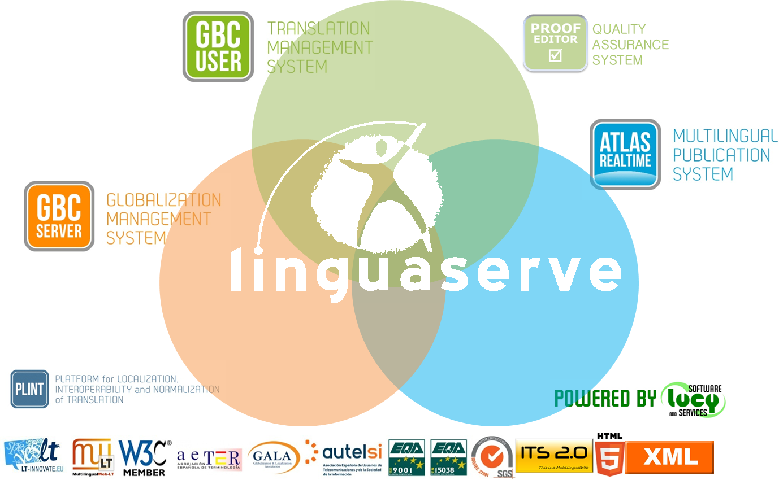
Linguaserve specializes in multilingual web advanced solutions for 21st Century Challenges.
Experience in interoperability since 2002
and real time multilingual web publishing
since 2008.
www.linguaserve.com

Slide 3

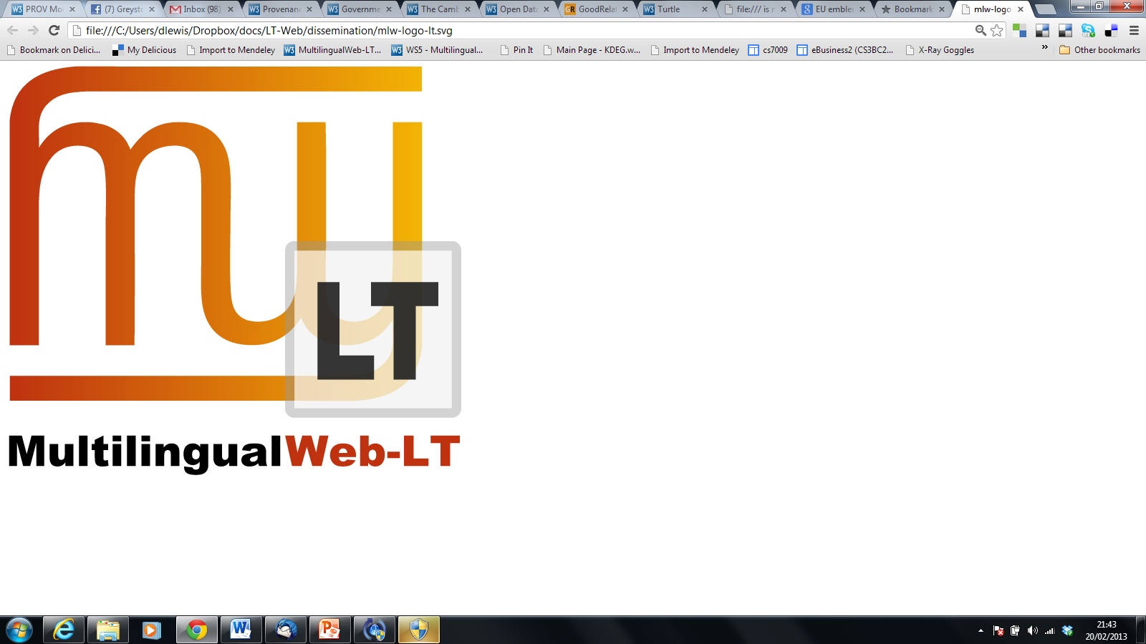


MLW-LT and ITS 2.0
Linguaserve is a member of MultilingualWeb-LT because:
  Standards help both SMEs and large companies.
  There is no magic button: human language and translation are extremely complex. Web content annotation greatly helps to improve results in Multilingual Web Linguistic Technology.

Slide 4
ITS 2.0-Aware Interoperability CMS-TMS
ITS 2.0-Aware Online Multilingual Publishing System
Horizons
Notes:
PORTADA

Slide 5

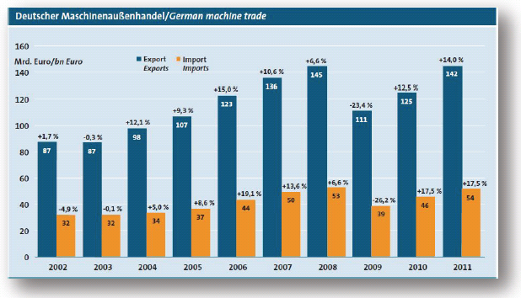
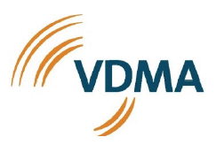
Use case: VDMA
ITS 2.0 Interoperability CMS-TMS
VDMA: German machinery and plant manufacturers' association
Largest industrial association in the capital goods industry in Europe (3170 industrial members)
Highly export-oriented

Slide 6
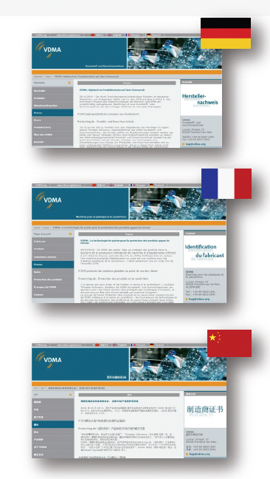
Use case: Scope
ITS 2.0 Interoperability CMS-TMS
Annotated, processed and translated 150 press releases
75,000 words annotated and processed with ITS 2.0
Using Drupal MLW-LT modules
ITS 2.0-aware automatic content round tripping
Languages: DE > FR, ZH

Slide 7
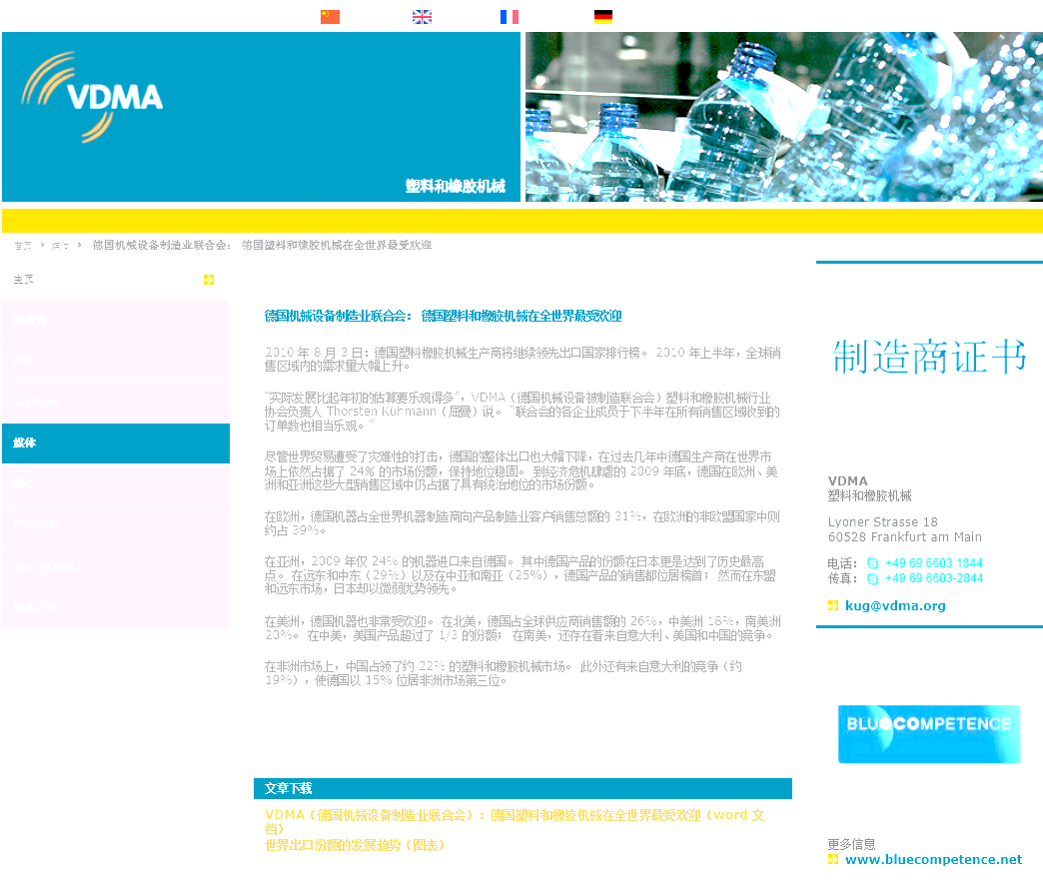





High level flow
ITS 2.0 Interoperability CMS-TMS
WEB SITE
CMS
Webservices
TMS
Engine
(Processing)
Workflow
(Management)
CAT Tool / Machine Translation
www.vdma.org

Slide 8
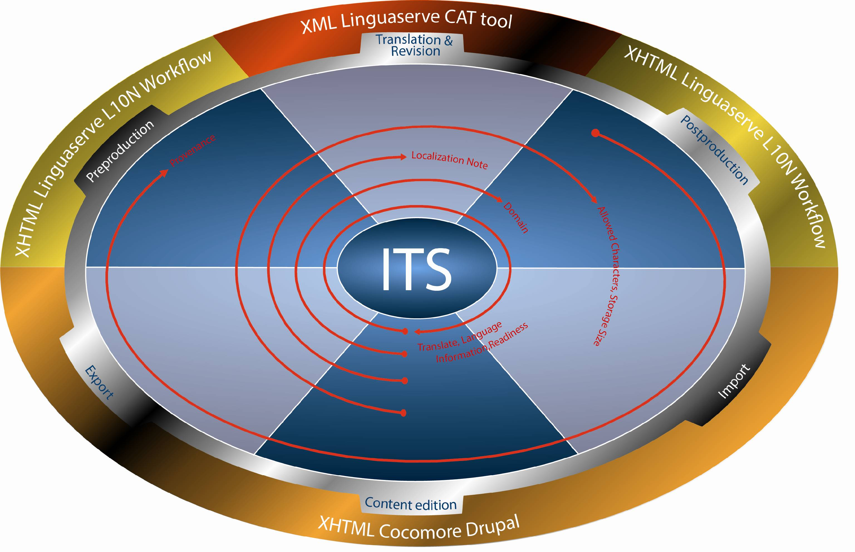
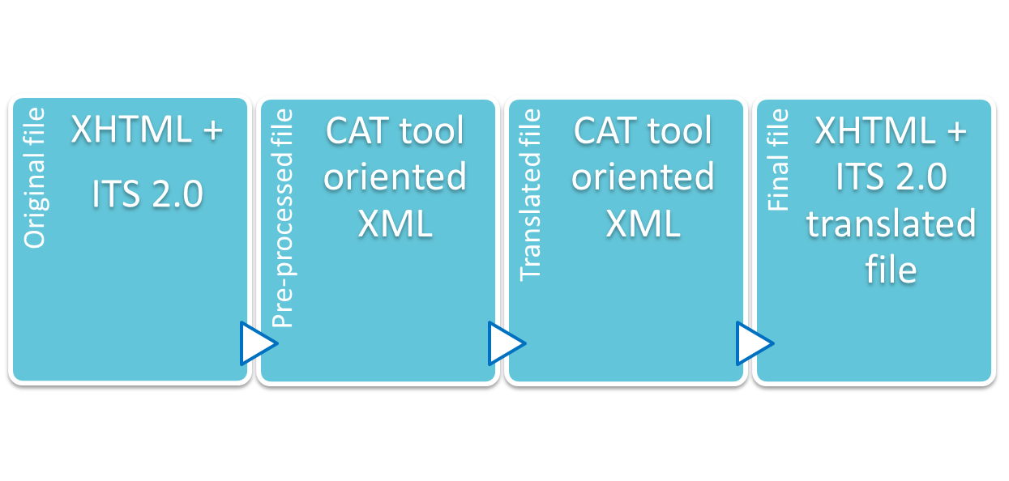
ITS 2.0 in CMS/TMS processing
ITS 2.0 Interoperability CMS-TMS

Slide 9

Some ITS 2.0 benefits (I)
ITS 2.0 Interoperability CMS-TMS
ITS 2.0 increases both user’s control and automatic decision processes, allowing more “intelligence“ in the systems involved:
  Translate: can be automatically or manually annotated. E.g. it allows not to add “non-translatable” terms in several specific glossaries or MT systems.
  Localization Note: direct communication between webmasters, PMs and translators. When alert type, it can be used for triggering certain processes in the Translation Workflow.
  Domain: automatic selection of CAT/MT terminology and dictionaries. Selection of Translation Memories by domains.

Slide 10
Some ITS 2.0 benefits (II)
ITS 2.0 Interoperability CMS-TMS
  Language Information: quality check to ensure the source language content is according to the Webservice parameter.
  Allowed Characters: quality check for the target content.
  Storage Size: quality check for both original content and the target content to be uploaded into the CMS. It can be used also for translators’ visual control.
  Provenance: possibility to reassign the same translator/reviewer in new versions of the same content and inform the PM. Tracking control in the CMS.
  Readiness (ITS 2.0 extension): control of processes to be done, date control for availability, delivery and priority.

Slide 11
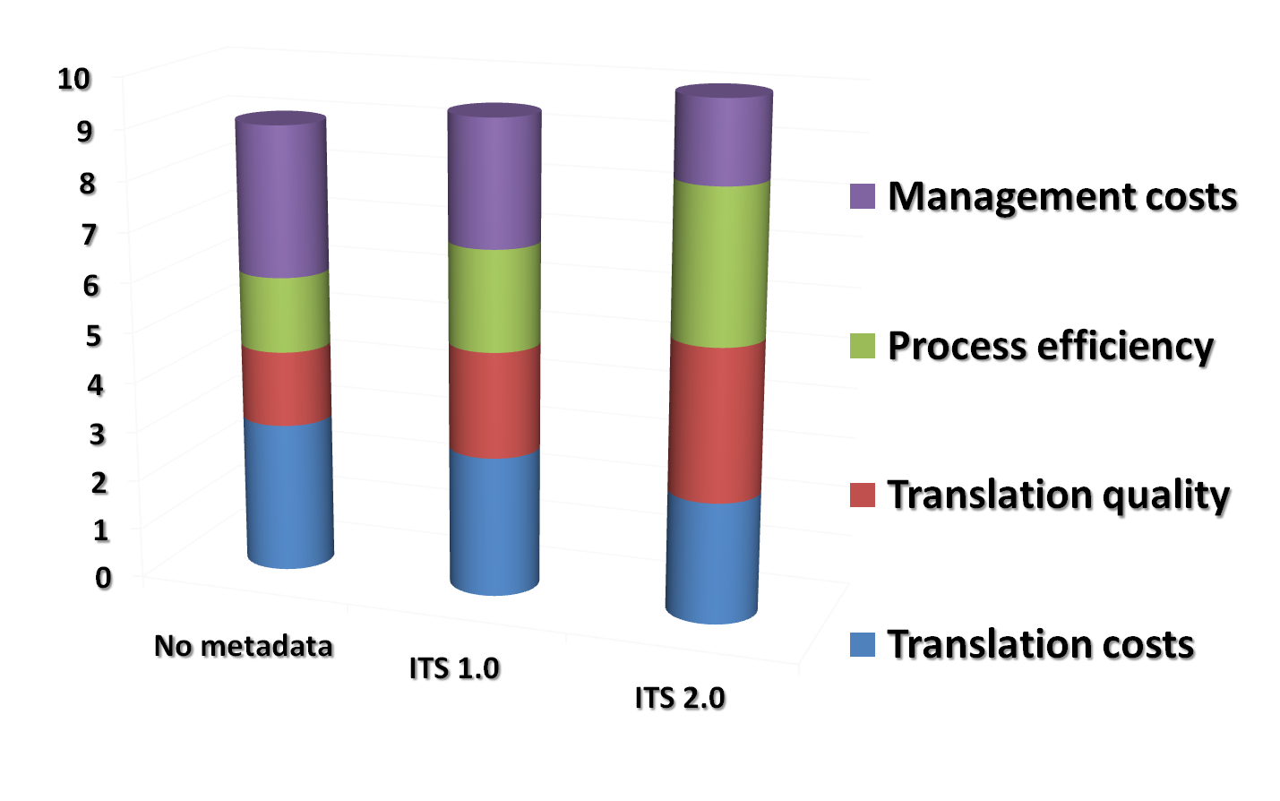
ITS 2.0 impact
ITS 2.0 Interoperability CMS-TMS
 Non-quality costs

Slide 12
Win-win business
ITS 2.0 Interoperability CMS-TMS
Content creators and editors, CMS developers, the localization industry and users are benefited.
More efficient control over the content and faster fine-grain communication between localization chain actors (e.g. webmaster/project manager)
Localization platforms and format Independent:
  Better web and linguistic technology machine/machine interaction
  Better web and localization human/machine interaction
Increasing fully automatic processes and localization expert systems in CMS and TMS.
Opens up ways for connectors, pre- and post-editing, and CAT tools.
New users
Existing users
Accelerating adoption of interoperability localization chains
Problem solving
Quality and control improvements

Slide 13

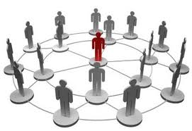
Business: Opportunities rise from needs
ITS 2.0 Interoperability CMS-TMS
Very frequently updated web sites that need efficient multilingual updates and maximum control:
  Corporate and industry information
  e-Government
  e-Commerce
  Educational web sites
Highly distributed content creation through the CMS
Web 2.0 and user content created
  Applying MT systems for immediacy
Using ITS 2.0 to contribute for multilingual SEO

Slide 14
ITS 2.0-Aware Interoperability CMS-TMS
ITS 2.0-Aware Online Multilingual Publishing System
Horizons
Notes:
PORTADA

Slide 15

Use case: the Spanish Tax Agency
ITS 2.0 Online Multilingual Publishing System
  www.agenciatributaria.es is the user in the “Online MT System” showcase in MLW-LT
Spain: General Indicators 2011
  Spain is a country that is regionally structured into 17 autonomous communities and 2 autonomous cities with 5 co-official languages
  Population : 47,190,493 inhabitants ( 12.2 % foreign residents)
Mission of the Spanish Tax Agency
  Effective application of Spain’s tax and custom system
  Management of tax resources on behalf of other public administrations when required by Law or Agreements
General taxpayer census
  Individual taxpayers: 46,509,231
  Companies: 2,674,547
  Other organisations: 2,293,939
Total taxpayers: 51,477,717
Notes:
PORTADA

Slide 16




Use case: Scope
ITS 2.0 Online Multilingual Publishing System
Online MT System Internationalization showcase components:
  ITS 2.0
  HTML5
  ATLAS RT (Linguaserve’s Real-time Multilingual Publishing System)
  Lucy Software MT (Rule-based Machine Translation)
  MaTrEx, from Dublin City University (Statistical Machine Translation)
  www.agenciatributaria.es (CMS: OpenText WEM)
RTMPS implementation and deployment in pre-production
  ITS 2.0 data categories: 6 (Translate, Localization Note, Language Information, Domain, Provenance, Localization Quality Issue)
  Prototypes, test suite engines, and use case
250 web pages ES-EN and 30 web pages ES-FR, ES-DE
  Content annotation and MT post-editing (EDI-TA methodology)
Notes:
Seventh Framework Programme (FP7)

Slide 17
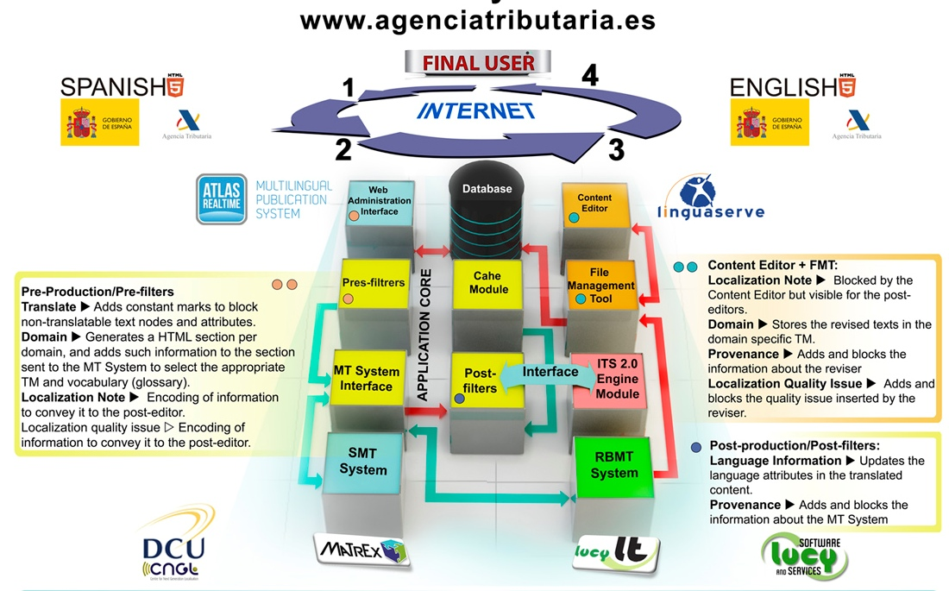
Online MT System I18N
ITS 2.0 Online Multilingual Publishing System
Cache Module

Slide 18
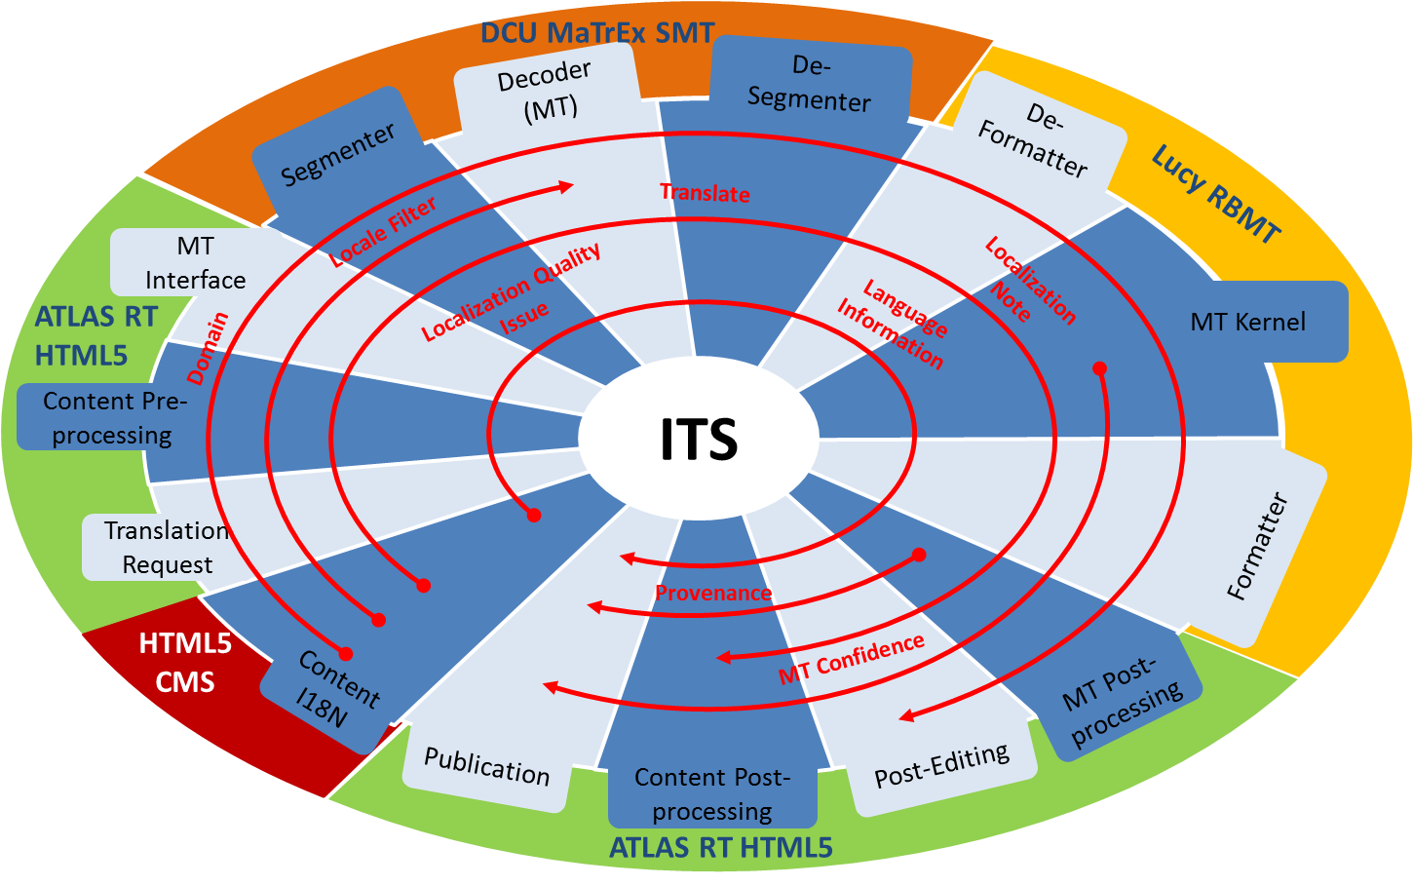
ITS 2.0 in Online MT System I18N
ITS 2.0 Online Multilingual Publishing System

Slide 19
ITS 2.0 immediate benefits
ITS 2.0 Online Multilingual Publishing System
ITS 2.0 increases user’s control and automatic decision processes:
  Translatability and language pair selection (Translate, Language information). It allows not to add “non-translatable” terms in specific glossaries or MT.
  Specific terminology to apply in the MT (Domain)
  Activation rules for MT post-editing (Localization Note)
  Quality aspects reported to translation consumer or post-editor (Localization Quality Issue)
  Post-editors judge quality of translation (MT Confidence)
  Identification of agents (provenance)

Slide 20
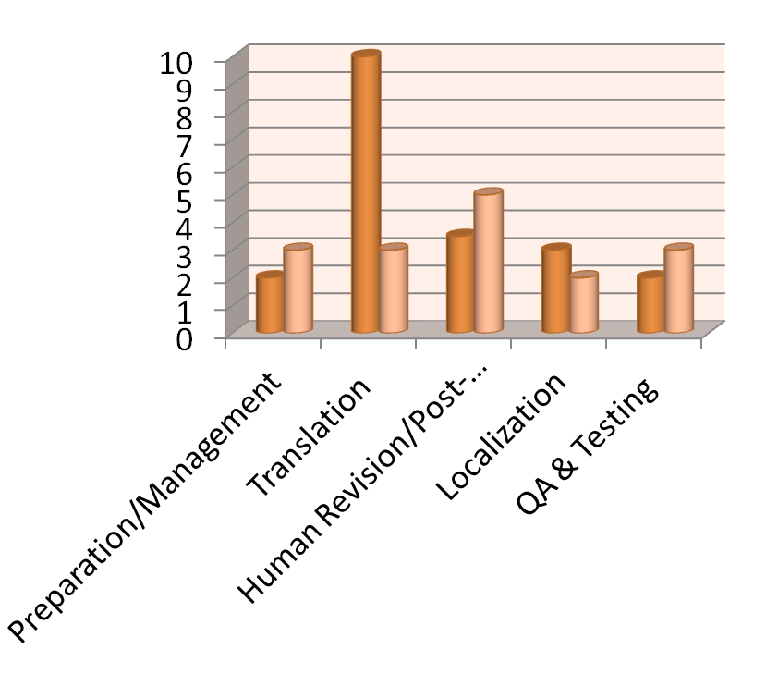
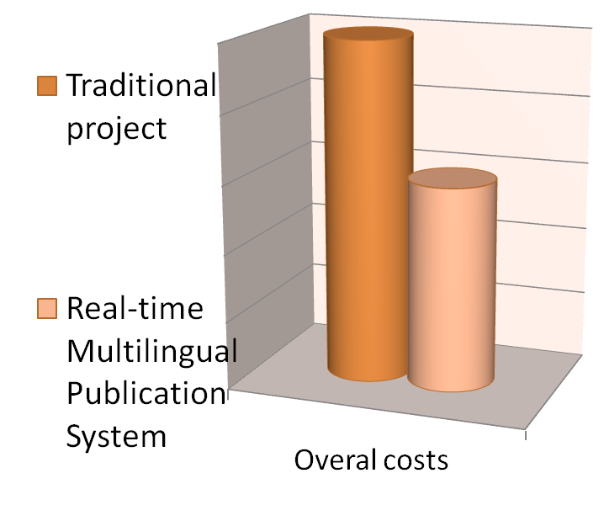
Shifting gears: New cost structure
ITS 2.0 Online Multilingual Publishing System

Slide 21
MLW-LT Online MT Business Case
ITS 2.0 Online Multilingual Publishing System
Strengths
Weaknesses
Lower translation costs (MT + PE) depending on % of post-editing (E.g. 100% post-edited: - 30%)
Management costs: higher setup / lower maintenance (-60%-80%)
Non-invasive technology
Real-time or fast post-edition
Viability dependent on :
Language combination and MT system output
Recent MT approaches (Hybrids, vertical sectors/users…)
Opportunities
Threats
Web sites with daily high volume updates: Ecommerce, Administration, Corporate news and publications, user content generated (social media)
In house installation for > 1 million words and frequently updated
Control, performance and security:
Real-time performance of MTs
Security level in shared RTMPS
Needs pre-editing and post-editing tools (ITS 2.0 and HTML5)
The client might lose control of the translation: solved with ITS 2.0

Slide 22

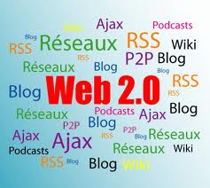
Business: Opportunities rise from needs
ITS 2.0 Online Multilingual Publishing System
e-Commerce
  Very high volume and rotation
  Short texts and repetitive descriptions
    Better for MT
    Quicker to post-edit
  Very sensitive to ITS 2.0 benefits
e-Government
  Controlled language and content policies
HTML from several CMS and other applications (Content source independent)
Web 2.0 and user content created
  GIST translation
  Immediacy

Slide 23
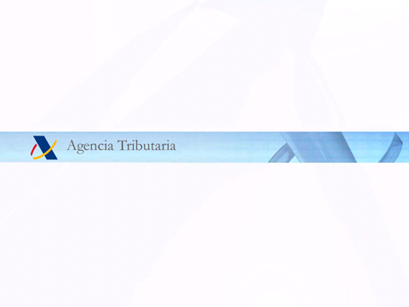
Use cases access and information
http://www.w3.org/International/its/wiki/ITS_Implementations
#CMS_Integration
#Real_Time_Multilingual_Publishing
Notes:
User: mlw-lt
Password: its2-wp4

Slide 24
ITS 2.0-Aware Interoperability CMS-TMS
ITS 2.0-Aware Online Multilingual Publishing System
Horizons
Notes:
PORTADA

Slide 25
Transversal View of Multilingual Web
Horizons: “Multilingual” Data value through the full creative flow
“Multilingual sensitive” content creation and exploitation:
  Automatic and assisted annotation and pre-editing tools to empower content creators and webmasters adoption.
  Linked Open Data and enrycher systems and tools.
  CMS, Web publishing systems, browsers, SEO and web applications.
  CMS-TMS interoperability standards (“Readiness”).
“Web sensitive” translation systems
  Management and Business Systems.
  Expert translation and localization systems and workflows.
  Performing and customizable Machine Translation (MT).
  MT Post-editing, Computer Assisted Translation and Terminology.
ITS 2.0: innovation opportunities for
key multilingual web applications.
Notes:
for many

Slide 26
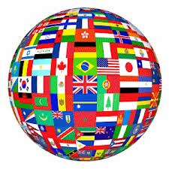
The Multilingual Web Server
Horizons: Digital single market in Europe and Big Data challenge
ITS 2.0 improves a full equipped multilingual web server:
  Interoperable Web Services.
  Real-time multilingual publishing and translation.
  Expert Translation and Localization Management Systems.
  Multilingual and interlingual Linked Open Data compliant.
  Collaborative and cloud solutions between MT and human translation.
  Maximizing re-use and productivity in pre and post-editing, lexical, terminological, and CAT Tools.
  Automated Quality Assurance.
  Operational and management virtual offices and interfaces.
Notes:
for many

Slide 27
Thank you! pedro.diez@linguaserve.com

