Slide 1
Text Analytics in ITS 2.0: Annotation of Named Entities
Tadej Štajner
Jožef Stefan Institute

Slide 2
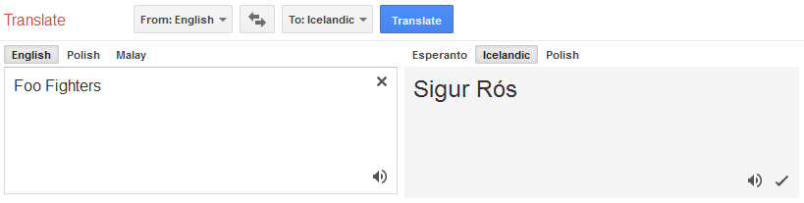
Motivation
Translating proper names
… can be problematic for statistical MT systems

Slide 3
Motivation (2)
Translation depends on source and target language:
  There are specific rules to translate (or transliterate) particular proper names or concepts
  Sometimes, they should not even be translated
Solution: figure out what is actually being mentioned and see if any existing translated expression exists for that entity

Slide 4
Motivation (3)
Localization of proper names:
  personal names, product names, or geographic names, chemical compounds, protein names
Names can appear without sufficient context:
  we can use ITS2.0 Text Analysis annotations to provide context for ambiguous content.

Slide 5
ITS2.0 Text Analysis
Support text analysis agents that enhance content by suggesting or identifying concepts, identities, identified by IRIs.
The data category provides three pieces of information:
  confidence
  entity type/concept class
  entity/concept identifier

Slide 6
ITS2.0 Text Analysis
<!DOCTYPE html>
<div
its-annotators-ref="text-analysis|http://enrycher.ijs.si/mlw/toolinfo.xml#enrycher">
<span
its-ta-ident-ref="http://dbpedia.org/resource/Dublin"
its-ta-class-ref="http://schema.org/Place">Dublin</span> is the <span
its-ta-ident-ref="http://purl.org/vocabularies/princeton/wn30/synset-capital-noun-3.rdf">capital</span> of <span
its-ta-ident-ref="http://dbpedia.org/resource/Ireland"
its-ta-class-ref="http://schema.org/Place">Ireland</span>.
</div>

Slide 7
Producing these annotations
NLP Techniques
  Named entity extraction & disambiguation
  Word sense disambiguation
Manual annotation

Slide 8
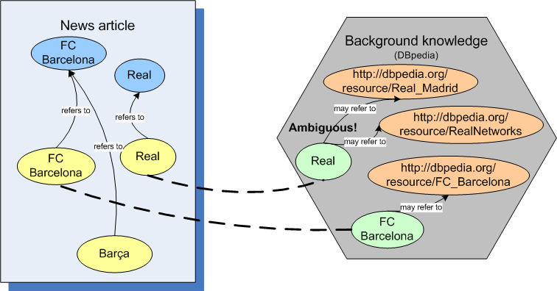
Named entity disambiguation
Document
Entity
Label
Mention

Slide 9
Use cases
Informing a human agent (i.e. translator) that a certain fragment of text is subject to follow specific translation rules: [this is taken up in OKAPI and the XLIFF generation]
  proper names
  officially regulated translations.
Informing software agent (i.e. CMS) about the conceptual type of a textual entity in order to enable special processing or indexing;
  geographic names
  personal names
  product names
  chemical compounds

Slide 10
Open issues
Text Analysis data category can’t represent stand-off annotations, so only one layer can be done
Support for the domain data category via text analysis tools

Slide 11
Business case
By itself, it’s infrastructure that indirectly supports business cases by supporting other technical scenarios
[Clemens:] Having metadata saves time,
  producing it automatically can compound the savings
[XLIFF roundtrip:] Human as well as machine consumption of this metadata

Slide 12
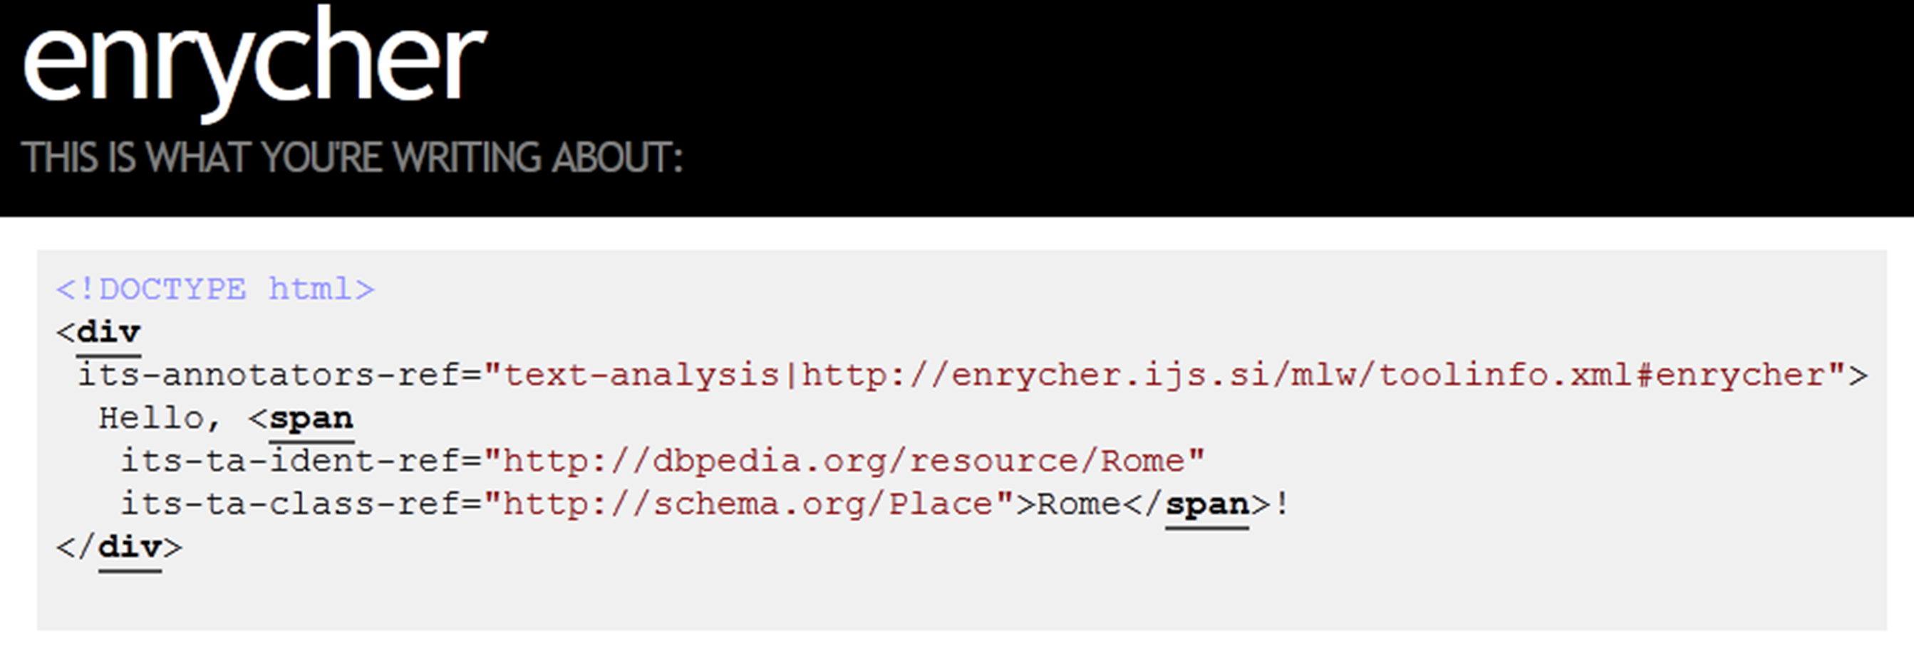
Demo
http://enycher.ijs.si/mlw/

