Slide 1
ITS 2.0 Ontology: Integrating ITS in RDF, NIF and the PROV ontology
Leroy Finn, Dave Lewis, Sebastian Hellman, Felix Sasaki and Dominic Jones
Presented by Dominic.Jones@scss.tcd.ie
Trinity College Dublin, Ireland.

Slide 2
Presentation Overview:
Introduction to ITS 2.0 Tag Set
RDF Overview
Ontology Overview
ITS XML / HTML to NIF & RDF
ITS 2.0 / RDF Ontology
Core Provenance Ontology
Worked Example
Next Steps

Slide 3
Internationalisation Tag Set (ITS 2.0)
Allows I18n and L10n tools to be instructed to treat specific text in specific ways and to record workflow actions
Principles:
Minimise disturbance of original content
Don’t reinvent wheel
Link to existing meta-data before adding new
ITS2.0 is “Dublin Core” of the Multilingual Web
Persistent semantics across content formats

Slide 4
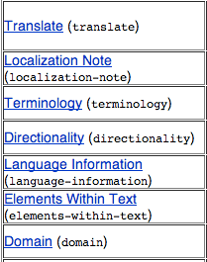
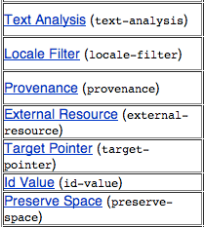
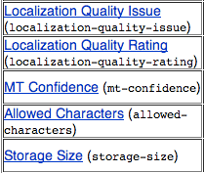
Internationalisation Tag Set (ITS 2.0)
http://www.w3.org/TR/its20/#datacategory-description
Simple
Translate
Example

Slide 5
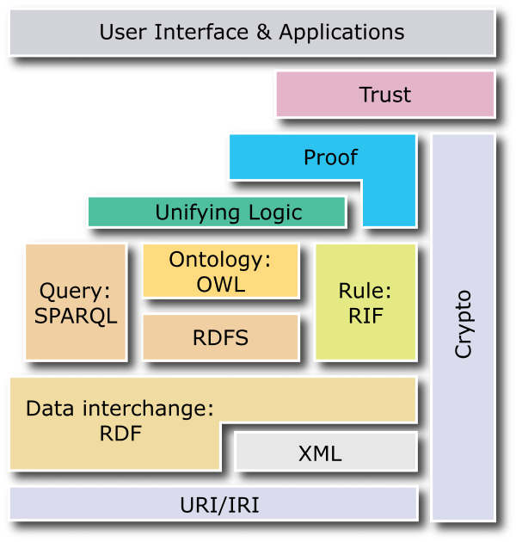
W3C Semantic Web Standards
Scalable in extension, good for incremental adoption
Link XML content and RDF meta-data (RDFa)
Leverage existing vocabularies, e.g. Dublin Core, Open Provenance Model, Creative Commons
Maturing Tools & Stores
RDF(S)
Subject-Property-Object
Name Spaces
URI
Classes and Subclasses
Range and Domain
Notes:
There has long been a quest to attach meaning to the content on the web, of the sort that can be used by machines, as well as people. If we can disambiguate the nasty conceptual mess that we navigate, we can make computers do more work for us, we can link knowledge together and maybe see some interesting results.
This is the Semantic ‘Layer Cake’, which shows the key technologies which are supposed to participate in the creation of the Semantic Web. Over the years, the boxes nearer the top have divided and been filled with technologies.

Slide 6
From Data Store to RDF
ISBN | Title | Author | Publisher ID | Pages
596002637 | Practical RDF | S. Powers | 7642 | 350
596000480 | Javascript | D. Flanagan | 3556 | 936
... | ... | ... | ... | ...
Row=Subject, Colum=Property, Cell=Object Value
This example from http://research.talis.com/2005/rdf-intro/

Slide 7
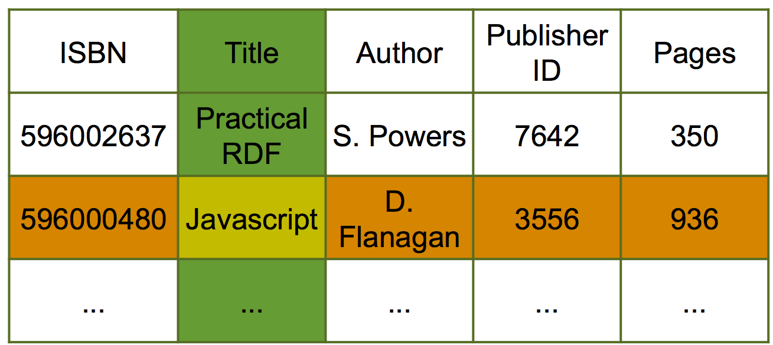
Graph View
subject
property
object
596000480
isbn
aBook
title
“Javascript”
publisher
3556
name
“O’Reilly”
Row=Subject, Colum=Property, Cell=Object Value
This example from http://research.talis.com/2005/rdf-intro/
Notes:
The key take home from this is that we can identify things, and we can identify labelled parts of things. That’s RDF in a nutshell.

Slide 8
Ontology 101
Classes model concepts
Cat, Sheep
Properties of concepts and relationships between them
Define characteristics of a class
Arbitrary relationships
Special relationships
isA subclass / superclass / subsumption
Transitive
E.g. “smaller_than”
Symmetric
E.g. “friendly_with”
Equivalence
“feline” is equivalent to “cat”
animal
vermin
domestic
dog
cat
cow
rodent
eats
mouse
isA
relationships

Slide 9
Ontology 102
Constraints or axioms on properties and concepts:
value: integer
domain: cat
cardinality: at most 1
range: 0 <= X <= 100
cows are larger than dogs
cats and dogs are disjoint
Individuals or Instances
Jerry, Mickey, Felix, Tom.
Ontologies for the semantic web
Every class, property, instance has a URI
animal
vermin
domestic
dog
cat
cow
rodent
eats
mouse
felix
tom
mickey
jerry

Slide 10
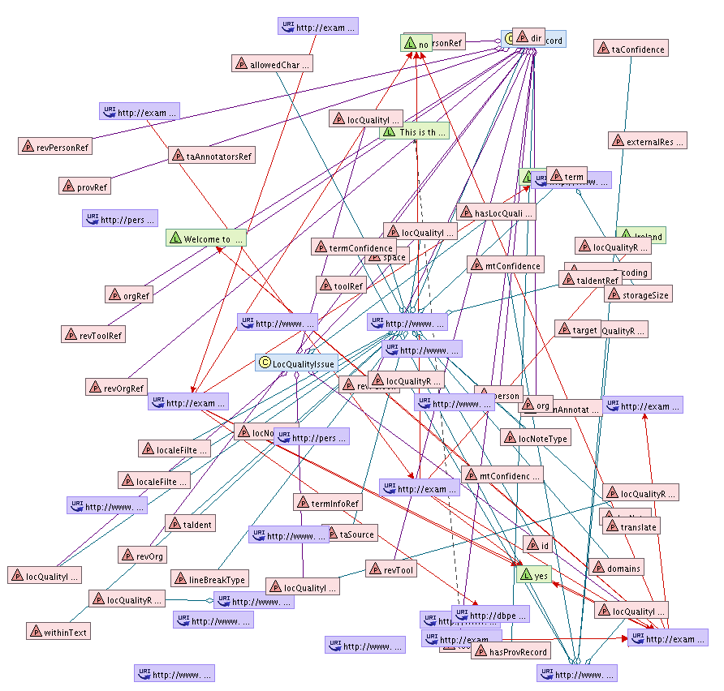
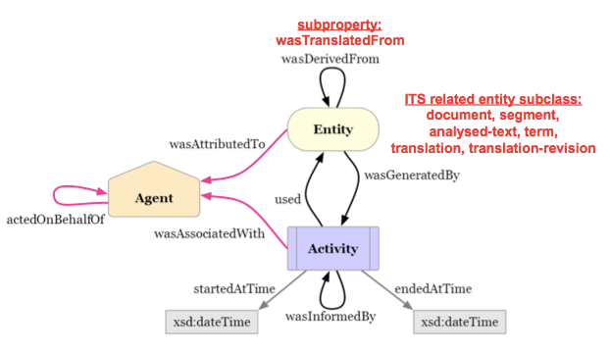
ITS XML / HTML to NIF & RDF:
ITS/RDF Ontology
OR
XML
The PROV Ontology
ITS 2.0
NIF-RDF
http://www.w3.org/TR/its20/#conversion-to-nif

Slide 11
Ontologies & NIF:
Given that an Ontology can be thought of formal, explicit specification of a shared conceptualisation:
The data categories in the ITS 2.0 W3C specification is provides a non-machine readable ontological model.
NLP Interchange Format (NIF) is an RDF/OWL-based format that aims to achieve interoperability between Natural Language Processing (NLP) tools, language resources and annotations.
http://persistence.uni-leipzig.org/nlp2rdf/

Slide 12
ITS 2.0 / RDF Ontology
Set of properties that can be applied to an RDF representation of a string(s) from a document.
Multiple sets of properties can be applied to the same string. (Prov Record and LocQualityIssue)
http://www.w3.org/2005/11/its/rdf-content/its-rdf.html

Slide 13
Semantic Model: PROV-O extension
W3C Provenance WG http://www.w3.org/2011/prov/
subproperty:
wasTranslatedFrom
ITS related entity subclass:
document, segment,
analysed-text, term,
translation, translation-revision
From: http://www.w3.org/TR/prov-primer/

Slide 14
Worked Example
Data categories being used in this example are:
Translate (Whether elements of text should be trans).
Domain (The domain for the document).
ElementsWithinText (e.g. Quotations in text).
Terminology (Keywords in text, e.g. “Motherboard”).
TextAnalysis (Enriched semantic annotations).
Provenance (History of the document).
LocQualityIssue (Misspellings, mistranslations, etc.).
This example uses NIF and shows the conversion from HTML to RDF using the ITS-RDF ontology to structure the data.

Slide 15
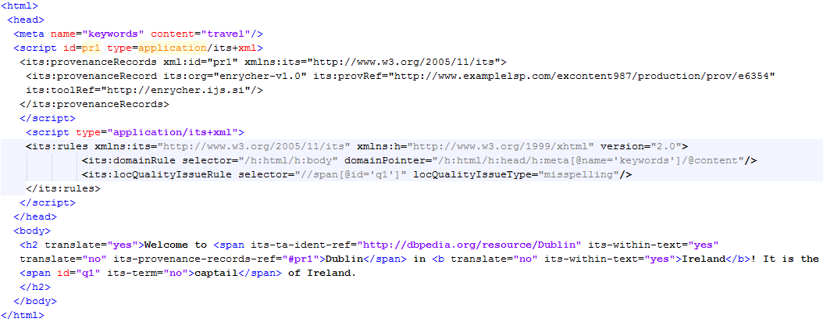
Example HTML
Domain
Provenance
TextAnalysis
ElmWithinText
Translate
LocQualityIssue & Terminology

Slide 16
ITS-RDF Ontology
The URI’s in the example are calculated via the NIF conversion algorithm: http://www.w3.org/TR/its20/#conversion-to-nif
The URI’s contain the char position of data.
The first URI is the (NIF type) “context” and gives the textual overview of the document.
The subsequent URI’s contain the char positions of data based on the context which ITS data has been applies.

Slide 17
Details of Clases & Properties Used
Both classes from the ontology are being used:
LocQualityIssue
ProvRecord
The following OWL Datatype Properties are used :
itsrdf:translate, itsrdf:domains, itsrdf:withinText, itsrdf:org, itsrdf:hasLocQualityIssueType
The following OWL Object Properties are used :
itsrdf:taIdentRef, itsrdf:provRef, itsrdf:toolRef, its:hasProvRecord(range is ProvRecord class), tsrdf:hasLocQualityIssue (range is LocQualityIssue class)

Slide 18
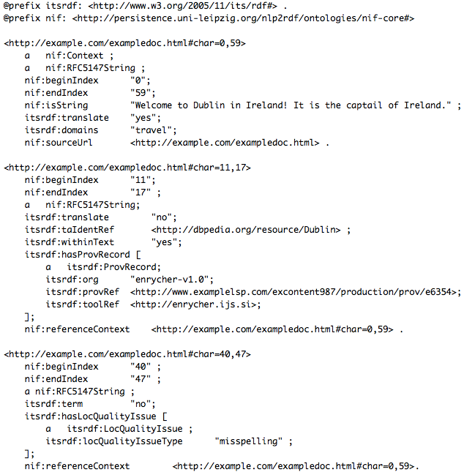
Output RDF

Slide 19
Next Steps:
Driving forward the usage and apoption of ITS-RDF Ontology via:
MLW-LT WG: Multilingual Web Language Technology (W3C Working Group). http://www.w3.org/International/multilingualweb/lt/
BP-MLODE CG: Best Practices for Multilinugal Linked Open Data (W3C Community Group http://www.w3.org/community/bpmlod/
LIDER: Linked Data as an enabler of cross-media and multilingual content analytics for enterprises across Europe (EU-FP7 CSA under negotiation).
MLI: Towards a Multilingual Data & Services Infrastructure (EU-FP7 CSA under negotiation).
FALCON: Federated Active Linguistic data CuratiON (EU-FP7 STREP under negotiation).
CNGL: GLOBIC Content Model, applied across the center's research themes. http://www.cngl.ie/research/research-areas/interoperability-and-analytics/
For more information please contact Dominic.Jones@scss.tcd.ie, Dave.Lewis@scss.tcd.ie or hellmann@informatik.uni-leipzig.de

