Slide 1
Implementing ITS 2.0 for post-editing purposes
Celia Rico Universidad Europea | Pedro L. Díez Orzas Linguaserve I.S. S.A. | Felix Sasaki DFKI / W3C fellow

Slide 2
“This paper presents part of the work carried out in EDI-TA, in the context of the project MultilingualWeb-LT. The aim is to implement the Internationalization Tag Set 2.0 (ITS 2.0) in an MT context for post-editing purposes. After a brief review of MultilingualWeb-LT’s main objectives and a presentation of ITS 2.0 major features, our paper will concentrate on the description of an Online MT showcase. Here ITS 2.0 information, so called “data categories”, are tested in a post-editing scenario.”
Notes:
PORTADA

Slide 3
Special thanks
Pablo Nieto Caride, Felix Fernández, Consuelo Aldana, Mauricio del Olmo, Laura Guerrero, Giuseppe Deriard Nolasco, Pablo Badía (Linguaserve)
Ankit Srivastava, Declan Groves (Dublin City University)
Thomas Ruedesheim (Lucy Software)
Román Díez, Alberto Crespo (Spanish Tax Office)

Slide 4
Working context
ITS 2.0 data categories for PE purposes
Online MT Showcase
Annotation strategy, processing and output
ITS 2.0 PE contextual information
Conclusion
Notes:
PORTADA

Slide 5
Multilingual Content Production needs help
“Which data elements need to be translated?”
<rsrc id="123"> ...
<data type="text">images/cancel.gif</data>
<data type="position">12,20</data>
<data type="text“>Cancel</data>
<data type="position">60,40</data>
<data type="text“>Number of files: </data>
</rsrc>

Slide 6
ITS 2.0 – the help
Comprehensive
Supports internationalization, translation, localization and other aspects of the multilingual content production cycle
Standardized
Building on ITS 1.0
Metadata
Data categories, values etc.

Slide 7
ITS 2.0 data categories – the list
Translate, Localization Note, Terminology, Directionality, Language Information, Elements Within Text, Domain, Text Analysis, Locale Filter, Provenance, External Resource, Target Pointer, Id Value, Preserve Space, Localization Quality Issue, Localization Quality Rating, MT Confidence, Allowed Characters, Storage Size

Slide 8
Working context
ITS 2.0 applies to the whole process of multilingual content production and has also a direct impact in the use of MT.
Data categories support the different automated backend processes of this service type
One of such services is MT post-editing (PE)

Slide 9
EDI-TA was designed as a subproject of MultilingualWeb-LT with the following objectives:
Contribute to defining metadata suitable for post-editing purposes.
Test the contribution of metadata in order to improve post-editing processes.
Define a practical methodology for post-editing between distant languages pairs.
Suggest improvements in the MT system so as to optimize the output for post-editing specific purposes.
Define a methodology for training post-editors in the following language pairs: ES, EN, FR and EU.

Slide 10
Working context
ITS 2.0 data categories for PE purposes
Online MT Showcase
Annotation strategy, processing and output
ITS 2.0 PE contextual information
Conclusion
Notes:
PORTADA

Slide 11
ITS 2.0 data categories used for PE purposes in EDI-TA
Data category | PE purposes
Translate | Informing the post-editor of sentences or sentence fragments should or should not be translated
Localization note | Providing post-editors with the necessary information to review the text in order to help them disambiguate and improve the quality and accuracy of the revision
Language information | Points to part of content in a language different from the rest, which could require MT and post-editing for an specific language pair.
Domain | It enables automatic selection of MT terminology, post-editor selection, and is a key to content disambiguation.
Provenance | Assessing how translation agents may impact the quality of the translation. Translation and translation revision agents can be identified as a person, a piece of software or an organization that has been involved in providing a translation that resulted in the selected content.
Localization quality issue | Detecting possible localization issues such as terminology, mistranslation, omission …

Slide 12
Working context
ITS 2.0 data categories for PE purposes
Online MT Showcase
Annotation strategy, processing and output
ITS 2.0 PE contextual information
Conclusion
Notes:
PORTADA

Slide 13
Online MT Showcase
Purpose of the showcase: to demonstrate usage of ITS 2.0 data categories in HTML, applying Real Time Multilingual Publishing Systems (RTMPS), using both Rule Base and Statistical Machine Translation”, in industrial showcase with the Spanish Tax Office

Slide 14
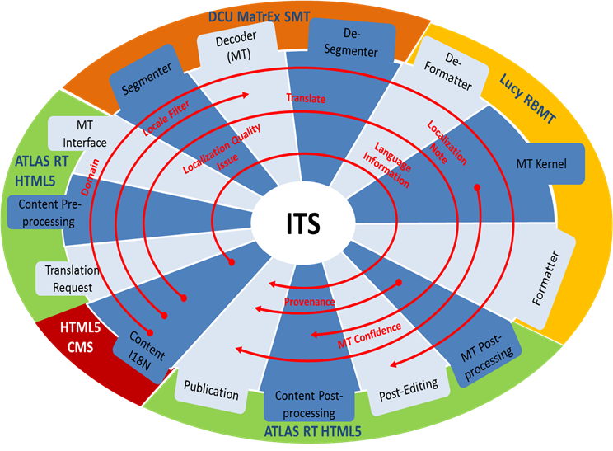
Annotation strategy

Slide 15
An example: Data category “localization note”
Stage 1. Annotation.

Slide 16
Stage 2. Processing/conversions
Detect note and convert to Special Plain Text (SPT)
MT system recognises SPT pattern and blocks its translation
When the revision process ends, the new revised file is generated and parsed to convert again the new mark-up into the original SPT so as to be loaded in the “Translation Memory”, where post-editing will then be performed.

Slide 17
Stage 3. HTML5 Output
After the processing the system will leave the note as it is

Slide 18
ITS 2.0 PE contextual information
an annotation tagging a whole page to indicate the context
use of the appropriate terminology in the source language
an annotation on style

Slide 19
Working context
ITS 2.0 data categories for PE purposes
Online MT Showcase
Annotation strategy, processing and output
ITS 2.0 PE contextual information
Conclusion
Notes:
PORTADA

Slide 20
Conclusion
Notes provide the post-editor with the necessary information for conducting a successful review: avoiding ambiguity, improving consistency and accuracy, using the correct terminology.
The use of notes make sentences slightly less understandable and more cryptic as they have tags with the explanations inserted directly between their words.
Additionally, in the event of finding an issue related to the source text or to the translation engine during the post-edition, the post-editor would have to insert an ITS 2.0 Localization Quality Issue annotation manually (more conveniently by copy-pasting the code).
The system could become faster and more efficient if there was an option in the post-editing tool that allowed the user to automatically add the html code with the issue’s information.

Slide 21
Further information
ITS 2.0 specification
http://www.w3.org/TR/its20/
Usage scenarios
http://www.w3.org/International/its/wiki/Use_cases_-_high_level_summary
Implementations
http://www.w3.org/International/its/wiki/ITS_Implementations
User & implementers feedback at
public-i18n-its-ig@w3.org

Slide 22
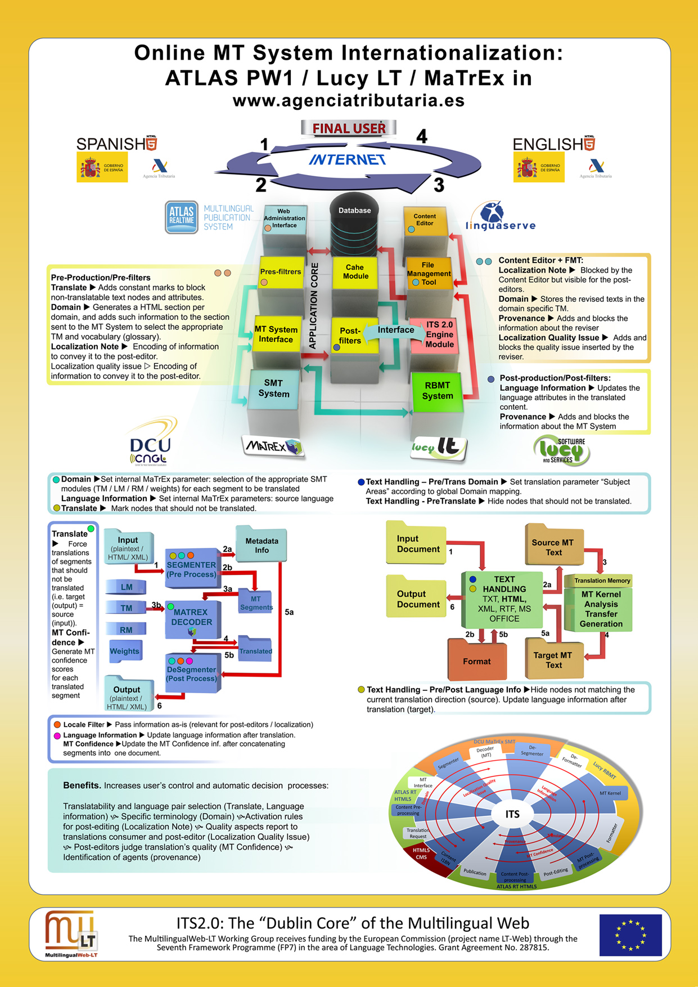
Thank you

