Slide 1
W3C ITS 2.0 http://www.w3.org/TR/its20/
Facilitating Automated Creation and Processing of Multilingual Web Content
Felix Sasaki (W3C, DFKI), Christian Lieske (SAP AG)

Slide 2
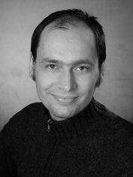
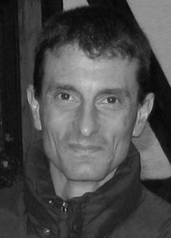
Authors
Prof. Dr. Felix Sasaki DFKI/FH Potsdam/W3C | Christian Lieske Globalization Services SAP AG
Appointed to Prof. in 2009; since 2010 senior researcher at DFKI (LT-Lab) Working in German-Austrian W3C-Office Before, staff of the World Wide Web Consortium (W3C) in Japan Main field of interest: combined application of W3C technologies for representation and processing of multilingual information Studied Japanese, Linguistics and Web technologies at various Universities in Germany and Japan | Knowledge Architect Content engineering and process automation (including evaluation, prototyping and piloting) Main field of interest: Internationalization, translation approaches and natural language processing Contributor to standardization at World Wide Web consortium (W3C), OASIS, Unicode Consortium and elsewhere Degree in Computer Science with focus on Natural Language Processing and Artificial Intelligence

Slide 3
Overview
Motivation for ITS (1.0 and 2.0)
Basic principles
Why ITS 2.0?
Selected data categories
Implementations and usage scenarios
Outlook and pointers for more information

Slide 4
Multilingual content production
Seen from the moon
Seen from an airplane
Seen from a desktop
Internationalize
Create
Specify directionality
Localize
Internationalize
Mark-up terminology
Translate
Translate/Localize
Add links about entities
Publish
Extract / filter content
Harvest
Segment
Analyze
Run through MT
Generate translation kit
Assess (linguistic) quality
Run post-production

Slide 5
Multilingual content production needs help
“Which data elements need to be translated?”
<rsrc id="123"> ...
  <data type="text">images/cancel.gif</data>
  <data type="position">12,20</data>
  <data type="text“>Cancel</data>
  <data type="position">60,40</data>
  <data type="text“>Number of files: </data>
</rsrc>

Slide 6
ITS 2.0 – The help
Comprehensive
Supports internationalization, translation, localization and other aspects of the multilingual content production cycle
Standardized
Building on W3C ITS 1.0 (W3C Recommendation)
Meta data
data categories, values etc.

Slide 7
Pitch: Why is this important?
Large quantities of multilingual data to be produced under time pressure
Ambiguous content needing accuracy, esp. with quicker turnarounds
An automated solution has been lacking and is getting more urgent
ITS 2.0 represents a solution that has been developed with a wide range of actors from the internationalization/localization/language technology space

Slide 8
Overview
Motivation for ITS (1.0 and 2.0)
Basic principles
Why ITS 2.0?
Selected data categories
Implementations and usage scenarios
Outlook and pointers for more information

Slide 9
ITS 2.0 Basic principles
Say important things
“Do not translate”
About specific content
“All or selected data elements”
In a standard way
With agreed upon syntax and values

Slide 10
1. Say important things:
ITS 2.0 “data categories”
Translate
Localization Note
Terminology
Directionality
Language Information
Elements Within Text
Domain
Text Analysis
Locale Filter
Provenance
External Resource
Target Pointer
Id Value
Preserve Space
Localization Quality Issue
Localization Quality Rating
MT Confidence
Allowed Characters
Storage Size

Slide 11
2. About specific content:
Content selection approaches
ITS selection can be compared to CSS
global = “style” element
local = “style” attribute
Selection global
Selection local
XPath (or CSS) to select markup nodes
ITS local attributes
<rsrc ...>
<its:rules xmlns:its="http://www.w3.org/2005/11/its" version="2.0">
<its:translateRule selector="//data" translate="no"/>
</its:rules>
  <data type="text" its:translate="yes">Cancel</data>
  <data type="position">60,40</data> ... </rsrc>

Slide 12
3. In a standard way (1/2)
Pre-defined (if appl.) meta data values
“Translate”: “yes” or “no”
Specific defaults (if appl.)
Elements: translate “yes”, attributes: translate “no”
Specific HTML5 behaviour
E.g. “alt” attribute default “yes”

Slide 13
3. In a standard way (2/2)
Independent
/orthogonal
Dublin Core, xml
Strict conformance clauses
Supported ITS 2.0 data categories
Supported selection mechanism (local / global) and type of content (HTML / XML)
Powerful (e.g. easy combination)
Test suite to guide implementers and users https://github.com/w3c/its-2.0-testsuite
Example: locQualityIssueComment in addition to storageSize

Slide 14
Overview
Motivation for ITS (1.0 and 2.0)
Basic principles of ITS
Why ITS 2.0?
Selected data categories
Implementations and usage scenarios
Outlook and pointers for more information

Slide 15
Why ITS 2.0 (1/2)
ITS 1.0 = simplified view of multilingual content production
Too limited for comprehensive automated content processing/usage scenarios (see http://www.w3.org/TR/mlw-metadata-us-impl/ for various ITS 2.0 usage scenario descriptions)
Example limitation: too few data categories

Slide 16
Why ITS 2.0 (2/2)
Coverage for additional types of content: HTML5
Easy bridge to main Web formats
Accommodate relevant HTML5 markup (e.g. HTML5 “translate” attribute behaviour)
Easy mapping/conversion to other formats
XML Localization Interchange File Format (XLIFF) = bridge to localization workflows; status: informal mapping, under discussion, for XLIFF 1.2 mostly stable.
Natural Language Processing Interchange Format (NIF) = bridge to the Semantic Web and Natural Language Processing; status: informal mapping
Introduced traceability
Which tool produced what?
ITS RDF Ontology
To make ITS a first-class citizen of the Semantic Web (see http://www.w3.org/2005/11/its/rdf-content/its-rdf.rdf)
Some parts of ITS 1.0 needed to go (at least temporarily)
Ruby, dir

Slide 17
ITS 2.0 in HTML5 (1/3)
Difference in syntax for local markup
<myXMLVocabulary ...>
<span its:term="yes"
its:termInfoRef="http://example.com/terms/t1"> ...
</myXMLVocabulary>
<!DOCTYPE html> ...
<span its-term="yes"
its-term-info-ref="http://example.com/terms/t1"> ...
</html>

Slide 18
ITS 2.0 in HTML5 (2/3)
Link to global rules via HTML “link” element
<!DOCTYPE html> ...
<link href=EX-translateRule-html5-1.xml rel=its-rules> ... </html>

Slide 19
ITS 2.0 in HTML5 (3/3)
Accommodation of existing HTML5 markup
<!DOCTYPE html><html lang="en" ...
<p id="p1" translate="no">This is a <em>motherboard</em> and
image: </p>
<img src="http://example.com/myimg.png" alt="My image"/> ...
</html>
ITS 2.0 processors “understand” without ITS markup:
“p” is not translatable
“alt” attribute at “img” is translatable
Language is “en”
“id” attribute at “p” is an “ID Value” data category value
“em” is “within text” (part of another text flow)

Slide 20
ITS 2.0 in XHTML
Consumption on the Web: use HTML5 its-* syntax
<html xmlns="http://www.w3.org/1999/xhtml">...
<p>Don't use
<span its-loc-note="Internationalization Tag Set">ITS</span> prefixed attributes inside the content, like its:locNote.</p>
</body>
</html>
Consumption in XML workflows: use XML its:* syntax and process as XML

Slide 21
ITS Mime Type
its+xml – registered at
http://www.iana.org/assignments/media-types/application/its+xml
Applicable for ITS 1.0 and ITS 2.0 content
One important means to foster ITS adoption on the web

Slide 22
What went away?
Where did “Ruby” go?
  Data category dropped from ITS2
  Current definition in HTML5 not yet stable
  Update of ITS2 might add then stable Ruby again
“Directionality” defined in terms of HTML 4.01
  Again awaiting stability in HTML5

Slide 23
Overview
Motivation for ITS (1.0 and 2.0)
Basic principles of ITS
Why ITS 2.0?
Selected data categories
Implementations and usage scenarios
Outlook and pointers for more information

Slide 24
Text analysis
Annotate named entities or other „conceptual items“
- identify items that need special translation rules
- assist in disambiguation of homonyms (e.g. the string “Armstrong” – dozens of meanings in Wikipedia)
<!DOCTYPE html> ...
<span
its-ta-confidence="0.7"
its-ta-class-ref="http://nerd.eurecom.fr/ontology#Movie"
its-ta-ident-ref=
"http://dbpedia.org/page/My_Neighbor_Totoro">
となりのトトロ</span>...</html>

Slide 25
Domain
Identify the topic or subject field of content
Example usage: choose the MT engine that fits to the domain
...<its:domainRule
selector="/h:html/h:body"
domainPointer=
"/h:html/h:head/h:meta[@name='dcterms.subject']/@content"
domainMapping=
"automotive auto, medical medicine, 'criminal law' law, 'property law' law"/>...

Slide 26
MT Confidence
Score from machine translation engine
Example for ITS2 capability: Tool traceability
<!DOCTYPE html> ...
<body its-annotators-ref="mt-confidence|file://tools.xml#T1">
<p>
<span its-mt-confidence=0.8982>Dublin is the capital of
Ireland.</span></p>
</body></html>

Slide 27
Locale Filter
Content relevant only for a specific locale
<!DOCTYPE html> ...
<div its-locale-filter-list="*-ca">
<p>Text for Canadian locales.</p>
</div>
<div its-locale-filter-list="*-ca" its-locale-filter-type="exclude">
<p>Text for non-Canadian locales.</p> </div> ...

Slide 28
Localization Quality Issue
For quality assessment
<!DOCTYPE html> ... <span
its-loc-quality-issue-comment="should be 'quality'"
its-loc-quality-issue-profile-ref=http://example.org/qaMovel/v1
its-loc-quality-issue-severity=50
its-loc-quality-issue-type=misspelling>qulaity</span> ...

Slide 29
Overview
Motivation for ITS (1.0 and 2.0)
Basic principles of ITS
Why ITS 2.0?
Selected data categories
Implementations and usage scenarios
Outlook and pointers for more information

Slide 30
Tooling for:
Content creation
Content enrichment
Workflows transporting ITS 2.0 between formats
  Source formats (e.g. DocBook > HTML)
  XLIFF roundtripping
A detailed example: ITS 2.0 processed via the OKAPI framework

Slide 31
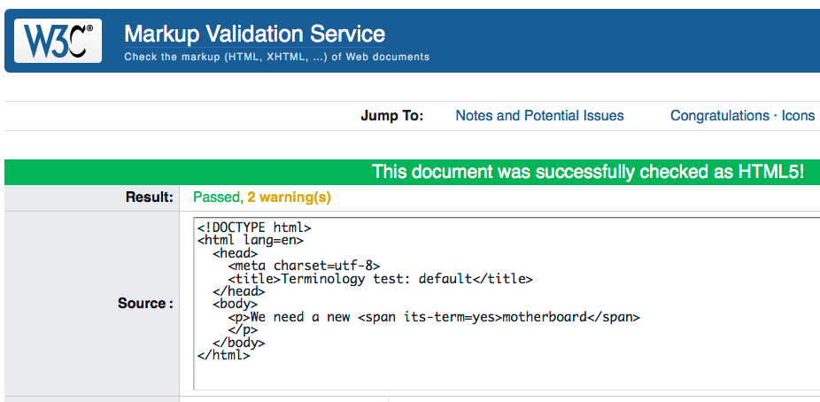
Helping creators: validation of HTML5

Slide 32
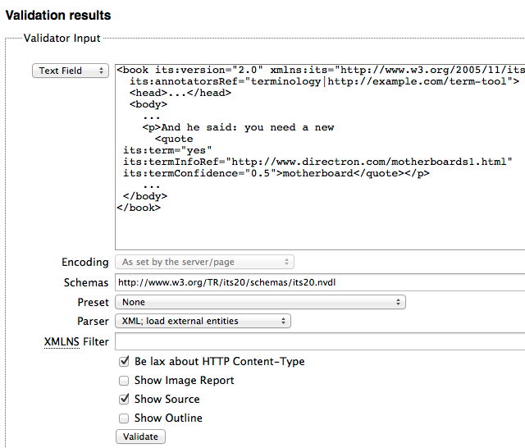
... and XML
Tool: validator.nu
Basis for HTML5 and XML validation
HTML5 ITS Tools
https://github.com/kosek/html5-its-tools
ITS 2.0 validation of file sets
Syntax conversion: HTML5 <> XML

Slide 33
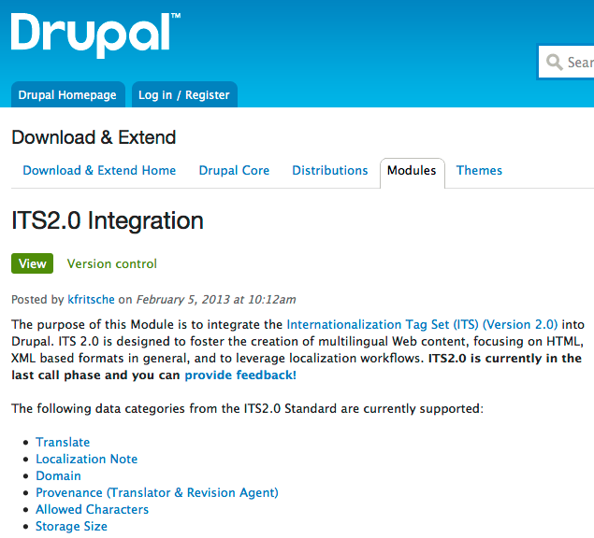


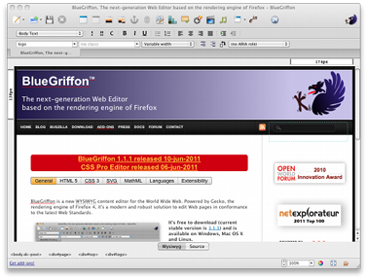
Helping creators: (plugins for) editing support
BlueGriffon
web editor
General JavaScript ITS2 parser
http://plugins.jquery.com/its-parser/

Slide 34
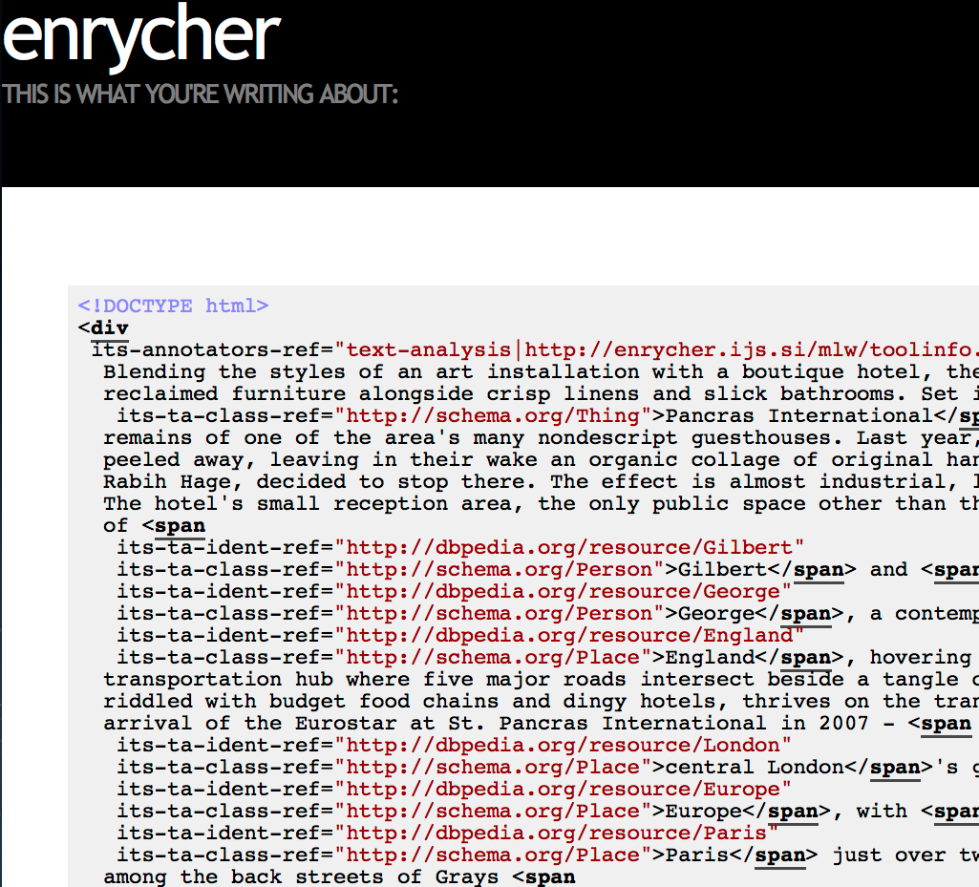
Adding more value to content: Named Entity Recognition and Disambiguation
See
http://enrycher.ijs.si/mlw/

Slide 35
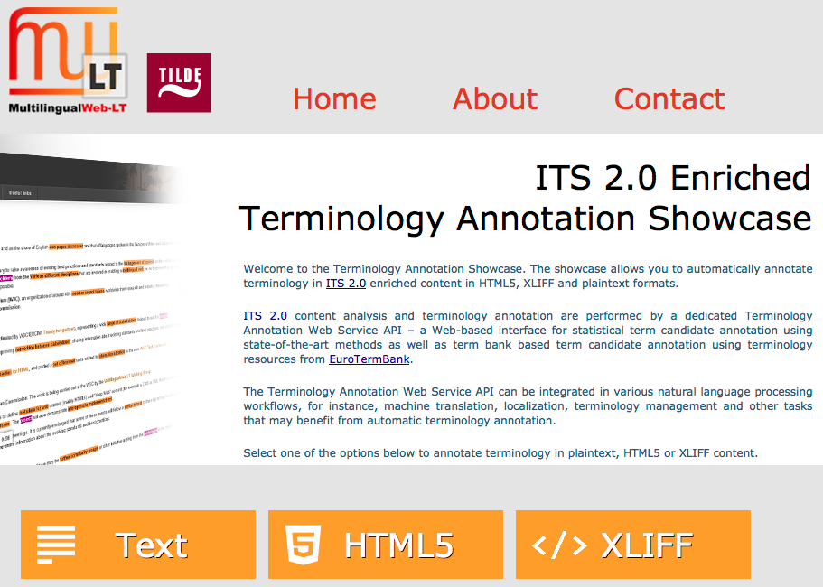
Adding more value to content: Generation of terminology markup
See
http://taws.tilde.com/

Slide 36
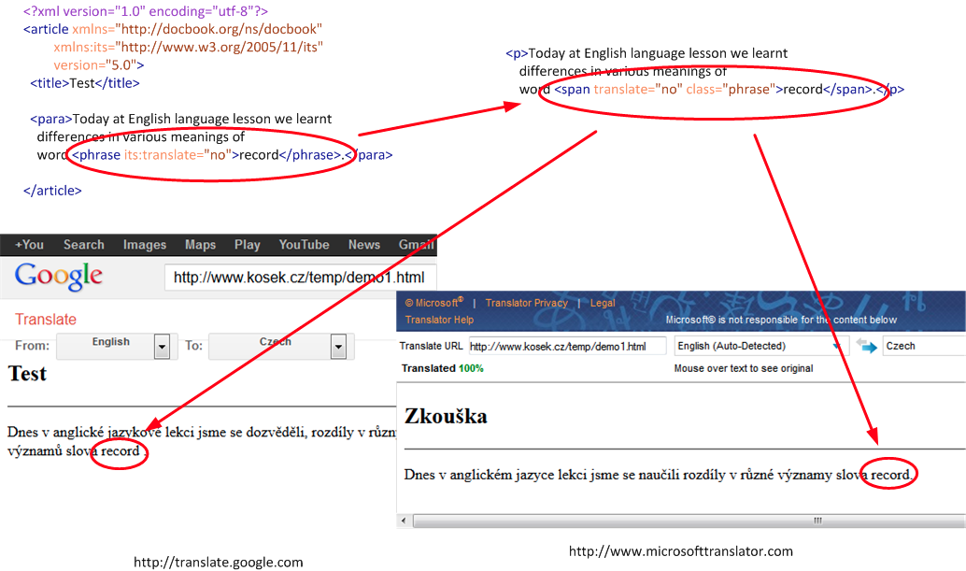
Format conversion and more:
DocBook - > HTML - > online MT
See http://xmlguru.cz/2013/05/docbook-and-its2

Slide 37
Service Oriented Localisation Architecture Solution (SOLAS)
See
http://mlwlt.moravia.com/mlwlt-web-test/Presentation.aspx
XLIFF in, (MT-translated) XLIFF out
ITS 2.0 mapped into XLIFF
Consumes data categories: Translate, Domain and Text Analysis
Generates metadata for data categories: Provenance and MT Confidence

Slide 38
A detailed example:
ITS2 processing with OKAPI framework
See http://okapi.opentag.com/
Components and applications for localization and translation
ITS1 and ITS2 (ongoing) implemented in many usage scenarios
Scenarios and examples provided by Yves Savourel (ENLASO); run with Rainbow & CheckMate tools

Slide 39
ITS2-aware XLIFF generation
<td class="totrans">
The Lost Temples of the Khmer</td>
<its:translateRule selector="//h:*[@class='totrans']"
translate="yes"/>
<its:storageSizeRule selector="//h:td[@class='totrans']"
storageSize="30"/>
<trans-unit ... <source xml:lang="en-us" its:storageSize="30">
The Lost Temples of the Khmer</source>

Slide 40
ITS2 “domain” mapping: choosing the ‘travel’ MT engine
<meta content="vacation packages" ... <td ...>
The Lost Temples of the Khmer</td>
<its:domainRule ...
domainPointer=
"/h:html/h:head/h:meta[@name='dcterms.subject']/@content"
domainMapping="'vacation packages' travel"/>
<trans-unit itsxlf:domains="travel"....
<target xml:lang="fr-fr">Les temples perdus des Khmers</target>

Slide 41
Segmentation, MT and quality checks
<td class="totrans">
Canyon X and the Land of the Navajo</td>
<its:domainRule .../>
<its:translateRule .../>
<its:storageSizeRule ... storageSize="30"/>
<target ... its:storageSize="30" its:locQualityIssueComment="Number of bytes in the target (using UTF-8) is: 32. Number allowed: 30." ... <mrk...>Canyon X et la terre des Navajos</mrk>...

Slide 42
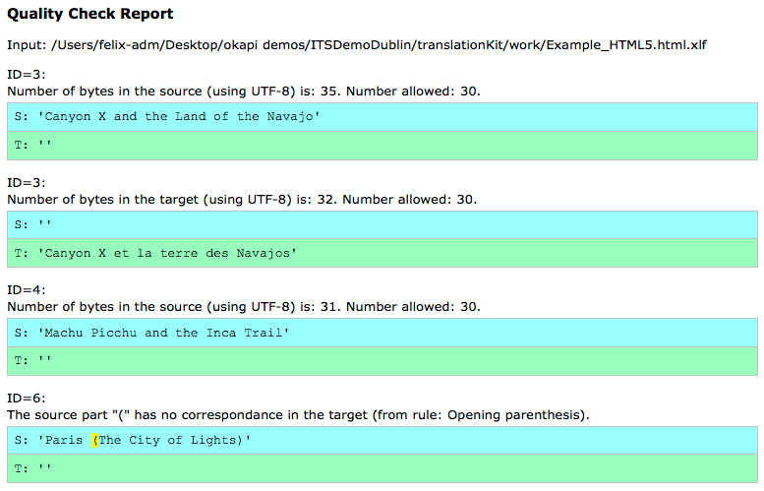
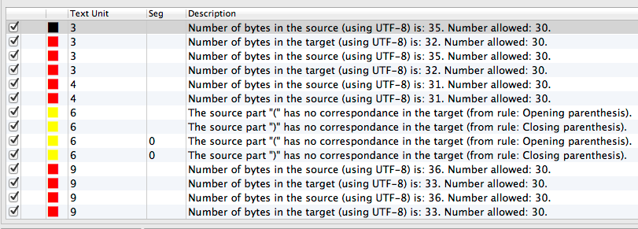
Quality check details
Rainbow
HTML output
CheckMate
tool report

Slide 43
Breaking news: Okapi Ocelot Editor
See http://open.vistatec.com/ocelot/
Open Source Java based XLIFF+ITS 2.0 Editor
Supports Localization Quality Issue, Provenance and MT Confidence
Also general XLIFF 1.2 editor

Slide 44
Showcases with “real clients” ...
ITS2-aware online MT
  Using “Translate”, “Domain”, “Language information” to drive rule based MT system
Localization chain integration
  Coupling Drupal Content Management System with Localization Service Provider/Translation Agency workflow
  Demonstrating workflow benefits achieved via ITS2 data categories

Slide 45
... and more
ITS2 data categories for the human review process
  Harvest metadata during the review
  Facilitate audit during the review, e.g. via Ocelot tool
Conversion of ITS2 documents (XML, HTML) into RDF – NIF format
  Informative feature
  Prototypes to generate e.g. “text analysis” information in RDF out of Wikipedia pages

Slide 46
Overview
Motivation for ITS (1.0 and 2.0)
Basic principles of ITS
Why ITS 2.0?
Selected data categories
Implementations and usage scenarios
Outlook and pointers for more information

Slide 47
What is missing?
XLIFF mapping to be finalized
  Representation of ITS2 markup in XLIFF not finished
  XLIFF 1.2 to be stabilized first; XLIFF 2.0 later
ITS and RDF – to be continued
  NIF conversion based on ITS RDF ontology
  Not stabilized & not yet “real life” deployment

Slide 48
What will come next?
For some time no new ITS version - but: more
  Usage scenarios
http://www.w3.org/International/its/wiki/Use_cases_-_high_level_summary
  Implementations
http://www.w3.org/International/its/wiki/ITS_Implementations
  User & implementers feedback at public-i18n-its-ig@w3.org
Join us in the ITS Interest Group!
For Multilingual Linked Open Data: Join BPMLOD group http://www.w3.org/community/bpmlod/

Slide 49
W3C ITS 2.0 http://www.w3.org/TR/its20/
Facilitating Automated Creation and Processing of Multilingual Web Content
Felix Sasaki (W3C, DFKI), Christian Lieske (SAP AG)

