Slide 1
Path Queries in Stardog
Pavel Klinov, VP R&D, Stardog Union
Evren Sirin, Chief Scientist, Stardog Union

Slide 2
Why path queries?
Main goal: add graph traversals to SPARQL
Similar to property paths but with intermediate nodes
paths start ?s = :Alice end ?e = :Bob via :friendOf
paths
start ?s = :Kevin_Bacon
end ?e = :Robert_Redford
via { ?movie :starring ?s, ?e }
:Sleepers
:Spy_Games
:starring
:starring
:starring
:starring
:Kevin_Bacon
:Robert_Redford
:Brad_Pitt

Slide 3
Expressivity
Can flexibly query not only for edges but also start/end nodes.
paths start ?s { :White_House:tenant ?s }
end ?t { ?t a :Country . filter ( ?t != :United_States ) }
via ?p
Support reasoning

Slide 4
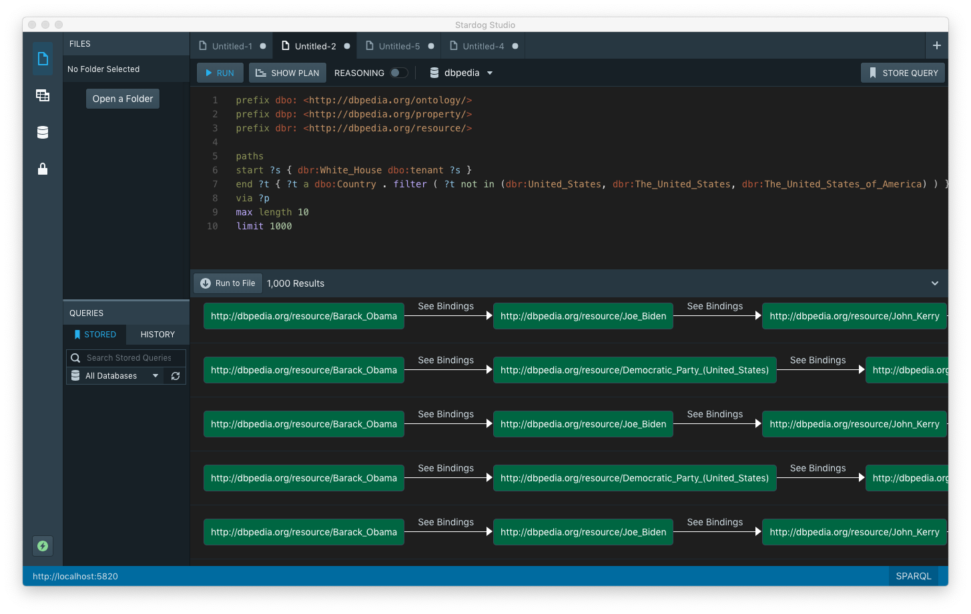
Demo tomorrow

