Slide 1
Information Architecture
04-3-2018

Slide 2
ECP Metadata Registry

Slide 3
ECP Metadata Registry - Introduction
What?
Create a system to catalogue and describe content in ECP
Implemented in RDF with an extensible ontology for content description
Support provenance and rights management across the platform using industry standards
Why?
Better content discoverability
Lower barrier to entry, with different levels of buy-in
More flexible in the types of technology it supports
Quicker creation and distribution of new bundles of content for product managers
??? Time to market for products
How?
Ontology created with industry standards
Extensible – e.g. CMP and CDF
SHACL constraints to enforce data quality & minimum thresholds
Work with governance to establish standards and procedures

Slide 4
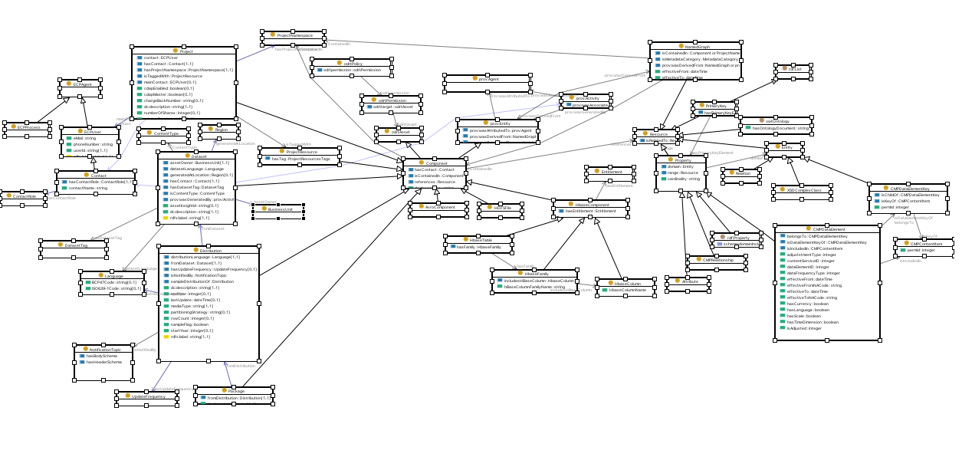
ECP Metadata Registry – Registry Ontology
https://git.sami.int.thomsonreuters.com/ecp-core/ecp-core-libs/blob/master/ontologies/src/main/resources/ontologies/registry_ontology.ttl
https://git.sami.int.thomsonreuters.com/ecp-core/ecp-core-libs/raw/master/ontologies/src/main/resources/ontologies/registry_diagram.png

Slide 5
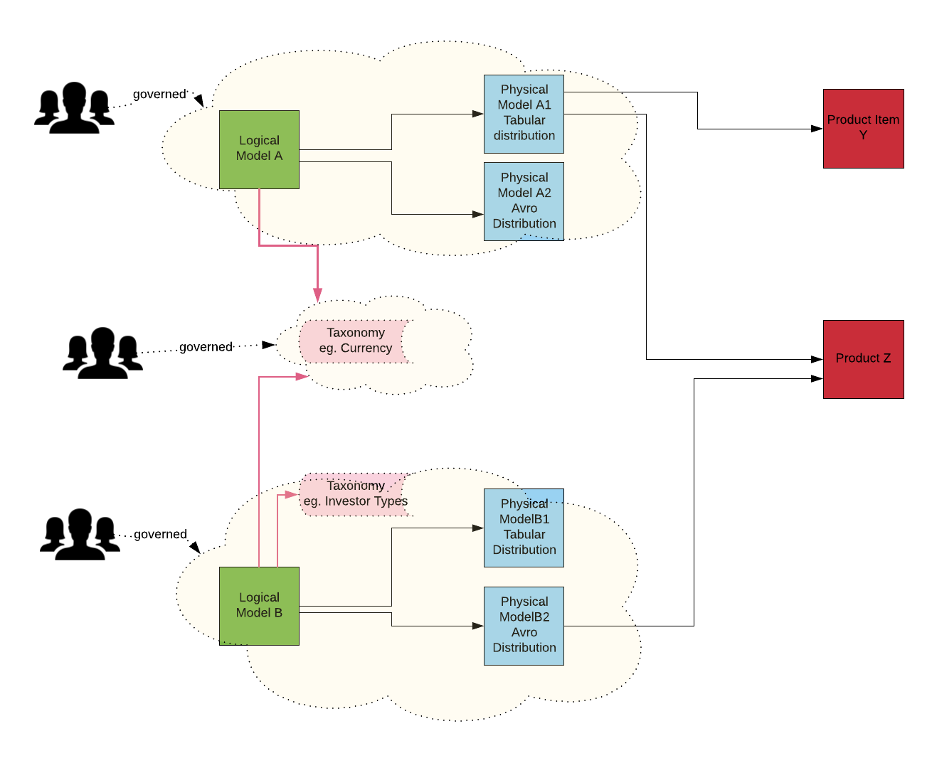
ECP Metadata Registry – Logical Model and various distributions

Slide 6
ECP Metadata Registry – simplified example
:Dataset
:Distribution
rdf:type
rdfs:subClassOf
rdfs:subClassOf
Exchange data feed
:TabularDistribution
:KafkaDistribution
rdfs:label
rdf:type
rdf:type
ecp:1-123456
:hasDataset
ecp:2-3456789
:hasDataset
ecp:2-234567
:contains
:contains
INSTTYP
ecp:8-947563
:hasHBaseColumnName
ecp:5-123456
:expresses
rdf:type
rdfs:label
rdf:type
Instrument Type
:HBaseColumn
:Property

Slide 7
Knowledge graph

Slide 8
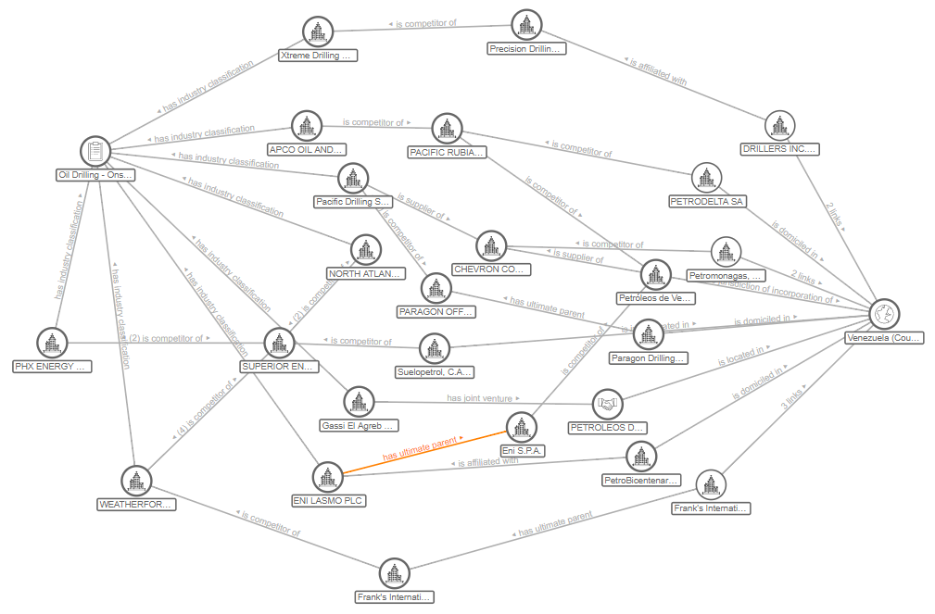
TR Knowledge Graph - Standards, Structure, Integration
Based on industry standards ( RDF, SHACL)
to organize and represent information
Structured data for objects
and their relationships
Automatic Integration and discovery
of previously undetected relationships
Notes:
TR Knowledge Graph is an RFD graph and is based on W3C standards ( OWL, RDF, SHACL) to represent objects and relationships in a structured way and enable automatic integerration

Slide 9
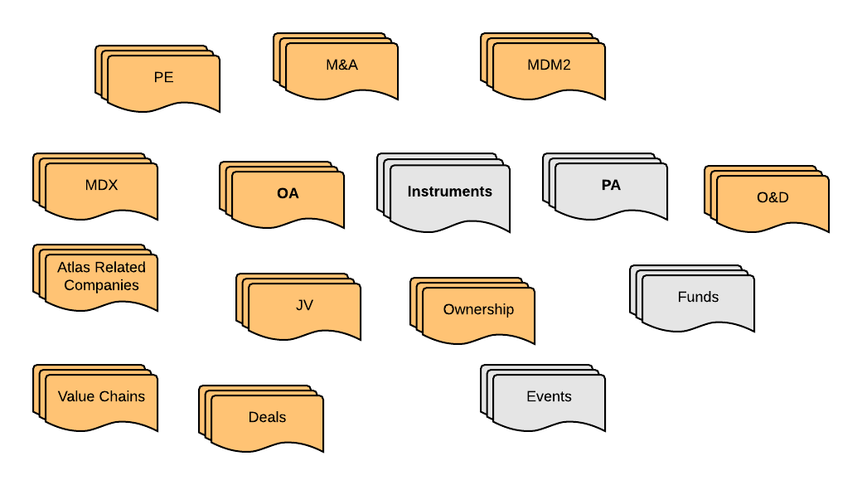
TR Knowledge Graph – RDFized DBORs
RDF can be an extra layer on all DBORs
Not all DBORs are covered
Priority must be given to master DBORs
(Instruments, PA ) to enable integration
?
?
?

Slide 10
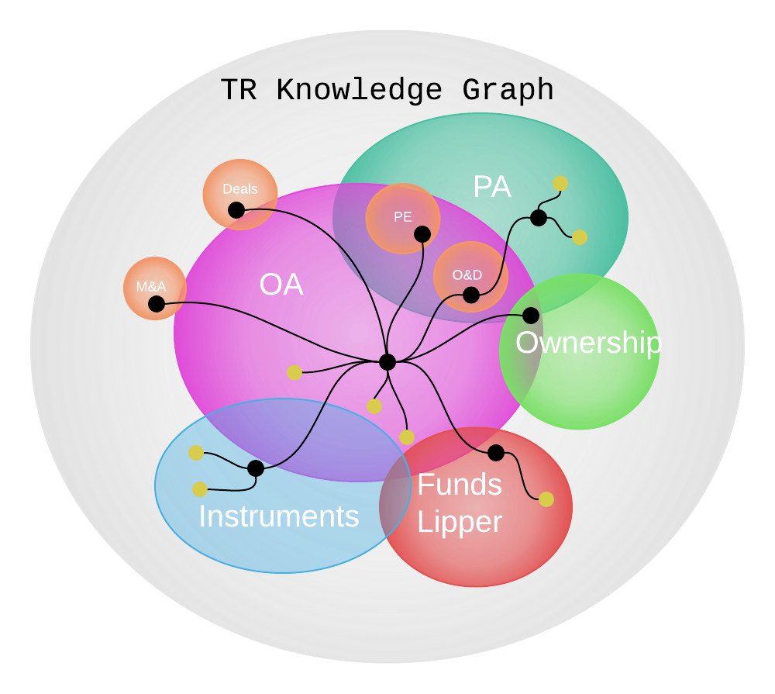
TR Knowledge Graph – Use Cases
Bold Framework
Graph Feeds from TR Graph Data
Eikon Seach & Discovery
Introducing graph search capability to surface news
stories about companies or lists that the user has
searched on but aren’t directly mentioned
Resource for AI
machine learning, NLP, intelligent tagging
DBORs may generate RDF versions
of their content
Integration of data from all DBORs
Webification – Web of Data

Slide 11
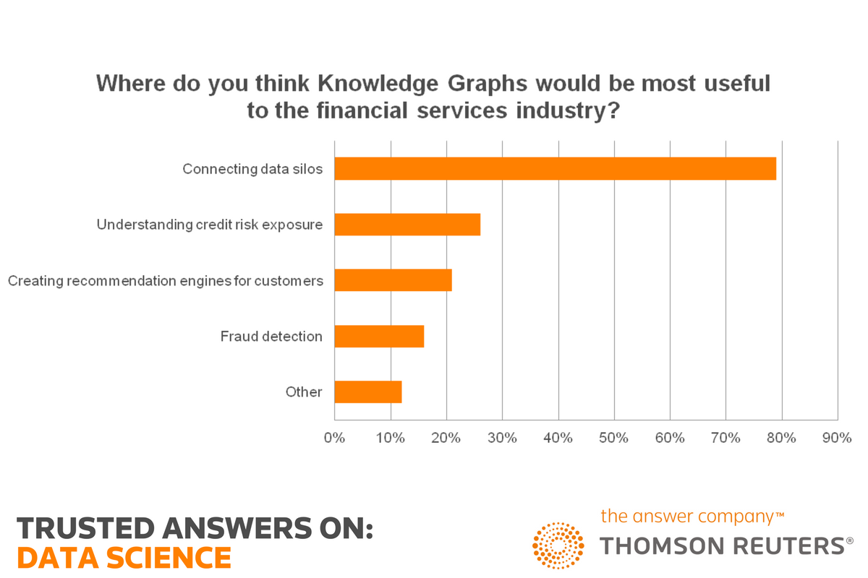
TR Knowledge Gragh –Integrate Data from DBORs
Notes:
According to Forrester, by 2017, 25% of enterprises will have implemented a graph database, while Gartner states that “graph analysis is possibly the single most effective competitive differentiator for organizations pursuing datadriven operations and decisions.”
TR Knowledge Graph is an RFD graph and is based on W3C standards ( OWL, RDF, SHACL) to represent objects and relationships in a structured way and enable automatic integerration

Slide 12
SHACL W3C Data Modelling Language
Notes:
New standard in W3C. Initiated from IBM to have a standard data language to describe data constraints

Slide 13
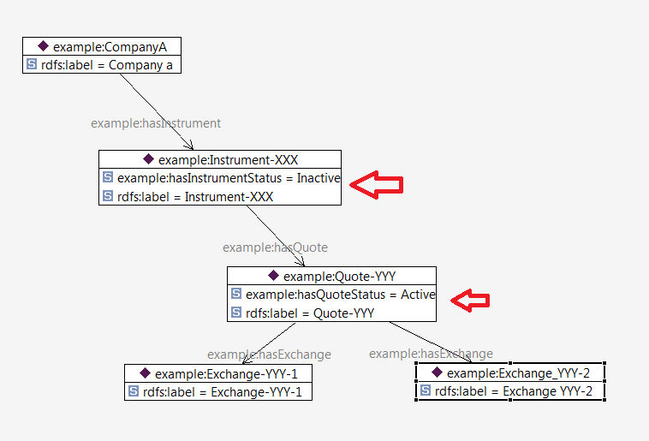
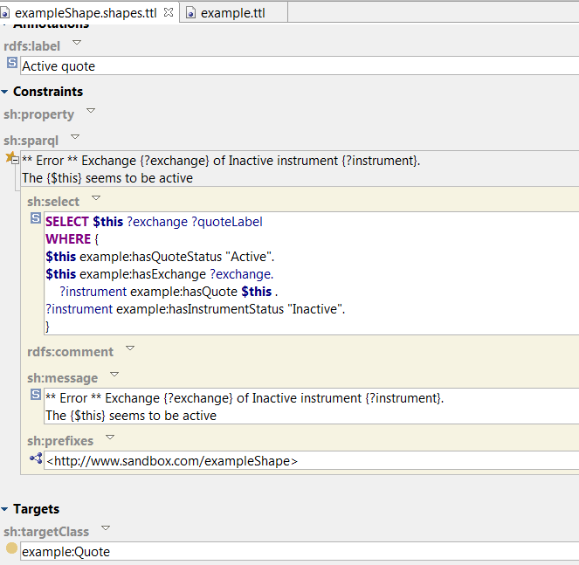
Data Quality – SHACL Constraints
Our TR models define also constraints, “shapes” on the data
Data can be checked on these constraints and creates violation messages
Example of a Violation:A quote is active and has exchanges
but the instrument
itself is inactive
We can create our own messages
.

Slide 14
Create new information - SHACL RULES
Creates new information based on conditions
Waves of rules with ordering to produce intermediate and target information
example:Organization
rdf:type owl:Class ;
rdf:type sh:NodeShape ;
sh:rule [
rdf:type sh:TripleRule ;
sh:condition [
sh:property [
sh:path example:Domicile ;
sh:in (
example:EEAMeberCountry ) ;
] ;
] ;
sh:predicate rdf:type ;
sh:object example:MIFIDOrganization ;
sh:subject sh:this ;
] ;
Example: If an organization is domiciled in a EEA Country
then classify it as an MIFIDOrganization
.
Notes:
Wave of rules to classify if organization is under MiFID or GDPR compliance regulations

