Slide 1
Neo4J for Enterprise RDF Data Management
Ghislain Atemezing, MONDECA
Acknowledgement: Anh Huynh

Slide 2

Goal
Use Neo4j as an RDF store, and expose a SPARQL endpoint
Leverage Neo4j graph database strengths and exposure
Call for action: PO bench challenge with Neo4J
Current applications of Neo4J as RDF backend (Knowledge Browser)

Slide 3
RDF store or Graph database Depends (sometimes) on the clients’ needs
Requirements :
  RDF inputs : terminologies, document records, models, controlled vocabularies, etc.
  ability to query data with SPARQL
  scalability in size and concurrent access
Solutions :
  RDF Store
    native RDF, native SPARQL endpoint
    many vendors (Virtuoso, Stardog, GraphDB, AnzoGraph,Marklogic, etc)
    satisfying performance, as tested internally on projects and benchmarks
  Neo4J en Cypher + SPARQL endpoint ?
    Tinkerpop stack to use Neo4j database as an RDF store (https://dzone.com/articles/rdf-data-neo4j-tinkerpop-story )
    Tinkerpop = stack comprised of Blueprints, framework to work with graphs, and connect to graph databases. Can be considered as JDBC for graph databases.
    Offers an implementation of Graph Sail for Neo4j
    Poor performance on SPARQL
    on Neo4 1.9.6

Slide 4
Target Neo4j + Tinkerpop
RDF
REST API
PUBLICATION API
QUERY API
Data Layer
RDF
CYPHER
SPARQL/RDF
SPARQL endpoint
Tinkerpop
Neo4J

Slide 5
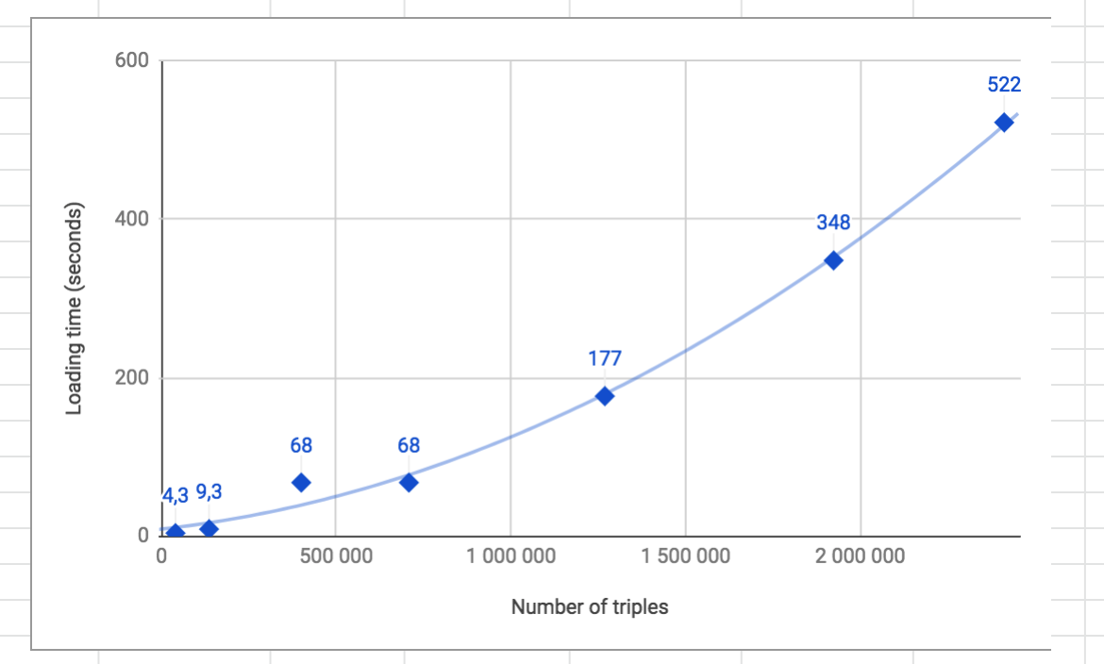
RDF ingestion benchmark with Neo4J
Server hardware
  128 GB RAM, 16 cores, 1 TB disk
  OK with small amount of data
  Loading 50K triples/transaction
Test with PO dataset
  727 Millions of triples
  Best run: memory leak after 16h 25min.
Current call for action: “PO bench challenge with Neo4J”

Slide 6
RDF in Neo4j @ Mondeca : current status
Write RDF:
  created a Neo4j procedure inspired from J. Barrasa’s https://jesusbarrasa.wordpress.com/2016/06/07/importing-rdf-data-into-neo4j/ (Gracias Jesús ☺ )
  adapted and extended the procedure to map to Tinkerpop’s model since J. Barrasa’s mapping of RDF is too limited : ok to showcase Neo4j’s simplicity of use, but leaves out many aspects of RDF (properties multivalues, language information, metadata info, etc)
  complies with TinkerPop model→ Fast.
Query RDF
  Done in Cypher directly.
  Managed to query Neo4j through Sail with a limited expressivity, but never by SPARQL

Slide 7
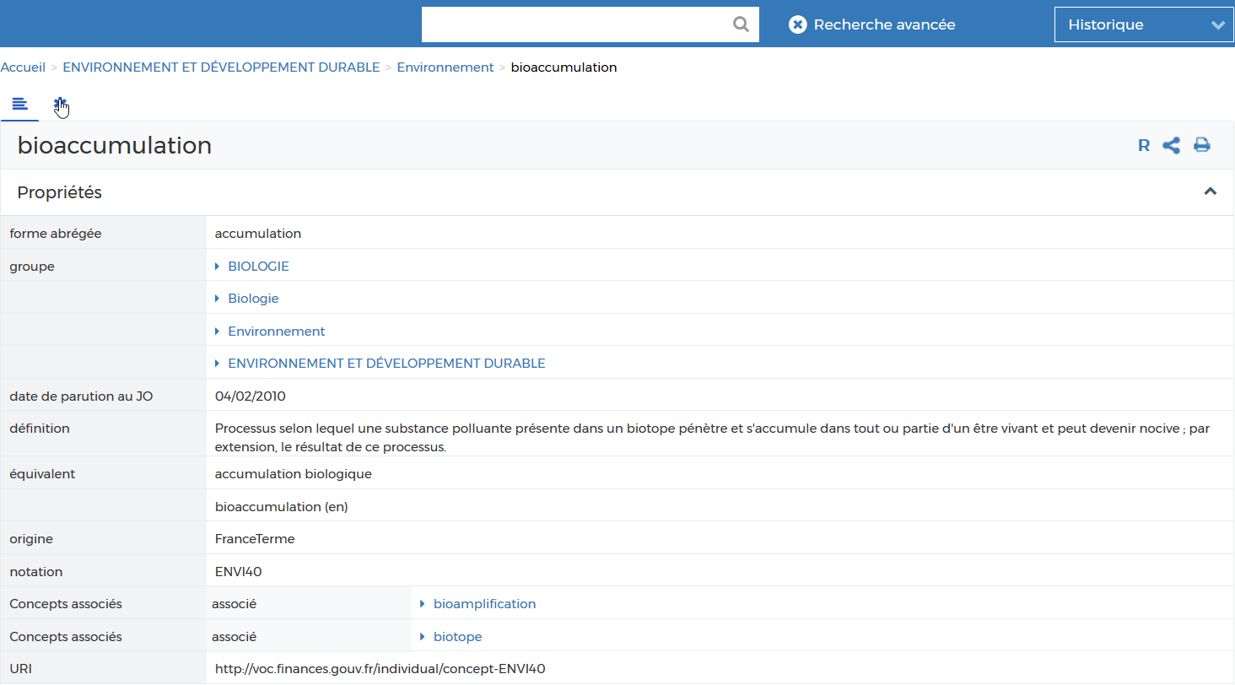
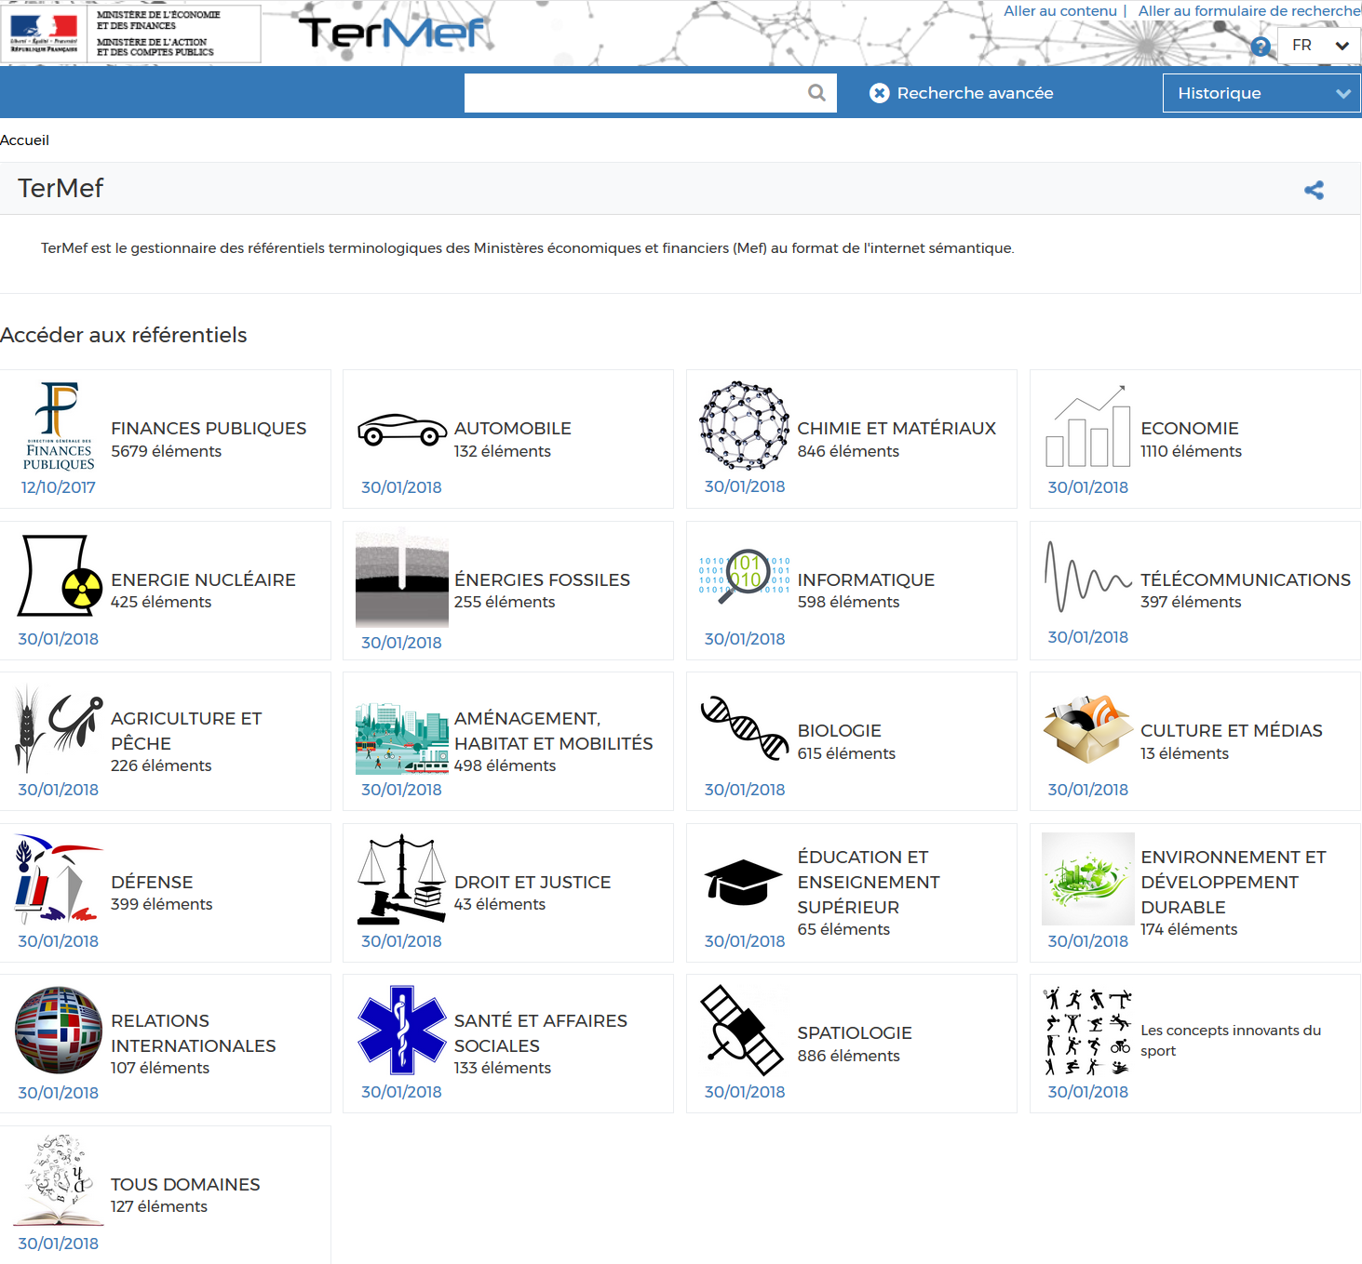
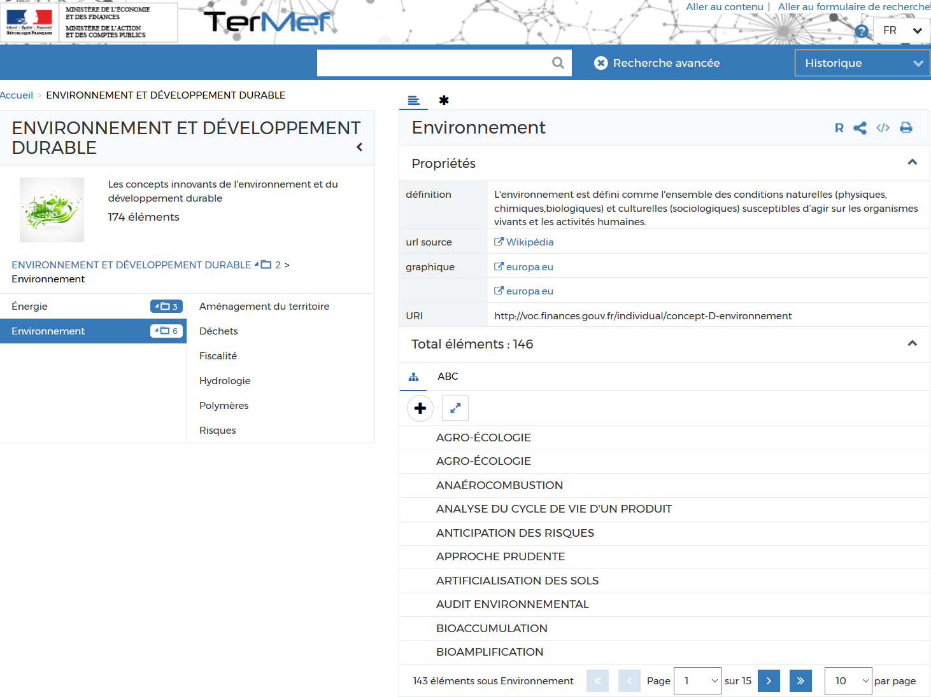
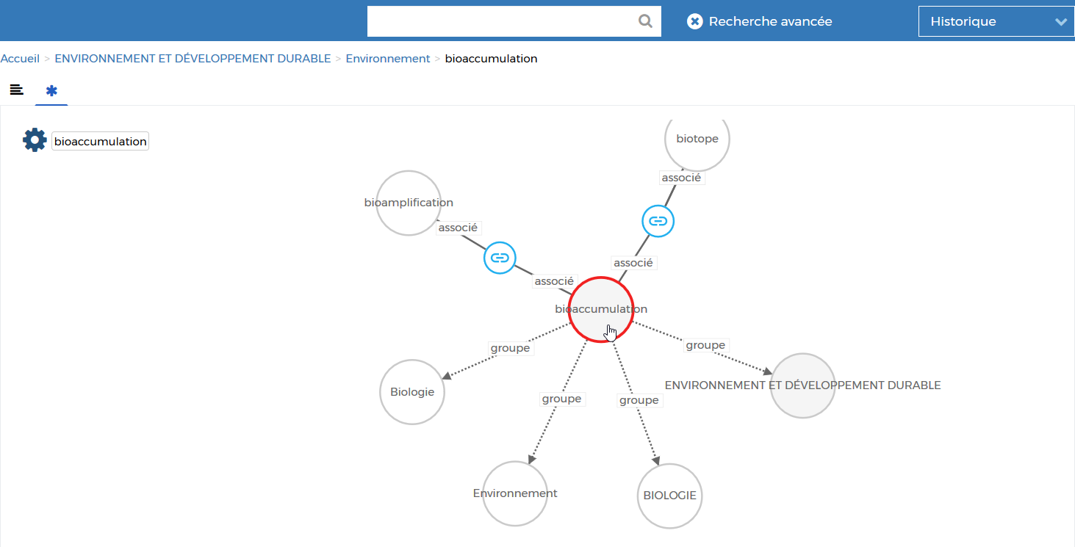


Applications in PROD: KNOWLEDGE BROWSER (KBr)
UIs

rdf
Knowledge Browser
API
Business Apps
REST web service
REST web service



Slide 8

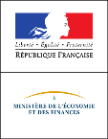

Live Public Use cases
ASIP Santé (French Agency for Digital Health)
ASIP’s Knowledge Browser is the French reference Terminology Server for the publication, dissemination and reuse of the international BIOLOINC terminology. It helps health stakeholders implement consistent indexing of patient records as defined by the nationwide shared medical records initiative. Link: https://bioloinc.fr/
French Ministry of Finance
The TerMEF Knowledge Browser supports the publication and dissemination on the web of the ministry’s controlled vocabularies to a broad audience of analysts and domain experts. Link: http://terminologie.finances.gouv.fr/

