Slide 1
Cypher and Gremlin Interoperation
Dmitry Novikov (Neueda Technologies)

Slide 2
Cypher Declarative query language
Gremlin Imperative/declarative query language
And more...
And more...

Slide 3
Cypher Declarative query language
Gremlin Imperative/declarative query language
Cypher for Gremlin
And more...
And more...

Slide 4
Cypher
Gremlin
SPARQL
Cypher for Gremlin
SPARQL-Gremlin
And more...

Slide 5
Cypher for Gremlin
Run Cypher on Gremlin-enabled databases
Call Cypher as start of Gremlin traversal
Call Gremlin from Cypher query
Tested on (feature support may vary):
And more...

Slide 6
1. Run Cypher on Gremlin-enabled databases
MATCH (p:Planet)-[orbit:ORBITS]->(:Star {name: 'Sun'})
WHERE orbit.au < 5
RETURN p AS planet;
g.V().as('p').hasLabel('Planet')
.outE('ORBITS').has('au', lt(5))
.inV().hasLabel('Star').has('name', eq('Sun'))
.select('p').project('planet').by(valueMap().with(tokens))

Slide 7
Cypher for Gremlin flow

Slide 8
Cypher for Gremlin flow

Slide 9
2. Call Cypher as start of Gremlin traversal
CypherTraversalSource
Works on all Gremlin-enabled databases
Returns map
Gremlin traversal can continue
gremlin> g.cypher("MATCH (n) RETURN n").select("n").outE().label().dedup()
==>created
==>knows

Slide 10
2. Call Cypher as start of Gremlin traversal
CypherTraversalSource
Works on all Gremlin-enabled databases
Returns map
Gremlin traversal can continue
See also SPARQL-Gremlin
gremlin> g.cypher("MATCH (n) RETURN n").select("n").outE().label().dedup()
==>created
==>knows
gremlin> g.sparql("SELECT * WHERE { }")
==>v[1]
==>v[2]

Slide 11
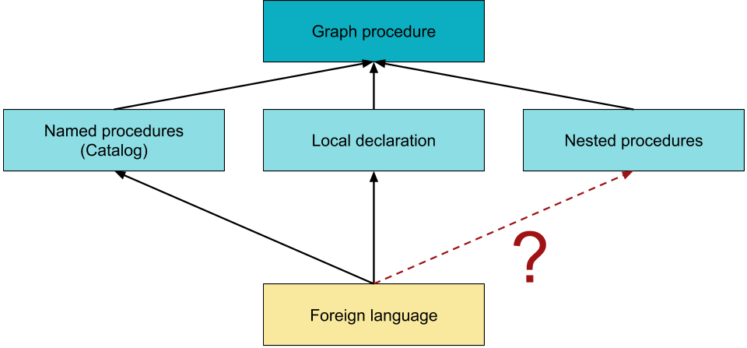
GQL Graph procedures
* As suggested in GQL Scope and Features

Slide 12
3. Call Gremlin from Cypher query
gremlin(...) Cypher function
Returns single (first) value
Sub-traversal of Gremlin map step
Has access to Cypher variable scope
Does not overwrite variables
MATCH (n:person {name: 'marko'})
RETURN gremlin("select('n').outE().label()") as r

Slide 13
3. Call Gremlin from Cypher query
Prototype
Extension of Cypher syntax
Allows to insert Gremlin
May access variables from the outer scope?
Optional return type definition?
MATCH (n)
FOREIGN "gremlin"
CALL "select('n').hasLabel('person').as('p').values('age').as('b')"
YIELD p::NODE, b::NUMERIC
RETURN labels(p)[0] as a, b
LIMIT 1

Slide 14
Open questions
Starting point of sub-traversal ?
Read only or allow modification?
Scope of variables?
Null handling?
Cypher has nulls, Gremlin does not
Return values?
Define type

Slide 15
Links
Cypher
Gremlin
SPARQL
https://github.com/opencypher/cypher-for-gremlin
http://tinkerpop.apache.org/docs/current/reference/#sparql-gremlin
dmitry.novikov@neueda.com
Cypher for Gremlin
SPARQL-Gremlin

