Slide 1
Vehicle graph data
Daniel Alvarez
BMW Research, New Technologies, Innovations

Slide 2
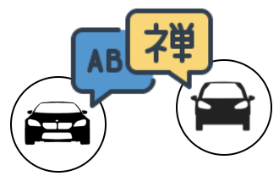
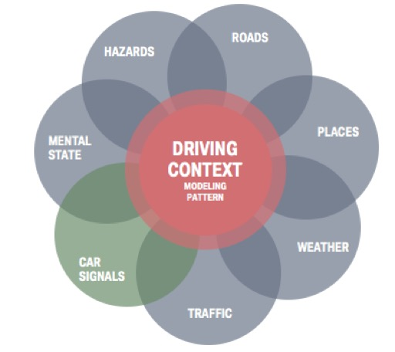
Overview
Current situation
Different formats across the industry
Data meaning is mostly unknown
What is desired?
Standards
Abstractions
Data-centric architecture
Knowledge bases

Slide 3
Vehicle Signal Ontology (VSSo) [1]
Based on VSS [2] and SSN/SOSA [3]
Proposed at the W3C automotive WG
Current limits
Industry inertia
Extensions needed
[1] Vehicle Signal Ontology: http://automotive.eurecom.fr/vsso
[2] Vehicle Signal Specification: https://github.com/GENIVI/vehicle_signal_specification
[3] Semantic Sensor Network Ontology: https://www.w3.org/TR/vocab-ssn/

Slide 4
Challenges
DATA
REAL-TIME
TOOLS & ACCEPTANCE
Several sensors
Time-series and spatial data
Variable sampling rates
Apps demand low-latency
Limited processing resources
Connectivity-independent
Developer friendly
Scale well
LPG vs. RDF triples
OPEN QUESTIONS
Where to use graphs?
What to store?
How to store?
Optimal data life cycles
Which data model to use?
Query language?

