Slide 1
Mobile Money in Africa
Alex Miłowski, Orange Silicon Valley

Slide 2
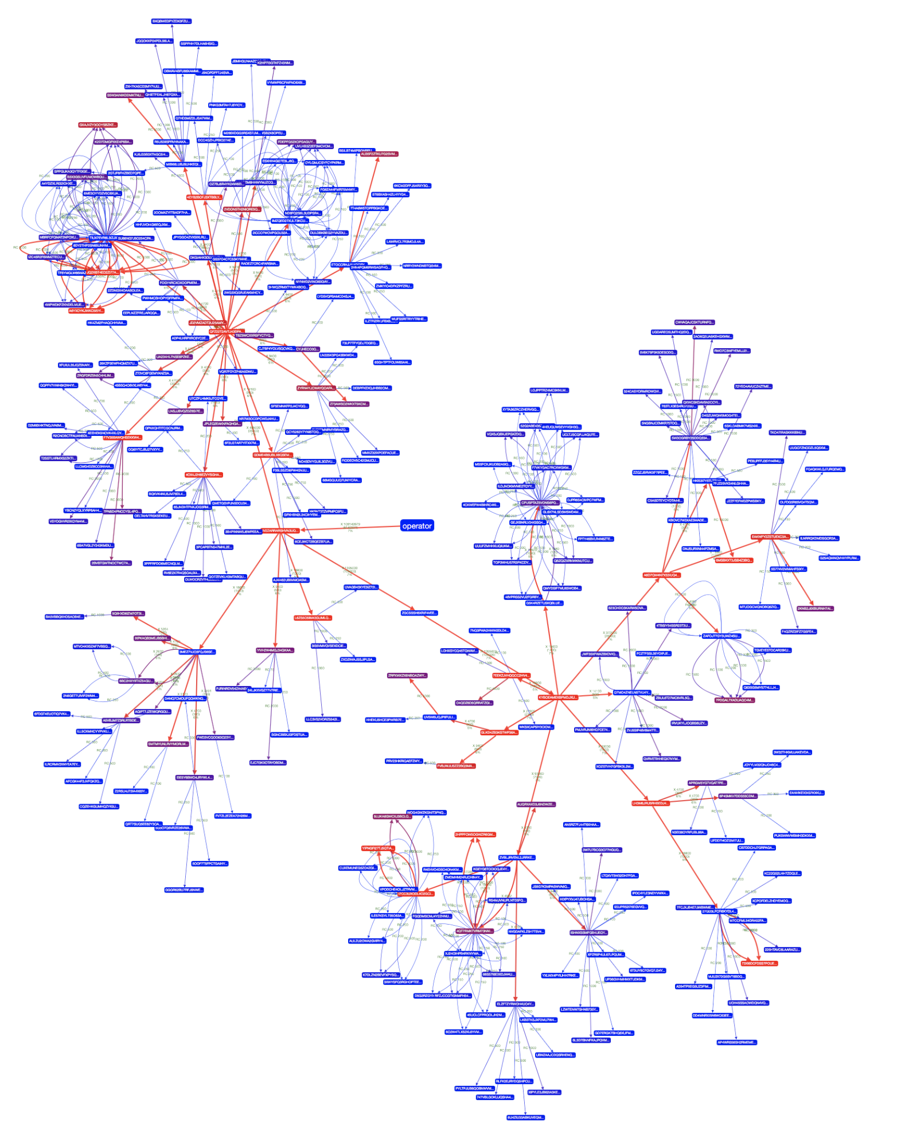
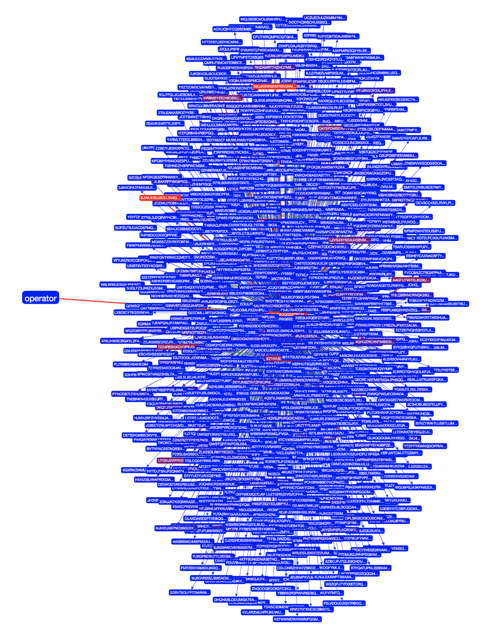
Problem Statement
200000000 CFA (300000 €)
09:00 for 1 hour; depth 3
What is normal behavior?
Person or robot?
Who is a good credit risk?
What is fraud?
116290300 CFA (174435 €)
10:00 for1 hour; depth 6

Slide 3
Graph Properties
Scale-out over time / geography (cells):
partitioned by transaction / action time
associated with cell towers
transactions, call records, sms, etc.
Derived properties:
social groups
action frequencies
transactions / call parameters or thresholds
typical role – operator, agent, ”spine”, edge user
90912345
xfer
from
type=TRANSFER amount=1000
at=2017-07-01T12:26:25+01:00
to
90954321

Slide 4
SPARQL – union challenges
construct { ?x ?p ?o }
where
{
{ <90912345> osv:xfer ?x }
UNION {
select ?x where {
?origin osv:xfer ?a .
?a osv:at ?at .
?a osv:to/osv:xfer ?x .
FILTER (?at >= "2017-07-01T12:00:00"^^xsd:dateTime && ?at < "2017-07-01T13:00:00"^^xsd:dateTime)
}
values ?origin { <90912345> }
}
UNION {
select ?x where {
?origin osv:xfer ?a .
?a osv:at ?at_a .
?a osv:to/osv:xfer ?b .
?b osv:at ?at_b .
?b osv:to/osv:xfer ?x .
…
}
?x osv:at ?at .
FILTER (?at >= "2017-07-01T12:00:00"^^xsd:dateTime && ?at < "2017-07-01T13:00:00"^^xsd:dateTime) .
?x ?p ?o
}
xfer
xfer
from=origin
to
xfer
from=origin
xfer
to
xfer
to
xfer
from=origin

Slide 5
GraphQL - tree projections
xfer
{
flow(func: eq(msisdn,"90912345")) {
msisdn
outbound: xfer @filter(ge(at, "2017-07-01T12:00:00") and lt(at, "2017-07-01T13:00:00")) {
amount
at
transaction_type
to {
msisdn
outbound: xfer @filter(ge(at, "2017-07-01T12:00:00") and lt(at, "2017-07-01T13:00:00")) {
amount
at
transaction_type
to {
msisdn
outbound: xfer …
…
}
}
}
}
}
}
from=origin
xfer
to
xfer
from=origin
xfer
to
xfer
to
xfer
from=origin

Slide 6
BigQuery – recursive selections / same table
select xfer_amount, at, type, from_msisdn, to_msisdn
from `osv-nirvana.niger.xfers`
where `at`>=cast('2017-07-01T12:00:00' as timestamp) and `at`<cast('2017-07-01T13:00:00' as timestamp)
and (
from_msisdn='90912345’
or (
from_msisdn in (
select to_msisdn from `osv-nirvana.niger.xfers`
where `at`>=cast('2017-07-01T12:00:00' as timestamp)
and `at`<cast('2017-07-01T13:00:00' as timestamp)
and from_msisdn='90912345'))
or (
from_msisdn in (
select to_msisdn from `osv-nirvana.niger.xfers`
where `at`>=cast('2017-07-01T12:00:00' as timestamp)
and `at`<cast('2017-07-01T13:00:00' as timestamp
and from_msisdn in (
select to_msisdn from `osv-nirvana.niger.xfers`
where `at`>=cast('2017-07-01T12:00:00' as timestamp)
and `at`<cast('2017-07-01T13:00:00' as timestamp)
and from_msisdn='90912345')))
…
)
xfer
from=origin
xfer
to
xfer
from=origin
xfer
to
xfer
to
xfer
from=origin

