Slide 1

Reasoning about ODRL Policies
Temporal and spatial conflict detection with automated provers
Daham M. Mustafa
with Diego Collarana, Christoph Lange, Sabrina Kirrane, Christoph Quix, Rafiqul Haque, Giancarlo Guizzardi, Stefan Decker
Position paper: Formal Semantics and Foundational Grounding for Comparable ODRL Policies in Data Spaces
Fraunhofer FIT · RWTH Aachen University
London · 20-21 July 2026

Slide 2
1
German Culture Dataspace (Datenraum Kultur)
In the German Culture Dataspace (Datenraum Kultur), cultural institutions, libraries, music, museums, share digital assets under usage policies written in ODRL.
A provider (e.g. the Bavarian State Library) offers a digitized manuscript; a consumer (e.g. the French National Library) requests it. Each attaches temporal, …, conditions.
Before they can agree, someone must check: are the offer's and the request's conditions compatible? Smart cotnrct.
Alongside ongoing efforts to formalize ODRL, Bonatti et al., Salas et al., and the W3C ODRL Formal Semantics group, we focus deeply on the constraints that decide when a policy applies.
At the deontic level, we ask what normative reality a policy creates, who may act, who must, and who has the authority to declare a violation. We answer this by grounding ODRL in a foundational ontology (UFO-L).
W3C Workshop on the Future of ODRL · Paper 19
3
Notes:
Scope of the work. (1) Conflict: some policies ask for something impossible, like stay inside A and inside B when A and B do not overlap. No location satisfies both, so the policy can never apply. (2) Redundancy: a condition another already covers, like inside France and inside Europe. Anything inside France is inside Europe, so the second is droppable. (3) Downstream restriction: when one policy passes data to another, the follow-on must only narrow. Europe then France is valid; Europe then Asia widens and is rejected.

Slide 3
What the reasoner decides: three tasks over ODRL Constraint
1- Conflict detection
Single policy self-consistency → "Can this policy ever be satisfied, or does it contradict itself?" = realizability.
Pair compatibility → "Can the offer and request constraint be satisfied together, or do they conflict?" = conflict detection
Two constraints on the same operand conflict when their intervals are disjoint: ⟦c₁⟧ ∩ ⟦c₂⟧ = ∅.
2- Downstream restriction (policy narrowing)
grant = Europe
next = France (≤ Europe) : valid
next = Asia : widens the grant
Does one policy properly restrict another? (Europe → France valid; Europe → Asia invalid), the key one for data-space contract negotiation.
When data flows from one party to another, the receiving policy should only narrow the permission, not widen it.
W3C Workshop on the Future of ODRL · Paper 19
3
Notes:
The first policy allows use in Europe. The next policy tries to allow Asia. But Asia is outside Europe, so this widens the permission to somewhere never granted. That's invalid, you can't hand on more than you received.

Slide 4
Before any data moves, the connector returns one verdict
Datenraum Kultur. Offer = Bavarian State Library, request = French National Library.
COMPATIBLE
CONFLICT
UNKNOWN
Every usage the request permits, the offer permits too.
The request permits a usage the offer forbids.
One policy constrains a condition the other leaves open, so on that condition there is nothing to compare.
→ clear the exchange
→ block
→ defer to negotiation
W3C Workshop on the Future of ODRL · Paper 19
2
Notes:
There's nothing to check against, so you can't say Conflict or Compatible. It's a structural verdict about the comparison of two policies.

Slide 5
Sort-Stratified Semantics for Temporal Conflict Detection in ODRL Policies
ODRL reuses one set of comparison operators for points in time and amounts of time. Operand ambiguity.
Instant (a point in time)
Duration (an amount of time)
(dateTime, lt, 2026-12-31)
(elapsedTime, lt, P30D)
earlier than Dec 31, "earlier" compares POINTS
shorter than 30 days "shorter" compares AMOUNTS
Same operator lt, two different meanings.
It cannot separate a point in time from an amount of time, so comparing two policies is unsound.
The fix: sort each operand
Type each temporal operand as an instant (a point in time) or a duration (an amount of time). Each operator then has exactly one meaning, and cross-sort comparisons are ruled out.
Preprint: arXiv:2606.23442
W3C Workshop on the Future of ODRL · Paper 19
6
Notes:
Temporal parallel to the external-knowledge slide. There ODRL leaves the operand's grounding unspecified; here it leaves unspecified whether time is a point or an amount. Same operator lt reads as 'earlier than' on a date and 'shorter than' on a duration. ODRL uses one operator set for both, so it cannot separate instants from durations and comparison is unsound. Fix: give each temporal operand a sort (instant or duration); every operator then has one clear reading. Next: the hidden cross-operand conflict (metered use can never exceed elapsed time).

Slide 6
Sort-Stratified Semantics for Temporal Conflict Detection in ODRL Policies
You cannot use something for longer than you have had access to it.
Offer 30 days of metered (actual) use
Facts about how time works
Request at most 10 days of elapsed (total access)
Metered use ≤ elapsed use can't exceed access
Each is satisfiable on its own.
Delay ≤ elapsed wait can't exceed access
But metered use ≤ elapsed time,
Durations are never negative
so 30 days of use in a 10-day window is impossible.
CONFLICT
Obvious to a person, invisible to per-operand checking.
The reasoner carries these facts, so it catches conflicts that checking each condition alone would miss.
Benchmark: github.com/Daham-Mustaf/odrl-temporal-benchmark
W3C Workshop on the Future of ODRL · Paper 19
7
Notes:
The memorable slide, powered by the background theory. Some properties hold in every execution: metered use never exceeds elapsed time, the delay before first use never exceeds elapsed time, and durations are never negative. We collect these into a background theory the reasoner intersects with the policies. The cross-operand conflict: offer wants 30 days of metered use, request allows at most 10 days elapsed; each is satisfiable alone, but metered use cannot exceed elapsed time, so together they are impossible, a Conflict that per-operand checking misses. Say 'facts about how time works' on the slide; if asked, it is formally a background theory Phi intersected with the denotations, formula in the paper.

Slide 7
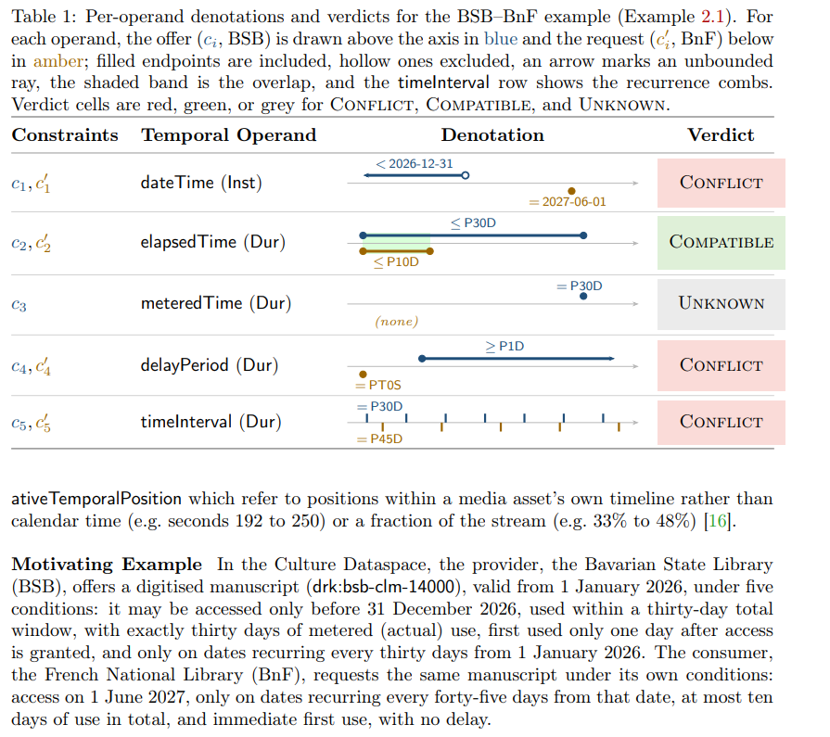
Sort-Stratified Semantics for Temporal Conflict Detection in ODRL Policies
We type each temporal operand:
Instant: dateTime
Duration: elapsedTime, meteredTime, delayPeriod, timeInterval
(The media-stream operands, positions within an asset's own timeline, are out of scope, future work.)
Each comparison operator gives an interval:
eq v → the point {v}
lteq v → up to v: (−∞, v]
gteq v → from v on: [v, ∞)
lt v / gt v → strictly below / above
(Per operand, only some are allowed, e.g. delayPeriod takes only eq, gt, gteq.)
Policies combine constraints with logical operators:
and , all must hold (intersect the denotations)
or , at least one (union)
xone , exactly one
andSequence , all hold in order, the distinctive one.
W3C Workshop on the Future of ODRL · Paper 19
8
Notes:
Framing for a non-UFO-L audience: two different questions, not two competing ontologies. The evaluator (formal semantics) answers 'given this situation, what is the verdict' (active, violated, fulfilled). A foundational ontology answers 'what legal reality exists when this policy is in force' (who holds a right, a duty, the authority to declare a violation). Complementary, not competing. Respectful framing: ODRL's semantics does what it was built for; we add the ability to answer a different, deeper question. UFO-L gets exactly one line: an off-the-shelf foundational ontology built for legal concepts that already models rights, duties, and powers. Internals stay out; sets up the 'beyond OWL' point later.

Slide 8
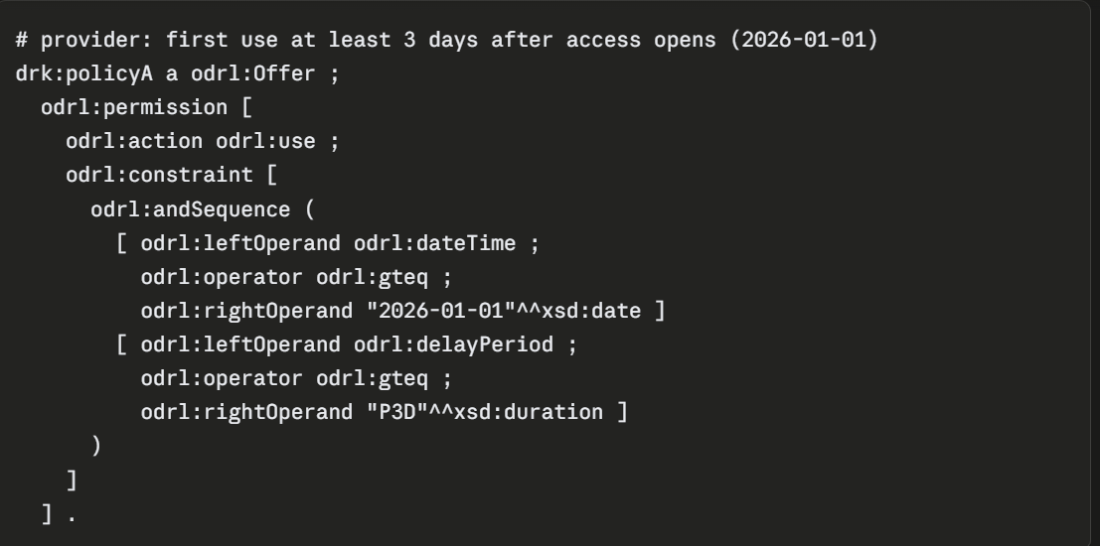
Sort-Stratified Semantics for Temporal Conflict Detection in ODRL Policies
github.com/Daham-Mustaf/odrl-temporal-benchmark
W3C Workshop on the Future of ODRL · Paper 19
7
Notes:
The memorable slide, powered by the background theory. Some properties hold in every execution: metered use never exceeds elapsed time, the delay before first use never exceeds elapsed time, and durations are never negative. We collect these into a background theory the reasoner intersects with the policies. The cross-operand conflict: offer wants 30 days of metered use, request allows at most 10 days elapsed; each is satisfiable alone, but metered use cannot exceed elapsed time, so together they are impossible, a Conflict that per-operand checking misses. Say 'facts about how time works' on the slide; if asked, it is formally a background theory Phi intersected with the denotations, formula in the paper.

Slide 9
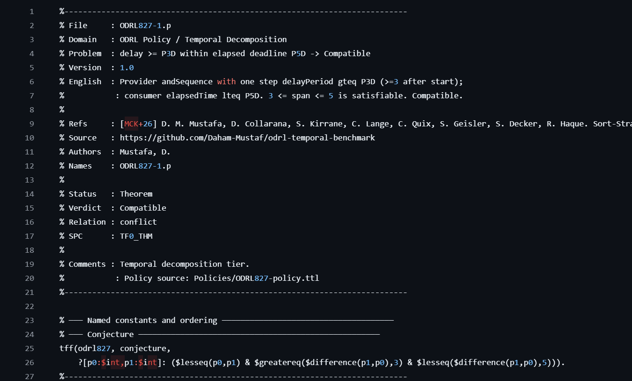
Sort-Stratified Semantics for Temporal Conflict Detection in ODRL Policies
github.com/Daham-Mustaf/odrl-temporal-benchmark
W3C Workshop on the Future of ODRL · Paper 19
7
Notes:
The memorable slide, powered by the background theory. Some properties hold in every execution: metered use never exceeds elapsed time, the delay before first use never exceeds elapsed time, and durations are never negative. We collect these into a background theory the reasoner intersects with the policies. The cross-operand conflict: offer wants 30 days of metered use, request allows at most 10 days elapsed; each is satisfiable alone, but metered use cannot exceed elapsed time, so together they are impossible, a Conflict that per-operand checking misses. Say 'facts about how time works' on the slide; if asked, it is formally a background theory Phi intersected with the denotations, formula in the paper.

Slide 10
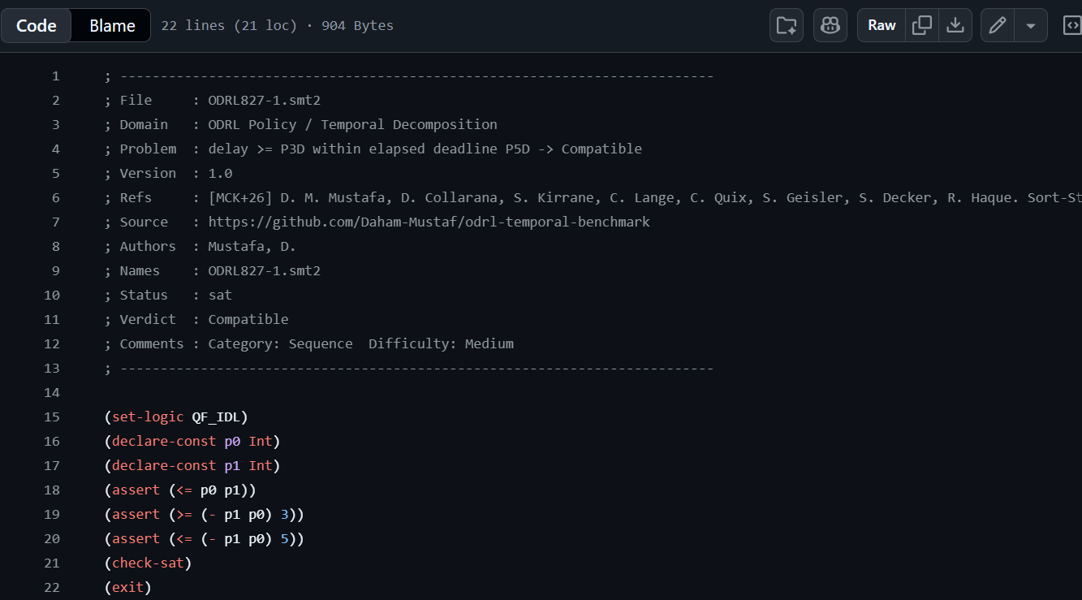
Sort-Stratified Semantics for Temporal Conflict Detection in ODRL Policies
github.com/Daham-Mustaf/odrl-temporal-benchmark
W3C Workshop on the Future of ODRL · Paper 19
7
Notes:
The memorable slide, powered by the background theory. Some properties hold in every execution: metered use never exceeds elapsed time, the delay before first use never exceeds elapsed time, and durations are never negative. We collect these into a background theory the reasoner intersects with the policies. The cross-operand conflict: offer wants 30 days of metered use, request allows at most 10 days elapsed; each is satisfiable alone, but metered use cannot exceed elapsed time, so together they are impossible, a Conflict that per-operand checking misses. Say 'facts about how time works' on the slide; if asked, it is formally a background theory Phi intersected with the denotations, formula in the paper.

Slide 11
What Does ODRL Mean? A Cross-Level Ontological Grounding of Permissions, Prohibitions, and Duties in UFO-L
ODRL's semantics evaluates policies. A different question is what legal situation a policy creates.
Other foundational ontologies (like BFO, DOLCE) describe general structure, objects, events, relations, but don't model legal concepts. UFO-L is built specifically for legal positions (rights, duties, powers), which is exactly what a policy creates.
Formal semantics (the evaluator):
Foundational ontology (the grounding):
Given this situation, what's the verdict? , evaluation. Is the rule active? violated? fulfilled?
What legal reality exists when this policy is in force? , who has a right, who has a duty, who has the authority to declare a violation.
→ a verdict
→ the legal reality
Legal positions come at two levels:
conduct , who may / must / must not do what
competence , who has the authority to declare a violation and impose its consequences
Foundational ontology (UFO-L): built for legal concepts, it already models rights, duties, and powers.
Accepted at FOIS 2026 · Preprint: arXiv:2606.24344
Benchmark: github.com/Daham-Mustaf/odrl-ufol-grounding
W3C Workshop on the Future of ODRL · Paper 19
8
Notes:
Framing for a non-UFO-L audience: two different questions, not two competing ontologies. The evaluator (formal semantics) answers 'given this situation, what is the verdict' (active, violated, fulfilled). A foundational ontology answers 'what legal reality exists when this policy is in force' (who holds a right, a duty, the authority to declare a violation). Complementary, not competing. Respectful framing: ODRL's semantics does what it was built for; we add the ability to answer a different, deeper question. UFO-L gets exactly one line: an off-the-shelf foundational ontology built for legal concepts that already models rights, duties, and powers. Internals stay out; sets up the 'beyond OWL' point later.

Slide 12
Why OWL isn't enough? From ODRL to automated reasoning
Grounding ODRL needs logic OWL can't express:
Omissions , a prohibition is a duty to omit an action. Representing "the omission of a" needs function symbols, OWL has none.
Correlativity , a Right exists exactly when its matching Duty does. This biconditional needs full first-order logic.
Incompatibility , you can't hold a permission and a duty-to-omit the same action. This contradiction needs full FOL.
OWL is a decidable description logic, it can't express these.
So we use theorem provers (Vampire, E) and SMT (Z3), not OWL reasoners.
Even gUFO (the OWL rendering of UFO) offloads what OWL can't state to SHACL/SPARQL, our grounding hits the same boundary.
Almeida et al., gUFO, arXiv:2603.20948
W3C Workshop on the Future of ODRL · Paper 19
8

Slide 13
From ODRL to automated reasoning
We compile each ODRL problem into a logic problem, in two standard formats; off-the-shelf reasoners then solve it.
TPTP: conflict as a theorem
TPTP → theorem provers (Vampire, E)
% conflict as a theorem to prove
fof(conflict, conjecture,
~ ( ? [X] : (policy1(X) & policy2(X)) )).
first-order theorem provers, great at logical structure but limited on arithmetic.
SMT-LIB → SMT solvers (Z3, cvc5)
MT solvers with built-in arithmetic, handle the numeric/divisibility parts theorem provers can’t. output is mapped on SZS.
"Do these policies conflict?" becomes "Is there any point satisfying both?"
CONFLICT
no such point exists, the prover proves it
COMPATIBLE
a point exists, the solver finds it
Why two formats: different reasoning strengths, and two independent encodings agreeing means the verdict is a property of the semantics, not the encoding.
W3C Workshop on the Future of ODRL · Paper 19
9
Notes:
Machinery at the idea level, not TPTP/SMT internals. We compile each ODRL problem to a logic problem in two standard formats: TPTP for theorem provers (Vampire, E), strong on logical entailment; SMT-LIB for SMT solvers (Z3, cvc5), which add built-in arithmetic for the numeric parts provers struggle with. Conceptually, 'do these policies conflict?' becomes 'is there any point satisfying both?': no such point, the prover proves it, Conflict; a point exists, the solver finds it, Compatible. Two independent encodings agreeing is the credibility argument: the verdict comes from the semantics, not from how we encoded it. Public benchmarks back this (odrl-benchmark, odrl-temporal-benchmark).
SZS = a standard vocabulary for reporting what an automated reasoner concluded (from the TPTP community). It gives standard labels like:
Theorem , the conjecture was proved.
Unsatisfiable , the constraints have no model.
Satisfiable , a model exists.
Timeout , couldn't decide in time.

Slide 14
Open Challenges: Grounding in External Knowledge
Challenge 1 , Alignment. When two parties ground the same domain in different vocabularies (GeoNames vs Wikidata), checking compatibility first requires knowing their identifiers refer to the same entity, an alignment that is often incomplete or inexact. Hierarchy and relations.
Challenge 2 , Non-monotonicity. External knowledge evolves. A verdict valid today (Compatible) may be retracted when the external resource updates, so verdicts hold only relative to a snapshot of external knowledge, unlike the self-contained case where the semantics is fixed. Open World Assumtion (OWA)
Challenge 3. We're also developing a geospatial profile for ODRL, and we'd welcome collaboration from the community.
W3C Workshop on the Future of ODRL · Paper 19
8
Notes:
Framing for a non-UFO-L audience: two different questions, not two competing ontologies. The evaluator (formal semantics) answers 'given this situation, what is the verdict' (active, violated, fulfilled). A foundational ontology answers 'what legal reality exists when this policy is in force' (who holds a right, a duty, the authority to declare a violation). Complementary, not competing. Respectful framing: ODRL's semantics does what it was built for; we add the ability to answer a different, deeper question. UFO-L gets exactly one line: an off-the-shelf foundational ontology built for legal concepts that already models rights, duties, and powers. Internals stay out; sets up the 'beyond OWL' point later.

Slide 15
Open Challenges: Grounding in External Knowledge
ODRL fixes dateTime and count through XSD. Other operands take their values from an external resource:
Knowledge graph
Taxonomy
Registry
spatial → GeoNames
purpose → DPV
language → BCP 47
Paris ≤ France ≤ Europe
ScientificResearch ≤ Research
de, fr, en (pairwise disjoint)
Same operand, different standards
When an offer grounds spatial in GeoNames and a request grounds it in ISO 3166, a compatible alignment (preserving order and disjointness) transports the verdict, so gn:France and iso:FR compare as the same place.
Preprints: https://arxiv.org/abs/2602.19883 V2 is coming.
W3C Workshop on the Future of ODRL · Paper 19
5
Notes:
Why external knowledge is needed and how different standards are reconciled. Self-contained operands (dateTime, count) get their values from XSD. Externally-grounded ones (spatial, purpose, language, and others) get theirs from an external resource of one of three kinds: a knowledge graph, a taxonomy, or a registry. When two policies ground the same operand in different standards (GeoNames vs ISO 3166), the reasoner uses a compatible alignment that preserves order and disjointness, so the verdict is the same whichever resource each side used.

Slide 16
Future work: connecting reasoning to the ODRL toolchain
Our reasoner checks compatibility before agreement (negotiation); runtime systems enforce after (runtime).
EDC (Eclipse Dataspace Connector), does contract negotiation then enforcement; our check fits its negotiation phase directly.
Runtime evaluators, SolidLab (Slabbinck et al.), ODRE (Cimmino et al.), evaluate the agreed policy and produce compliance output.
Their output (e.g. the Compliance Report Model) could carry our reasoning verdicts, so negotiation-time and runtime share one vocabulary.
W3C Workshop on the Future of ODRL · Paper 19
10
Notes:
Future work as two distinct threads connecting to real community tools. Output: the Compliance Report Model (Slabbinck & Esteves, SolidLab/KNoWS, part of the FORCE framework) is the interoperable output format for ODRL evaluation, capturing not just activation but the rationale. Map the reasoner's definite verdicts (conflict = SZS Theorem/unsat, compatible = Satisfiable) into that vocabulary; a Timeout is a non-answer, not a report entry, so undecided stays undecided. Pipeline: the reasoner runs at negotiation time (checks compatibility across all situations before agreement); a runtime evaluator enforces one situation after agreement. Note on tools: the Compliance Report Model's own reference evaluator is the SolidLab ODRL Evaluator, which already emits Compliance Reports; ODRE (Cimmino et al.) is a separate enforcement framework. Both are directions, not recipes, so no scooping risk.

Slide 17
Summary
ODRL policies need a precise meaning at two levels:
Constraints , when a policy applies. Sort-stratified temporal semantics; conflict as interval comparison; decidable tiers.
Deontic , what a policy creates. Grounding in UFO-L; a prohibition creates duty, right, and the authority to declare a violation (2 → 8 positions).
External knowledge , some operands get their meaning from external resources (is France in Europe?); grounding
Spatial semantics + a geospatial profile , extending the same approach to spatial constraints; developing a companion Both need reasoning beyond the evaluator and beyond OWL, theorem provers and SMT, verified on our benchmarks.
arXiv:2606.23442 (temporal) · arXiv:2606.24344 (FOIS) ·
W3C Workshop on the Future of ODRL · Paper 19
10
Notes:
Future work as two distinct threads connecting to real community tools. Output: the Compliance Report Model (Slabbinck & Esteves, SolidLab/KNoWS, part of the FORCE framework) is the interoperable output format for ODRL evaluation, capturing not just activation but the rationale. Map the reasoner's definite verdicts (conflict = SZS Theorem/unsat, compatible = Satisfiable) into that vocabulary; a Timeout is a non-answer, not a report entry, so undecided stays undecided. Pipeline: the reasoner runs at negotiation time (checks compatibility across all situations before agreement); a runtime evaluator enforces one situation after agreement. Note on tools: the Compliance Report Model's own reference evaluator is the SolidLab ODRL Evaluator, which already emits Compliance Reports; ODRE (Cimmino et al.) is a separate enforcement framework. Both are directions, not recipes, so no scooping risk.

Slide 18
Acknowledgement
Acknowledgements
Supported by a Fraunhofer ICON grant through the Next Generation Dataspaces Initiative (NGDI), and the German Ministry for Research and Education (BMBF) project WestAI (Grant no. 01IS22094D). Also supported by the JUPITER AI Factory (JAIF) Project, funded via the EuroHPC Joint Undertaking (JU) under Grant ID 101250682; and in part by the German Federal Government and the German States of North Rhine-Westphalia and Hesse, coordinated by Forschungszentrum Jülich and the involved consortium partners, including RWTH Aachen University, Fraunhofer, and the Hessian AI Ecosystem.
W3C Workshop on the Future of ODRL · Paper 19
10
Notes:
Future work as two distinct threads connecting to real community tools. Output: the Compliance Report Model (Slabbinck & Esteves, SolidLab/KNoWS, part of the FORCE framework) is the interoperable output format for ODRL evaluation, capturing not just activation but the rationale. Map the reasoner's definite verdicts (conflict = SZS Theorem/unsat, compatible = Satisfiable) into that vocabulary; a Timeout is a non-answer, not a report entry, so undecided stays undecided. Pipeline: the reasoner runs at negotiation time (checks compatibility across all situations before agreement); a runtime evaluator enforces one situation after agreement. Note on tools: the Compliance Report Model's own reference evaluator is the SolidLab ODRL Evaluator, which already emits Compliance Reports; ODRE (Cimmino et al.) is a separate enforcement framework. Both are directions, not recipes, so no scooping risk.

