Slide 1

Evaluation and Comparison Semantics for ODRL
Jaime Osvaldo Salas, Paolo Pareti, Semih Yumuşak, Soulmaz Gheisari, Luis-Daniel Ibáñez, and George Konstantinidis
Contact: p.pareti@soton.ac.uk

Slide 2



Acknowledgements

Slide 3
Data Sharing and Negotiation
I like that dataset!
I need to use it as described in Policy A
I can only give it to you if you follow Policy B.

Slide 4
Compliance Monitoring
I am processing the data
and keeping logs of what I do.
Can I check if I am complying with the Policy?
Data Processing System
Data
Logs

Slide 5
Introduction
Defining ODRL semantics is necessary to solve many fundamental ODRL problems
  Comparison of ODRL policies
  Policy Evaluation for Access Control (evaluation over an access request)
  Policy Evaluation in a Monitoring Scenario (evaluation over a state of the world)
To implement large scale automation we needed exact semantics.
As of August 2025, there was no comprehensive mathematical semantics of ODRL 2.2

Slide 6
Disclaimer
A mathematical model is a powerful tool, but it is not a universal solution to all problems.
Within the mathematical model, there is no ambiguity.
It enables automation that is predictable and exact.
We can explain and communicate meaning clearly using the mathematical language.
However, representing real world concepts (often vague or unclear) to an exact model is not trivial
Assumptions/generalisations that no longer hold can be met by extensions of the semantics.

Slide 7
Background
ODRL core components:
  Action (e.g., print, anonymise)
  Party (e.g., customer, patient)
  Assets (e.g., medical data)
  Rule (permission, prohibition, duties)
Components can be refined:
  Boolean expressions
  A refinement is an expression (left operand, operator, right operand) or a Boolean combination of them.
  “Customer is 18 or older” is modelled as: (age ≥ 18)

Slide 8
Example
Permission from Bob for Alice to read document D subject to the constraint the day being Monday and Document D to be refined to its Subset of Pages 1-10.
odrl:permission [
odrl:action “Read” ;
odrl:assigner :Bob ;
odrl:assignee :Alice ;
odrl:target [
rdf:value :D ;
odrl:refinement [
odrl:leftOperand :pageNumber ;
odrl:op odrl:lteq ;
odrl:rightOperand 10
]
] ;
odrl:constraint [
odrl:leftOperand :day ;
odrl:op odrl:eq ;
odrl:rightOperand :Monday
]
]

Slide 9
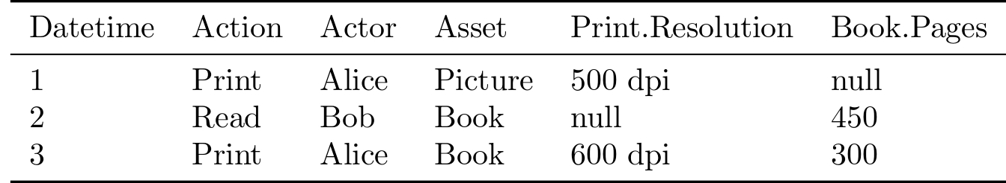
Mathematical ODRL Semantics
We ground our ODRL semantics on the monitoring problem, that is the evaluation of ODRL policies on a state of the world.
Intuitively:
  Given a set of rules on how we should behave (ODRL Policy P)
  Given information on the events that happened (State of the World )
  We ask the question: were any rules violated?
    If Yes, then evaluation(P,ω) = false
    Else evaluation(P,ω) = true
We will see later how we define evaluation(P,ω), but based on this we can define other important decision problems.

Slide 10
A few Assumptions
We assume the State of the World contains a log of events that is:
  Correct
  Relevant
    Reuse same concepts (IRIs) as in the Policy we want to evaluate
  Complete (Close-World)
    This assumption can be relaxed, but this naturally leads to an alternative semantics (Open-World) where evaluations can result in the value “unknown”.
We assume that the Policy
  Everything not explicitly permitted is prohibited (prohibited-by-default)
    Our semantics can be trivially modified to support the opposite (permitted-by-default)

Slide 11
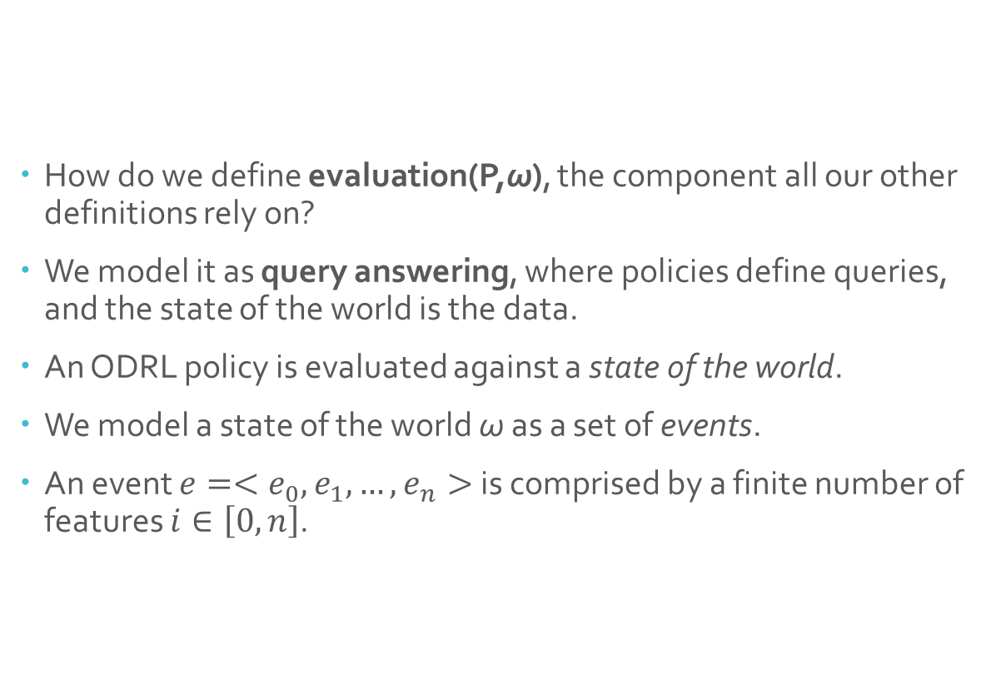
First-order ODRL Semantics
How do we define evaluation(P,ω), the component all our other definitions rely on?
We model it as query answering, where policies define queries, and the state of the world is the data.
An ODRL policy is evaluated against a state of the world.
We model a state of the world ω as a set of events.
An event $e=<e_{0},e_{1},…,e_{n}>$ is comprised by a finite number of features $i∈\left[0,n\right]$.

Slide 12
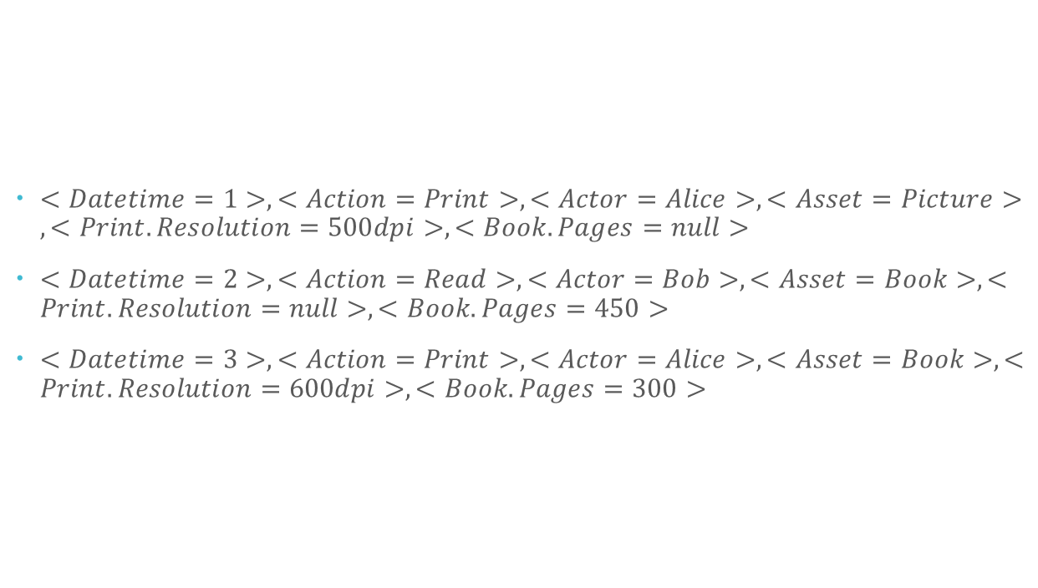
State of the world (example)
$<Datetime=1>, <Action=Print>, <Actor=Alice>, <Asset=Picture>, <Print.Resolution=500dpi>, <Book.Pages=null>$
$<Datetime=2>, <Action=Read>, <Actor=Bob>, <Asset=Book>, <Print.Resolution=null>, <Book.Pages=450>$
$<Datetime=3>, <Action=Print>, <Actor=Alice>, <Asset=Book>, <Print.Resolution=600dpi>, <Book.Pages=300>$

Slide 13
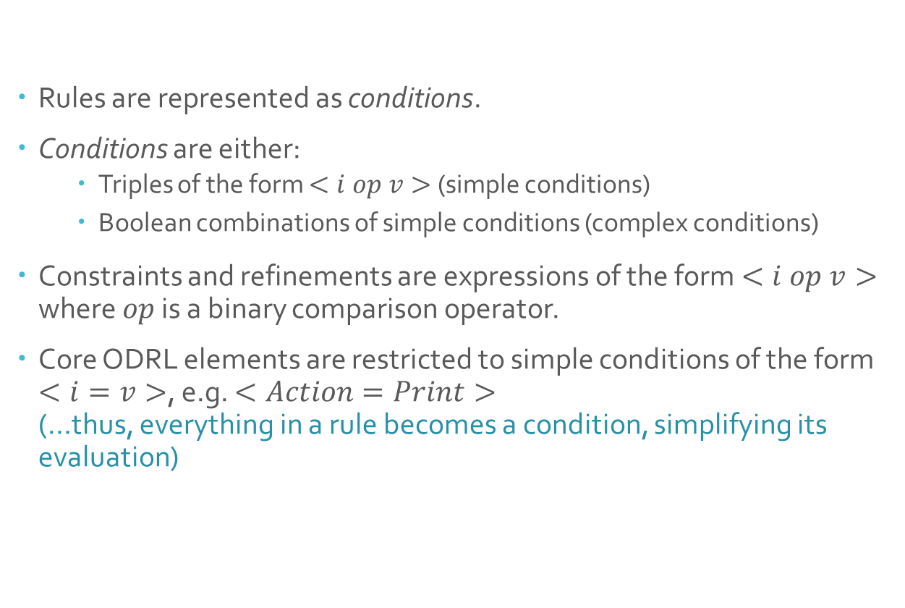
Rules
Rules are represented as conditions.
Conditions are either:
  Triples of the form $<i op v>$ (simple conditions)
  Boolean combinations of simple conditions (complex conditions)
Constraints and refinements are expressions of the form $<i op v>$ where $op$ is a binary comparison operator.
Core ODRL elements are restricted to simple conditions of the form $<i=v>$, e.g. $<Action=Print>$
(…thus, everything in a rule becomes a condition, simplifying its evaluation)

Slide 14
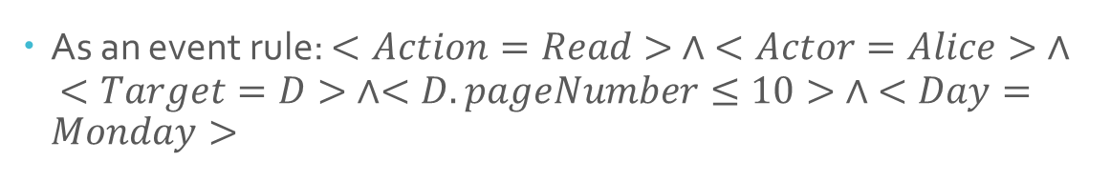
Rules (cont’d)
odrl:permission [
odrl:action :Read ;
odrl:assigner :Bob ;
odrl:assignee :Alice ;
odrl:target [
rdf:value :D ;
odrl:refinement [
odrl:leftOperand :pageNumber ;
odrl:op odrl:lteq ;
odrl:rightOperand 10
]
] ;
odrl:constraint [
odrl:leftOperand :day ;
odrl:op odrl:eq ;
odrl:rightOperand :Monday
]
]
As an event rule: $<Action=Read> ∧ <Actor=Alice> ∧ <Target=D> ∧<D.pageNumber≤10> ∧ <Day=Monday>$

Slide 15
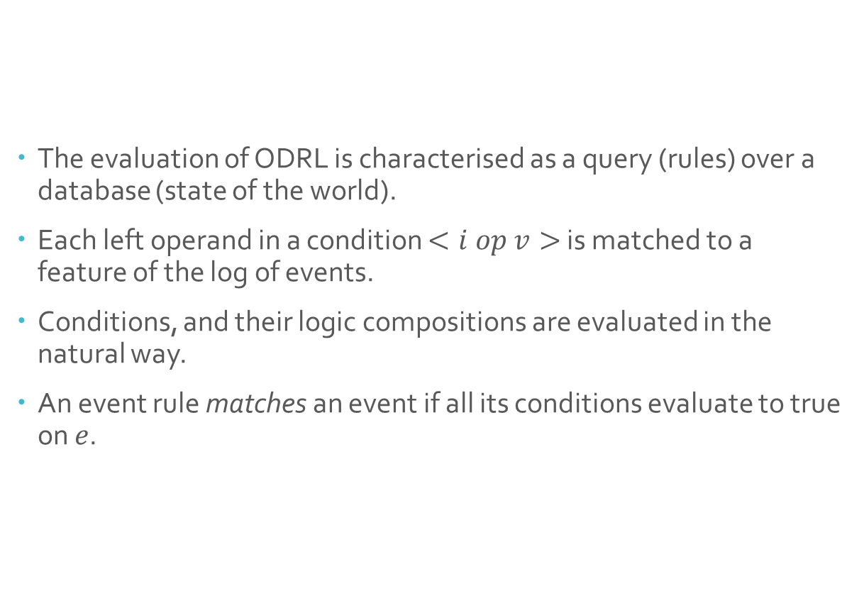
Evaluation
The evaluation of ODRL is characterised as a query (rules) over a database (state of the world).
Each left operand in a condition $<i op v>$ is matched to a feature of the log of events.
Conditions, and their logic compositions are evaluated in the natural way.
An event rule matches an event if all its conditions evaluate to true on $e$.

Slide 16

Evaluation
(example)
For example, which rows of the data match this condition?
$$<Book.Pages<500> ∧ <Action=Print>$$

Slide 17

Evaluation
(example)
For example, which rows of the data match this condition:
$$<Book.Pages<500> ∧ <Action=Print>$$

Slide 18
ODRL Lite
If we only consider Permissions, Prohibitions and Obligations,
a state of the world ω violates a policy if any of the following are true:
  There exists an event such that no permission rule matches it.
  There exists an event that is matched by a prohibition rule.
  There exists an obligation rule that matches no events in the state of the world.

Slide 19
Full ODRL
Our full semantics cover all rule types:
  Permissions with duties.
  Permissions with duties and consequences.
  Prohibitions with remedies.
  Obligations with consequences.
A Full ODRL Policy is violated also if:
  There exists an event that is matched by a permission with duties, but there is no prior event that is matched by the duty.
  … and other conditions to match the other rule types (details in the paper)

Slide 20
Policy Comparison
Our evaluation decision problem (evaluation(P,ω)) allows us to define:
Policy Comparison
  Policy Equivalence
  ODRL policies P and P’ are semantically equivalent
  (…that is, P and P’ mean the same thing)
  IFF
  for any state of the world ω
  evaluation(P,ω) = evaluation(P’,ω)
  Policy Containment
  ODRL policy P is contained in policy P’
  (…that is, P is stricter than P’)
  IFF
  for any state of the world ω, evaluation(P,ω) → evaluation(P’,ω)
  (…that is, if evaluation(P,ω) is true, then evaluation(P’,ω) is true)

Slide 21
Access Control
We can model Access Control in two different ways.
  Access Request as an ODRL Policy (more expressive)
  Access Request as an event logged in the State of the World (faster to compute)
Both approaches can be extended with a pre-existing State of the World (for example, to keep track of duties, or limits on how often a permission can be exercised)

Slide 22
Access Control
(Request as Policy)
We can model Access Control in two different ways.
The Access Request can be modelled as a Policy itself.
For example, if I want to download dataset X tomorrow, I can express this with a Policy R:
  Action: Download
  Target: Dataset X
  Assignee: Me
  Constraint:
    datetime > “23:59:59 20/07/2026”
    datetime <= “23:59:59 21/07/2026”
Access request R, is acceptable under Policy P
IFF
R is contained in P

Slide 23
Access Control
(Request as Event)
The Access Request can be modelled as a future event.
For example, if I want to download dataset X tomorrow, I can express this with a state of the world ω that contains the information of the following event
  On date 21/07/2026, I download dataset X.
Access request R, is acceptable under Policy P
IFF
evaluate(P, ω) is true

Slide 24
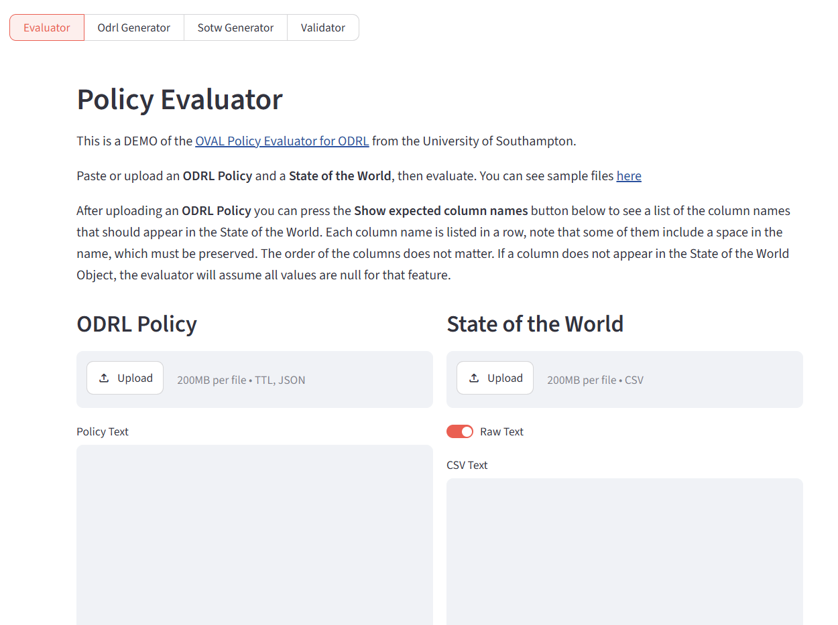
An ODRL Evaluator based on our semantics
https://dips.soton.ac.uk/odrl-engine/odrl-engine-dashboard/
https://arxiv.org/abs/2607.15987

Slide 25
Thank you!

