Slide 1
AI Agent Protocol CG
Song Xu

Slide 2
Agenda
About the group
Scope of work
Communication and meetings
White paper
Protocol
Use cases

Slide 3
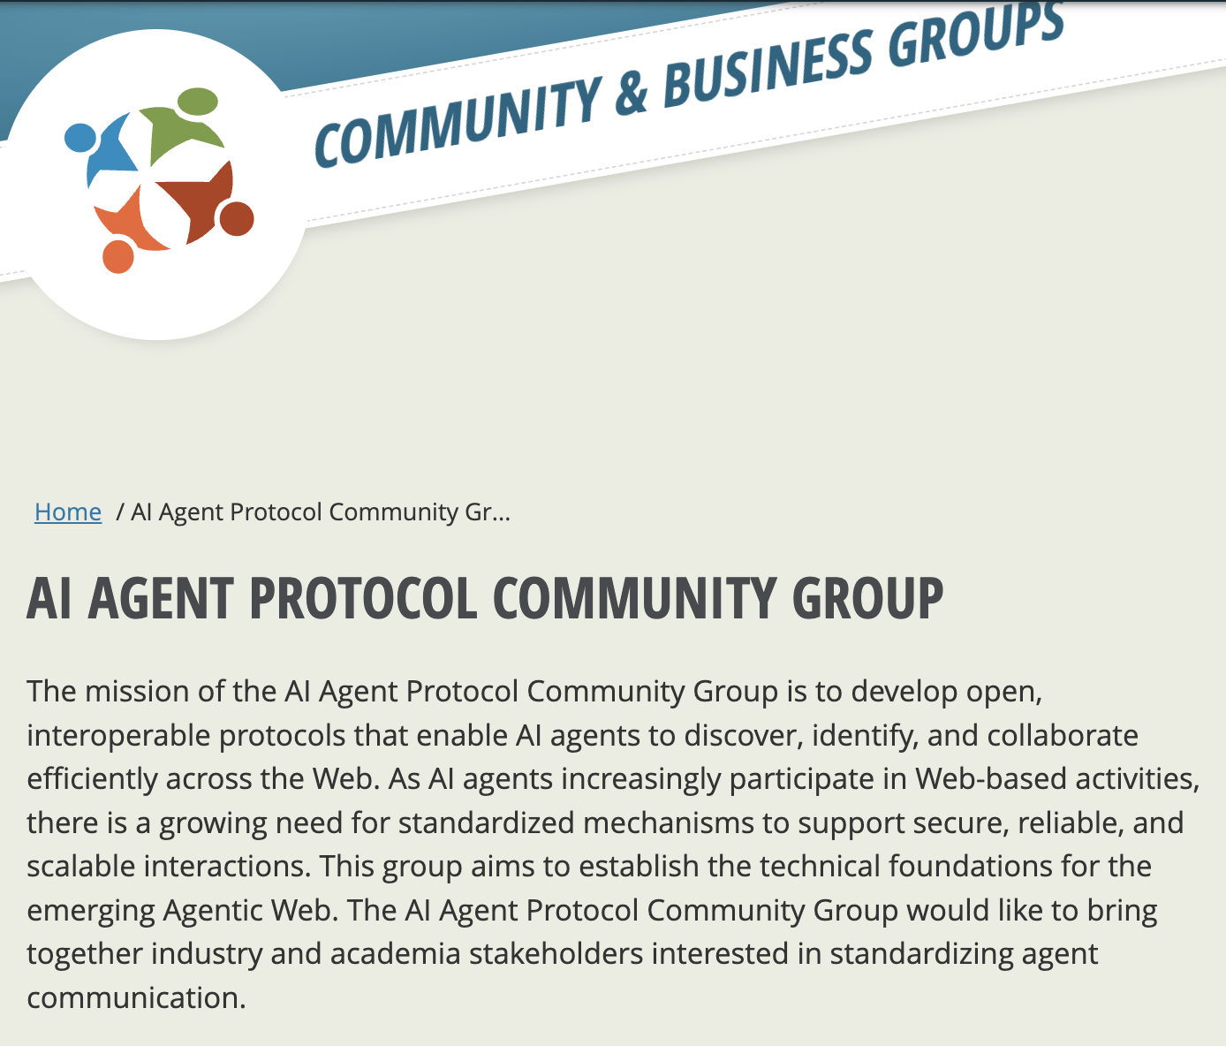
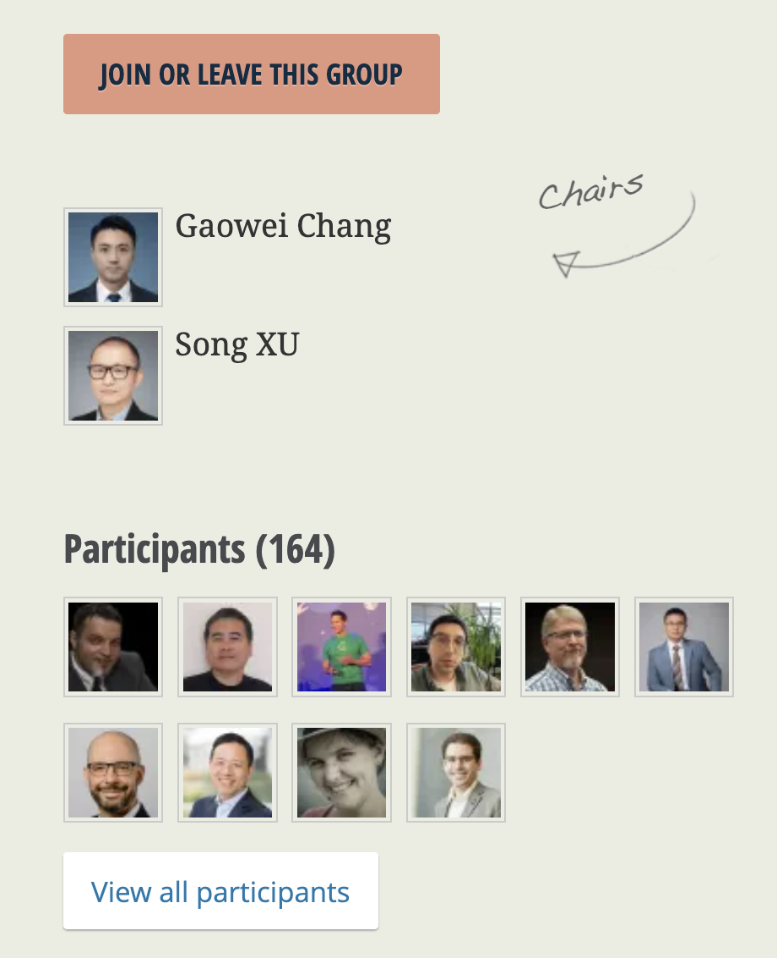
ABOUT https://www.w3.org/community/agentprotocol/

Slide 4
Scope of Work
Inter-agent Communication Protocol: Allows agents to discover each other，exchange intent and capabiity information, negotiate roles, and dynamically establish or dissolve collaborations.
Agent Identity/Authorization Model: An open standards-based Al agent identity framework that supports secure, interoperable authentication and authorization between cross-domain agents.
Standardized Metadata Format: Structured descriptions of agent capabilities，interfaces, goals, and states, enabling automated reasoning and orchestration ofagent behaviors.

Slide 5
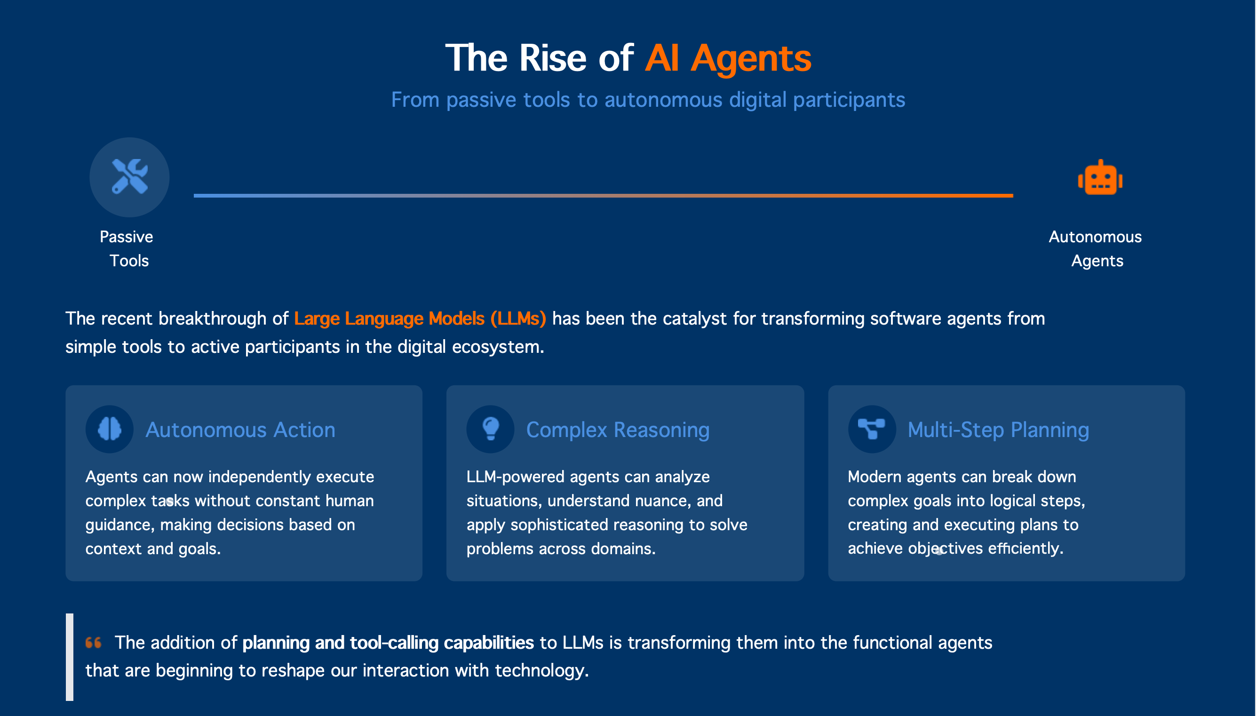
The Rise of AI Agents

Slide 6
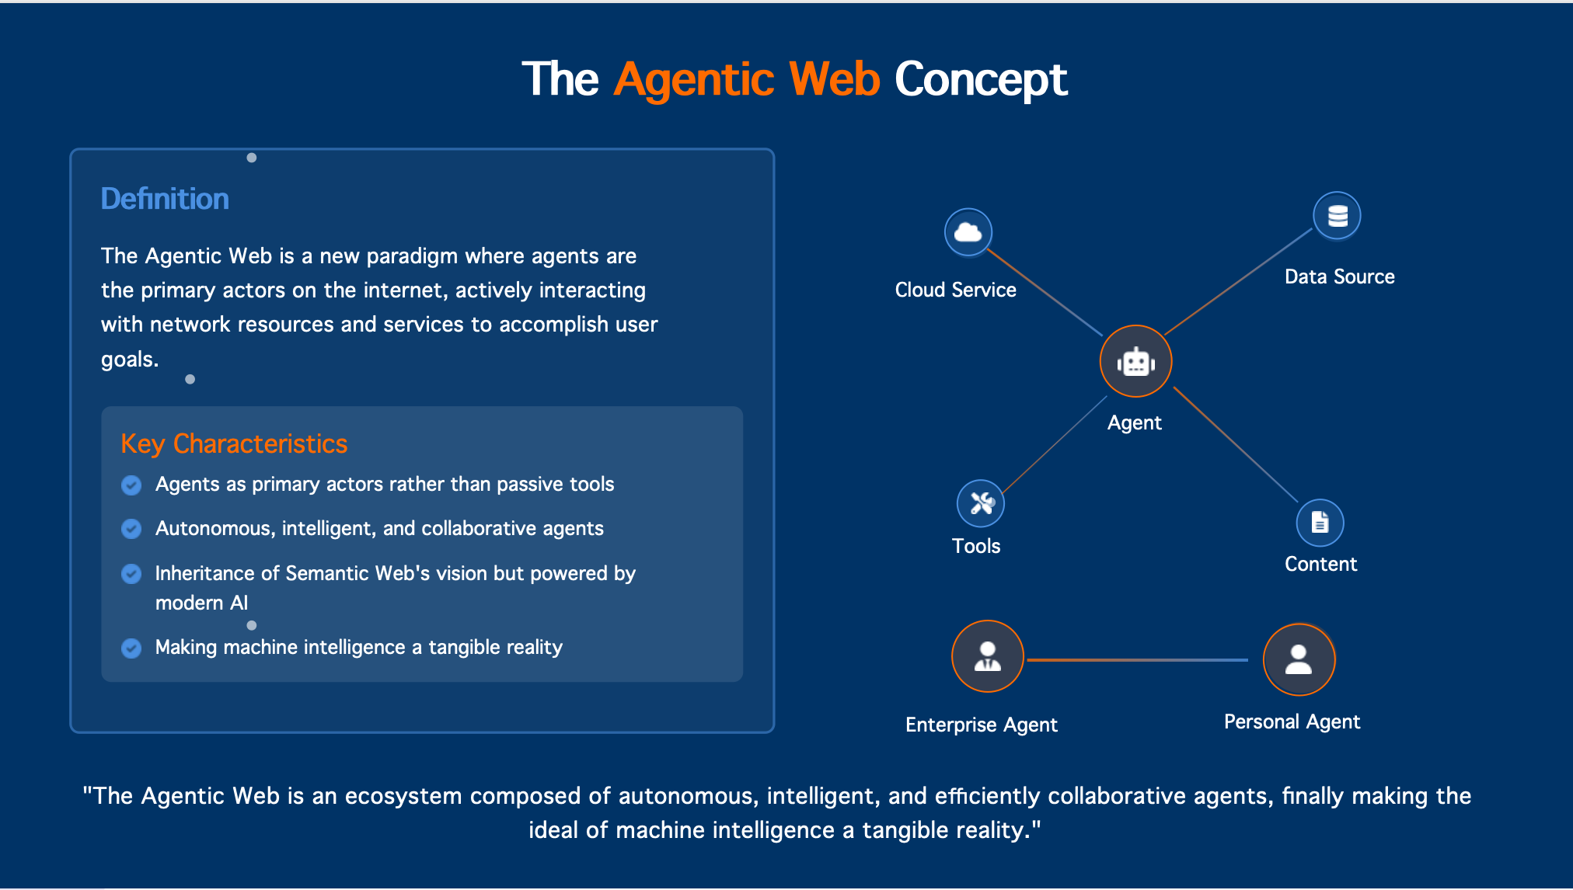
The Agentic Web Concept

Slide 7
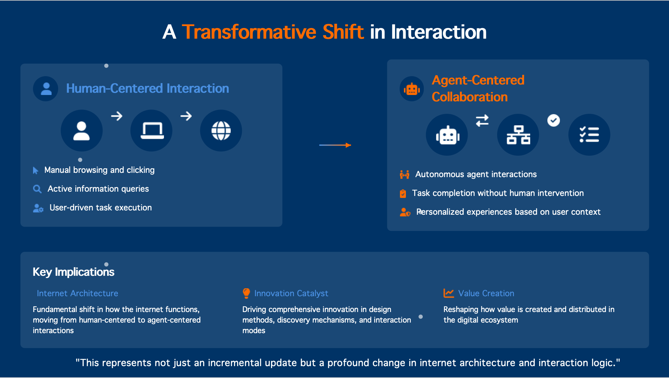
A Transformative Shift in Interaction

Slide 8
Communication and meetings
Bi-weekly meeting
GitHub: https://github.com/w3c-cg/ai-agent-protocol/issues/new
Email: public-agentprotocol@w3.org
Slack channel: https://w3ccommunity.slack.com/archives/C091V1SCF8W

Slide 9
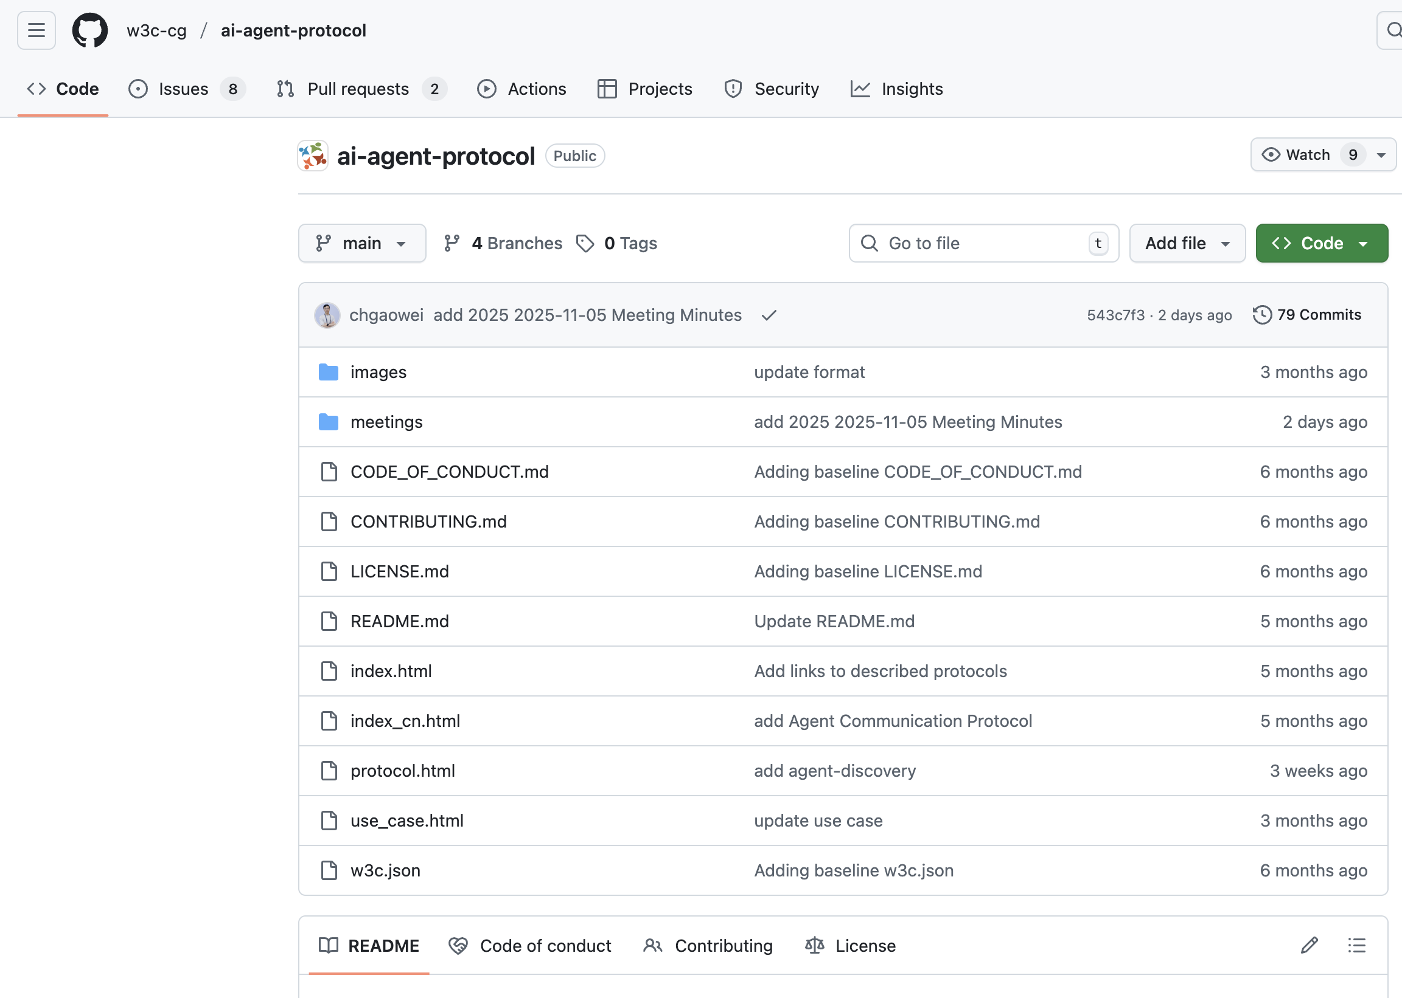
Communication and meetings
https://github.com/w3c-cg/ai-agent-protocol

Slide 10
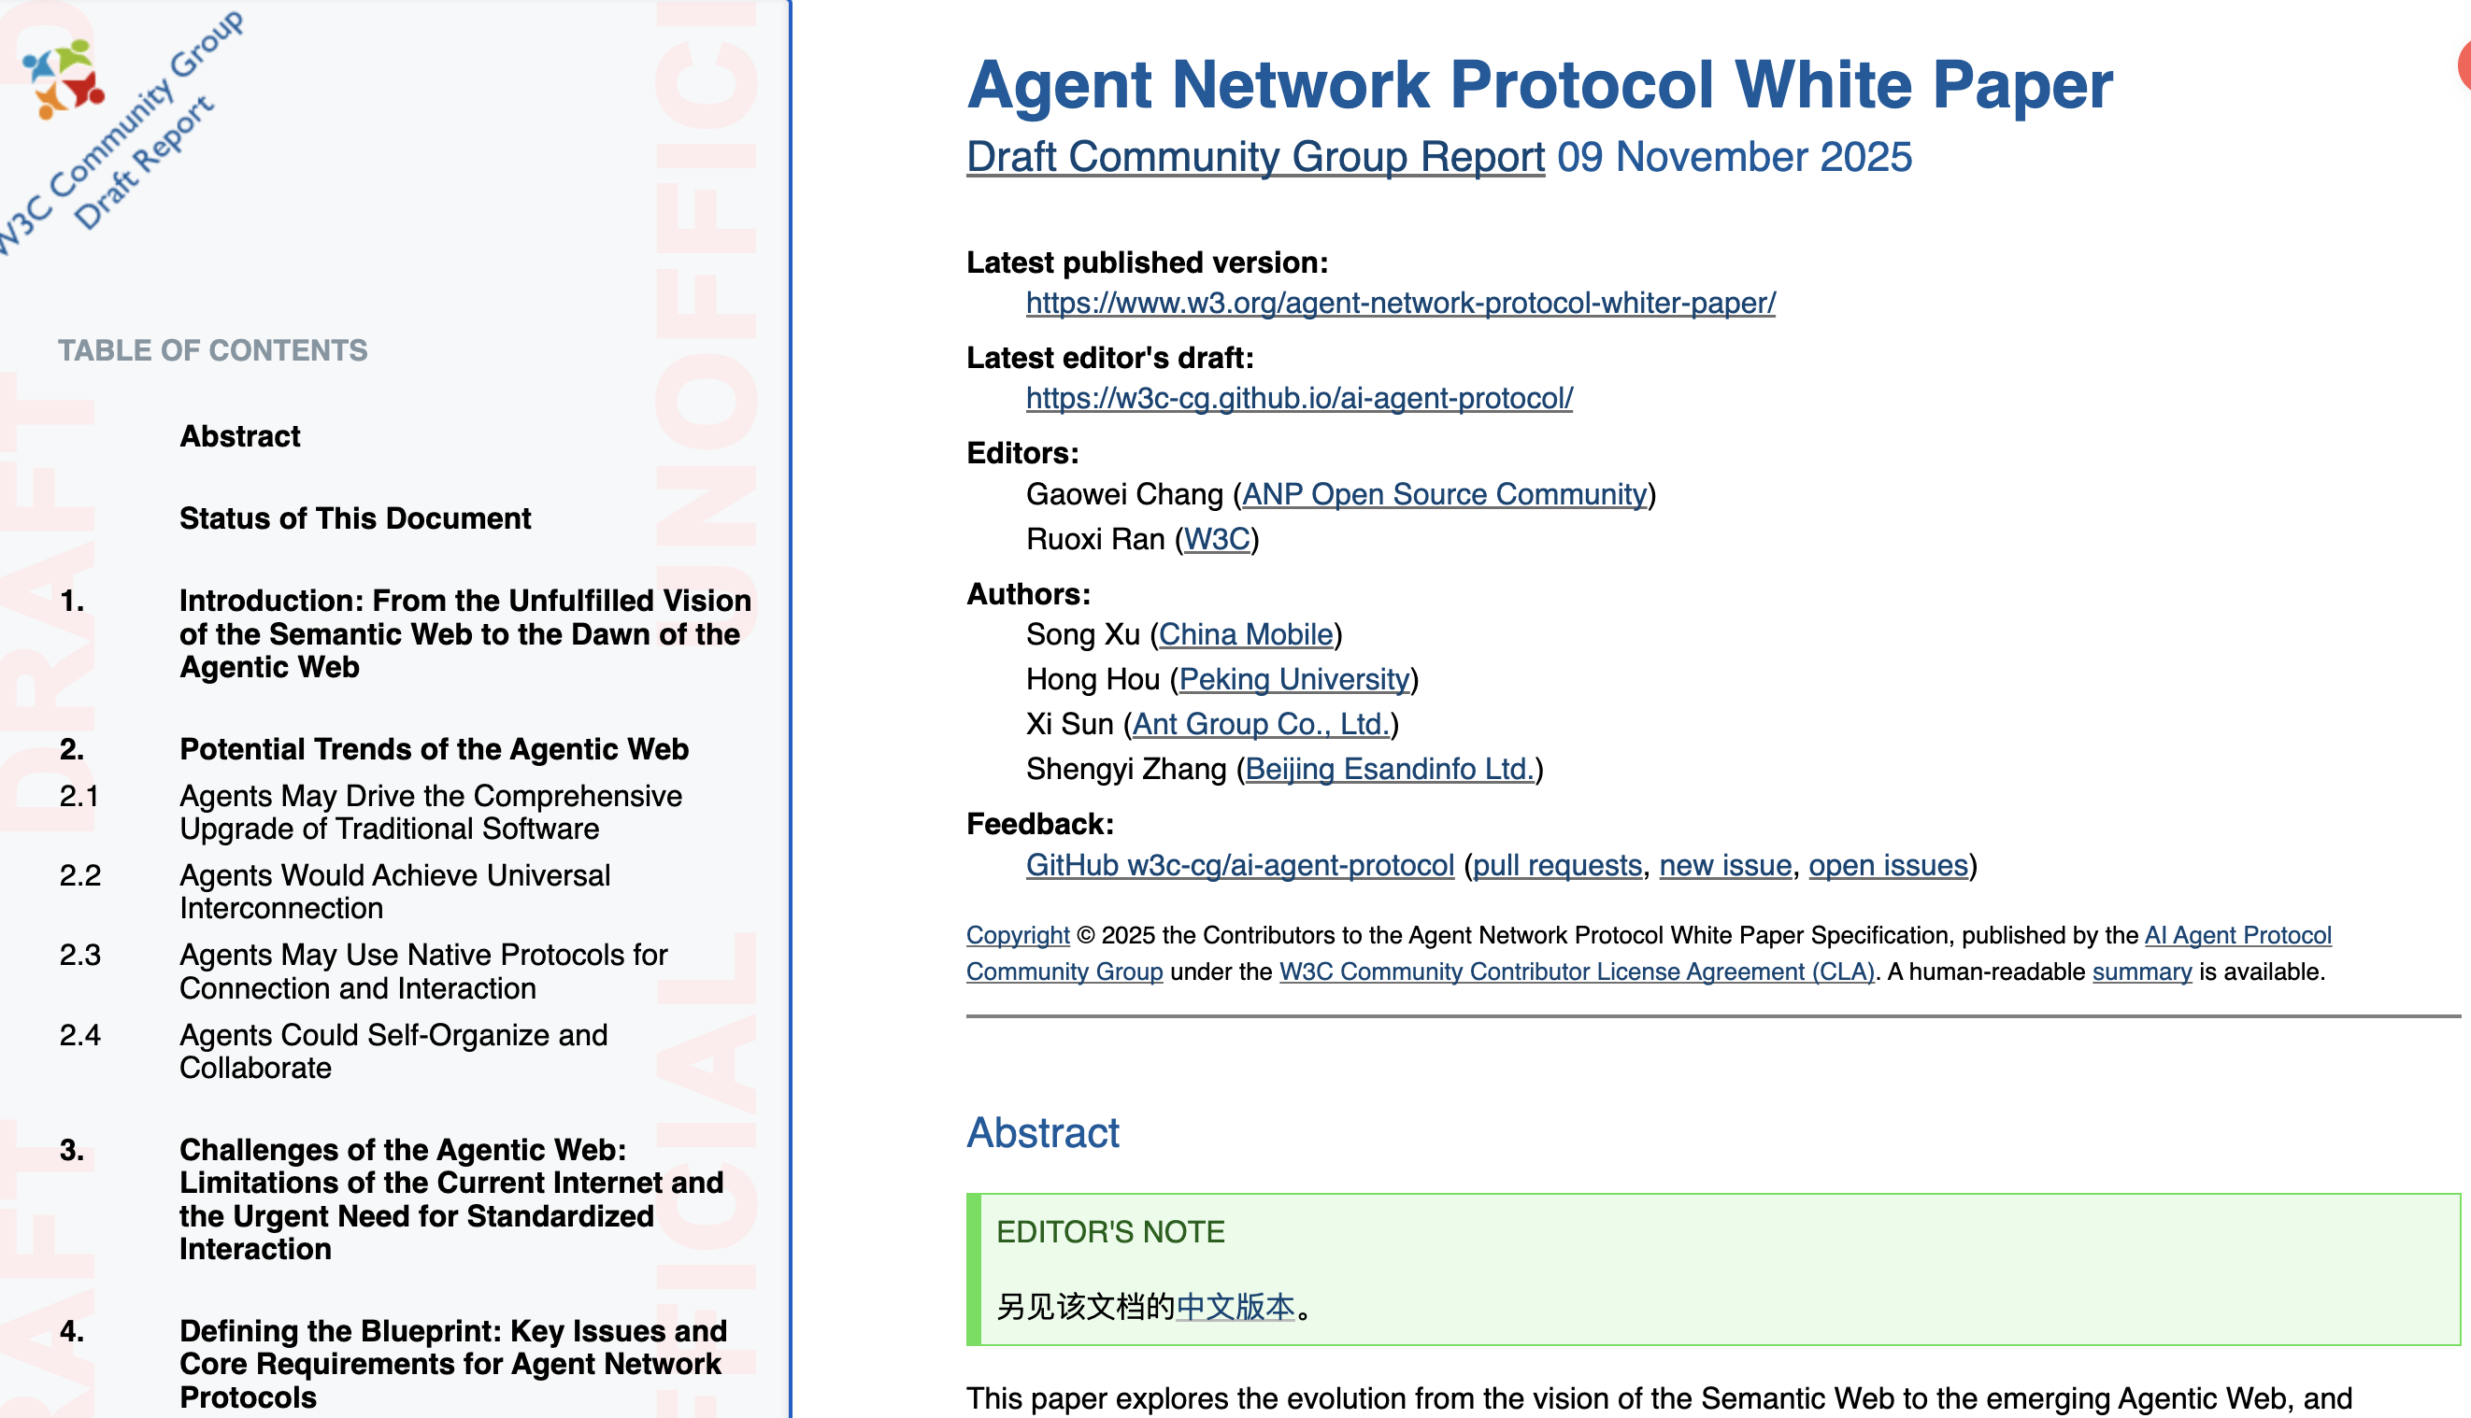
Whitepaper
From Semantic Web to Agent Network.
Four Major Trends of Agent Network.
Necessity of Standardized Protocols.
https://w3c-cg.github.io/ai-agent-protocol/
Notes:
With the development of modern AI, technologies such as LLMs, agents can now autonomously execute tasks，perform complex reasoning, and solve multi-step problems
Agents emerging as an Internet infrastructure, universal connectivity between agents, protocol-based native connection modes, and autonomous organization and collaboration among agents.
Breaking data silos, enabling heterogeneous agent collaboration, building Al-native data networks，ultimately achieving an open and efficient agent network.

Slide 11
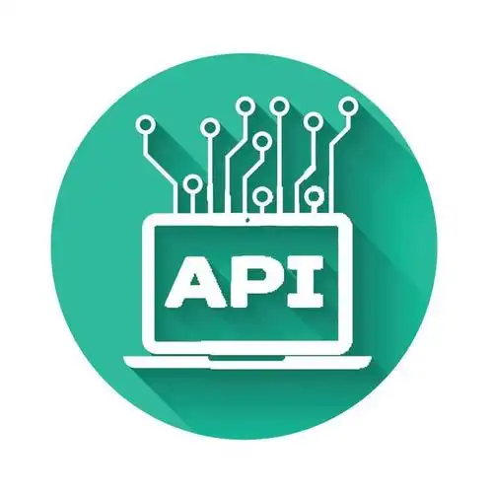
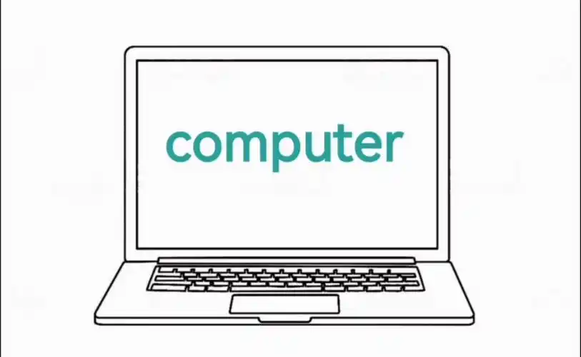


Protocol
Why Protocols Matter for the Agentic Web?
API
Computer Use
Browser Use
Protocol
High efficiency
Lack of standards
Few APIs
Most abundant supply
High cost
Poor user experience
Inaccessible apps
Security issues
AI-native connection method
Standardization
High transformation cost
Protocol is the most efficient container for context transmission

Slide 12
Does the Agentic Web need a new HTTP?
Business Layer
Business Layer
MCP A2A ANP
HTTP is more like a business-agnostic general-purpose transport protocol, agent protocols need to be deeply coupled with business logic
Application Layer
HTTP
Application Layer
Transport Layer
Transport Layer
TCP UDP
Internet Layer
Internet Layer
IP ICMP
Network Interface Layer
Network Interface Layer
Ethernet Wi-Fi PPP
Notes:
HTTP is more like a business-agnostic general-purpose transport protocol, while agent protocols need to be deeply coupled with business logic — for example, how to use the protocol to book hotels or purchase goods.

Slide 13
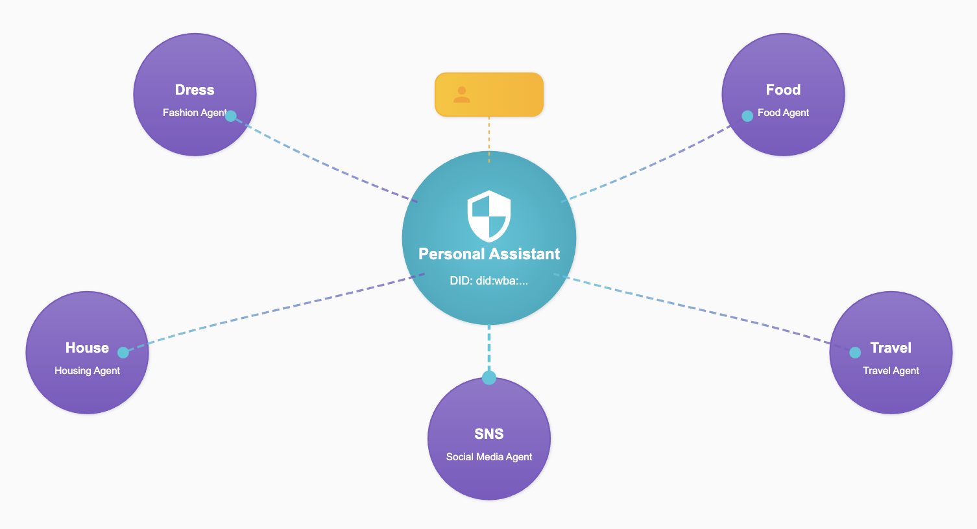
ANP agent identity scheme
Based on W3C DID, a distributed identity authentication scheme
Notes:
Based on W3C DID, a distributed identity authentication scheme with good interoperability is designed: agents can use their own identity ID to authenticate, communicate and collaborate with agents of any other platform or organization. Similar to email service.

Slide 14
DID: A CURD operation on the WBA (Web-Based Agent)
www.alice.com
www.bob.com
Deactivate
https://alice.com/user/did.json
did:wba: alice.com: user
Create
Update
Deactivate
Create
Update
Read
did:wba:bob .com: user
https://bob.com/user/did.json
Read
Private Keys
DID Document
Private Keys
DID Document
CURD Operational Definition:
Create (register): Defined by the implementer
Read (parse): Get the DID document through the HTTP GET method
Update (update): defined by the implementer
Deactivate (deactivating): Defined by the implementer
Method characteristics:
The existing Web infrastructure can be fully utilized to support billions of users.
Decentralize and interoperate Agent identities to break down data islands.
Similar to existing E-mail services: identity management based on domain name system.
Notes:
CURD Operational Definition:
Create (register): Defined by the implementer
Read (parse): Get the DID document through the HTTP GET method
Update (update): defined by the implementer
Deactivate (deactivating): Defined by the implementer
Method characteristics:
The existing Web infrastructure can be fully utilized to support billions of users.
Decentralize and interoperate Agent identities to break down data islands.
Similar to existing E-mail services: identity management based on domain name system.

Slide 15
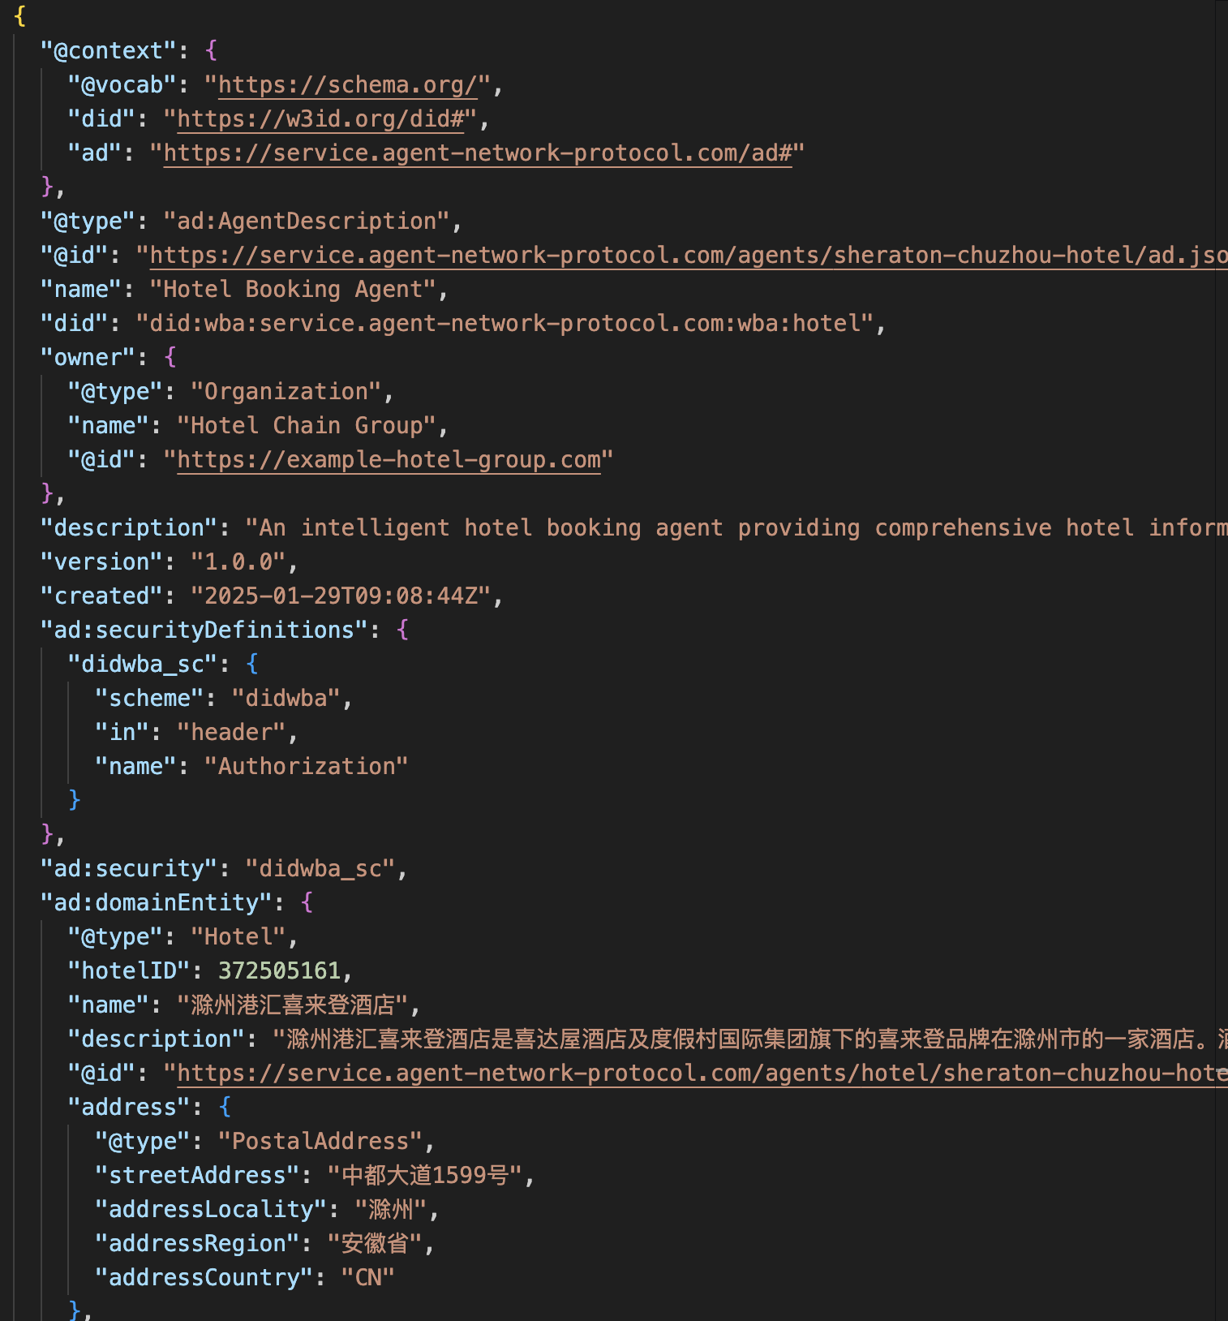
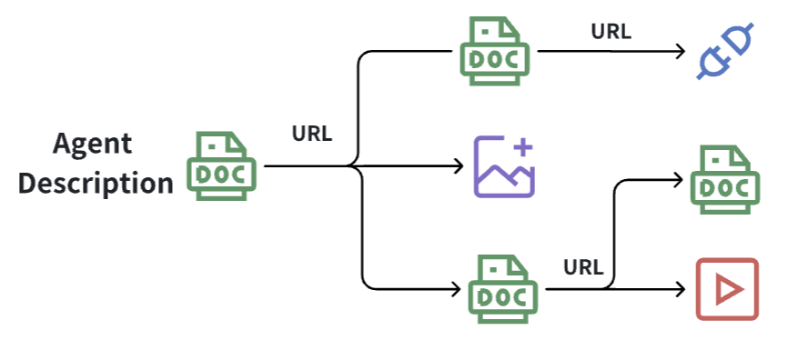
Agent description scheme
Notes:
Based on semantic web related technologies such as JSON-LD and schema.org, agents can make their basic information, capabilities, interfaces, etc. public, and link these information into a data network that is easy for AI to read and understand.

Slide 16
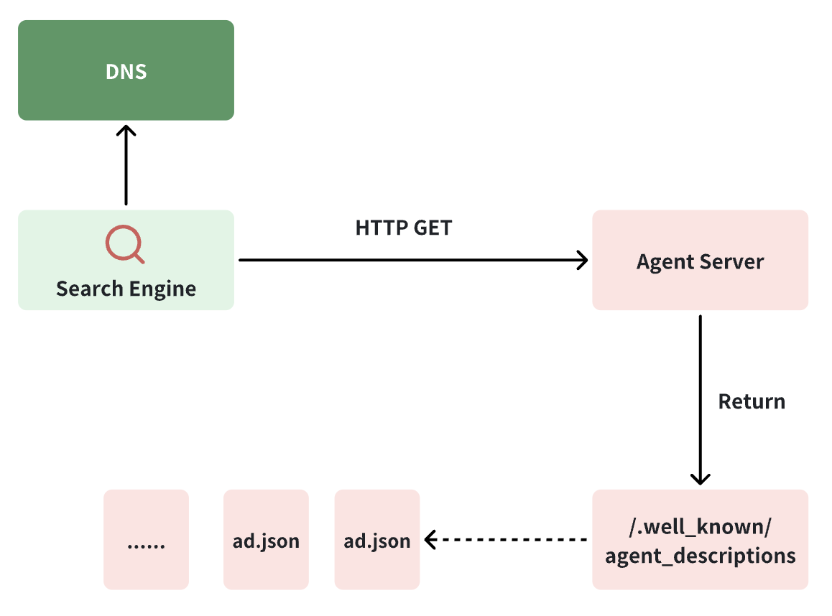
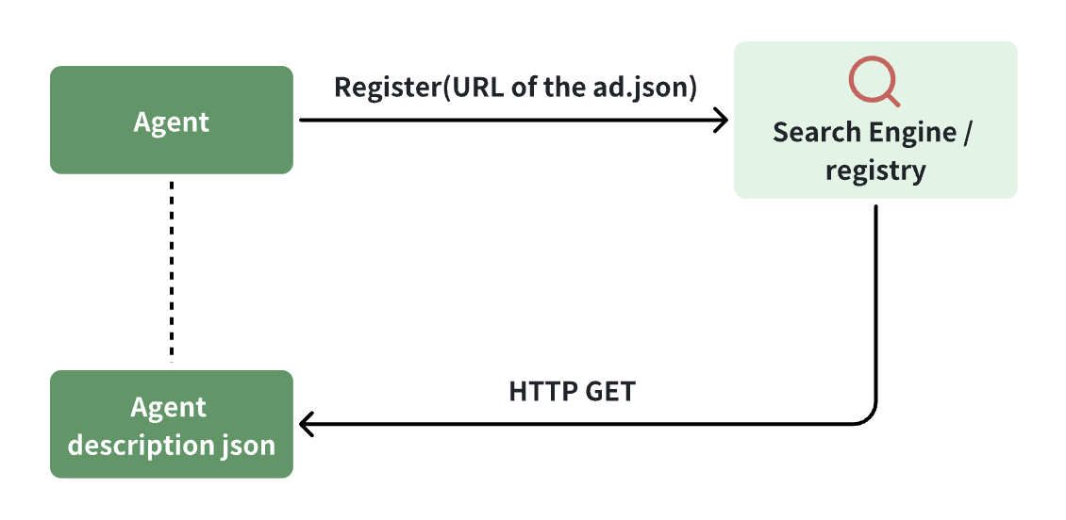
Agent Discovery Mechanism
Notes:
By adopting discovery technologies similar to those used for websites and based on DNS, search engines can discover all agents across the network along with their public information, making it easier for agents to be accessed and invoked.

Slide 17
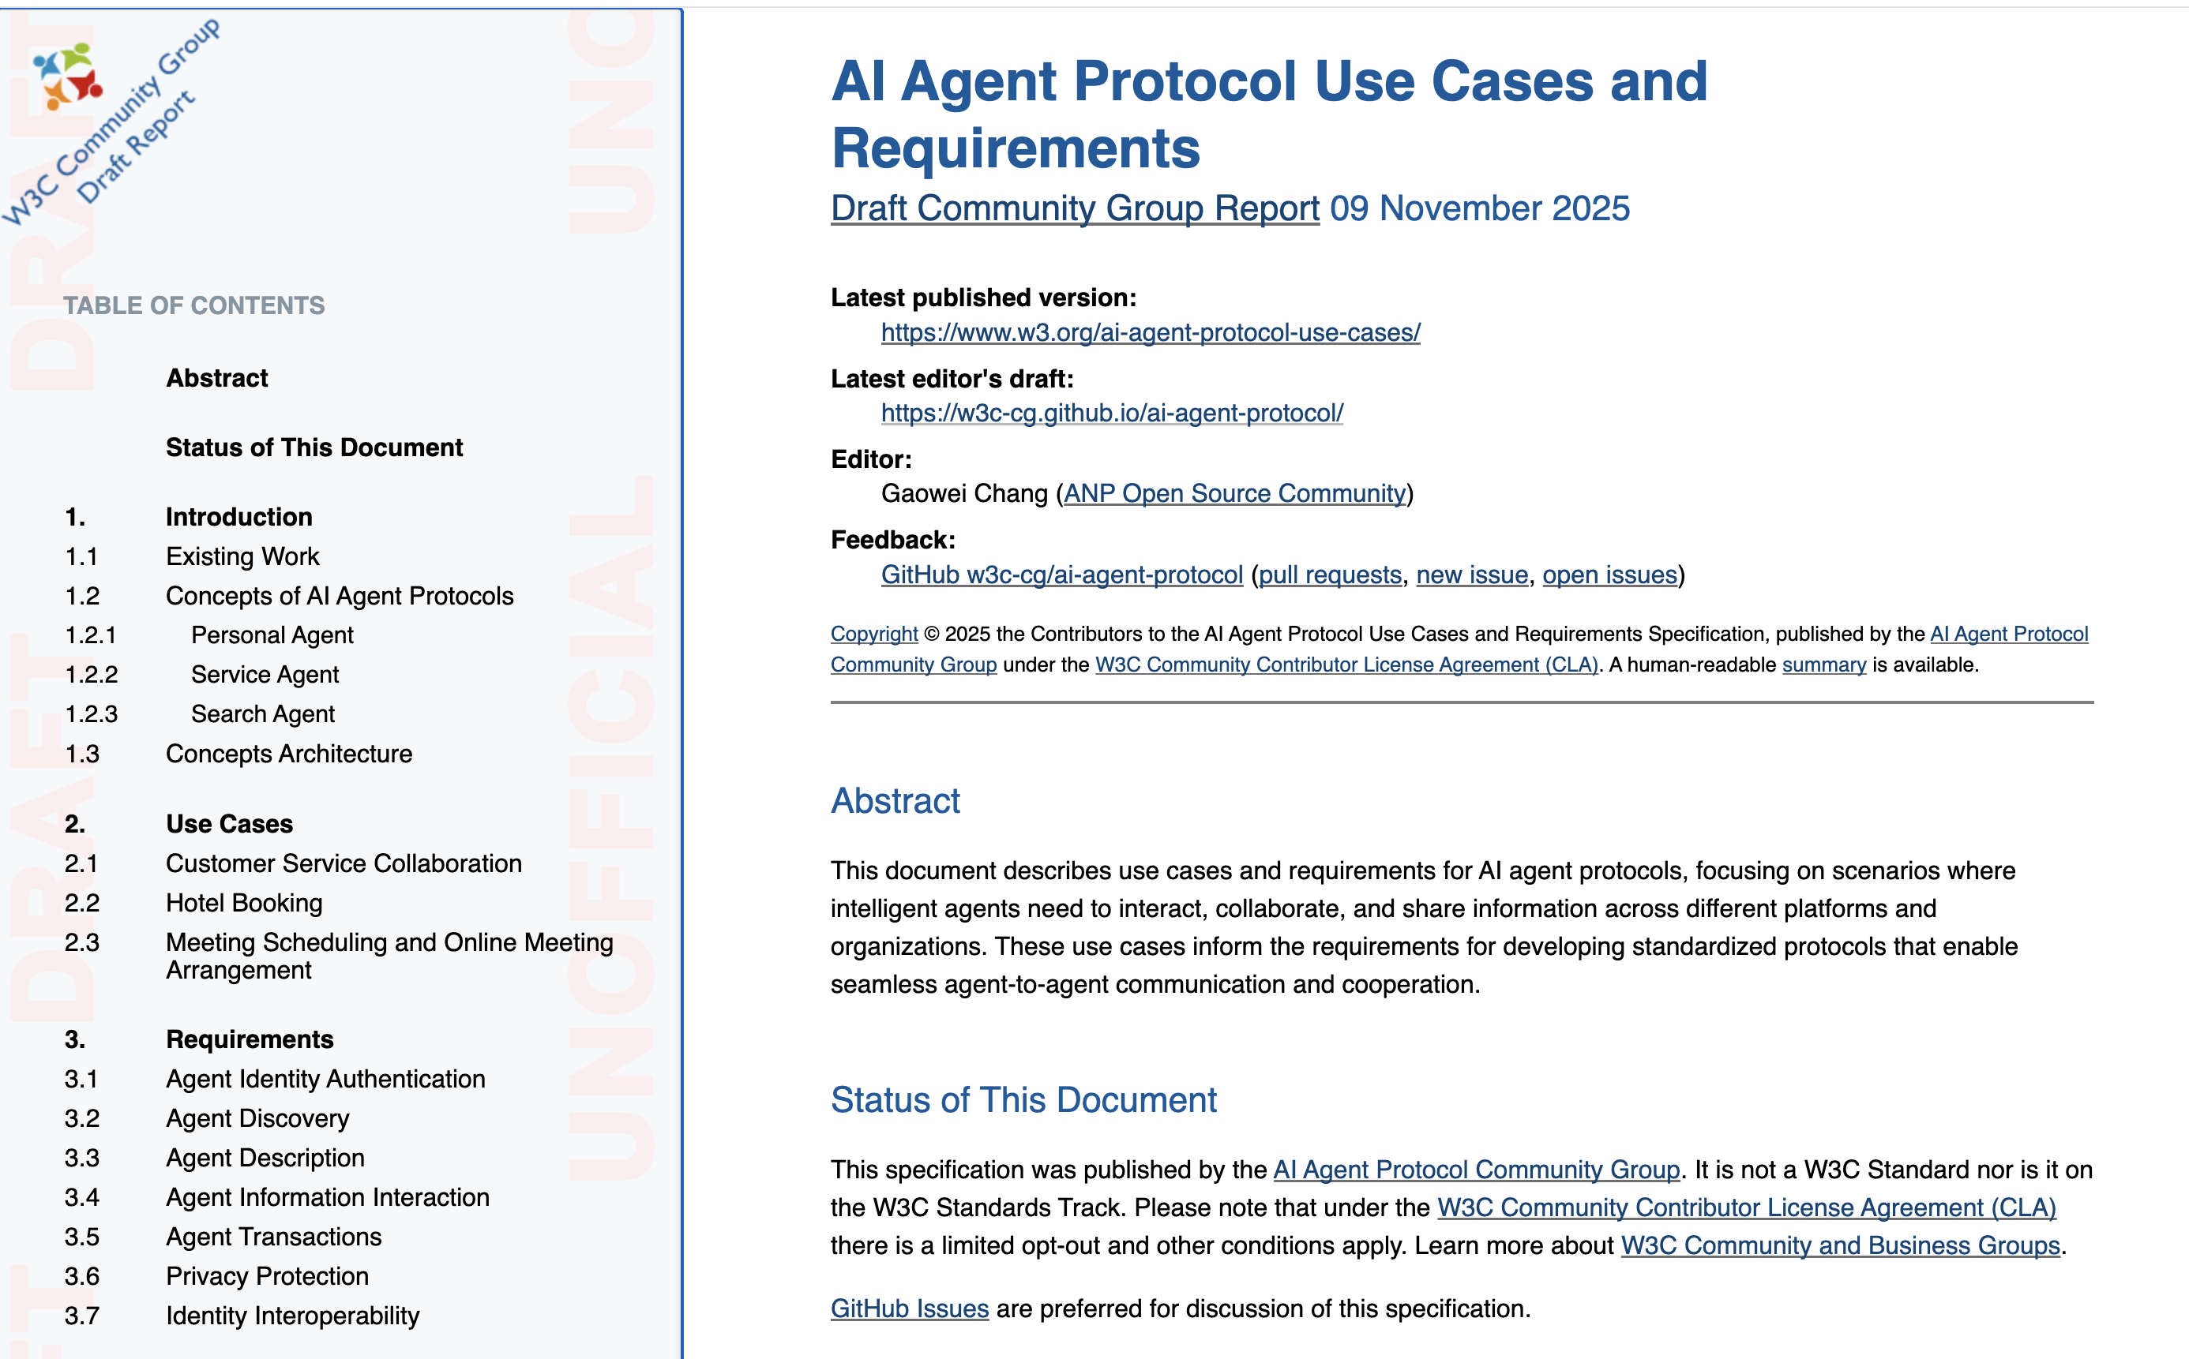
Community Group Use Cases
Personal Agent: Directly serves individual users, represents user interests，manages preferences, schedules, communications, and persona/ tasks, while protecting user privacy and control.
Service Agent: Provides services to other agents rather than directly to individual users. Offers specialized capabilties that can be invoked by personal agents or other service agents through standardized protocols.
Search Agent: Facilitates agent discovery and connection. Maintains a directory of available agents and their capabilities, enabling agents to findand connect with each other, forming a dynamic agent network.
https://w3c-cg.github.io/ai-agent-protocol/use_case.html

Slide 18
Use Case Architecture
Personal Agent
Service Agent
Search Agent
Directly serves individual users, acting as their digital representative.
Provides specialized services to other agents through standardized protocols.
Facilitates agent discovery and connection in the ecosystem.
User authorization
Privacy protection
Personalized service
Domain expertise
Standard interfaces
Scalable delivery
Agent discovery
Capability matching
Network formation

