Slide 1
Digital Identity & Authentication W3C Discussion
Jeremy Grant
Managing Director, Technology & Innovation
Venable LLP
jeremy.grant@venable.com

Slide 2


About me
Managing Director in Venable’s Technology & Innovation Practice
Identity: 25+ years experience across government and industry
Led National Strategy for Trusted Identities in Cyberspace (NSTIC)
Senior Executive Advisor for Identity Management at NIST
U.S. Senate staff – covering health and technology issues (Senate Finance Committee & Joint Economic Committee)
Five years building and delivering identity solutions (ID proofing, PKI, smart card, biometrics, federation)
Three years as a market analyst covering the identity space
Ten years advising identity vendors, end-users, investors and governments on how to best position in the identity market
Government:
Industry:
2

Slide 3
One caveat
I am not directly involved with the W3C…
…but the work W3C does in identity and authentication impacts my work in FIDO Alliance (WebAuthn) and on digital identity issues (Digital Credentials API, DIDs, VCs, etc.)

Slide 4

Setting the stage – What do we mean by “Identity?”
Identity Proofing
Relevant at account opening – determining:
Does a Heather Flanagan really exist?
Of 37,000 Heather Flanagans in the US, which of them are you?
Are you really a particular Heather Flanagan?
Authentication
Relevant after an account has been created – and someone is logging back in – determining:
Are you the same person who was previously issued a credential?
aka “the password problem”
I’m Heather Flanagan!
Let me back in!

Slide 5

The challenge
“Digital identity presents a technical challenge because this process often involves proofing individuals over an open
network, and always involves the authentication of individual subjects over an open network...”
“The processes and technologies to establish and use digital identities offer multiple opportunities for impersonation and other attacks.”
- National Institute of Standards and Technology (NIST)

Slide 6
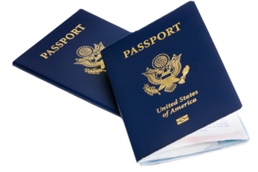
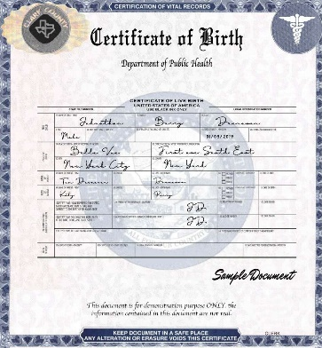
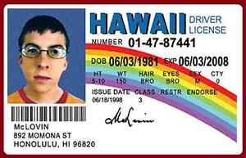
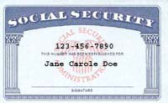
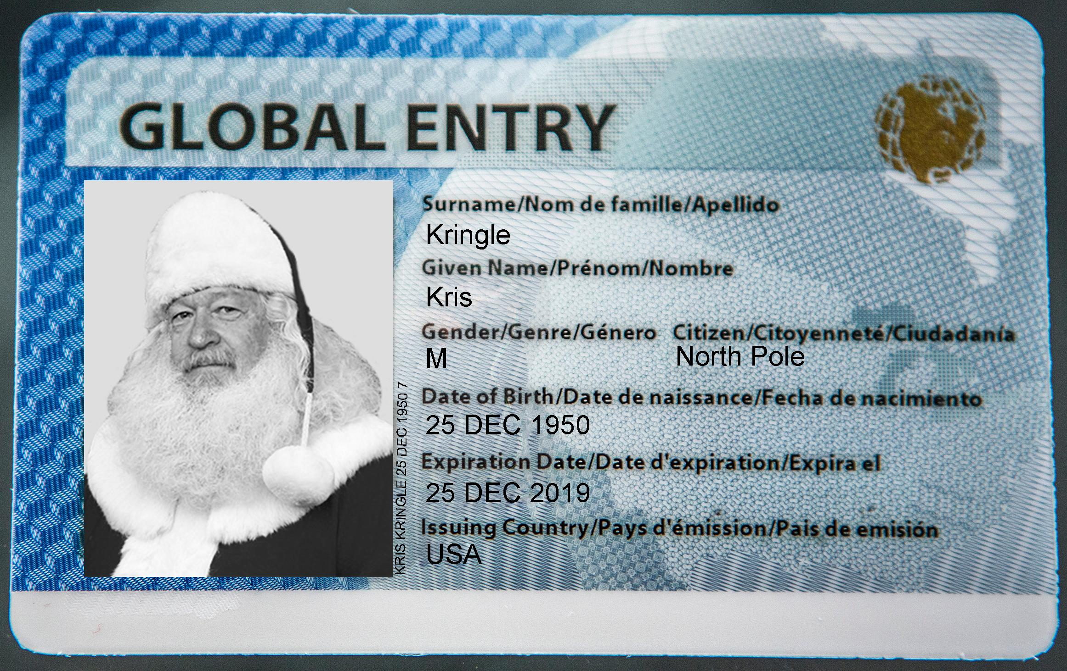
Online identity proofing has been particularly hard to solve
Why? The “identity gap” – the U.S. has many nationally recognized, authoritative identity systems…
…all are trapped in the paper world

Slide 7

This was an attempt to get around the “identity gap”
WHICH
Industry needed something to enable trusted digital commerce – this was the best solution out there
…of the following 4 banks gave you a loan in 2013?
It sort of worked for a while…

Slide 8
Identity Proofing: A Core Idea
If I’ve gone through the process of having an agency vet my identity once – can I ask that agency to vouch for me when I need to prove who I am to another party?
America’s legacy paper-based systems should be modernized around a privacy-protecting, consumer-centric model that allows consumers to ask the government agency that issued a credential to stand behind it in the online world – by validating the information from the credential.

Slide 9
Summary: Where we are today
The Private Sector Cannot Solve Identity Alone.
Doing So Will Require Better Access to Government Data.
The Challenge:
How to do This in a Way That’s Good for Security + Privacy?

Slide 10
While there are pockets of activity in government…
…there are no efforts to coordinate digital identity activities across the US government…
…or think about identity as infrastructure.

Slide 11
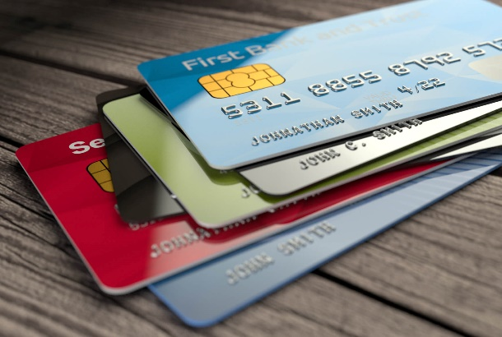
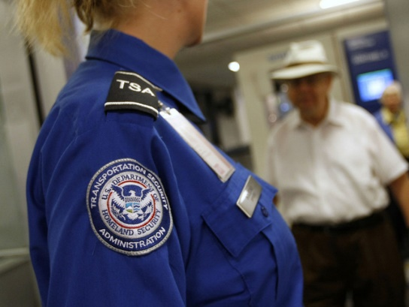
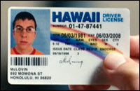


Here’s what this means
Going through a TSA checkpoint?
You can now use a mobile driver’s license (mDL) at several airports, but you can’t (yet) use that mDL for any other use case on this slide
Apply for a credit card online?
SSA will validate whether Name/DOB/SSN match
No other agency validates identity data for banks (outside of some DMVs)
Need to prove you’re 18 for Instagram or porn?
New Senate bill calls for Commerce Department to create a new system just to support online age verification
Need to apply for a government benefit?
Duplicate (more or less) what you went through at the DMV – but this time, online! (Login.gov)
SSA won’t validate data
Need to drive or get a state ID?
Stand in line at the DMV to prove who you are
Get a plastic card

Slide 12
In identity and authentication, policy matters to standards… …and standards matter to policy

Slide 13
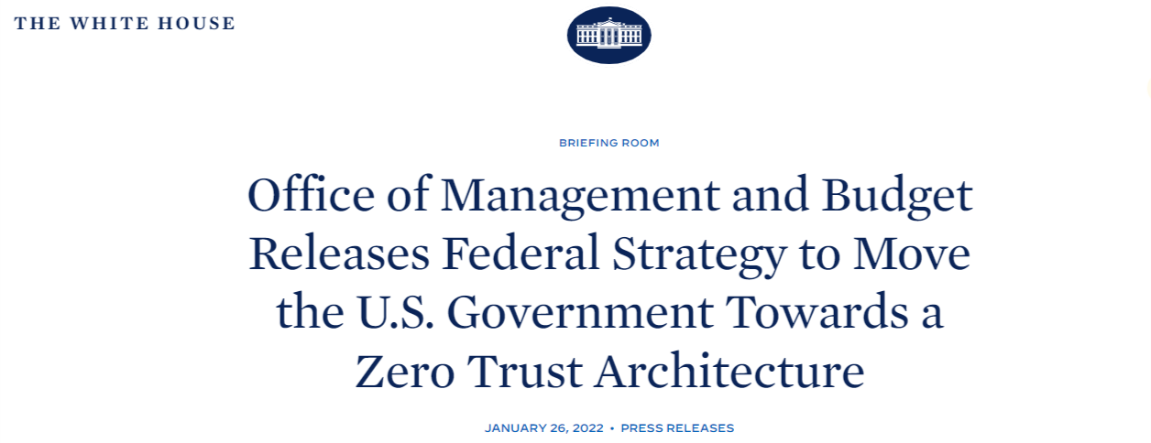
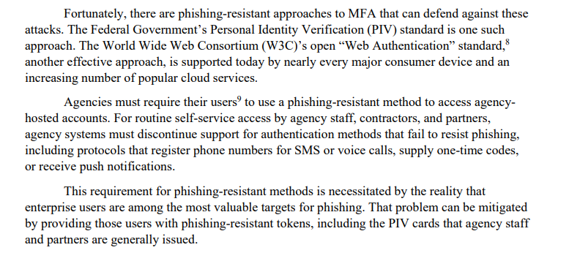
Authentication and Policy

Slide 14
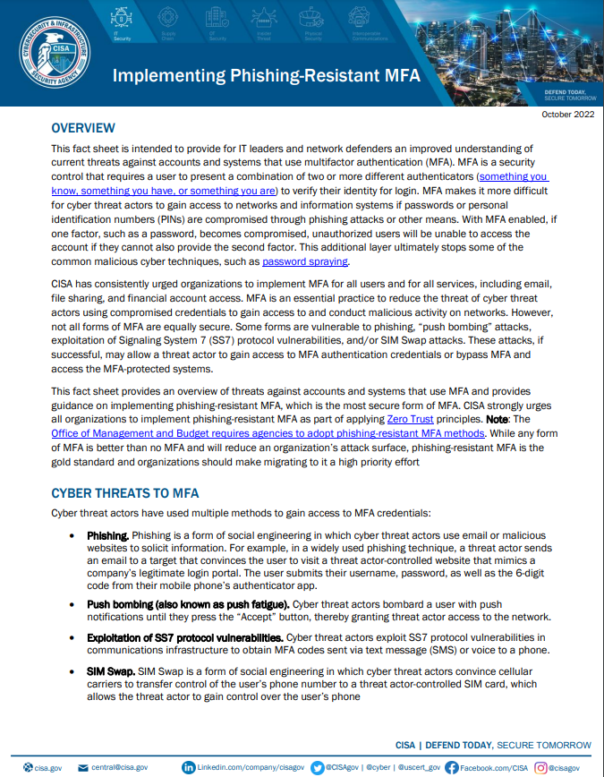
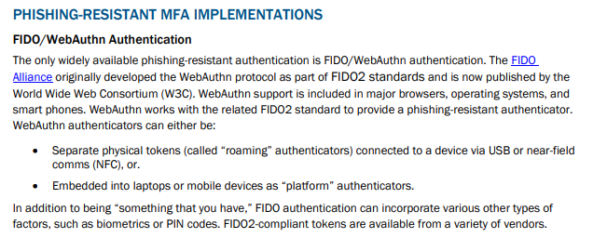
Authentication and Policy

Slide 15
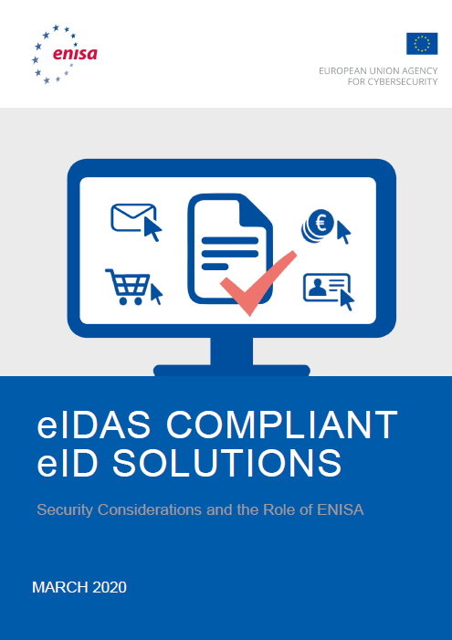
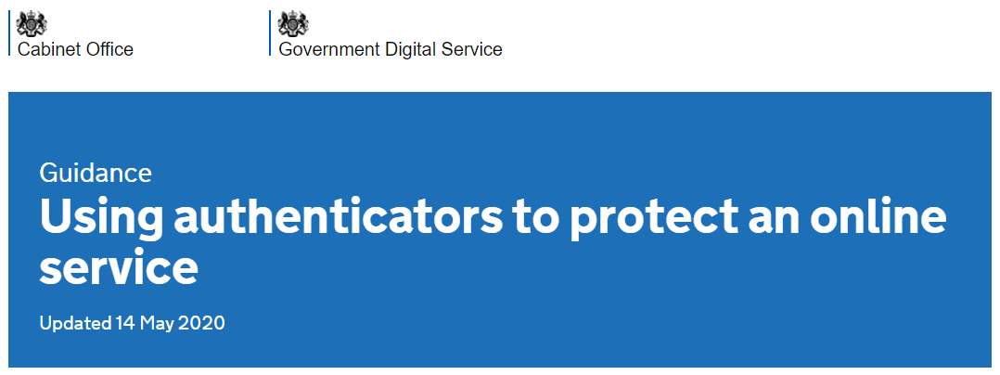
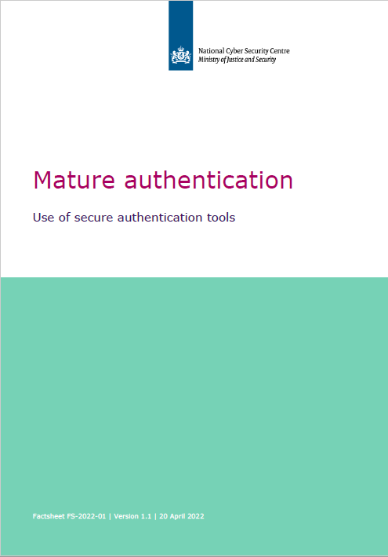
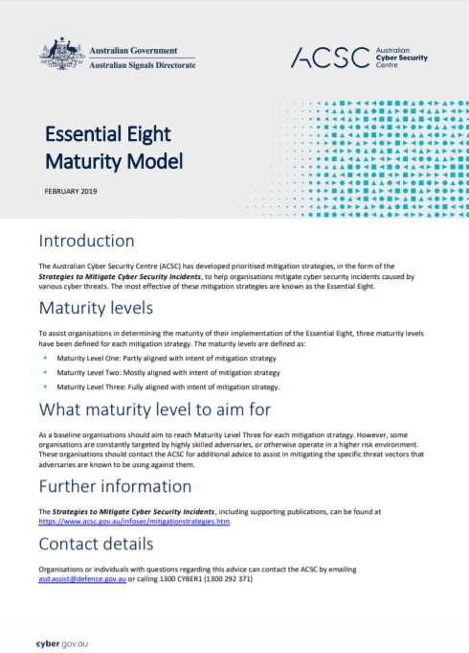
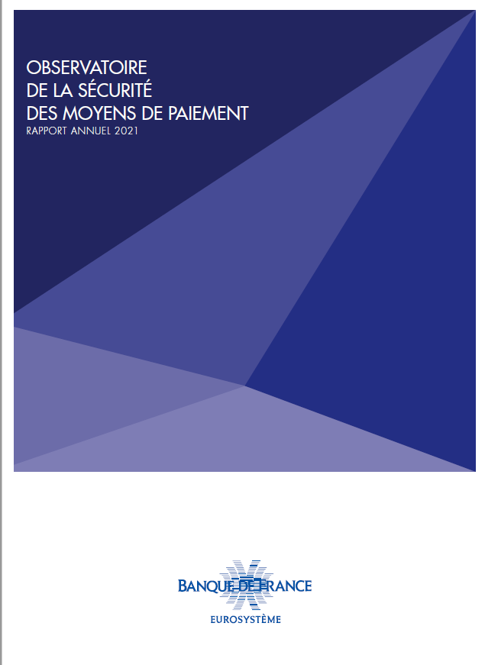
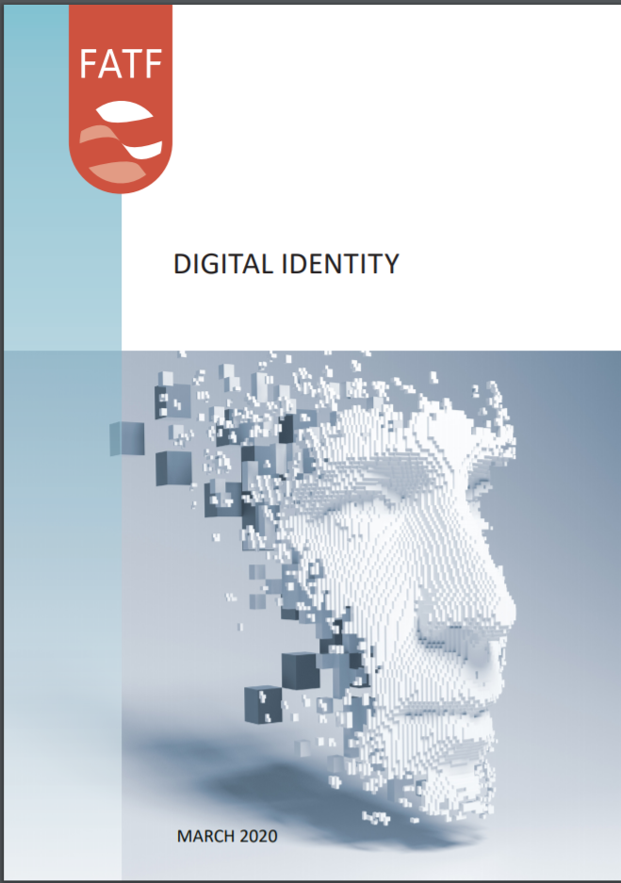
Part of a broader trend of government recognition of FIDO and WebAuthn
é
15

Slide 16
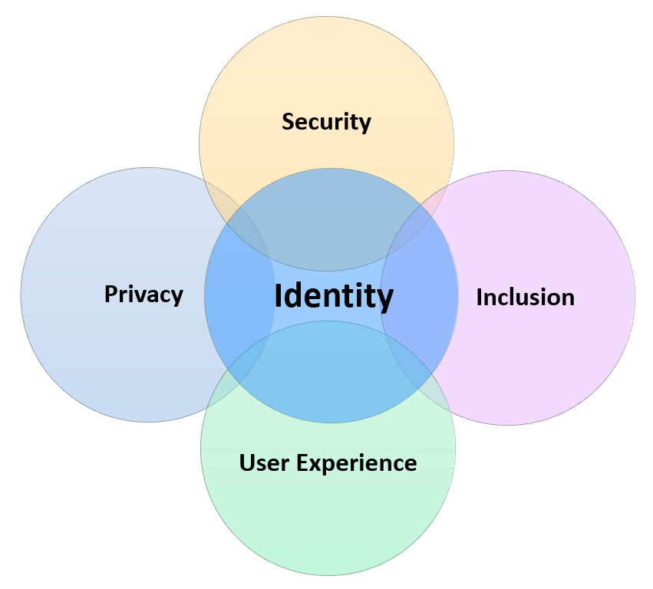
On the ID proofing side…many policy objectives
Enabling data minimization – so I only share what is needed for a transaction
Less tracking of our activity
Confirming someone is “real”
and not a synthetic ID
↑ acceptance of credit applications from “thin file” consumers
AI/Deepfakes
ID Theft
Cybercrime
PETs
Selective Disclosure
Account
opening
Easier high-risk transactions
Account opening
Well-designed systems make it easier for people to choose what data to share – and what to withhold
↑ UX (vs KBV or IDV) = ↑ people completing the application process/less abandonment

Slide 17
While there are pockets of activity in government…
…there are no efforts to coordinate digital identity activities across the US government…
…or think about identity as infrastructure.

Slide 18
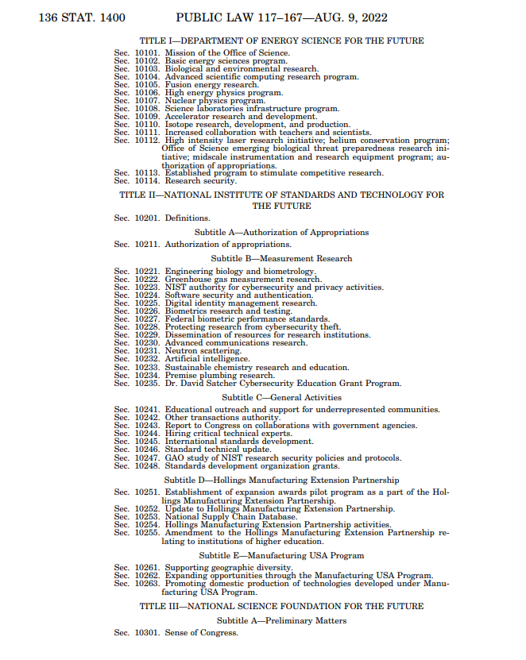
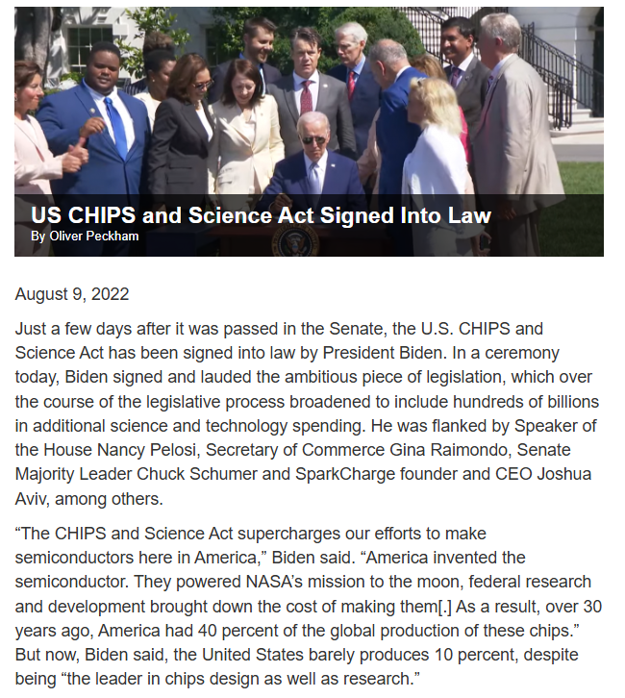
That said…

Slide 19
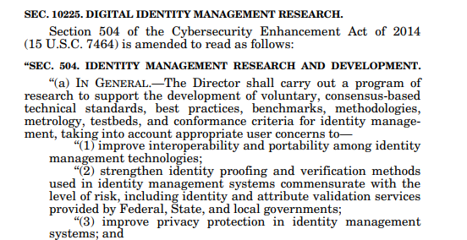
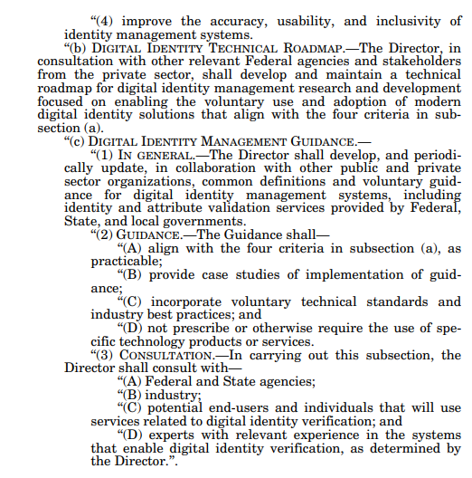
Identity Management Research

Slide 20
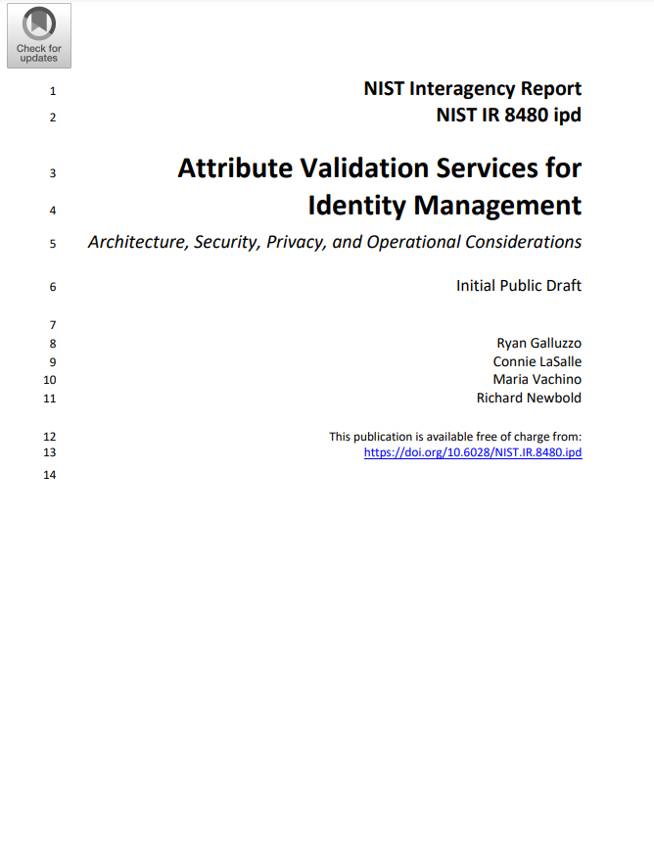
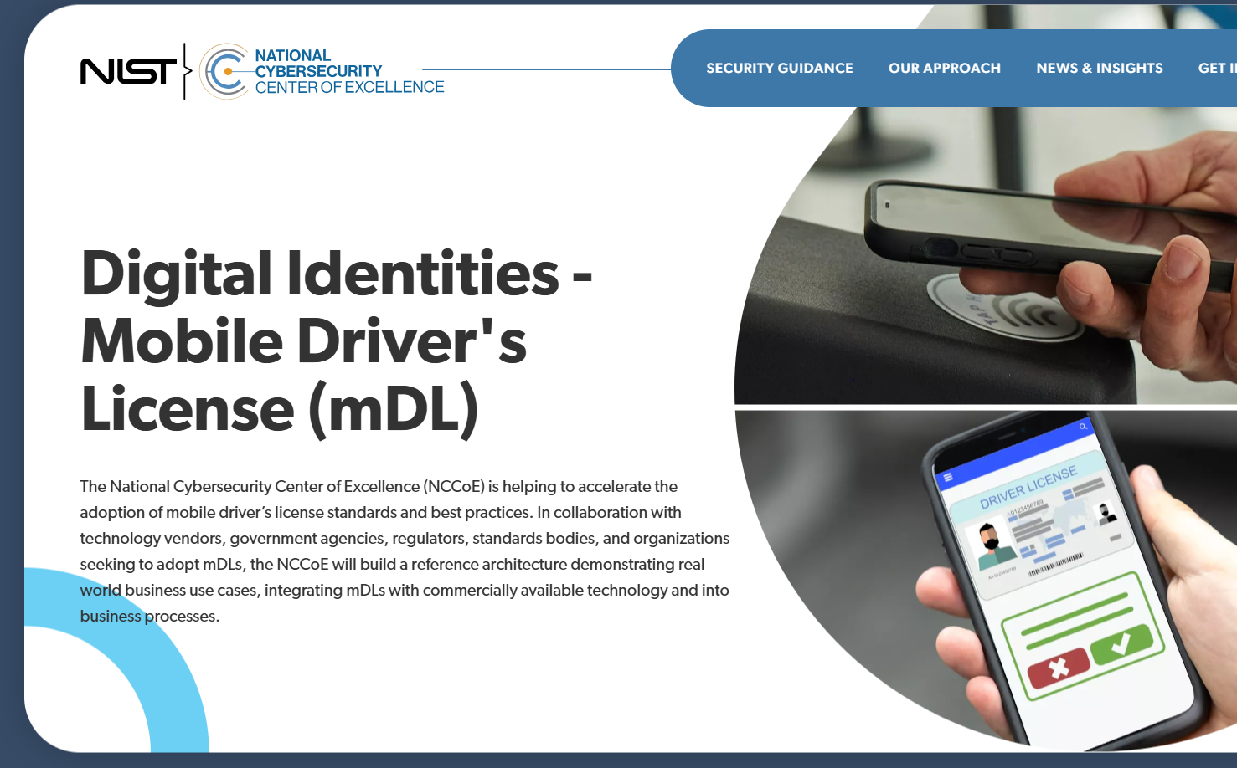
Policy matters to standards!

Slide 21
Questions?
Jeremy Grant
Managing Director, Technology & Innovation
Venable LLP
jeremy.grant@venable.com

