Slide 1
W3C NA Member Meeting
Henna Kapur

Slide 2
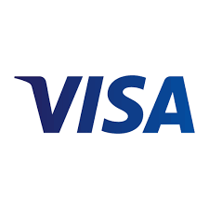

About Visa Inc.
Visa is a world leader in digital payments, facilitating transactions between consumers, merchants, financial institutions and government entities across more than 200 countries and territories. Our mission is to connect the world through the most innovative, convenient, reliable and secure payments network, enabling individuals, businesses and economies to thrive. We believe that economies that include everyone, everywhere, uplift everyone, everywhere and see access as foundational to the future of money movement.
Our participation
Speaker - Henna Kapur
Member of W3C for 13 years (and counting!)
Committed to Safe, Secure Payments on the Web
Promote interoperability, foster innovation and standards to help achieve scale
Support W3C’s mission to make the web work for everyone.
Director, Product Management, Authentication, Identity and Tap – Visa Inc
Advisory Committee Member – W3C
Board Member – FIDO Alliance
Not a W3C submission

Slide 3



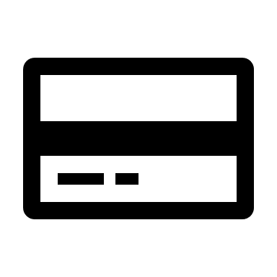



A card-based online transaction flow
User
Merchant
Acquirer (Merchant bank)
Visa or
Other networks
Issuer (Cardholder bank)
Selection of payment method
Authentication
Other web technologies – EMVCo
Transaction confirmation
Convenience and Usability
Privacy preserving User identification
Not a W3C submission

Slide 4
Payments at W3C
Web Payments Working Group
Web Payments Security Interest Group
Make consumer retail payments easier and more secure on the Web.
Reduce shopping cart abandonment by improving consumer confidence in the Web checkout experience
improve Web payment security
Simplify and streamline Web checkout experiences.
Enhance interoperability of various Web payments technologies (EMVCo, FIDO, W3C)
Define areas of collaboration and identify gaps between specifications
Increase compatibility among different technologies and harmonization with other standards activities
Not a W3C submission

Slide 5
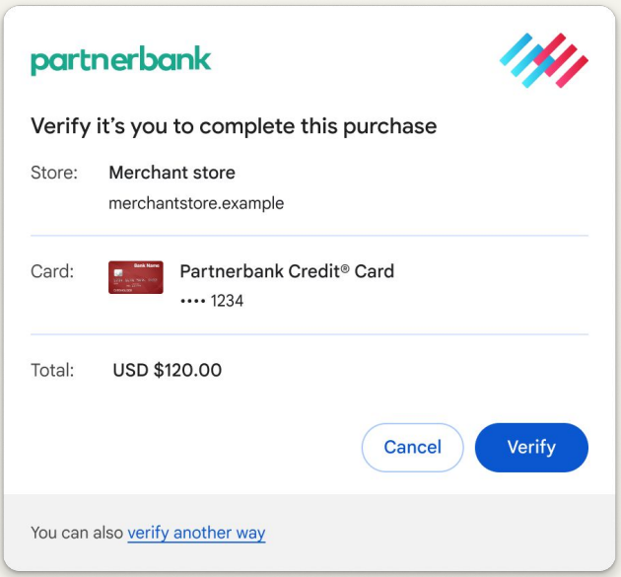

Secure Payment Confirmation - Candidate Recommendation
Web API to support streamlined authentication during a payment transaction.
//Check if browser supports spc using, proceed if true isSecurePaymentConfirmationAvailable()
const request = new PaymentRequest
([{
supportedMethods: "secure-payment-confirmation",
data: { // List of credential IDs obtained from the RP.
credentialIds,
rpId: "fancybank.com",
// The challenge is also obtained from the RP.
challenge: /*random bytes generated by the RP */]),
instrument: {
displayName: “Partner bank Card ****1234",
icon: "https://fancybank.com/card-art.png", },
payeeName: "Merchant Shop",
payeeOrigin: "https://merchant.com",
}], {
total: {
label: "Total",
amount: { currency: "USD", value: “120.00“, },},
});
try {
const response = await request.show();
await response.complete('success’);
// response.data is a PublicKeyCredential, with a clientDataJSON that
// contains the transaction data for verification by the issuing bank.
/* send response.data to the issuing bank for verification */
Issuing bank and scheme logo / icon enables trust
Trx data so user knows who they are paying to, how much and using which payment credential.
Not an iframe. It’s a browser modal window
Upon clicking verify, user is authenticated using webauthn flow.
Fall back option in case the user does not want to go ahead with this authentication method
Not a W3C submission

