Slide 1
PSP Use Cases
W3C TPAC
Brant Peterson - FIS
September 12, 2022

Slide 2
Agenda
About FIS Worldpay
Customer Personas & Use Cases
PSP Problem Statements
Recommendations
Future Collaboration and Engagement

Slide 3
FIS MERCHANT SOLUTIONS
⁺1M
Merchant Locations
Powering global commerce
Processing for 8 of the Top 10 largest merchants globally
#2
GLOBAL
MERCHANT
ACQUIRER
Industries we serve:
We accept over
RETAIL
DIGITAL
AIRLINES
300
payment methods in:
126
GAMING
TRAVEL
FINANCIAL
currencies across
146
countries
of the TOP 20 clearing firms

Slide 4
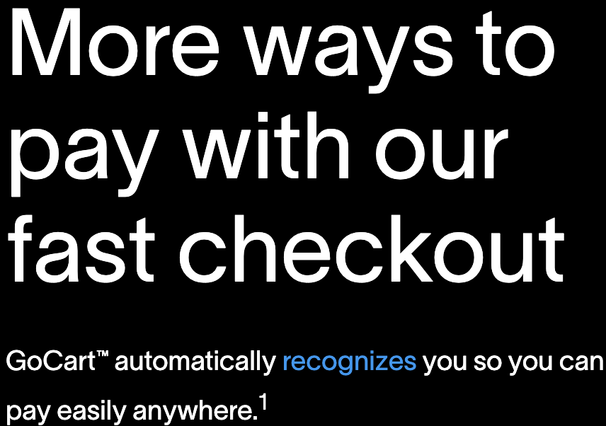
GoCart
Accelerates Frictionless Checkout
Provide merchants access to growing network of shoppers using wallet and checkout solution deeply integrated into FIS’ merchant processing platform.
Mission to accelerate progress in the frictionless checkout space, modernizing digital checkout experience for consumers
Partnered with large US issuers to create a network of millions of consumers.
Offers ability for merchants to deliver “shoppable” marketing emails and advertisements which further strengthen FIS’ ability to drive value for our merchants.

Slide 5
Customer Personas
& Use Cases

Slide 6

Customer Persona
Post Pandemic Reinventors
Enterprise retailers with storefront transforming their ecommerce platform to how customers are now shopping – online, through an app.
Shifting to digital first strategy, building digital experiences to keep customers returning to their sites and storefronts.
Leveraging existing loyalty programs as foundation to enhance shopper experience such as new ways to pay.
Identifying their shoppers through browser level data to offer shoppers experience at time of checkout
Focused on expanded product offerings like subscription services
Have different PSPs across card present and CNP processing channels, creating friction with identifying their shoppers across processing platforms and payment acceptance channels.
We are focused on building a digital-first, omnichannel model that delivers a best-in-class eCommerce experience, including the most comprehensive set products wherever and however customers want to shop.”

Slide 7

Customer Persona
Seamless Shopper Experience
Want offer personalized experience for their shoppers to increase sales
Want support for PCI DSS Compliance to minimise risk to sensitive payment data
Latest payment options
Quick and simple integrations
Speed to market for new developments
Seek seamless and personalized checkout experiences for their shoppers to increase payment conversion and avoid risk like cart abandonment
Identifying who their shopper are to drive experience is key to personalize, so capture and store account data for ease of purchase (web fill)
Use data (public/private) that create insights to relevant payment options to the shopper
Personalization like one-click payments

Slide 8
Customer Persona
Passion for Control
Increased flexibility and control of checkout experience
Enterprise organizations with a passion for increasing lifetime customer value
  WP has 16% of all ecommerce market share from these top 15-retailers
Experienced, well staffed, and been investing in created personalized experiences for their shoppers
Desire to maintain control over ubiquitous experiences to serve their shoppers
Consistency limits their design experience they heavily invest in as they lose feature functionality capabilities contra to business goals
They feel know their shoppers better than anyone, and want optionality to do so
  Payment tender strategy – want choice in what to present (card and payment strategy) is it co-branded, are they EBT
Need control in smart routing to low-cost providers and/or alternative debit networks
Implement Retry and fallback strategies based on decline transaction to recover sales – believe in high auth rate is better than cost savings….

Slide 9
Key Customer Themes
For merchants to serve their shoppers, they must know who their shoppers are prior to the authorization.
Data not always available based on payment types or implementations
  Merchants unanimously use payment credential as representation of their shopper
Merchants lose sales when shoppers abandon baskets because of extra friction & payment problems
Industry initiatives driving for ubiquity abstract merchants away from optionality and flexibility to service their customers

Slide 10
Real World
Problem Statement
for Merchants

Slide 11
Merchant Sentiments Around Web Fill
Appreciate the need to for security and fraud prevention, however, comes at a cost as there are implications to shopper experience
No control over the experience, restricting the ability to serve their shoppers
Don’t have tools in place to support tokens – intelligent help consumers (non FPE capabilities limit and restriction troubleshooting)
Taking away data merchants legally allowed to have to interrogate, ability to route, use to lower fraud, lower payment costs, increase auth rate
May create resistance within merchant community

Slide 12
Engagement Offer to W3C
FIS is a trusted name in innovation with merchant acquiring, card issuing, and checkout capabilities with global scale
How can FIS play a more active role within W3C?
FIS has development and business resources to assist with forming standards and proving out interoperable browser standards & capabilities
Access to merchant, issuer, checkout community?

