Slide 1
Bounce Tracking Mitigations
TPAC 2022

Slide 2
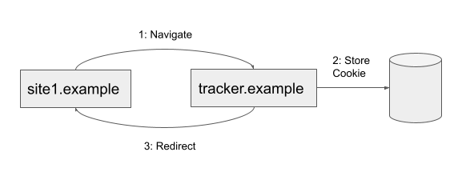
Review - What is bounce tracking?
Sites can bounce through a tracker domain to allow it to set cookies in a first party context.
Effectively simulates a third-party cookie even when third-party cookies are blocked.
May be a "bounce back" (pictured below) or a "bounce through".

Slide 3
Review - What do browser do about it today?
Following is from Privacy CG Navigational-Tracking Mitigations draft report.
Safari
Classifies sites as trackers based on behavior.
If a navigation or redirect is from a tracker site then client-side cookies have lifetimes capped to 24 hours.
(Update from TPAC feedback) Bounce trackers are classified and have storage deleted within an hour. The 24 hour expiration cap is on the destination site.
Firefox
Sites are considered to be trackers if they are on the disconnect.me list.
Storage for trackers is removed after 24 hours unless the user has interacted with the site within the last 45 days.
Brave
Maintains a list of sites considered to be trackers.
When a user visits a tracker site the browser will use ephemeral storage unless there is already first party storage on disk for the site.

Slide 4
What about Chrome?
Started to work on bounce tracking mitigations.
Published an explainer of our current thoughts:
https://github.com/wanderview/bounce-tracking-mitigations/blob/main/explainer.md
Some goals:
Converge on a solution that can be interoperable across browsers.
Deliver a consistent experience for web developers (avoid lists and classifiers if possible).
Avoid breaking non-tracking use cases that use redirects and bounces.
Prevent bounce tracking on short-lived domains that may evade list-based approaches.
Initial proposal largely aligns with the Firefox solution.

Slide 5
Chrome's Proposal
Detect "stateful bounces"
Basically any chain of server- or client-side redirects.
May include all such redirects or only those that access storage. (Network stack is largely stateful, though.)
Not based on any kind of tracking list or behavioral classification.
After some time (x hours) delete storage for site that was bounced through…
Unless we determine the user has purposely chosen to use that site:
Previous interaction (up to x months to a year).
Post-visit interaction before the deletion timeout occurs.
Perhaps foreground view-time or other signals, etc.

Slide 6
Non-Tracking Use Cases
Authentication / SSO
The bounced site will have a current or past interaction during login.
Payments
Wide variety of flows, but we believe most involve link decoration and server-side state. Client-side state deletion may not impact these flows.
Looking for feedback to improve our understanding of payments.
Link Shorteners Measuring Unique Visitors
Link shorteners involve a redirect bounce with a site the user never sees or interacts with.
Some shorteners may use a cookie to measure "unique visitors" a particular short link.
These cookies will end up getting deleted by our proposal.
See: https://github.com/wanderview/bounce-tracking-mitigations/issues/5
Looking for more feedback on other non-tracking use cases to consider.

Slide 7
Comparison
 | Chrome Proposal | Firefox | Brave | Safari
Scope: | All Stateful Bounces | List | List | Classifier
Action: | Delete | Delete | Ephemeral | Cap Expiration Time (Delete)
Exemption: | Interaction | Interaction | Existing State | Classifier

Slide 8
Discussion
Is there room for alignment?
What are the tradeoffs of:
ephemeral state vs deletion vs capping expiration?
exempting based on interaction vs existing state?
lists vs classifier vs all bounces?
Other thoughts?

