Slide 1
MiniApp Standardized Solutions
Martin Alvarez & Zitao Wang
2022/09/07

Slide 2

Good work MiniApp!
By 2022, the DAU of MiniApp on the entire network reached 450 million.
DAU: 170 Million
DAU: 230 Million
DAU: 330 Million
DAU: 400 Million
DAU: 450 Million
2017
2018
2019
2020
2021
Data from www.aldzs.com
It brings enough convenience to our lives, like with the health code. You can't live without it these days.
If you don't, you probably won't be able to enter the gate.

Slide 3
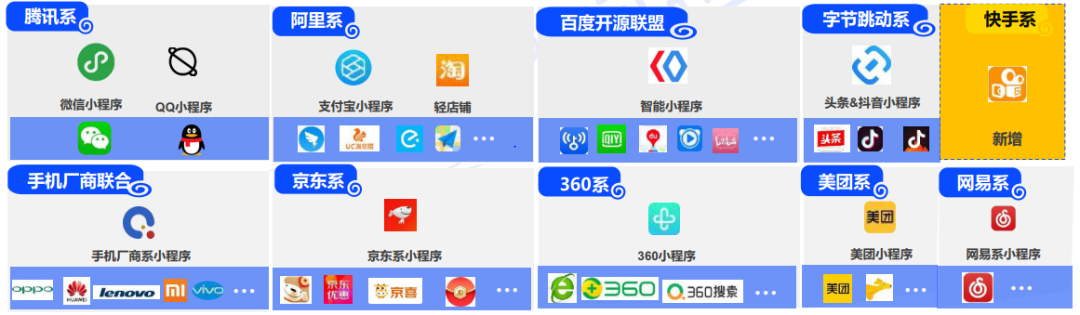
But……
But when you want to learn MiniApp development from scratch, you have to deal with...
Data from www.aldzs.com
I have to say that the repetitive input and the tedious learning are really boring, especially since they share concepts, but the coding is very different...

Slide 4

Is there any way? –Yes! But……
The good news is that there are already projects that provide development tools for multi-platform implementations, like Taro
Thank YOU! Ultraman
You are welcome!
However, the difficulty is that different platforms support different standards. Typically, the CSS used by MiniApp platforms is very different.

Slide 5




So we set up the W3C MiniApp working group
Our goal:
  A set of specifications: app configuration, packaging, lifecycle, URL, UI, API, etc.
  A standardized MiniApp full-stack solution
Pre-Standard Unified Framework
Standard Framework
Standard Framework
Some differences that are hard to smooth
Platform-developed plug-ins are compatible with existing non-standard deployments.
Each platform supports standards, achieving a unified development framework.

Slide 6
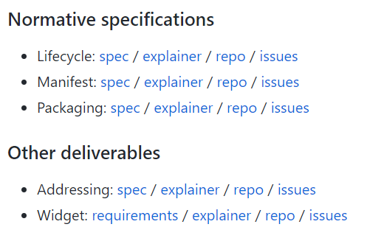
What's going on now
CG note
WG note
Cross Review
Test Report
Publish
Standard covered.
There is no need to provide standard methods
Standardization urgently needed.

Slide 7
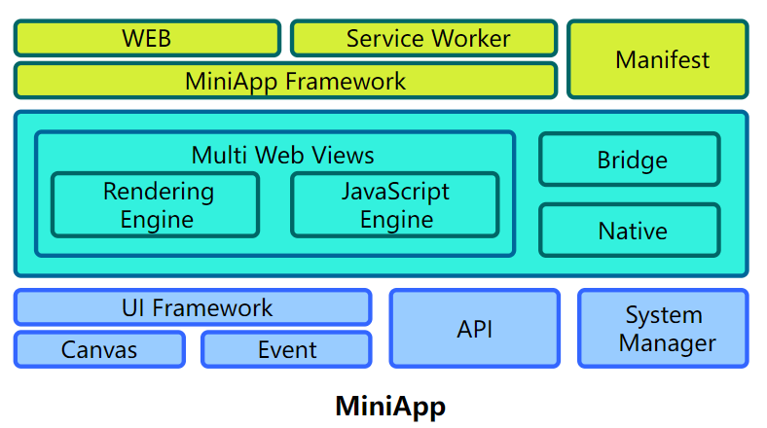


It's a good start, but not enough.
Lifecycle
URl
otherwise
Standardized solutions can achieve a hello world
However, only one hello world can be implemented.
Standard covered.
There is no need to provide standard methods
Standardization is urgently needed.

Slide 8
Good News is
We're working on
  Since last year, we have held several working group meetings to discuss UI Components and API standardization.
  Our CG set up a Github Repository (https://github.com/w3c/miniapp-components)
  We proposed an Explainer to set out the necessity and work scope.
  We will define the specifications for the UI Components first, and then the common APIs.

Slide 9

However, the MVVM architecture and V-DOM mode used by the MiniApps differ greatly from the existing W3C standards.
Component is an extensible and reusable high-level building block to create MiniApps
  Based on HTML-like elements (e.g., <div>, <image>, <text>,…)
  Supporting events specific (e.g, click, swipe…)
  Supporting a subset of CSS
  Components support data binding, like text interpolation.
Concept similar to Web Components
  Custom HTML Elements
  HTML modules
  HTML Templates
  Shadow DOM
  CSS
lego by jon trillana from the Noun Project

Slide 10
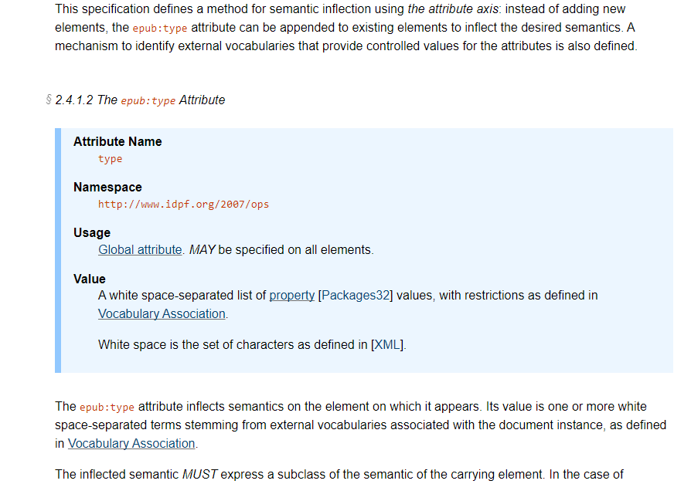
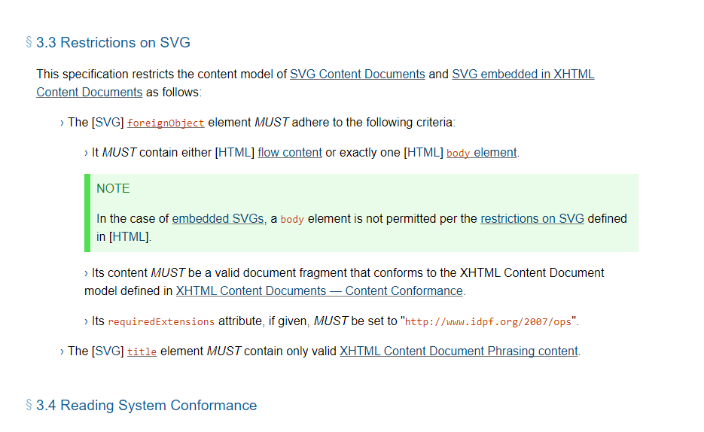
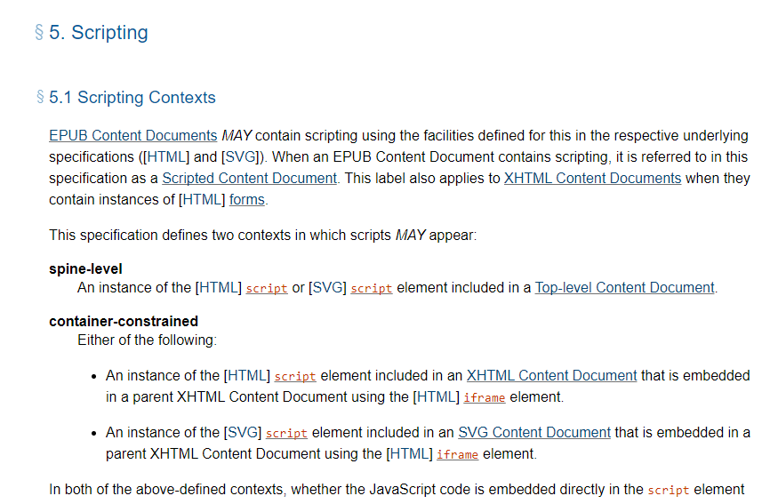
How to write the UI Components specification
Case 1: standard DOM/HTML
If the MiniApp model follows the standard DOM/HTML (compatible with existing Web standards)
  We could define HTML extensions (e.g., EPUB’s attributes) if needed.
  We should present what technologies (HTML, CSS) are supported.
  We would use HTML and CSS subsets, so we need to indicate these subsets (e.g., EPUB’s Deviations & Constraints or CSS).
  We should define the scripting mechanisms supported in MiniApps (e.g., EPUB’s Scripting)
  Mechanisms to include localized strings.
First step: to organize a meeting with OpenUI CG (I am part of the CG already)
The UI Components specification could be a Group Note to define MiniApp contents, including:
  Structure of a MiniApp page (how to bind components)
  Overview of the basic elements (or components) → no technical definition, just high level.
  What styles are supported (e.g., the CSS subset, how to bind external stylesheets)
  Scripts supported (e.g., version and limitations for security)
  Mechanisms to extend the components.

Slide 11
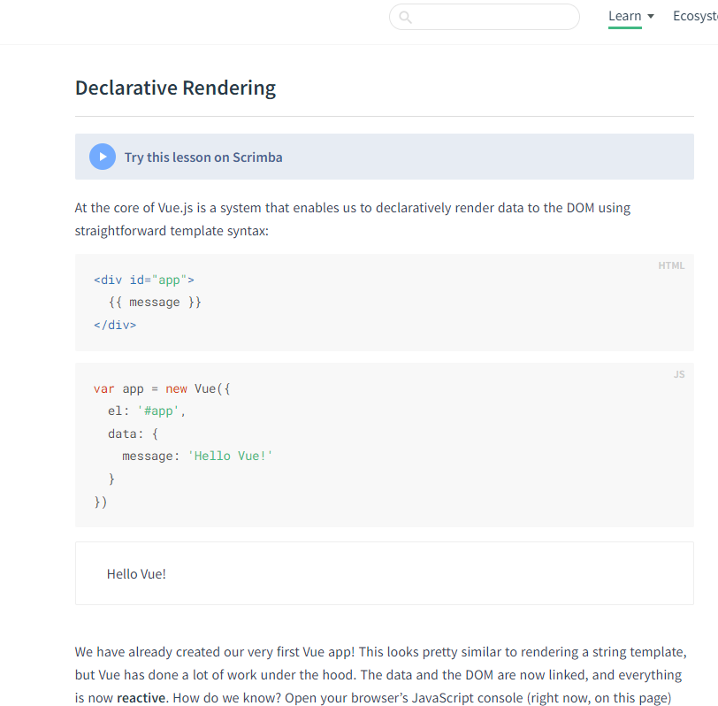
How to write the UI Components specification
Case 2: Vue.js-like framework
If the MiniApp model follows the existing MVVM (non-compatible with current standards)
  We could define an informative (non-standard) specification to document the architecture;
  We should include what technologies (HTML, CSS) are supported and the extensions.
  We should document the data and event binding.
  We should define the scripting mechanisms supported in MiniApps.
First step: publicly confirm that MiniApps wouldn’t follow the HTML/DOM standards. No WebAPIs available
To avoid friction with other W3C groups, the UI Components specification should be an informative Group Note or similar to define MiniApp contents, including something like the documentation of Vue.js:
  Structure of a MiniApp page (how to bind components);
  Explain the differences with HTML.
  What styles are supported (e.g., the CSS subset, how to bind external stylesheets);
  Scripts supported (e.g., version and limitations for security);
  Data interpolation, internationalization, etc.

Slide 12
Well, soon we have standards, and then we need to deploy
  Thanks to the W3C's standards release mechanism, standards must be deployed before they can be released.
  And set up a Github Repository for developing automated test tools and standard test cases.
    https://github.com/w3c/miniapp-tests

Slide 13
Everything's ready, I guess

Slide 14
Appendix
Gap Analysis for
  PWA and MiniApp: https://www.w3.org/TR/mini-app-white-paper/#gap-between-miniapps-and-pwa
  Comparison of APIs in MiniApps, W3C specs, and PWAs: https://www.w3.org/TR/mini-app-white-paper/comparison.html
  Comparison with existing standard UI components: https://github.com/w3c/miniapp-components/blob/main/docs/explainer.md

