Slide 1
PWAs & MiniApps
Origin from:
Alex Russell <alexrussell@microsoft.com>
infrequently.org @slightlylate on
PWA Dev Day, August 2022 https://pwadev.io/
Notes:
Hello! I’m Alex Russell, I’m a Product Manager on the Edge team, and my pronouns are he and him.
While I’m sad not to be able to join you in person today, I’m delighted to be with you virtually and see how much the PWA community has grown around the world and in China.

Slide 2
宋青见
PM @ Microsoft Edge /
首席产品经理

Slide 3
Notes:
As I think about the landscape of PWAs, mobile, and mini-apps, I’m reminded of how and why we began work on PWAs in the first place.
You see, back then I was part of the Chrome team, and I was working on a project to develop Web Components along with JavaScript and CSS language features that we knew web developers needed.
At the same time, my colleagues were hard at work on something called ChromeOS, and at the time, there was a debate about what the application model for this new platform should be.

Slide 4
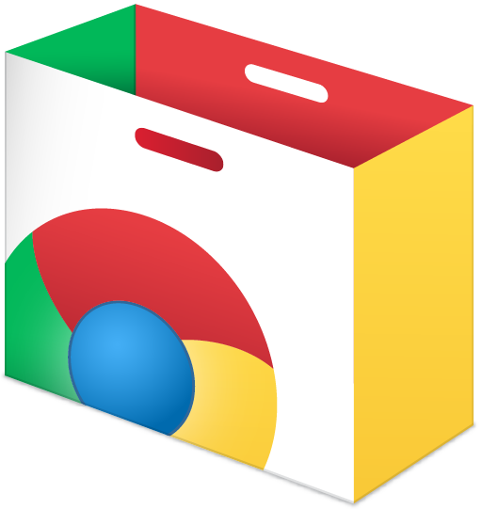
Notes:
Some argued that we couldn’t evolve the web platform to solve the hard problems that needed solutions, at least not on a fast enough.
Others, like me, argued that we could improve the web directly to meet those same needs, and while it might not be as fast, we would gain something profound from that approach: we would preserve the web’s distribution model.
Distribution is the hardest problem in software, and the web’s low friction for many use-cases is facilitated by browsers enforcing a paranoid security model. The alternative, and the path chosen by the Chrome Apps team, was a store-based security approach.

Slide 5
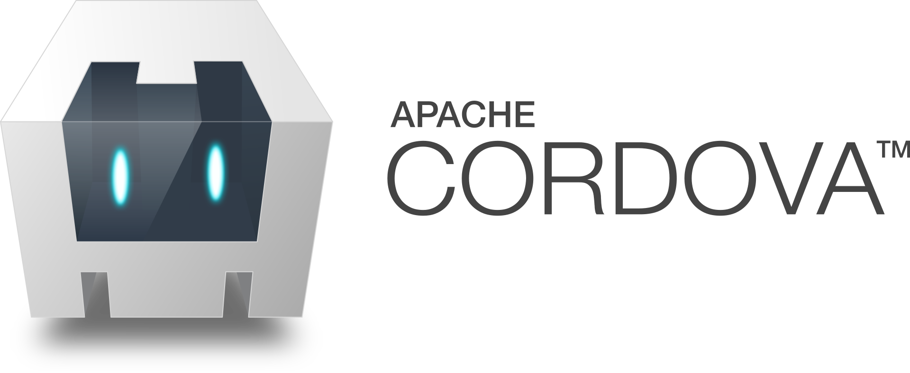
Notes:
At the same time, others were trying to marry web technologies with store or installer-based distribution, notably PhoneGap, later re-branded to Cordova.
There have been many attempts at this combination before and since, including BlackBerry WebWorks, FirefoxOS’s Packaged Apps, W3C Widgets, Palm WebOS packaged apps, and Electron.
Each of these systems flips the web’s core model on its head, accepting a more difficult up-front step for users to begin interacting with content in exchange for greater capabilities that developers craved.

Slide 6
A Gnawing Question: What Was The Web Missing?
Offline
Device APIs
Push Notifications
High-power compute
Access to storage & files
First-class UI & OS integration
…?
Notes:
Back in 2010 I lost the debate, and Chrome Apps launched later that year. In defense of those arguing that the web couldn’t have evolved fast enough, it’s safe to say that given the position of Chrome and Chromium in the ecosystem, and our relative newness on the team in developing web standards, it would have been unlikely that we’d do a great job in providing all the necessary features.
But for years following that debate, I kept thinking back on the list of features that folks would tell us were missing from the web…and my question was always the same: could we bring them to the web platform without accepting a different distribution model?
Put another way, could we preserve the power of the link to enable frictionless discovery while still making the web sufficient for most of the needs that caused folks to reach for native apps and alternative platforms?

Slide 7
Radical Distribution Simplicity: <a href=“https://...”>…</a>
Notes:
If you think about websites as individual apps, it’s pretty clear that the web’s low-friction model was radical at the time it was introduced.
By starting with a high-level, interoperable system that’s based on standards, browsers have been able to apply an increasingly paranoid security model that ensures that it is still safe for users to simply click or tap on a link to visit the next page, without gatekeepers mediating the relationship between the user and the publisher. And this unique property of low-friction access has continued, even as browsers have grown all manner of powerful new features in the past two decades.
The difference between this model and the store or gatekeeper-mediated model is, foundationally, a question of power.
Who has the power to allow a publisher to create content? And will the runtime those publishers use be powerful enough to service user’s needs in the moment?

Slide 8
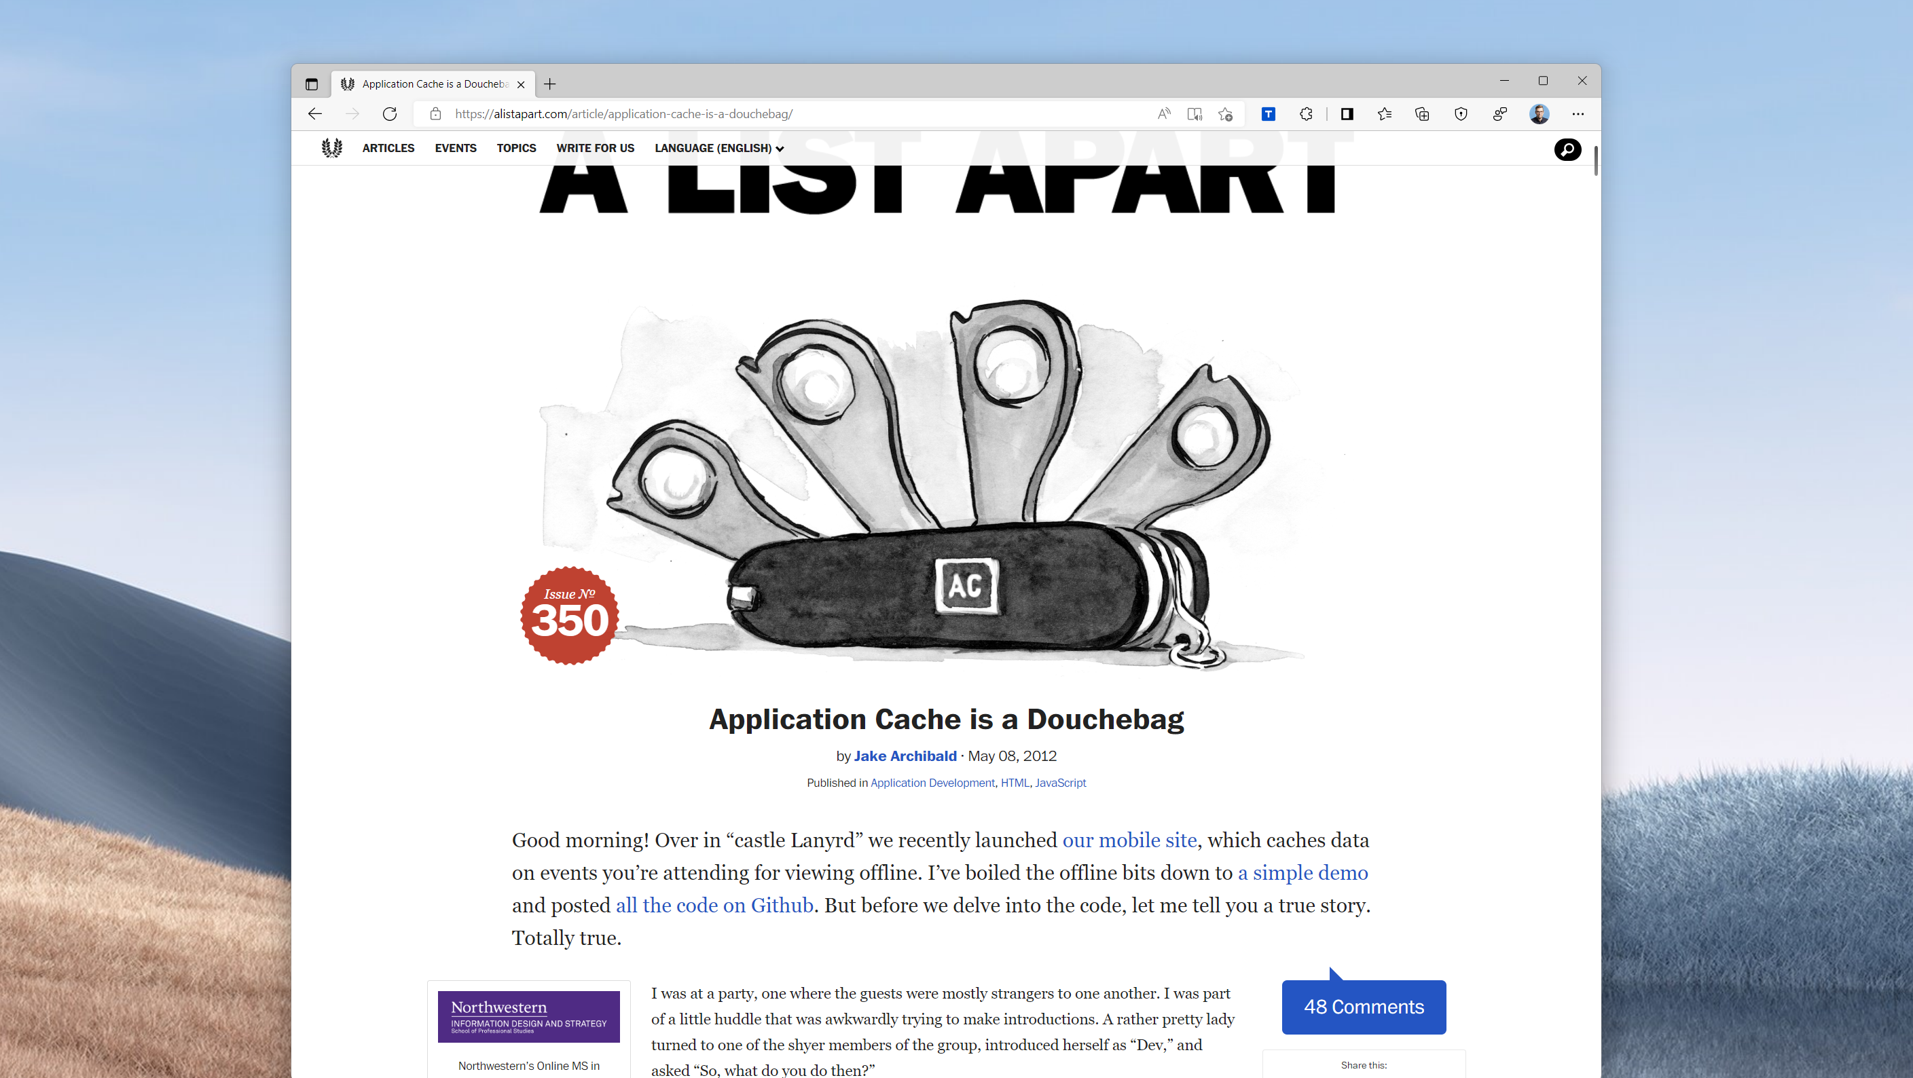
Notes:
The gnawing questions about which features were missing were in the back of my mind in 2012 when a set of workshops in London began to explore how we might fix the broken design of AppCache that was making it difficult to build web applications that were resilient in the face of flaky networks.
This was an opportunity to knock one of the persistent objections off the list.

Slide 9
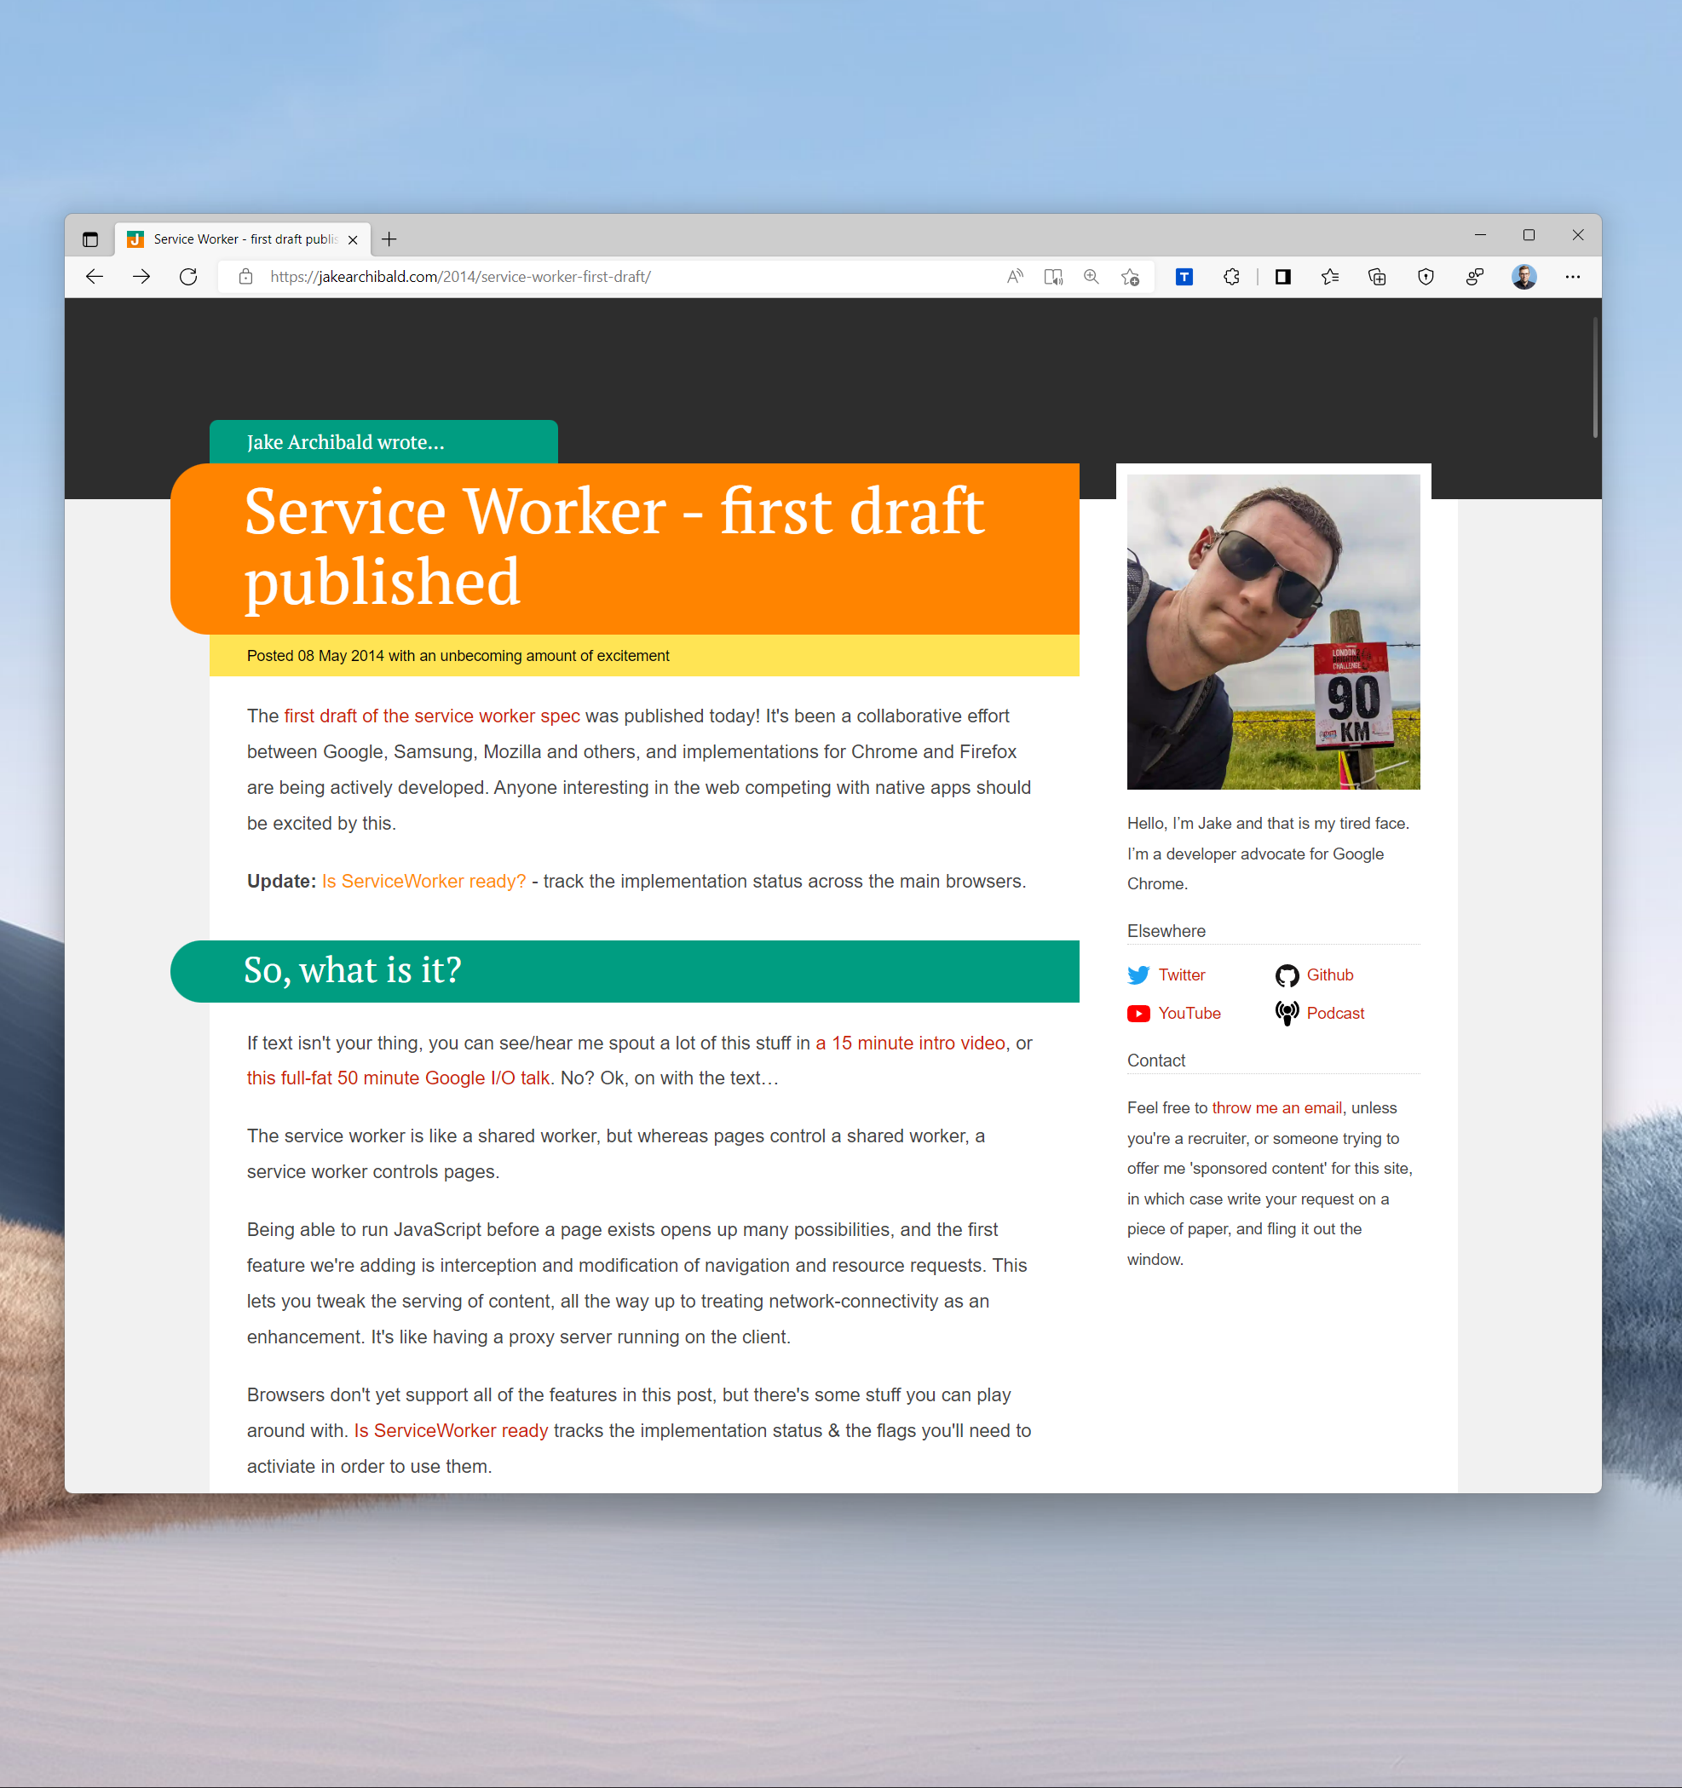
Fast Forward: 2014
✅ Developer interest & feeback
✅ Cross-browser collaboration
✅Working implementations
Notes:
Several years of work followed, including a robust collaboration between teams at Google, Mozilla, Microsoft, and Samsung, culminating in the launch of Service Workers in Chrome in late 2014.
While working on this problem, I’d also drafted a short document at Google that outlined how this new Service Worker system, combined with a small amount of metadata, might enable web apps to be installable.
Happily, I soon found out that work had started on the Web App Manifest project. We would soon have everything we needed for web apps to be installable.

Slide 10
Notes:
With the introduction of Web App Manifests and Service Workers, for the first time, developers could communicate to the browser that a set of pages were related, could work offline, and could logically be treated as “an app”.
The installation UI launched on Chrome for Android in early 2015, and later that year Frances Berriman and I named this technology Progressive Web Apps.

Slide 11
What Was The Web Missing?
Offline
Device APIs
Push Notifications
High-power compute
Access to storage & files
First-class UI & OS integration
…?
Notes:
So we had proven that it was possible to make regular web experiences installable, to create standards that enabled critical features like Push Notifications.
Microsoft’s introduction of PWAs in the Windows Store in 2017 further demonstrated that we didn’t need to give up the core principles of linkability or a basis in standards to deliver additional reach through store discovery.
Finally, web developers could reach all users in a browser, but also those who were searching for their brand or experience in the store.

Slide 12
Notes:
In the years that have followed, we have continued to use this same style of process to pour a long list of new features into the web without the need for gatekeepers, helping developers everywhere deliver experiences through PWAs that maintain their incredible reach without sacrificing user safety.
Most of this work has happened under the umberella of the the Fugu project, a Chromium collaboration to push the state of the platform forward.

Slide 13
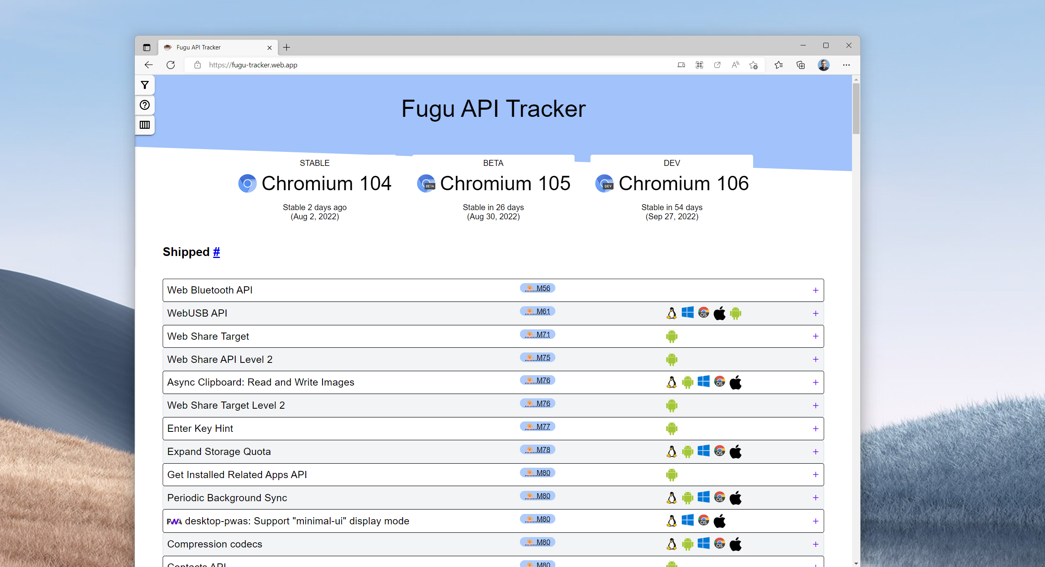
Notes:
If you visit fugu-tracker.web.app, you’ll see a long list of features we’ve developed over the past few years to expand the power of web apps.

Slide 14
PWAs & MiniApps: What Is The Web Missing?
Notes:
I tell this rather long story not to bore you with the details of how PWAs came to be, but because I view it as something of a template as we consider PWAs and MiniApps.
Like App Stores before them, Super Apps are gatekeepers that manage an ecosystem of content.
If a gatekeeper is exceedingly wise, perhaps they can ensure the hurdles they create do not remove more potential commerce from the ecosystem than they facilitate, but it is often the case that successful gatekeepers instead use their positions to entrench their dominance and tax developers.
It’s in this light that I have found the past several years of discussions in the W3C and other standards bodies regarding MiniApps to be an interesting expression of these tensions.

Slide 15
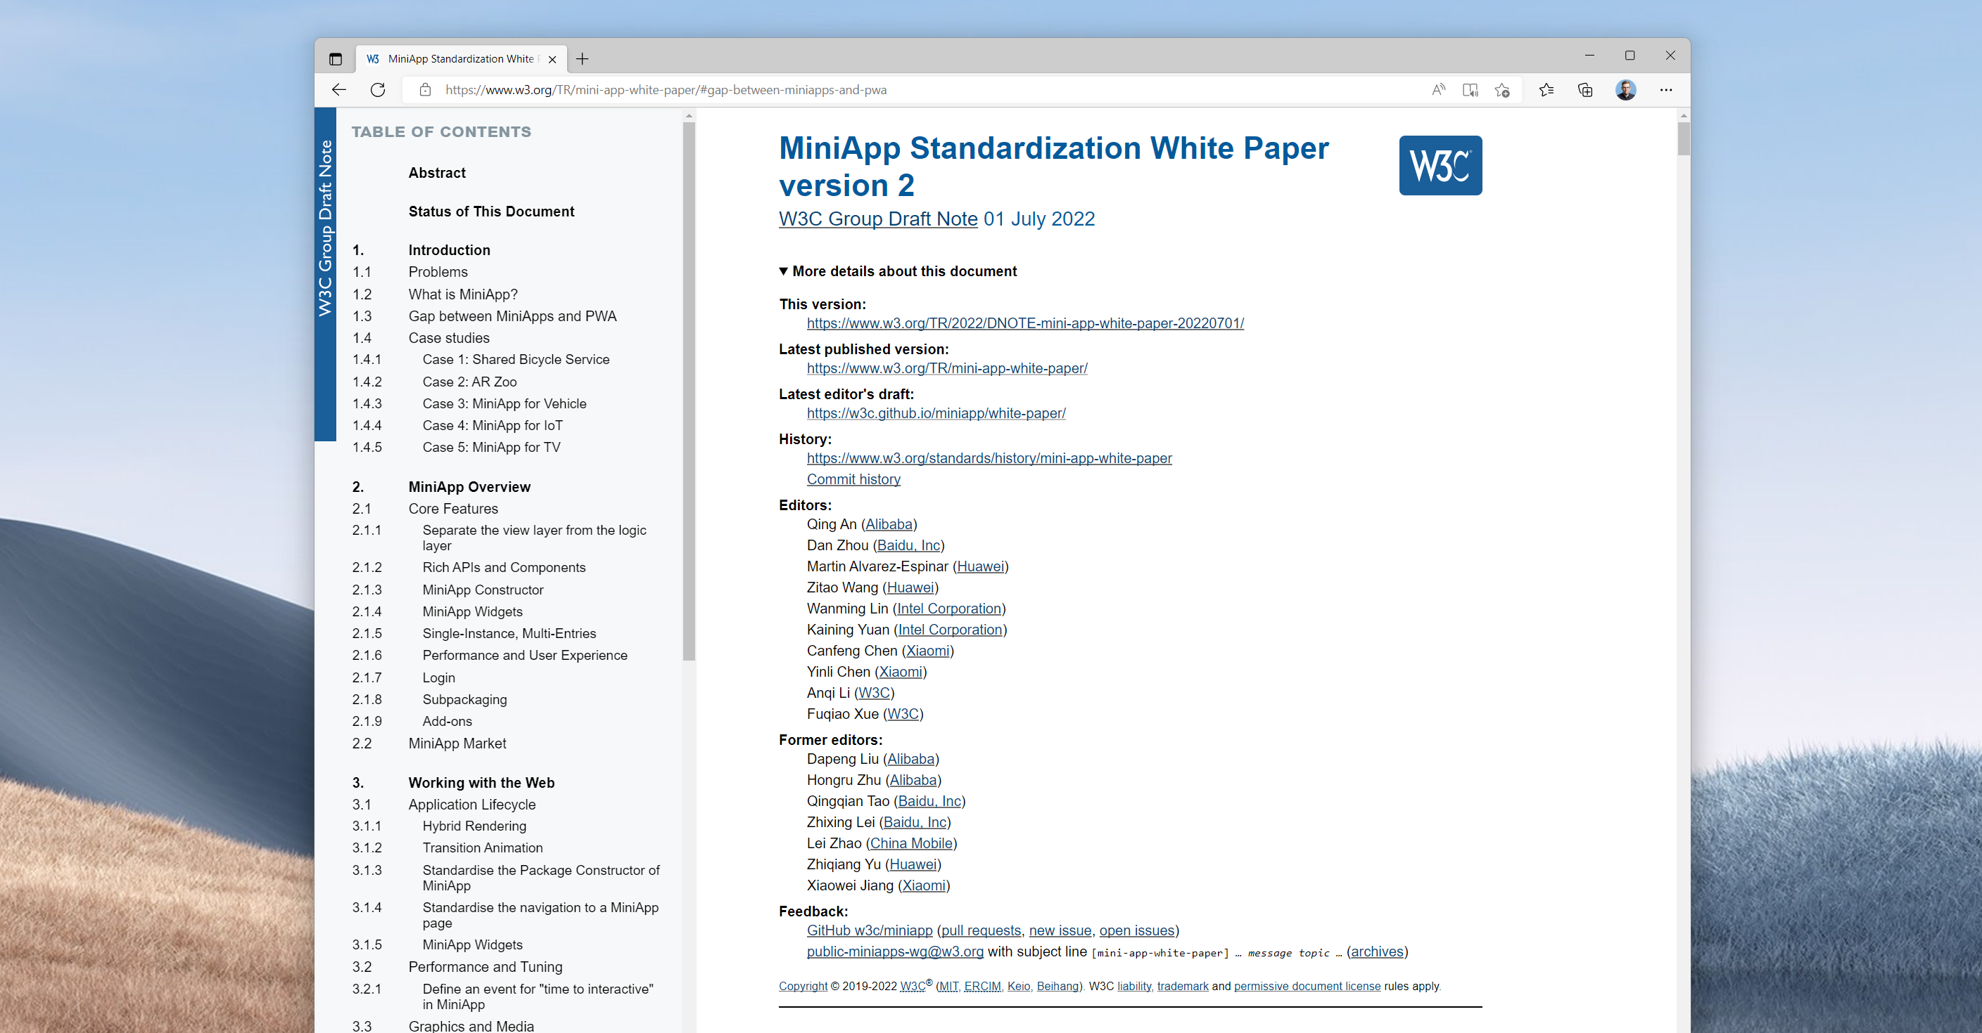
Notes:
The MiniApps Community Group initially formed and produced a whitepaper in 2019, outlining both the technical differences between miniapp runtimes and web browsers, but also the differences in API surfaces and distribution models.

Slide 16
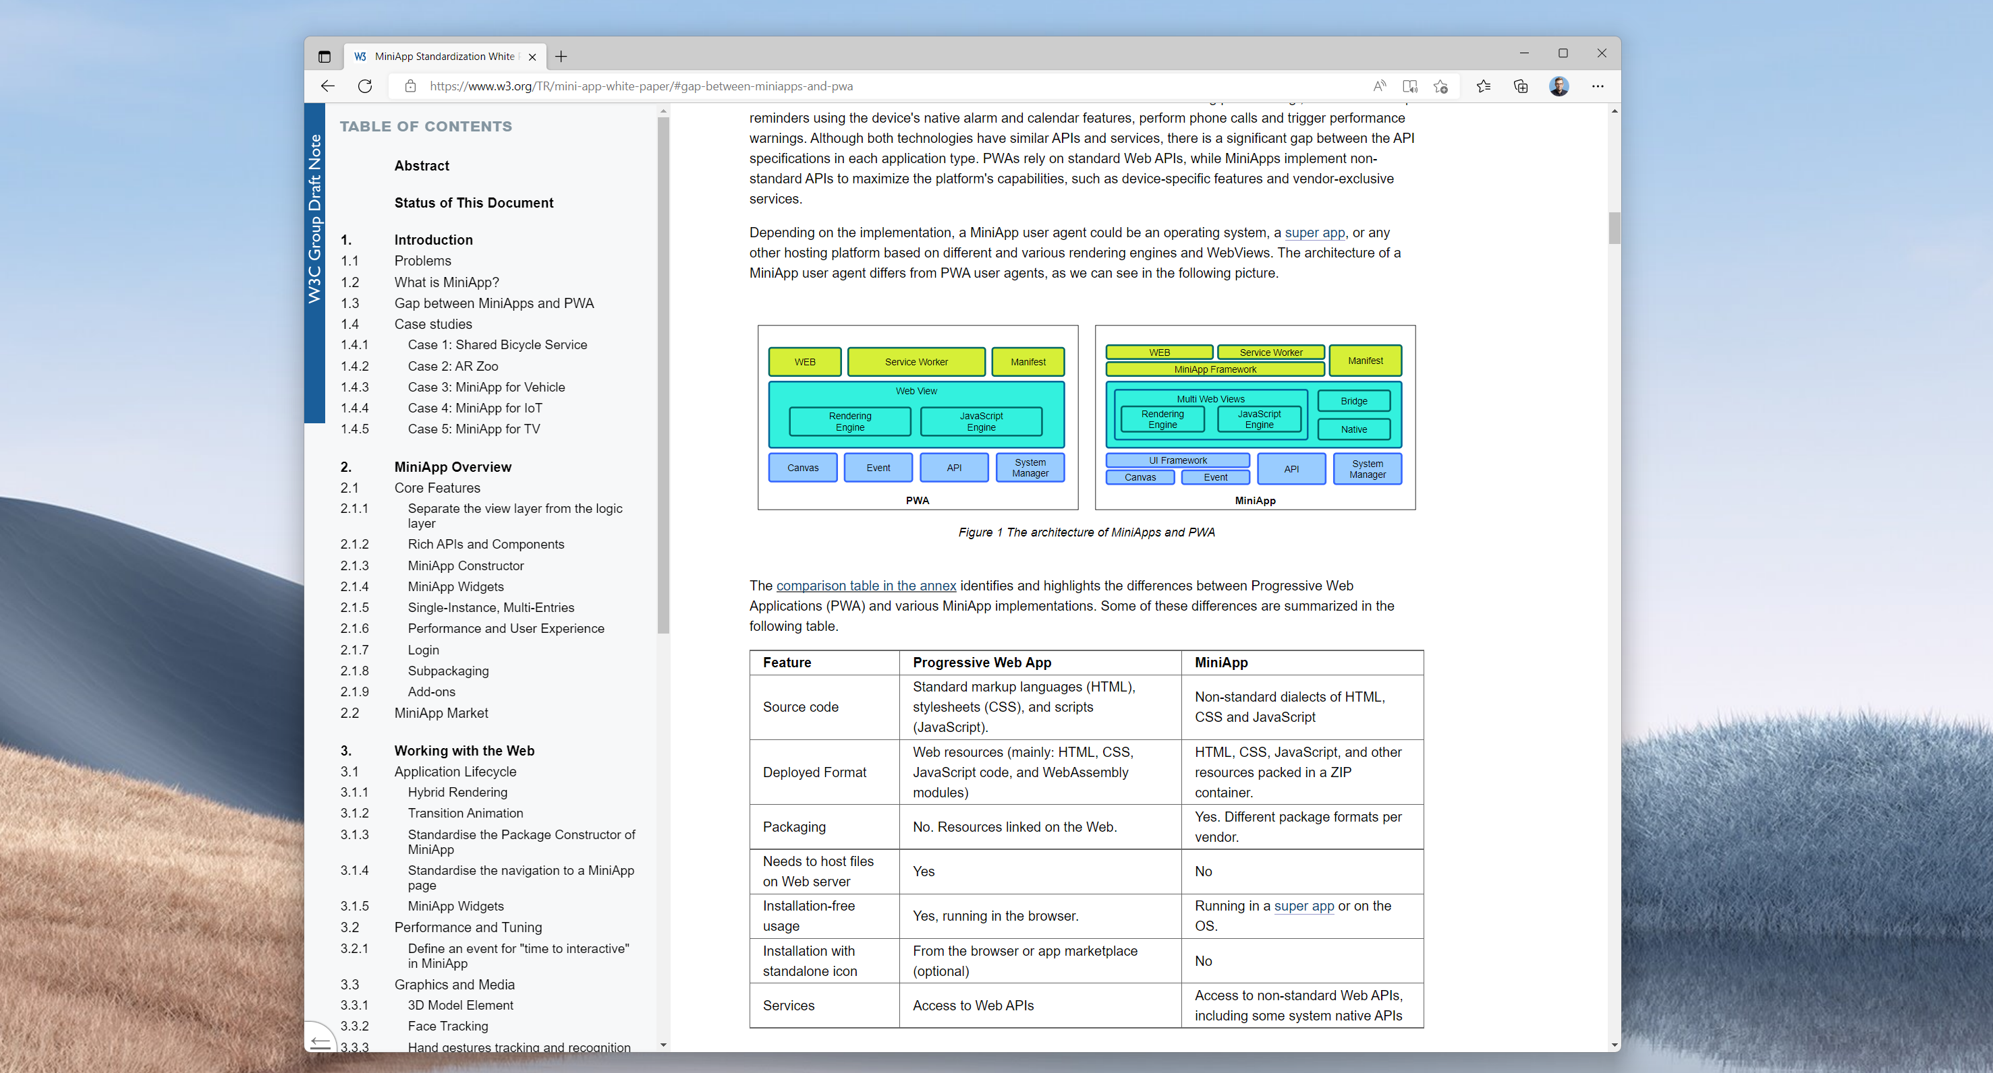
Notes:
Through a dialog with the W3C’s Technical Architecture Group and others working in web standards, the document has evolved significantly, but the latest version contains a table that I find fascinating, in that it lists very clearly some of the benefits and costs associated more with the distribution model than with the APIs themselves.
From my perspective as a browser maker, it also suggests places where I think browsers need to become much more open-minded about how we facilitate embedding of open web content.

Slide 17
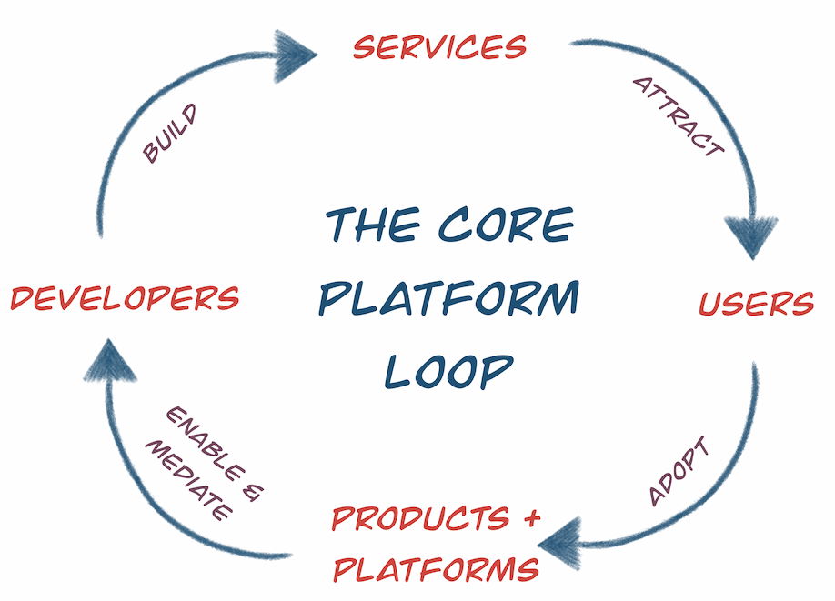
Notes:
I think a lot about these questions in terms of the loop of value that sits at the core of every platform.
Platform vendors and promoters often build their systems to facilitate the inclusion of services and content in their products that they themselves cannot or will not produce.
These platforms are introduced into the world through products that include them, and platforms succeed if they help developers achieve their goals while simultaneously delivering some sort of value to the product that embeds them.
An important property of these systems are the ways that platforms mediate and enable developers in delivering services, as this is the location where platform vendors can levy taxes on developers and the services they build.
Standards often emerge out tensions between these parties, as a proxy for resolving tensions in the power relationships they embody.

Slide 18
A Gnawing Question: What Is The Web Missing?
Packaging & Signing
Super-App Service Integration
Upgrades to HTML & CSS
API access
Notes:
So in thinking about the future of PWAs and MiniApps, I am mostly thinking about how we can expand PWAs to fit these needs, particularly to help meet the needs of developers and app providers that are not in the #1 position and for whom the idea of building another mini-app for every superapp is deeply unattractive.
This costs a great deal in terms of upkeep and coordination, in much the same way that native mobile apps have taxed developers into needing to develop separate codebases for Android and iOS.
In the same way that PWAs have helped to deliver app portability for developers bringing their experiences to Android, Windows, Mac, and Linux, my hope is that if we understand the needs of budding superapps and their developer ecosystem, we can set about the same sort of intentional gap-closing project as we undertook with Project Fugu, but in areas that are relevant to MiniApps.
We may already be making more progress on this front that is generally understood.

Slide 19
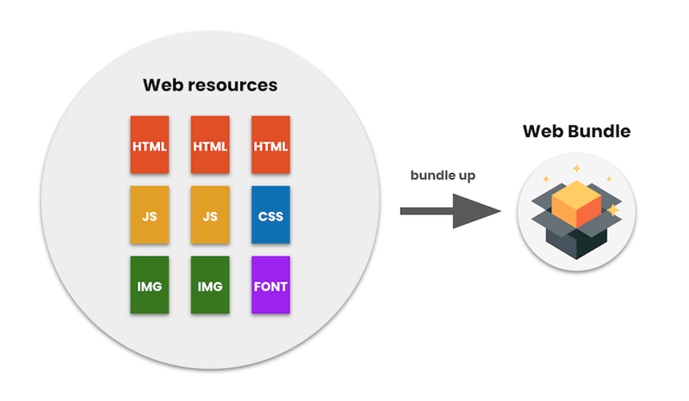
Notes:
Take, for instance, Web Bundles.
This is work that has been under way in Chromium for the past few years, starting with the launch of a technology called “Signed Exchanges”. You can think of Signed Exchanges as a recording of a single HTTPS request/response, and Web Bundles build on this technology to allow developers to package up many of these individual resources.
The key to this design is that these resources, once signed, are understood by web browsers as coming from the original publisher’s domain, even though the user may be send the bundle file from a totally different server.
This technology is opening up the ability to meet one of the items on the MiniApps Working Group’s list of challenges, and I think that with some creative thinking, we can envision a world of PWAs that can also *be* MiniApps.
Such a future is great for developers, and I think, good for users. It will allow miniapp developers to avoid sinking time and effort into small proprietary differences and standardize on common web APIs that might behave slightly differently when their PWAs are experienced in the context of a SuperApp versus a browser, but which don’t require us to perpetually contemplate a separate development and deployment mechanism for each combination of service and entrypoint.

Slide 20
Desktop
桌面复兴 开发者的新大陆

Slide 21
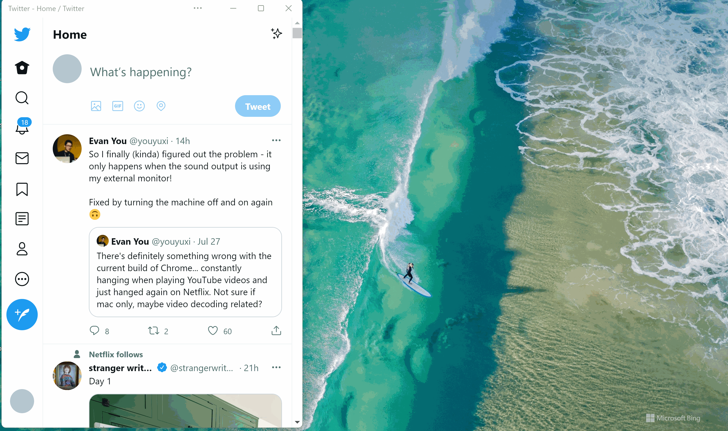
移动端到桌面，体验升级

Slide 22
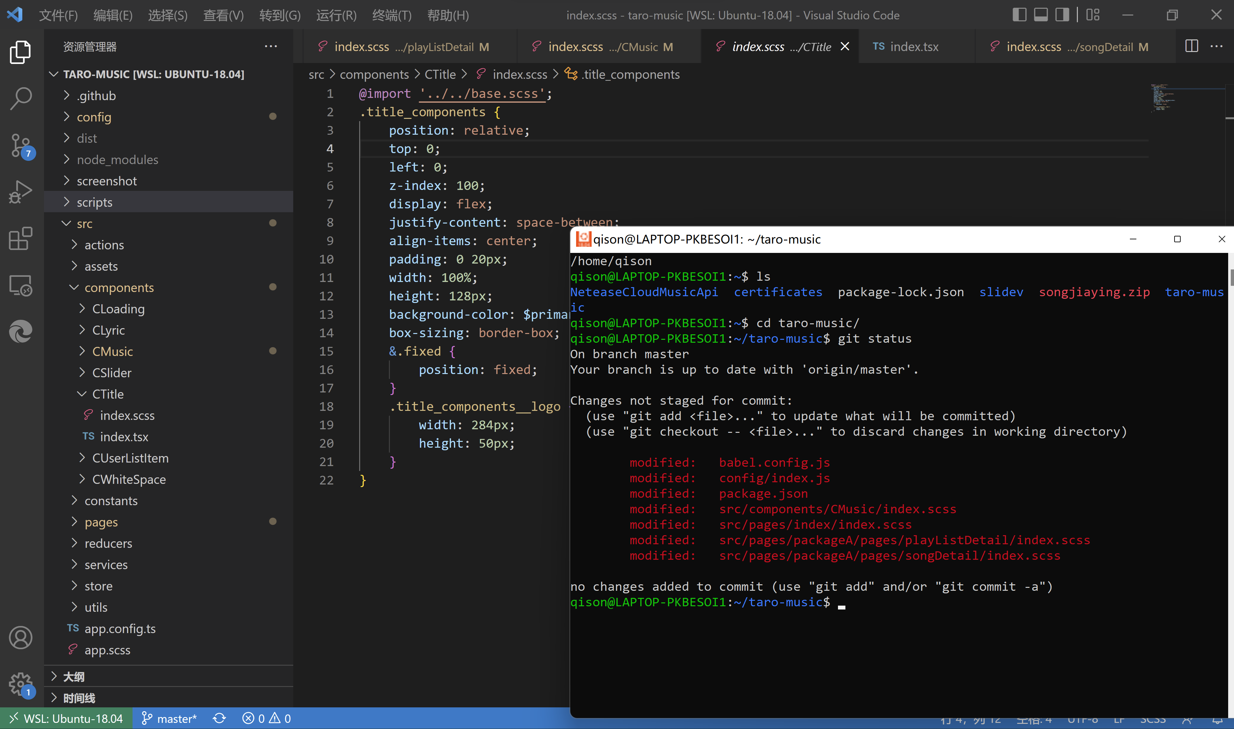
移动端到桌面，开发友好

Slide 23
移动端到桌面，框架成熟

Slide 24
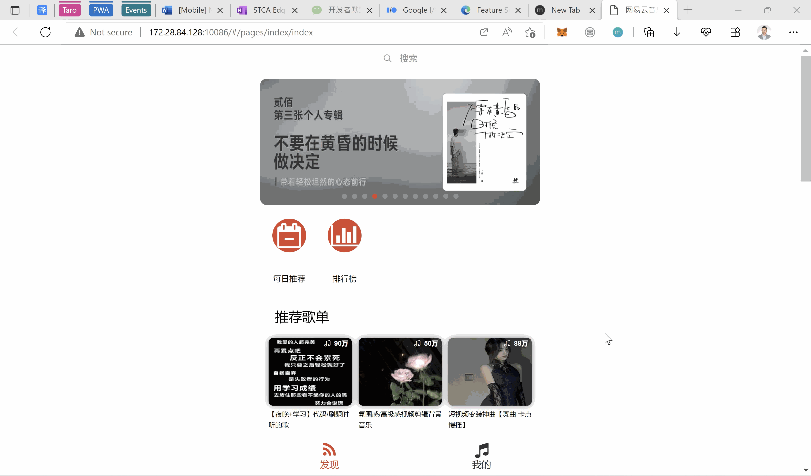
移动端到桌面，灵活变身

Slide 25
Thank You.
https://aka.ms/PWA
Notes:
So that’s my vision: a world where browser makers can listen humbly to the needs of SuperApp makers and MiniApp developers and work to intentionally close the gaps.
We have some precedent that it can work, because we’ve done it before. I’m optimisitic that it will work again if we try.
Thanks again for inviting me, and thanks to the organizers for putting on such a compelling day of content.

