Slide 1
MiniApps for Vehicle
Qing An
Co-chair of MiniApps WG/CG
Alibaba Group
2022-09-07

Slide 2
Outline
Overview
Scenarios and demo
Discussion on the next step in W3C
2

Slide 3
MiniApps ecosystems
Mobile phone MiniApps Framework
IoT MiniApps Framework
Vehicle MiniApps Framework
Mobile phone MiniApps
IoT
MiniApps
Vehicle MiniApps
Mobile phone MiniApps Runtime
IoT MiniApps Runtime
Vehicle MiniApps Runtime
Super App
Mobile OS (iOS、Android)
IoT OS
Vehicle OS
3

Slide 4
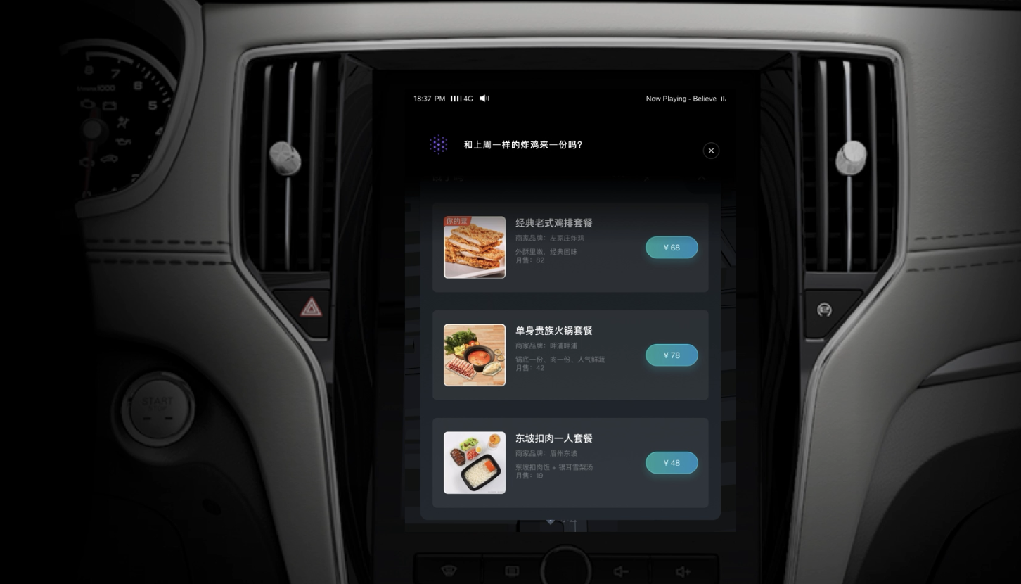
Overview of MiniApps for Vehicle
Voice Control
Integrated within Map
Scenario Based
MiniApps Platform
Vehicle MiniApps Package Management
Vehicle OS
Vehicle MiniApps
Vehicle MiniApps Container
Common API
Vehicle Capabilities API
Map and Navigation
Infotainment
Payment
…
4

Slide 5
Vehicle MiniApps: low cost to provide services
Development
Reach to Users
MiniApps On-board
After a vehicle is sold, new MiniApps can still be uploaded and pushed to users
Develop once, deploy to multiple vehicle types
Unified IDE
Unified IDE for mobile phone MiniApps, IoT MiniApps and Vehicle MiniApps
Easy journey for developers
5

Slide 6
Scenarios
Driver Services
Traffic violations inquiry
Gasoline price inquiry
Living Services
Restaurant booking
Entertainment
Social media
News
Roadside assistance
Weather inquiry
Movie booking
Calendar
etc.
etc.
Games
etc.
Trip Services
Hotel booking
Flight booking
Train booking
etc.
Find designated driver
6

Slide 7
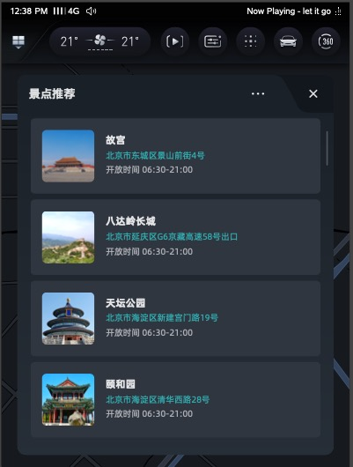
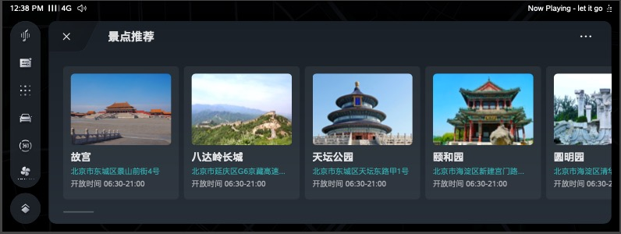
Adaptive to screens
开发者按照车载小程序标准规范开发
由小程序容器实现窗口UI适配
7

Slide 8
What can we do in W3C?
From the perspective of vehicle vendors, to fully integrate MiniApps in vehicle, what standardization work should we do?
Adaptive to different size screen
Accessibility, etc.
MiniApps WG/CG, and Automotive WG/CG:
Discuss use cases
Outline MiniApps requirements and vehicle requirements necessary to satisfy use cases
8

Slide 9
Thanks

