Slide 1
Web云边端算力网络协同
W3C Web & Network IG
WNIG工作进展
Collaborated Computing with Cloud+Edge+Mobile
云边端协同工作
TPAC 2022 CHINA
W3C WNIG工作组联合汇报：徐嵩 中国移动咪咕 刘大鹏 阿里巴巴
Notes:
Hello Everyone. We, the chairs of the Web & Networks Interest Group are glad to connect with you at TPAC 2022. The Web & Networks Interest Group is co-chaired by Dan Druta, Song Xu and Sudeep Divakaran.
We are excited to see the wonderful innovations and developments evolving in the Web and Networking space and would like to share some of that with you.

Slide 2
WNIG介绍
Mission使命
Explore 探索
solutions for web applications 万维网世界的技术路线
To leverage 平衡
network capabilities 异构多模态的网络下计算能力
In order to 目的
achieve better performance and resources allocation, both on the device and network.
为云、边、端等Web计算环境提供更好性能与资源分配
Notes:
Our Interest Group was chartered in May 2019 and since then we have been focused on our mission which revolves around exploring solutions for web applications, that can leverage existing and upcoming network capabilities, to achieve better performance and resource allocation, both on the client device and network.
Let me share some of the key topics of focus. One of them is the usage of application hints by networks and also, network hints by Web applications. We look into how evolving WiFi, 5G and other networking standards and new technologies deployed using Edge Computing can be leveraged by the Web community. We also discuss Developer tools that can help the next generation Web Developers to test their applications with more insights about the network conditions metrics.

Slide 3
Multipath, multi-carrier, multi-connectivity handling; Latency vs bandwidth trade-offs
多路径、多载波、多连接处理；延迟与带宽的权衡，例如高带宽4K视频流或低延迟视频呼叫等。
Network hints to device applications to enable moving of compute functions across the network between client, edge or cloud depending on user-experience and compute requirements.
向设备应用程序提供网络提示，以根据用户体验和计算要求以及最佳资源利用率，在客户端、边缘或云之间跨网络移动计算功能。这可以补充其他卸载决策因素，如上下文信息，例如成本、隐私、电池电量等。
Exposure of specialized services such as DiffServ, 5G Slices, WebTransport and Edge Computing, including load balancing computing between client devices, edge and cloud
探索研究DiffServ、5G Slice、WebTransport和边缘计算等专业服务，包括客户端设备、边缘和云之间的负载平衡计算，尤其是机器学习推理和云游戏等延迟敏感应用（用于在云上渲染游戏）
Evaluation of aggregated web metrics for enhanced troubleshooting and network performance optimization to improve web application experience.
评估聚合的web度量，以增强故障排除和网络性能优化，从而改善web应用程序体验。此外，分析隐私和安全风险，并评估相关的缓解措施
WNIG工作
Notes:
上行:内容制作、节目制播，授权频谱、空口资源预留、走核心网路由或独立专网
下行:音视频分发，单播、组播、移动电信5G大小塔混合模式
Application hints to the network (e.g. ways for applications to declare their operational wishes to the network). Specifically, the group will focus on hints and similar approaches that can simultaneously benefit web application and network performance (in general-purpose browsers, tablets, phones). For instance:
Multipath, multi-carrier, multi-connectivity handling;
Latency vs bandwidth trade-offs, for instance high bandwidth 4K video stream, or low latency video call, etc.
Network hints to device applications to enable moving of compute functions across the network between client, edge or cloud depending on user-experience and compute requirements, and optimal resource utilization. This can complement other offload decision factors like contextual information, for e.g. cost, privacy, battery level, etc.
Exposure of specialized services such as DiffServ, 5G Slices, WebTransport and Edge Computing, including load balancing computing between client devices, edge and cloud, particularly in latency-sensitive applications like Machine Learning inference and Cloud Gaming (used for rendering game on the cloud).
Evaluation of aggregated web metrics for enhanced troubleshooting and network performance optimization to improve web application experience. In addition to this, analyze privacy and security risks and evaluate related mitigation considerations.
Liaise and coordinate with relevant networking standards organizations
Propose incubation of new work
Share the latest developments in networking standardization bodies
Our tasks are to identify opportunities and new use-cases, about which we will share some examples later. We liaise and coordinate with W3C groups and networking standard development organizations, and identify ideas for incubation.
We maintain a public distribution list and also a Wiki of the latest Networking features, use-cases and ideas that we are tracking or investigating. You can access the Wiki using the link here.
https://www.w3.org/wiki/Networks

Slide 4
Jun 2020: Edge Distr. Web Eng.
Jan 2020: ETSI MEC
Jul 2020: Edge Offload
WNIG发展
Feb 2020: Offload to Edge
Aug 2020: eCDN P2P
Jul 2019: Guiding Principles
May 2019: IG Charter Approved in W3C
Edge Computing Workstream
TPAC Sept 2019
Network Quality Monitoring & Prediction Workstream
Nov 2019
Kickstarted
2 Workstreams
Jun 2019 First Meeting
Sept 2019: Link Performance Prediction
Feb 2020: Network Info API
Mar 2020: Predictive QoS,
5GAA
Sept 2020: LPP Update
Trace based Net. Emul.
Edge Computing with the objective of understanding the impact of Edge Computing for Web applications and build a roadmap to enable its adoption
Web Work Migration and Edge Worker Concept for offloading compute to Edge
Edge Compute and Capability Discovery
Network Quality Monitoring and Prediction with the goal of improving how Web apps can monitor and prepare for changes in network conditions
Predicted Cellular Network Information
ETSI Mobile Edge Computing API & Network Information API
Notes:
Let's move into a bit about what we have done so far. As mentioned earlier, we started in May 2019 and ever since then, we have had around 12 meetings were we discussed wide-ranging topics related to network use-cases. Back in November, we kickstarted two workstreams - one called Edge Computing and other Network Quality Monitoring and Prediction.

Slide 5
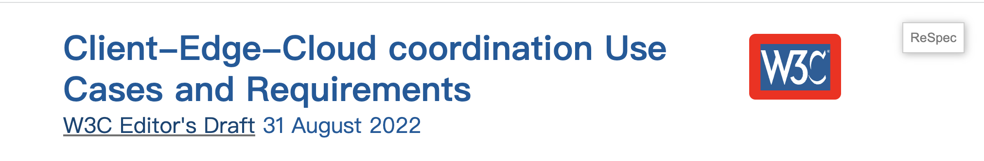
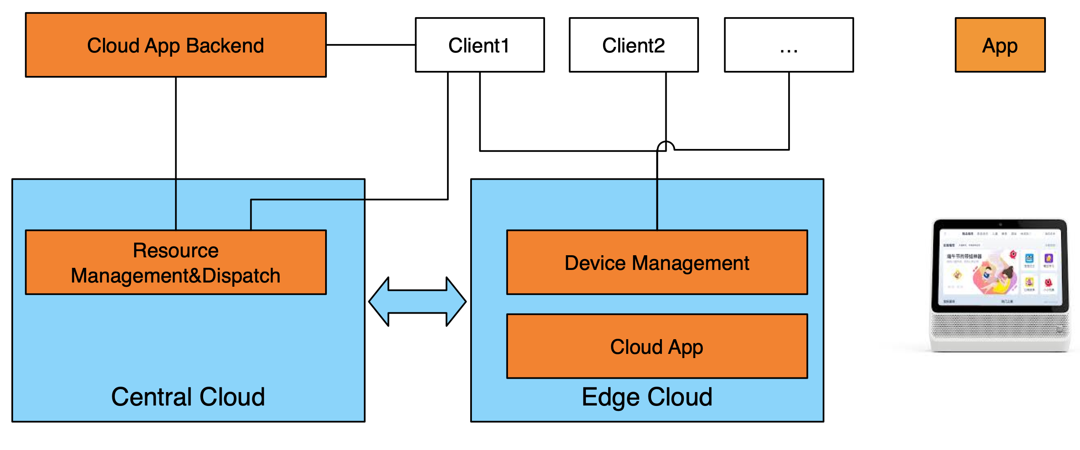

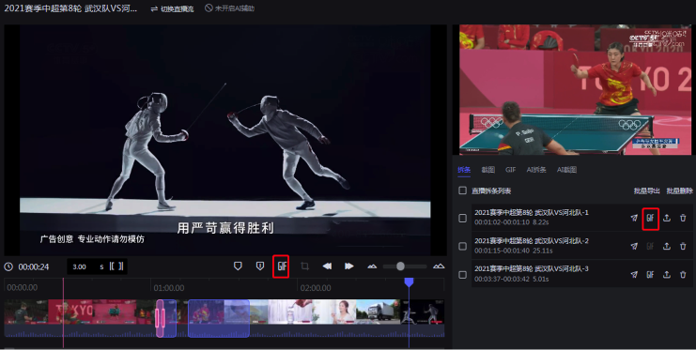
云边端协同场景和需求
云边端协同
https://w3c.github.io/edge-computing-web-exploration/#contributors
Use Cases：
4.1 Accelerated work loads
4.1.1 Cloud App
4.1.2 VR/AR Acceleration
4.1.3 Cloud Gaming
4.1.4 Streaming Acceleration
4.1.4.1 Online Video Conference
4.1.5 Machine Learning Acceleration
4.1.5.1 Image and Video Processing and Understanding
4.1.5.2 Professional Web-based Media Production

Slide 6

Use Cases：
4.1.6 Robustness of Workload Acceleration for Certain Applications
4.1.6.1 Live video broadcasting mobile application
4.1.6.2 Automatic License Plate Recognition
4.2 IoT workloads
4.3 Persistent workloads

Slide 7
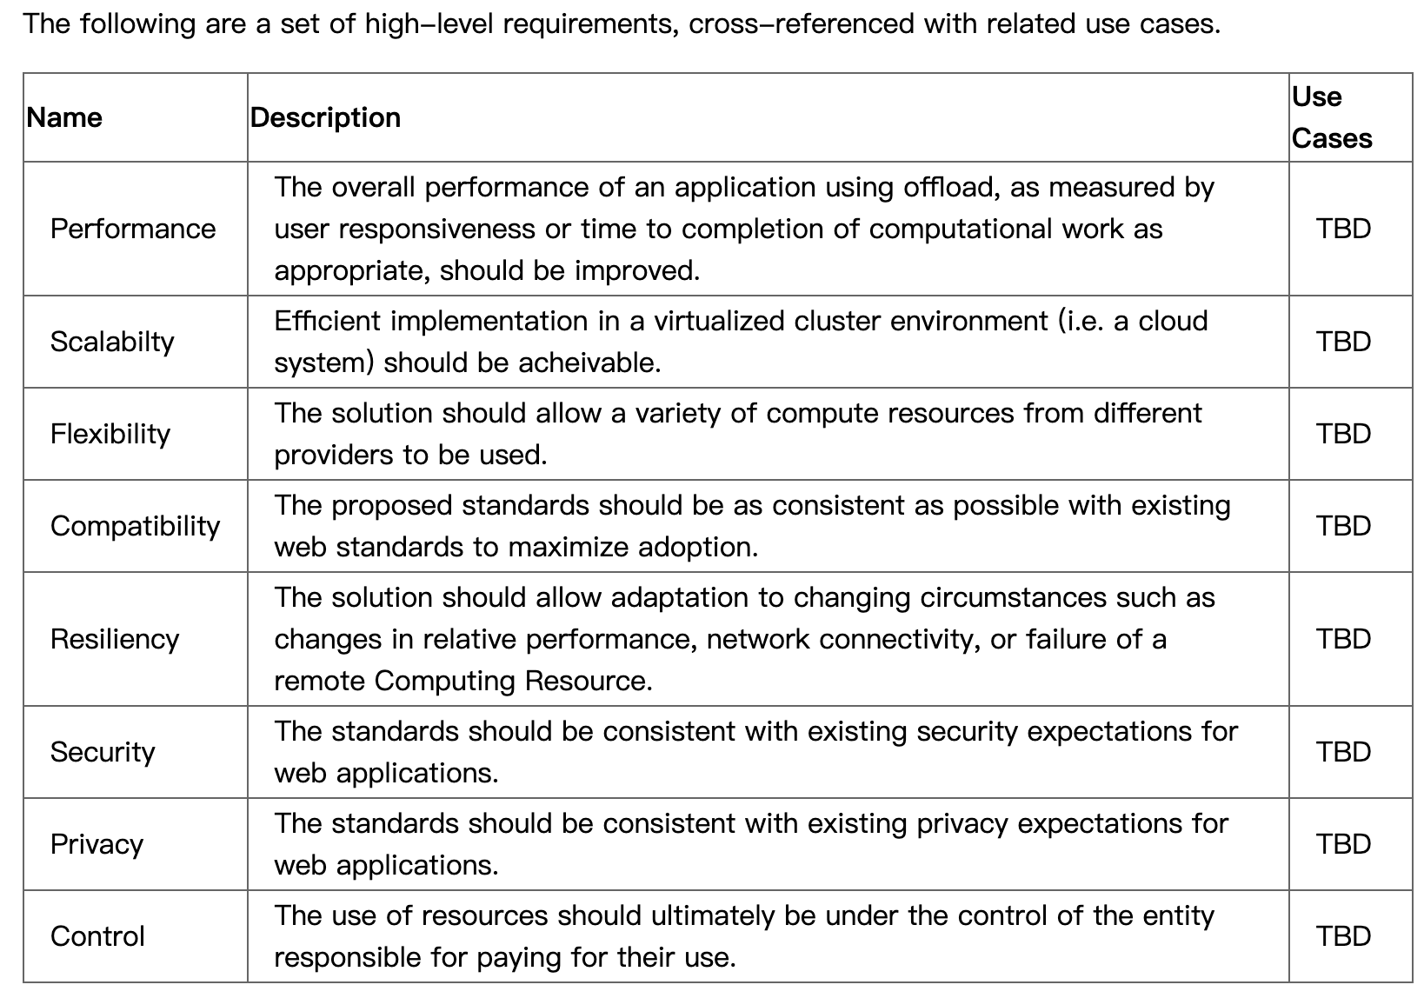
Requirements
云边端协同

Slide 8
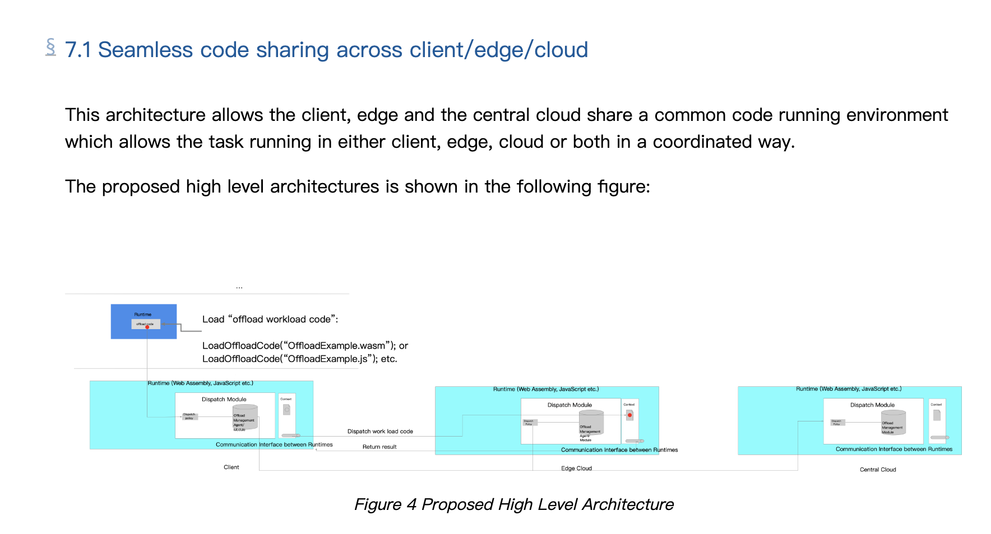
Architecture Proposal（1/2）
云边端协同

Slide 9
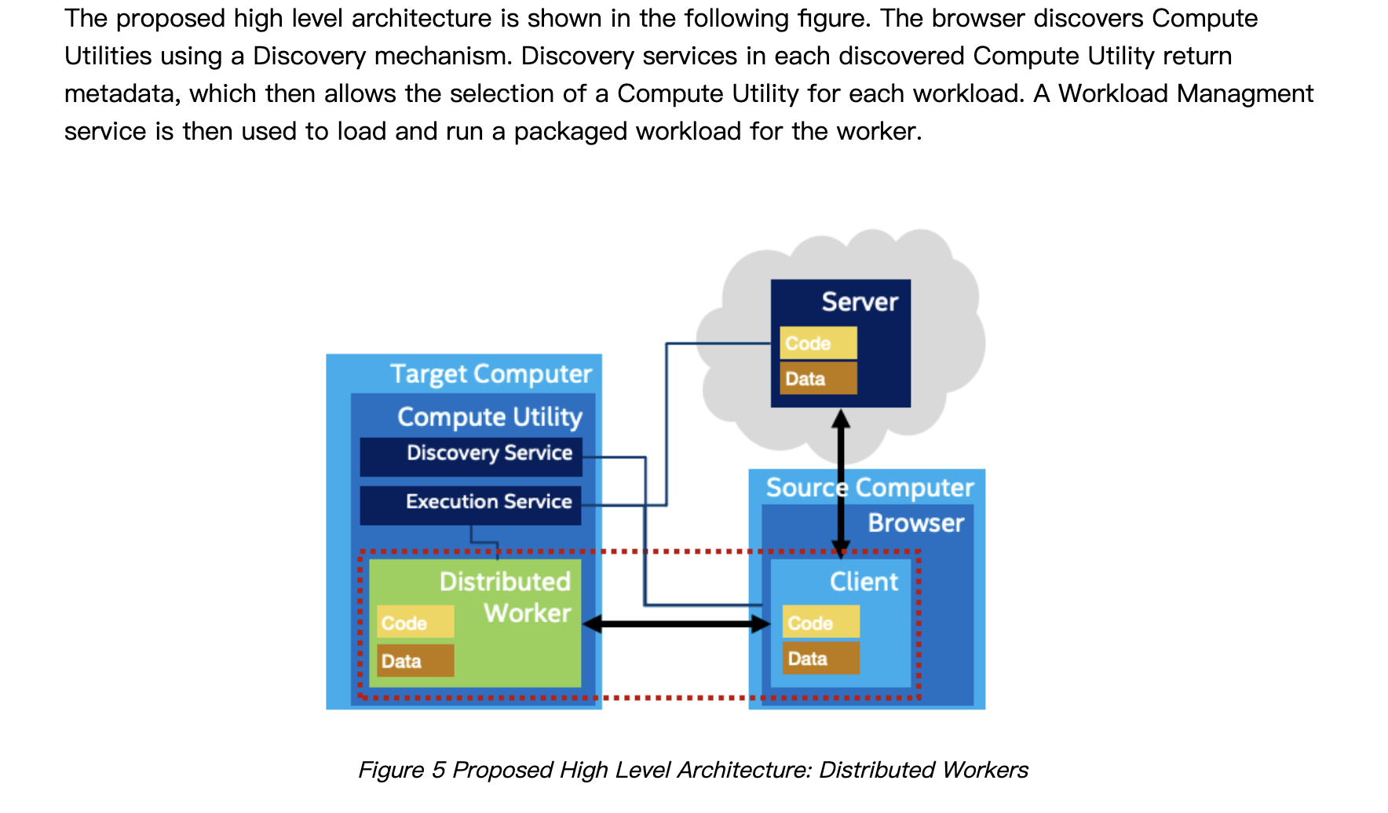
Architecture Proposal (2/2)

Slide 10
Standardization Proposals
API to load workloads
Communication mechanism and protocol between client and Edge cloud
Edge cloud availability and network condition discovery
Recommendations for the Way Forward
Establish a new working group that focus on the standardization of this problem.

Slide 11
When something is such a creative medium as the web, the limits to it are our imagination.
- Sir Tim Berners Lee
The Web And Networks Interest Group envisions unlocking the potential of web by leveraging latest advancements in wireless and wired technologies.
特别致谢共同撰写贡献者：
Dapeng(Max) Liu (Alibaba Group) Michael McCool (Intel) Song Xu (China Mobile) Feiwei Lei 阿里巴巴，Jingyu Yang 阿里巴巴, Wenming Wang, 字节跳动, Dian Peng, 字节跳动, Lei Zhao, 中国移动
Notes:
Sir Tim Berners Lee said "When something is such a creative medium as the web, the limits to it are our imagination" .
The Web And Networks Interest Group envisions unlocking the full potential of web by leveraging latest advancements in wireless and wired technologies.

