Slide 1
Collaborative Map Making
By Plan4all, Lesprojekt, BOSC, Asplan Viak
Notes:
Welcome to this little breakout session where we are going to use the next half-an-hour to hour discussing a couple of ideas and their prototypes that may have the potential to inform or change the way we collaborate in the world of web GIS .
We are going to divide the time between three speakers.
Raitis Bersinz of Latvia
Karel Charvat of the Czech Republic
...and
Myself Stein Runar Bergheim of Norway
It is at least the intention that this is going to be an interactive session so hopefully there will be some speaking time for the attendance too. Towards the end of the session there is a sectoin devoted to discussions.

Slide 2
Passing of an idea as an innovation
Notes:
However, first a disclaimer. We’re not going to lie to you…
We did this because we think it looks “cool” to have someone else work and to see their work appear on our screens without having to do anything
However, when introducing our folly to a group like the OGC, who, presumably has higher, nobler and more important motives than things being “cool” we feel that it is imperative to make our idea stand out in the
Thus, like so many before us, but with the distinction that our idea is not yet proven to be ingenious, we are going to try to retroactively fit a rationale to our decision
This will make it seem to you as if we have been working systematically and with a vision - and had it not been for this slide, might have put us in a more favorable light.

Slide 3
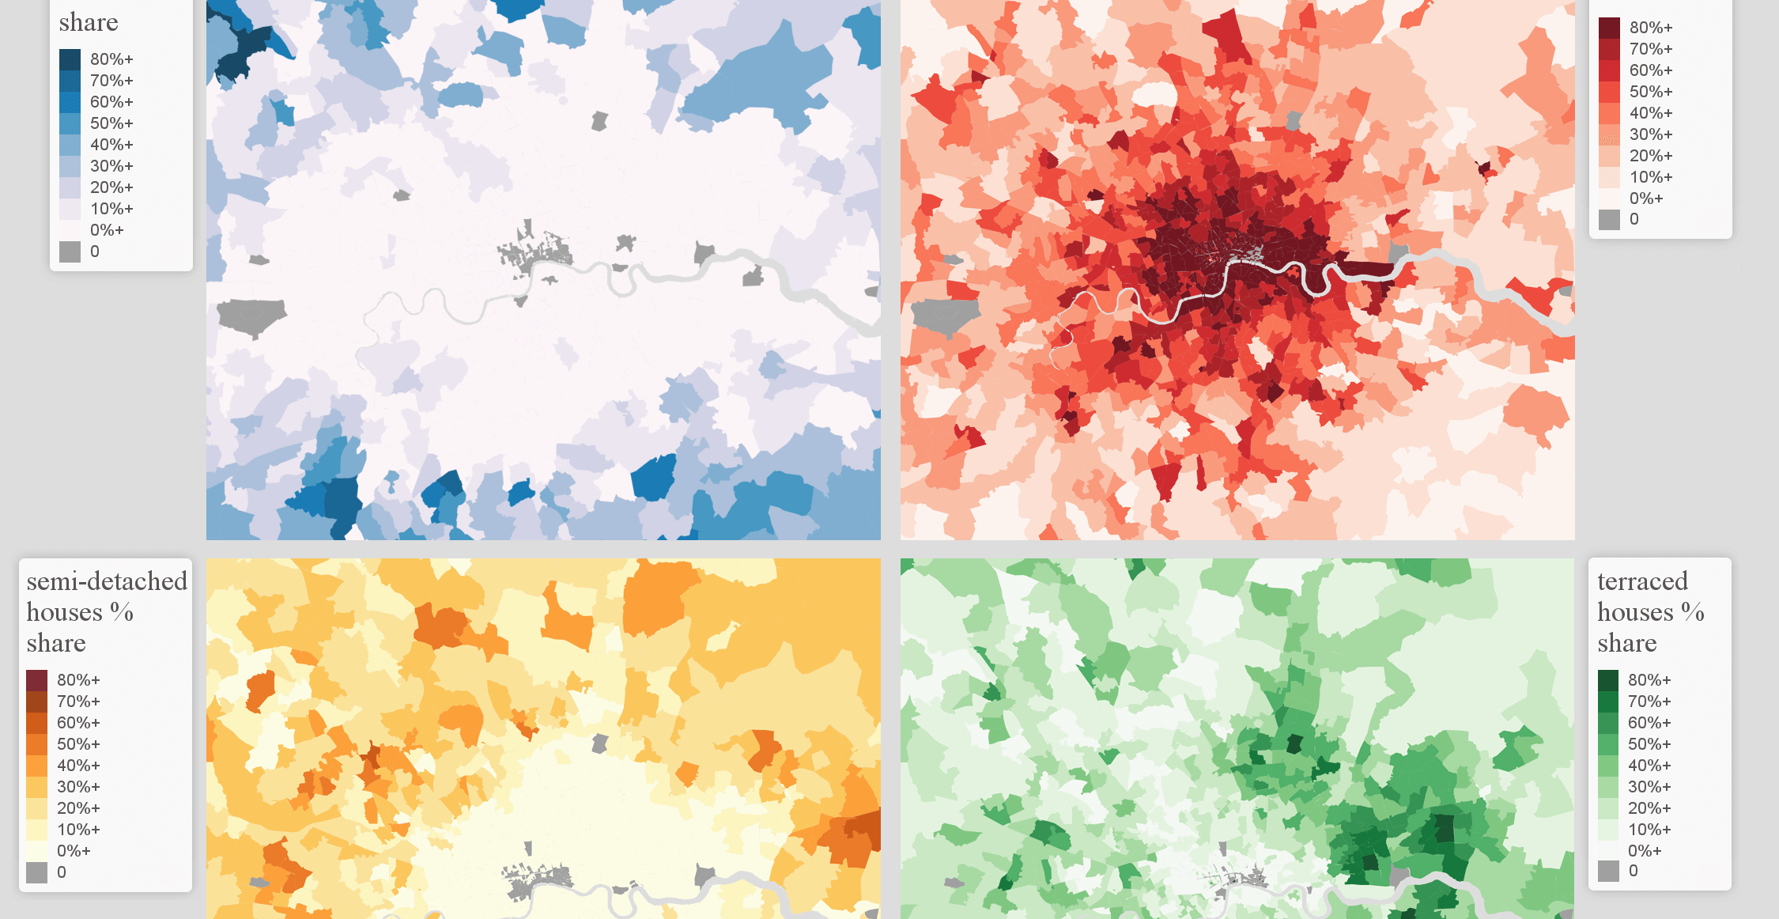
We share data & apps - what about maps?
Notes:
Over the past 20 years we have grown quite mature when it comes to data sharing.
The first barrier that was torn down was map data licensing - i.e. the politics of sharing.
The second and most successful catalyst for information sharing (perhaps not data) was the Web Map Service
Strangely, the pre-WMS methods of data sharing has not decreased. ESRI Shapefiles are still common staple - as, surprisingly, are CSV files. The latter would be the big winner of the PSI .gov style data portals.
Shared file data (data.gov style PSI portal)
Shared map protocol data (OGC web map/feature/coverage/processing services)
Shared map applications
Shared maps independent of applications

Slide 4
Is this *really* a problem worth solving?
Notes:
There is distinctively a first-world flavor to the problems we have identified in the current state-of-the art
...but…
Bear with us for a little while longer

Slide 5
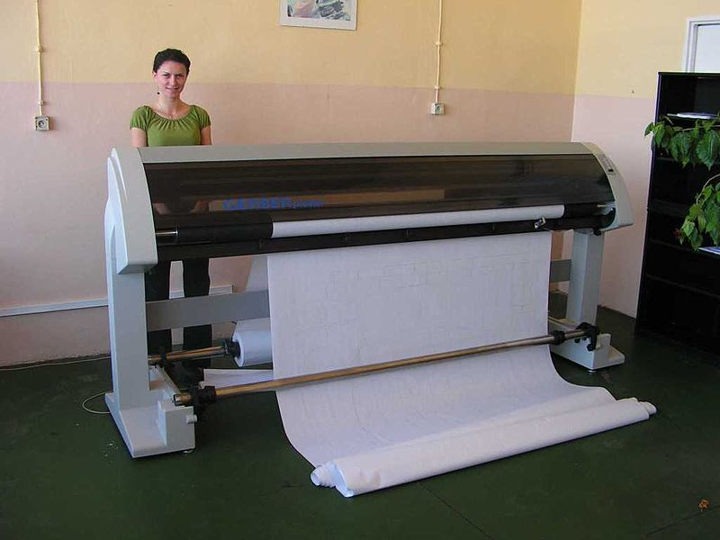
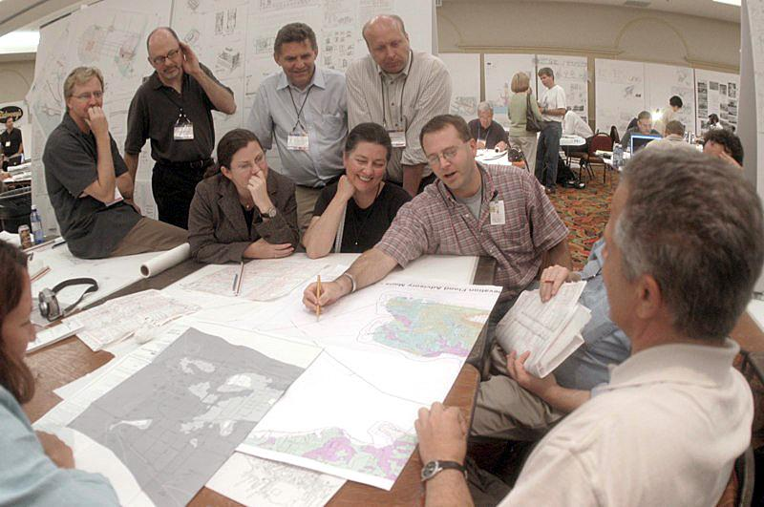
Resilient processes and tech
Notes:
There are five things that haven’t changed as much as one could hope for during the past 40 years
There is a large format plotter looming in some dark recess of government GIS departments
Middle-aged, gray men invariable stand huddled together in undersized meeting rooms, peering over A0 sheets of printed maps pointing and gesticulating while spilling coffee, cookie crumbs and making annotations with markers
If 2020 has taught us anything, but that when it rains it really really pours, it is that a lot of physical meetings were/are/will remain non-essential
Even the most avid opposers of progress have been forced to find some way to live in peaceful co-existence with web conferencing and collaborative platforms
Sharing maps - rather than just data - and enabling client-to-client map data creation allow for a qualitatively richer and quantitatively more efficient online experience

Slide 6
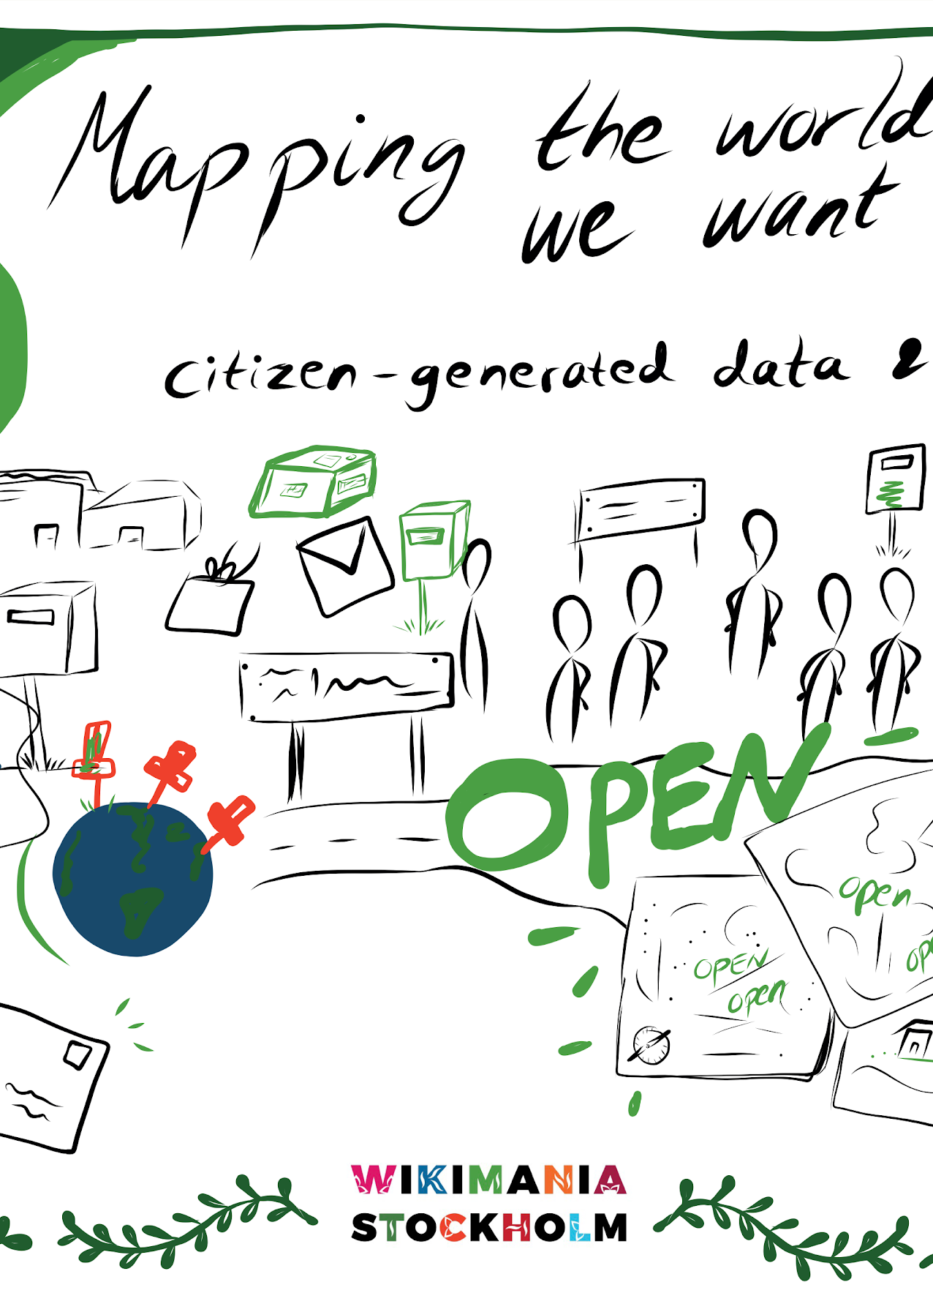
Creating data together
Notes:
We have become quite adept at creating data together.
Some of the big efforts, like base mapping, have become near ubiquitous.
There is more ground to cover with regards to
Client-server data creation
Ability to interact between multiple connected clients in real-time

Slide 7
Creating maps together
Notes:
Shared web map applications (everyone’s got their own)
Shared map making

Slide 8
Today we’re going to discuss two enabling technologies
Some way of storing and exchanging a map consisting of stacked “layers” of information
Our current candidate: Map Compositions
Some way of enabling client-to-client communication for common GIS tasks
Our current candidate: Map Whiteboards

Slide 9
Introducing Map Compositions
Raitis Berzins

Slide 10
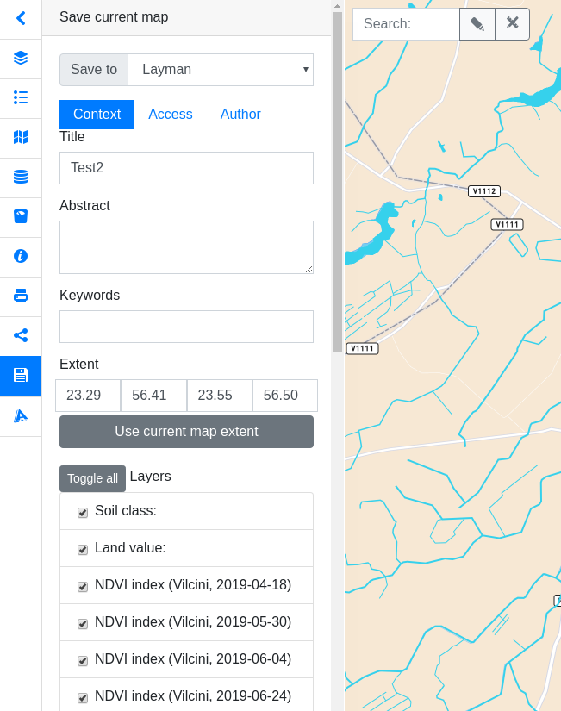
Why - WHY - W H Y !
Can be viewed as project files.
Used to store and annotate complete maps either for sharing or saving of state between user sessions.
Guided by ‘in the field’ usage while developing web map applications integrating open source tools such as:
QGIS
Hslayers-ng (UI extension of OpenLayers)
Layman (Upload of vectors and convert to WMS)
Micka (Metadata catalogue)
Notes:
Can be viewed as projects files in GIS but in our case it was our custom mapping library / geoportal.
Humble origins: Saving status such as turned on layers, or their features between page reloads
Later on came sharing when the users where given chance to add new layers.
Micka metadata catalogue supports layers and these can be mixed in different configurations. Same goes for Layman which is

Slide 11
Origins
Inspired by and lending shamefully from OGC Web Map Context and its successor OWS Context
Encoded in JSON format
A lighter format eases implementation
Notes:
Our composition format was inspired by and lending shamefully from OGC Web Map Context and its successor OWS Context
Encoded in JSON format
A lighter format eases implementation

Slide 12
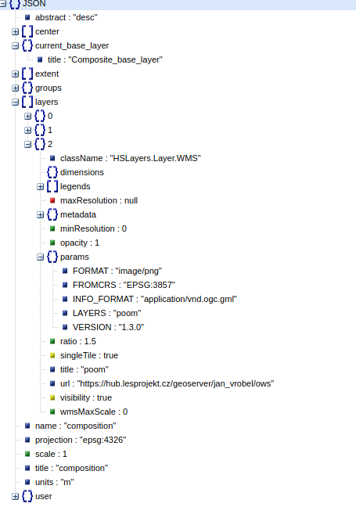
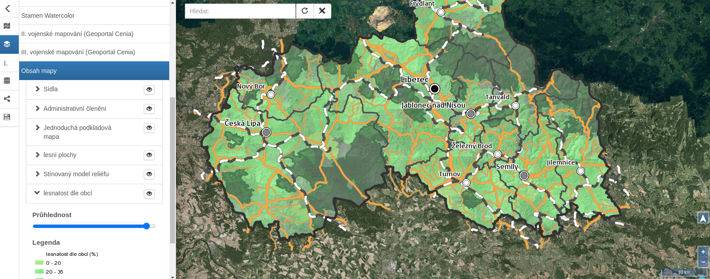
Example of composition structure
Visualizing schema described in
https://github.com/hslayers/hslayers-ng/wiki/Composition-schema
Notes:
Layer parameters - sent to server vs used on map client
An example of the parameters used client side would be opacity or weather to request wms imagery as single tile vs tiled wms
User rights / groups mimic linux filesystem
Current base layer
In the provided link you can see the composition schema definition which can be used for validation.

Slide 13
Classname
"className": {
"$id": "#/properties/layers/items/properties/className",
"type": "string",
"title": "Classname",
"description": "Type of layer. Vector layers are subdivided by protocol property",
"default": "",
"enum": [
"HSLayers.Layer.WMS", //For backwards compatibility
"OpenLayers.Layer.Vector", //For backwards compatibility
"WMS",
"WFS",
"Vector",
"XYZ",
"ArcGISRest",
"StaticImage"
]
}
Notes:
Map layers are described using a classname where the possible values are wms, wfs, vector, XYZ for openstreetmap, bing and similar tile providers.
Obviously all of these layer types share a common url property.

Slide 14
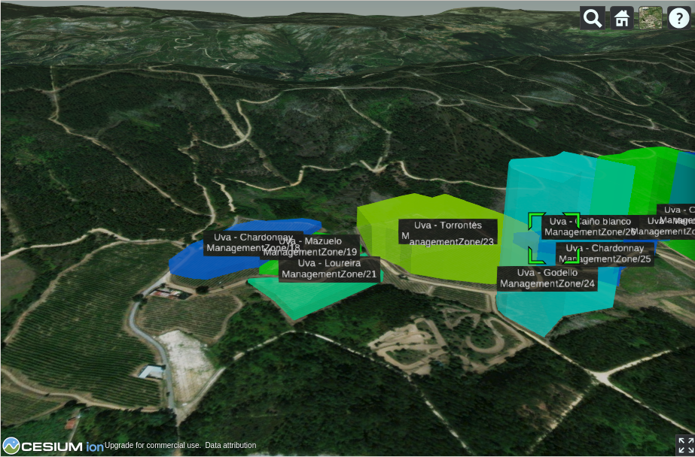
Additional service providers and edge cases
Vector layers:
GeoJSON files, Sparql endpoints
Imagery:
XYZ, ArcGISRest, Static images
Vector layers can embed Geojson encoded features in composition directly.
Notes:
Vector layers are further subdivided by protocol property, which gives pointers to the composition consumer or client application how to load the data.
Possible values could be formats such as kml, geojson or string describing the server endpoint type, such as sparql endpoints or 3d vector tiles.
We don’t restrict anybody to predefined protocol values.
For imagery layers we have added XYZ, ArcGISRest and static image classes which correspond to similarly named OpenLayers layer classes.
One counterintuitive but quite useful capability is the possibility to store geojson encoded features directly into the composition.
This was intended for temporary low volume data such as scratch layers for notes or unfinished features which would later on be sent to wfs services for example,
but in the context of map whiteboard can be used to request all the features in all or just a subset of layers for a given composition using one query to the map whiteboard server.
That would happen either when the user connects to the whiteboard application or on drawing layer selection.
More on that from Runar

Slide 15
Introducing Map Whiteboards
Notes:
A map whiteboard is a peer-to-peer technoogy that allows cursor movements and map interactions to be propagated from one web client to other connected web clients looking at the same map
When someone moves their cursor, I can see it on my screen
When someone draws a feature I can see it on my screen
I can edit the features they’ve drawn
They can edit mine
We can add layers to maps - and they’ll show up with all of us

Slide 16
Why do we want a map whiteboard?
Rationally Inspired by existing solutions
Fleet monitoring
Google Docs
User generated content
Supporting tool for online conferencing
Irrational desire to see stuff move on the screen without doing anything

Slide 17
How does it work?
A naȉve illustration of the concept on the right

Slide 18
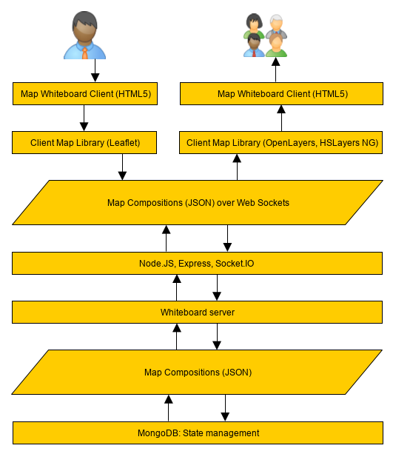
Technical architecture

Slide 19
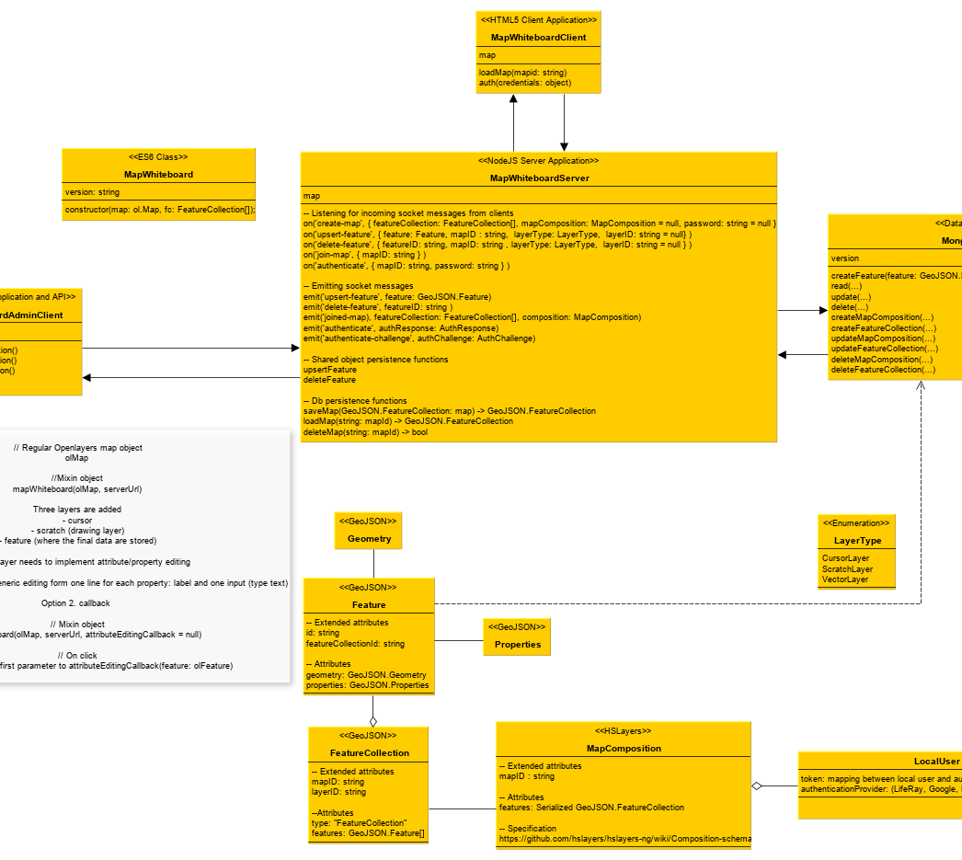
Map Whiteboard API
Notes:
Authorization
Document management
Streaming features, cursors, updates to map compositions
Licensing

Slide 20
A standardized interaction or an application feature?
Do Map Whiteboards have the potential to become anything more than a feature in a web map application?
Notes:
Perhaps yes, perhaps no.
If it would be a standard feature, ANY two or more software clients could share ANY map and edit ANY vector layer in that map collaboratively.
That could have some interesting use cases in terms of digital transformation
Product? Commercial?
Are Map Whiteboards anything more than a feature in yet-another web map application?
Perhaps yes, perhaps no.
If it would be a standard feature, ANY two or more software clients could share ANY map and edit ANY vector layer in that map collaboratively.
That could have some interesting use cases in terms of digital transformation
Product? Commercial?

Slide 21
Potential value creation
Karel Charvat
10 min

Slide 22
Potential areas
Notes:
Agriculture
Crisis management
Any form of planning with a spatial component (nearly all planning)
Meeting aid
COVID 19
Education
Data capturing etc.

Slide 23
Are you ready to cooperate
Join our two challenges on COVID 19 INSPIRE HAckathon
CHALLENGE #3: Citizen Science Network for Peer to Peer Maps Sharing
CHALLENGE #5 WhiteBoard – Future Collaborative Maps

Slide 24
Discussion
On Map Compositions and Map Whiteboards

Slide 25
Some questions to ponder over
Why do we need map compositions - and DO we need map compositions
Is this really the same intention as MapML
What could be the business cases for this technology
WebSockets is traffic intensive - more load - more cost - how to cover costs?

Slide 26
Thanks for attending
Now, join our hackathon...

